Slide 1
CY-6120: Software Security Practices
Module 1: cgi-bin

Slide 2
What is CGI-BIN?
CGI (Common Gateway Interface) is a standard for web servers to execute external programs (scripts) and pass the results back to the web client (usually a browser).
The CGI-BIN directory on a web server is where the server stores these scripts or programs.
It can handle tasks like form submissions, data processing, and database queries by invoking scripts written in various languages, such as Perl, Python, or Bash.

Slide 3
Why is it used?
CGI allows for dynamic content generation on websites. When a user submits a form, the server can process this input using a CGI script and return the result.
It was a simple and effective way to add interactivity to early websites, especially in the 90s.

Slide 4
When was it popular?
CGI-BIN became popular during the early web era (1990s to early 2000s). Many websites relied on CGI for dynamic web pages and applications.
At that time, web development technologies like PHP, ASP.NET, and Java Servlets hadn’t matured, so CGI was a widely-used solution.

Slide 5
Is it still popular?
NO.
Performance: Each CGI request spawns a new process, which is resource-intensive and slow compared to modern web technologies like FastCGI, mod_perl, or other server-side languages.
Security: CGI scripts can introduce severe security risks, especially if not written properly, such as exposure to command injection, file inclusion vulnerabilities, or improper input handling.
Complexity: Modern frameworks such as Node.js, Django, and Flask allow developers to create dynamic content more easily and securely, with better support for scaling and performance.

Slide 6
Problems with CGI-BIN:
Security vulnerabilities: Input from users can be passed to the scripts without proper validation, leading to potential security issues like:
Command injection attacks – run as same privilege as web server
Path traversal vulnerabilities
Buffer overflows (if written in C/C++)
Performance: As mentioned earlier, each CGI request creates a new process on the server, which can be slow and resource-heavy.
Maintenance: Writing and maintaining CGI scripts in low-level languages like Perl or C can be cumbersome compared to modern server-side languages or frameworks.

Slide 7
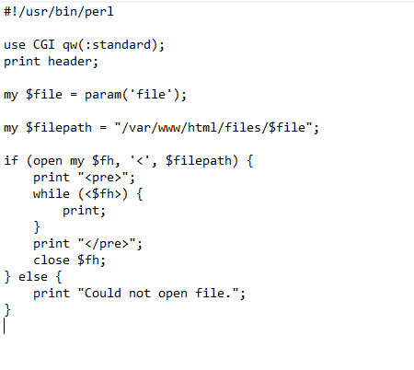
Example .cgi file

Slide 8
Do we see any cgi vulns?
YES – CVE-2024-4577
PHP CGI Argument Injection vulnerability (CVE-2024-4577) to obtain RCE on a vulnerable PHP version running in a Windows environment.
https://www.akamai.com/blog/security-research/2024-php-exploit-cve-one-day-after-disclosure
https://github.com/watchtowrlabs/CVE-2024-4577

Slide 9
Class task 1
Cgi-bin Exploitation

Slide 10
Task
A 2014 CVE related to cgi-bin. Well-known.
locate and read the flag.txt
Submission – your exploit input, AI conversations if any
Wait…Let me start the challenge.

