Slide 1
CY-6120: Software Security Practices
Module 1: regex

Slide 2
What is Regex?
Regex, short for Regular Expressions, is a sequence of characters that forms a search pattern. It is used for pattern matching within strings.
Regex can be used to check if a string contains a specific search pattern, find strings that match a pattern, and replace substrings.

Slide 3
Why Use Regex?
Pattern Matching
Efficiently find and manipulate text based on specific patterns.
Validation
Validate user input, such as email addresses, phone numbers, or passwords.
Text Processing
Extract relevant information from text data.

Slide 4
Advantages of Using Regex
Efficiency
Fast and powerful tool for text processing.
Flexibility
Handles a wide variety of pattern matching requirements.
Conciseness
A few lines of regex can replace many lines of code written for manual string manipulation.

Slide 5
Disadvantages of Using Regex
Complexity
Can be difficult to read and understand, especially for complex patterns.
Maintenance
Hard to maintain and debug.
Performance
Can be inefficient for very large texts or complex patterns.
REDOS
most Regular Expression implementations may reach extreme situations that cause them to work very slowly (exponentially related to input size).

Slide 6
Basic Syntax
Characters: a, b, 1, 2, etc.
Metacharacters: ^, $, . , *, +, ?, {}, [], (), |, \
Character classes: [a-z], \d, \w, \s
Quantifiers: *, +, ?, {n}, {n,}, {n,m}
Anchors: ^ (start of string), $ (end of string)

Slide 7
Use cases
Email validation: ^[a-zA-Z0-9._%+-]+@[a-zA-Z0-9.-]+\.[a-zA-Z]{2,}$
Phone number validation: ^\d{10}$
Password strength validation: ^(?=.*[a-z])(?=.*[A-Z])(?=.*\d)[a-zA-Z\d]{8,}$

Slide 8
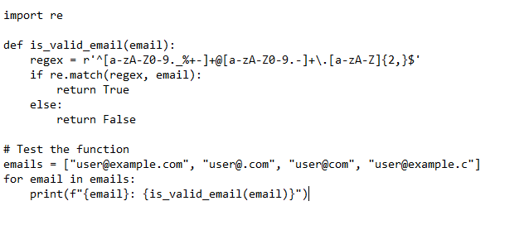
Code example: Email Validation
^[a-zA-Z0-9._%+-]+ ensures the local part of the email consists of valid characters.
@[a-zA-Z0-9.-]+ ensures the domain part contains valid characters.
\.[a-zA-Z]{2,}$ ensures the domain extension is at least two characters long.

Slide 9
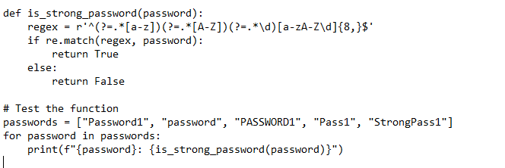
Code Example: Password Strength
(?=.*[a-z]) ensures at least one lowercase letter.
(?=.*[A-Z]) ensures at least one uppercase letter.
(?=.*\d) ensures at least one digit.
[a-zA-Z\d]{8,}$ ensures the password is at least eight characters long.

Slide 10
Class task 2
Find valid passwords

Slide 11
Task
Find valid passwords from a list
password policy : must contain 1 caps 1 small 1 digit 1 special and at least 10 chars long.
Submission – your code that outputs valid passwords, AI conversations if any
Wait…Let me start the challenge.

