Slide 1
CY-6120: Software Security Practices
Module 0: Introduction

Slide 2
Software¹ Security² Practices³
What do they even mean?

Slide 3
Software
Software is like a set of instructions that tells a computer what to do. Think of it as the brain behind your apps, websites, and systems.
It comes in many forms, like applications (games, tools, etc.), operating systems (like Windows or macOS), or even code that runs in the background on servers.
Key Idea: Software is what turns hardware (your computer or phone) into something useful by giving it a purpose or functionality.
Program - A program is a set of instructions that a computer follows to perform a particular task.
My noob definition – Software == Program == Code.

Slide 4
Is this a software?
Operating System (e.g., Windows, macOS)
Microsoft PowerPoint (this slide)
Static Website (just HTML/CSS)
Video Game (e.g., Fortnite, Minecraft)
Google Chrome (web browser)
Computer Mouse
Cloud Services (like Google Drive)
Mobile App (like Instagram)

Slide 5
Software Security
Software security means making sure that the software we use is safe and protected.
Just like you lock your doors to protect your house, we need to secure software so that it can’t be misused or attacked.
Key Idea: It's about keeping software working the way it’s supposed to, without letting bad actors break in or cause harm.
Examples?
Antivirus
Firewall
Encryption
Multi-factor Authentication (MFA)

Slide 6
Software Security Practices
These are the steps or methods developers and companies take to make sure software stays safe.
It’s like following good habits when building software, such as writing clean code, testing for vulnerabilities, and keeping systems updated.
Key Idea: Just as you brush your teeth to prevent problems, developers follow security practices to keep software healthy and secure.
Examples?
Writing Secure Code
Input Validation (Module 1)
Regular Security Audits
Using Strong Password Policies
Code Reviews and Peer Testing

Slide 7
“The only system which is truly secure is one which is switched off and unplugged locked in a titanium lined safe, buried in a concrete bunker, and is surrounded by nerve gas and very highly paid armed guards.”
-- Gene Spafford, Director, Computer Operations, Audit, and Security Technology (COAST) Project, Purdue University

Slide 8
Software Security and You
What is your favorite software development technology? (language, tool, library, etc.)
Have you ever written software where security mattered?
Did you do anything about it then?
How do you know that you have delivered secure software?
Try to think of examples
What are your indicators?
How will you convince others that your software is secure?

Slide 9
Discussion Takeaways
Security is not black-and-white
Security is “until proven insecure”
Security “Theater”
Feeling safer vs. Being safer
People act on their perception of reality, not necessarily on reality
Protection can be costly
E.g., personal liberty and privacy

Slide 10
So, why are insecure software still out there?

Slide 11
Why is most software insecure?
Few developers know how to develop secure software
It is NOT their incentive to keep security in mind!
Most schools don’t have it in their curricula
If it is, it’s optional graduate level, not required undergrad
Programming books/courses don’t teach it
Some common operations intrinsically dangerous (Language Specific Vulns – Module 2 and 3)
Most developers don’t think like an attacker
“How could this be attacked?” – be slightly paranoid
Developers don’t learn from others’ security mistakes
Most vulnerabilities caused by same mistakes over 40+ years
Customers can’t easily evaluate software security
Security often not seriously considered
Managers don’t always resource/train adequately

Slide 12
How to solve this?
Secure SDLC?

Slide 13
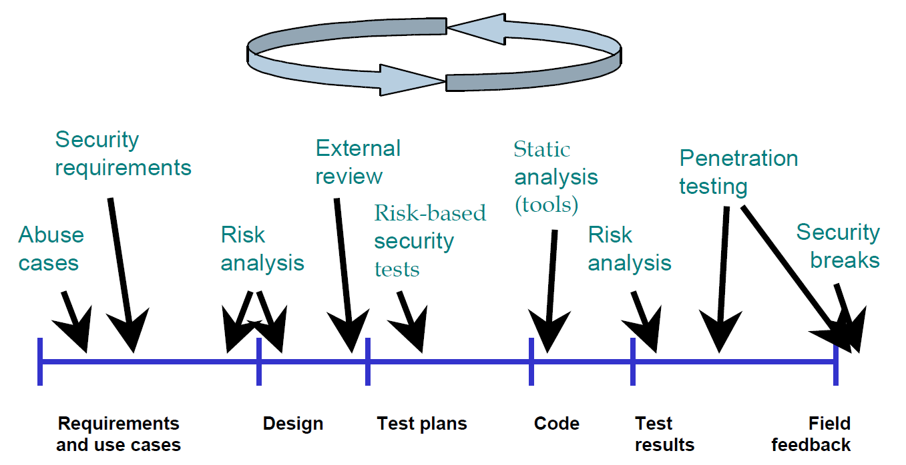
Must consider security throughout lifecycle
Developing secure software requires actions throughout lifecycle
“Defense-in-breadth”

Slide 14
Wait…. What?
Time and manpower?
Testing?
Competitors?
Budget?
Expertise? Skills? Mindset?
Employees leaving and joining
Documentation for all these!!!
Customer/Client says – I don’t like this! Change this!
Restart? Again?

Slide 15
After all of this…still….
How do you know that you have built a system that cannot be broken into?
What evidence do you look for?
How do you know you’re done?
How do you prioritize security against everything else drawing upon your time?
Software Engineering is a zero-sum game
- “If I need to focus more energy on security, what should we take away?”
Better to build the software fast and effectively and think about security later.

Slide 16
Segway

Slide 17
What is the vulnerability?
#include <stdio.h>
int main() {
char buffer[16];
printf("Enter some text: ");
gets(buffer);
printf("You entered: %s\n", buffer);
return 0;
}

Slide 18
How did you know?

Slide 19
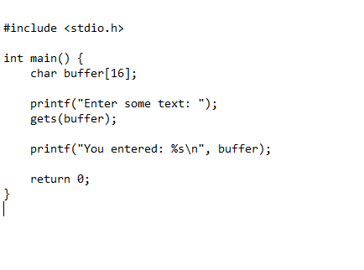
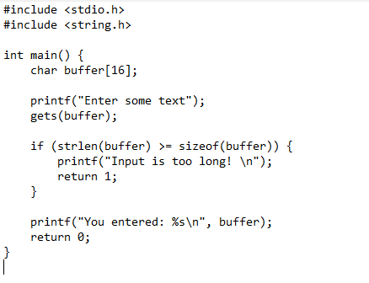
What about now?

Slide 20
What is the vulnerability?
from jose import jwt
from flask import Flask, request, session, jsonify
# set user session
token = jwt.encode({‘user': ‘$SESSION'}, ‘supersecret', algorithm='HS256’)
# verify user session
token = request.form.get('user_id')
jwt.decode(token, ‘supersecret')

Slide 21
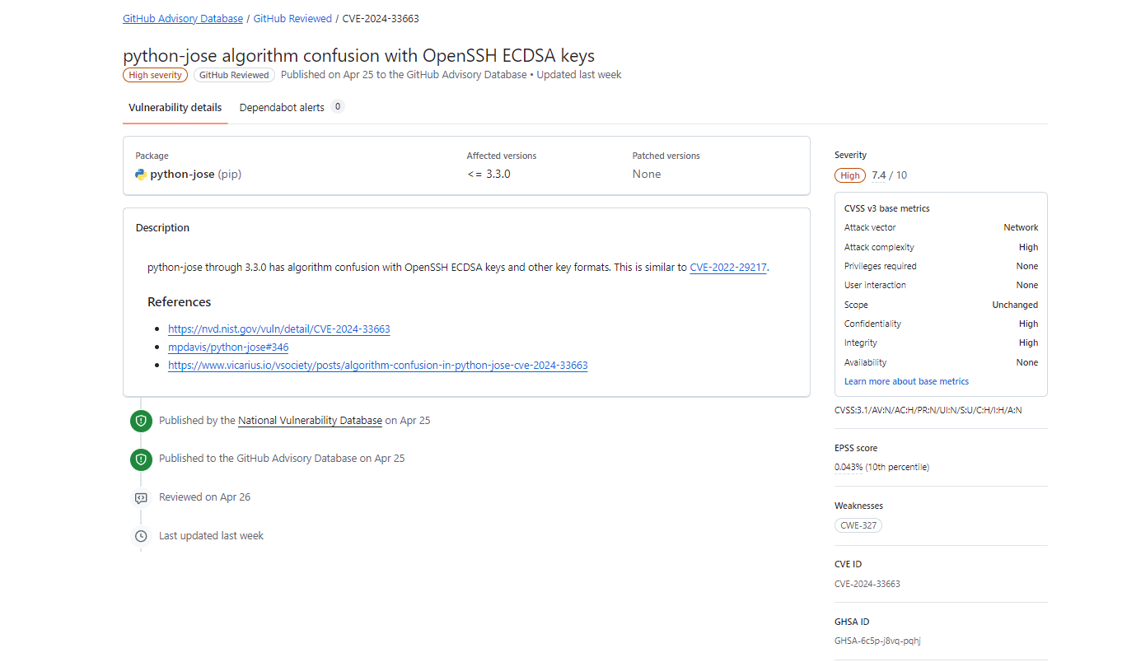
NOW?

Slide 22
Terminologies
gets is 1st party code. SAST
python-jose is 3rd party code. SCA
SCA scans applications for the features of vulnerabilities that were introduced by open-source components and third-party libraries.
SAST, on the other hand, examines an organization's proprietary source code, looking for security weaknesses that have their roots in coding mistakes or insecure coding practices.
Creator of python-jose will be using SAST for its own library. SCA for its own 3rd party.
Direct dependency – Transitive dependency.

Slide 23
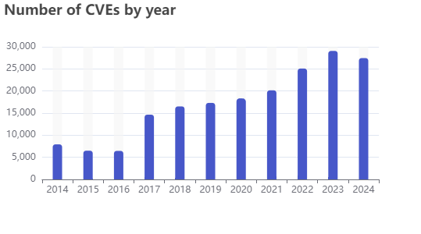
How many security issues?
Source: https://www.cvedetails.com/

Slide 24
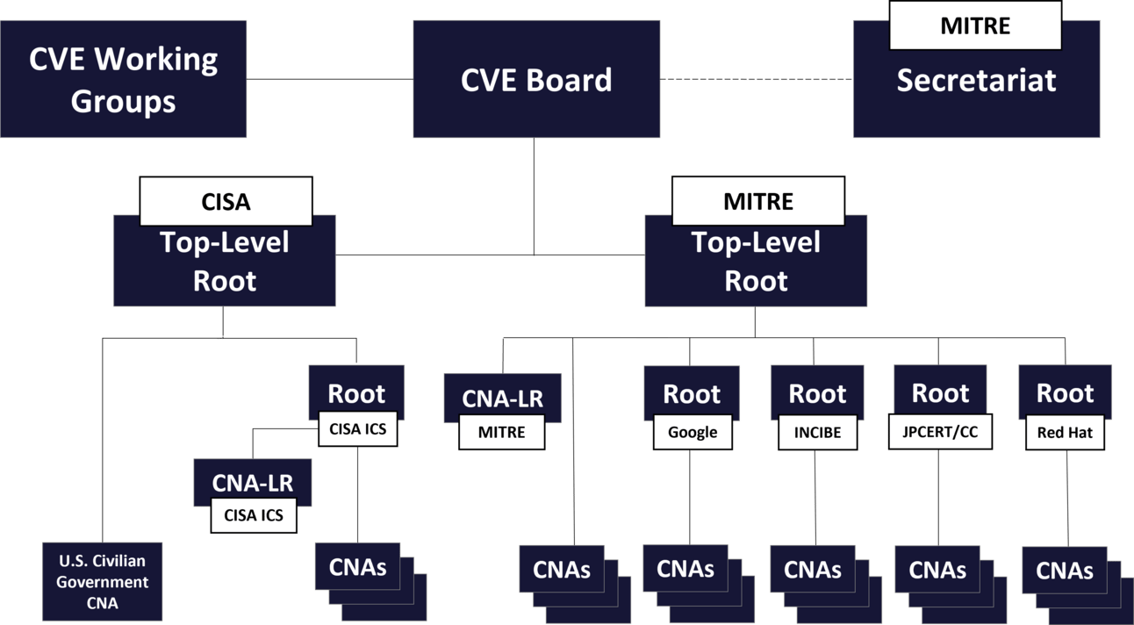
Vulnerability Management
Who finds all these vulnerabilities?
Who releases them?
At the time of this writing, there are 383 CVE Program partners to whom people can report vulnerabilities. Becoming a partner or CVE Numbering Authority doesn’t require much, and once you’re approved, there isn’t much expected of you. Jerry Gamblin reported that almost 100 CNAs did not report a single CVE in 2023.

Slide 25
Other terminologies - KEV
KEV (Known Exploited Vulnerabilities)
CISA’s Known Exploited Vulnerabilities (KEV) Catalog
Directly from their website: “CISA maintains the authoritative source of vulnerabilities that have been exploited in the wild.”
Vulnerabilities added to the KEV Catalog do not always mean the vulnerability is actively exploited. It could have been exploited in the past.
Over 250,000 total CVEs and only 1,100 have been entered into the KEV Catalog.
If you’re vulnerable to something in the KEV, prioritize it. Still, I would instead use something like VulnCheck’s KEV, which considers publicly available exploit codes and academic research. It’s free to use and contains ~2,000 vulnerabilities with 8,500+ cited references and 3,500+ POC references - which CISA’s KEV Catalog does not include.

Slide 26
Other terminologies - EPSS
Exploit Prediction Scoring System (EPSS)
There’s often confusion about what EPSS measures.
Most people think it evaluates the likelihood of a vulnerability being exploitable.
In reality, it predicts the probability of a vulnerability being exploited in the wild (if it is exploitable!). This distinction is crucial.
This means that a high EPSS score indicates a higher likelihood of real-world exploitation (if it is exploitable!).
EPSS considers commonly targeted references in its scoring system. For instance, a security advisory mentioning a high-profile target like Microsoft will likely have a higher EPSS score due to the increased likelihood of exploitation.

Slide 27
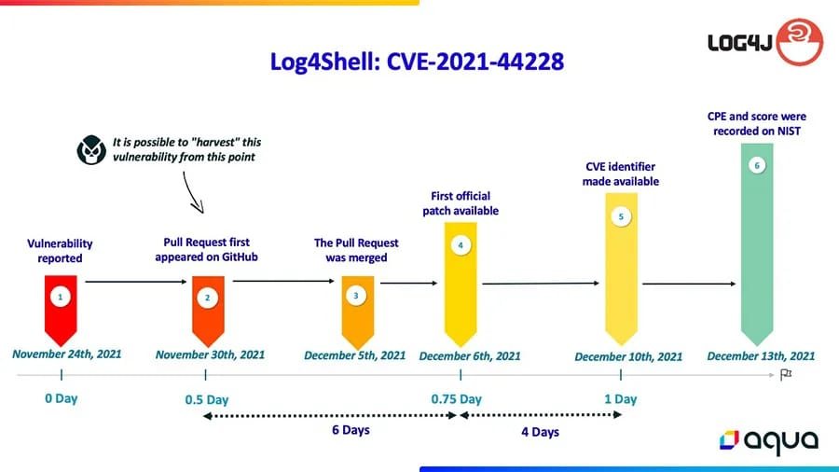
GitHub Security Advisory Database
One critical issue is that there’s no requirement to publish a CVE. Instead, open-source maintainers frequently publish security advisories on alternative platforms like the GitHub Advisory Database.
OSS (Open-Source Software) vulnerabilities go untracked by traditional databases like NVD.

Slide 28
GitHub Security Advisory Database
Only 19k reviewed from 2017 till now? Does not match the data!
Some vendors or organizations manage their own advisories and disclosures, which may not always align with the CVE database or GitHub’s advisory listings.
GitHub's Security Advisory database primarily focuses on vulnerabilities related to open-source projects and software commonly used in repositories hosted on GitHub. It may not include vulnerabilities that are less relevant to GitHub's ecosystem, such as those affecting proprietary software, hardware, or closed environments.
GitHub may prioritize the inclusion of CVEs that are directly relevant to the repositories and packages hosted on its platform.
GitHub's advisory system may not synchronize directly with all CVE sources or databases.

Slide 29
Beyond the CVE
There are over 250,000 CVEs, but only a tiny fraction impact open-source software. There is no easy way to filter the CVE database for those impacting open-source software.
Many open-source project maintainers prefer the control and simplicity of GitHub security advisories over the CVE submission process.
>2,000 GitHub Security Advisories have no corresponding CVE.
Note: GitHub is an authorized CVE Numbering Authority (CNA). Therefore, GitHub can assign a CVE to security advisories under their scope.

Slide 30
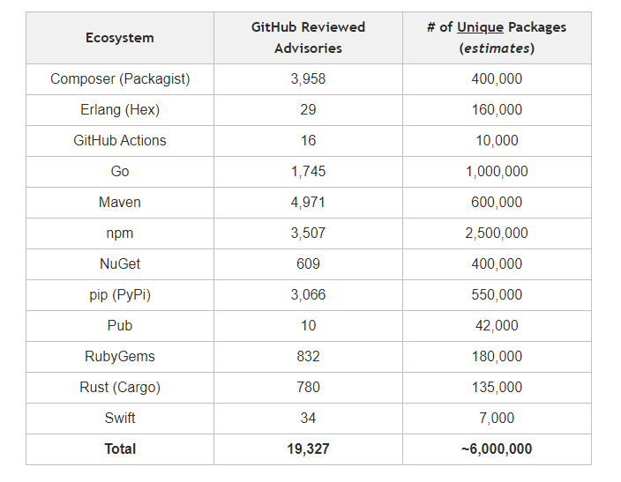
Project Overview and Ecosystem Support
Packages often have numerous releases/versions. PyPi reports 550,000 unique packages but almost 6,000,000 releases. If we apply this ratio (10 releases per unique package), we’re talking ~60,000,000 total packages for these supported ecosystems.
How do you feel about <20,000 security advisories for ~60,000,000 total packages?

Slide 31
The Necessity of Manual Review
Advisories require manual intervention to become “approved” security advisories.
Currently, there are >220,000 unreviewed advisories in the queue, and god knows how many more aren’t.
This also means security advisories tend to stop, or at least slow down, around certain times of the year for holidays.
There isn’t a transparent distribution of efforts across the ecosystems. Depending on the week, you may see more Maven advisories versus NPM or vice versa.

Slide 32
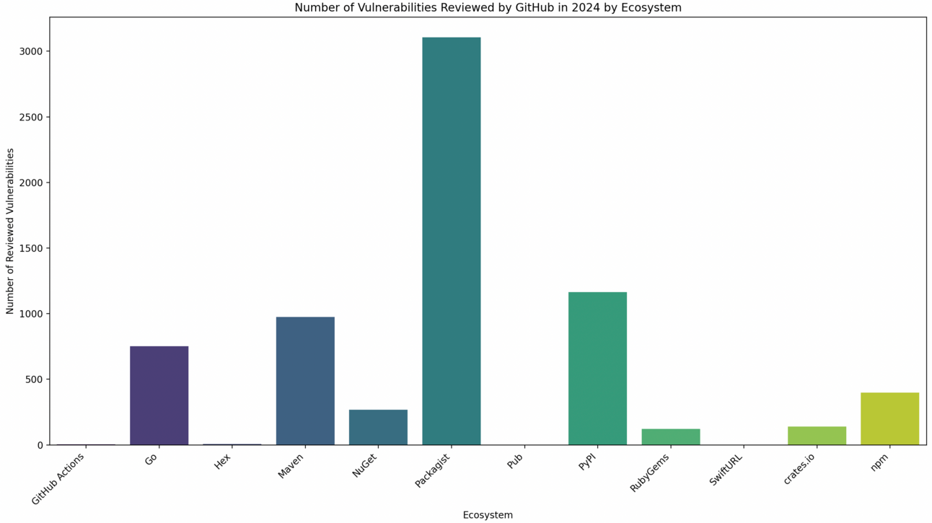
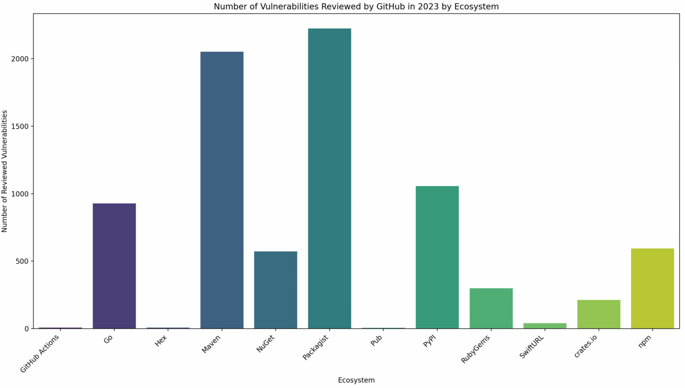
Which Ecosystems Receive the Most Attention?

Slide 33
Google’s Vulnerability Database
Google has an open-source vulnerability database (osv.dev)
Ingests GitHub Security Advisory data, including malware advisories and additional sources not supported by the GitHub Security Advisory project.
Google has this database available for free download and keeps it continuously up-to-date.
The quality of osv.dev advisories largely relies on the work done by its sources, such as the GitHub Security Advisory project.

Slide 34
Conclusion

Slide 35
Software Security is …
NOT a myth but a reality
Insecure software causes immeasurable harm
Sony, NSA, Equifax, OPM, Anthem/Premera, Android, Browsers, Mueller report, SolarWinds, log4Shell… just read the news
NOT an arcane black art
Much of it seems arcane
Finding a severe vulnerability w/o source code
Crafting the exploit
Endless clever ways to break software

Slide 36
Software Security is …
NOT a set of features
Secure software > Security software
Although tools and experts are helpful,
You can’t just deploy a magical tool and expect all vulnerabilities to disappear
You can’t outsource all of your security knowledge
Even if you are using a security library, know how to use it properly
NOT a problem for just mathematicians
Cryptography
Is important and needed
Cannot solve all of your security problems
Pick-proof lock vs. open window

Slide 37
Software Security is …
NOT a problem for just networking and operating systems
Software had security problems long before we had the internet
If you left a window open in your house, would you try to fix the roads?
A reality that everyone must face
Not just developers, all stakeholders
A learnable mindset for software engineers (expensive though!)
The ability to prevent unintended functionality
At all layers of the stack
In all parts of your system

Slide 38
References
https://dwheeler.com/secure-programs/
Kyle Kelly @ Semgrep - https://www.cramhacks.com/
Google Search
CVEdetails.com
CVE.org
Numerous Others..,

