Slide 1
CY-6120: Software Security Practices
Module 4: Static analysis and Semgrep

Slide 2
Make it cheap to make it expensive to exploit software. or less eloquently: Prevent people from shooting themselves in the foot. Brandon
Semgrep

Slide 3
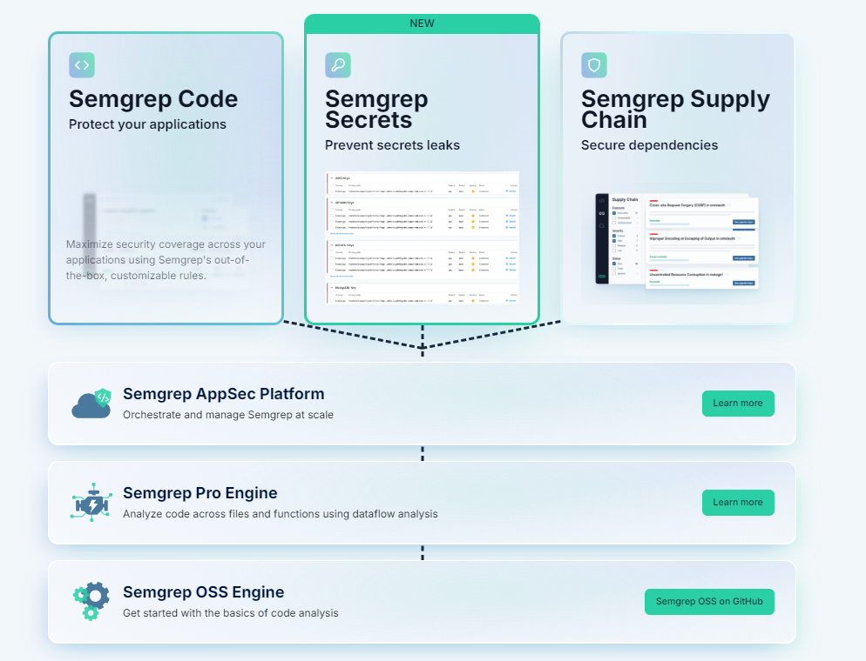

Slide 4
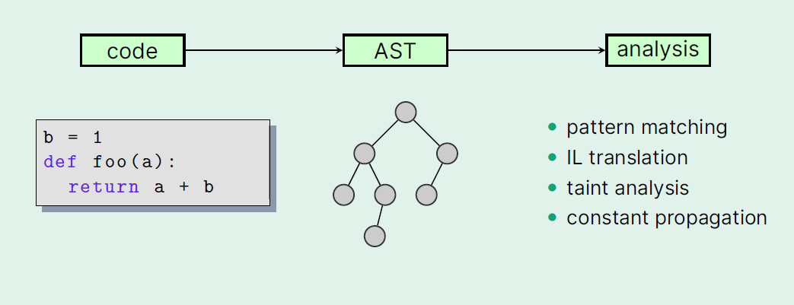
What is Semgrep?

Slide 5
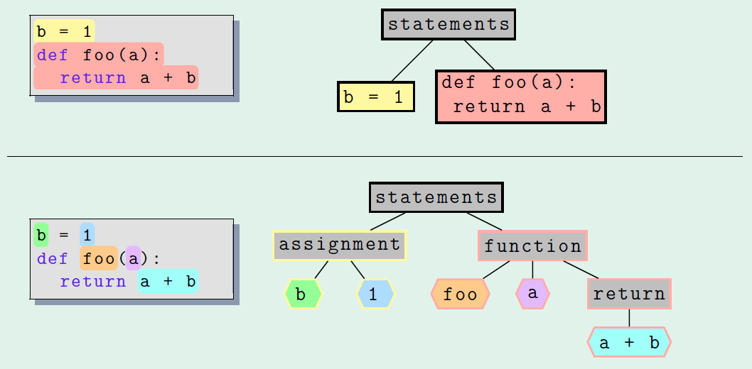
Abstraction

Slide 6
Why not just search for what we want to find?
For a known DANGEROUS function like gets

Slide 7
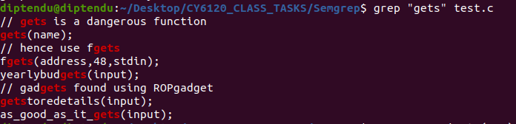
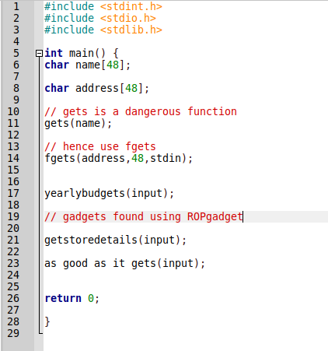
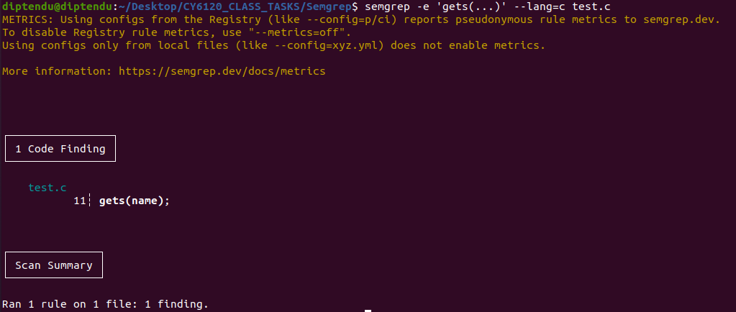
grep vs. Semgrep (Semantic grep)

Slide 8
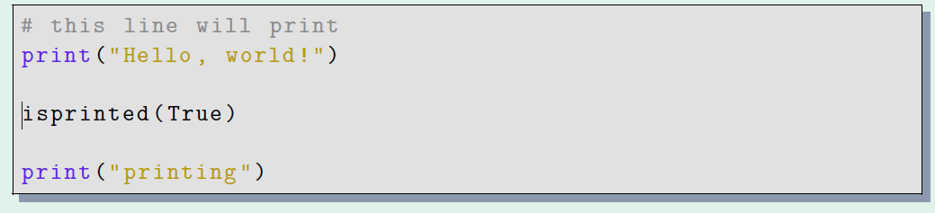
Example
Semgrep is about matching nodes and obtaining ranges.
Suppose we were interested in matching calls to print in Python. We could be concerned with the following program:

Slide 9
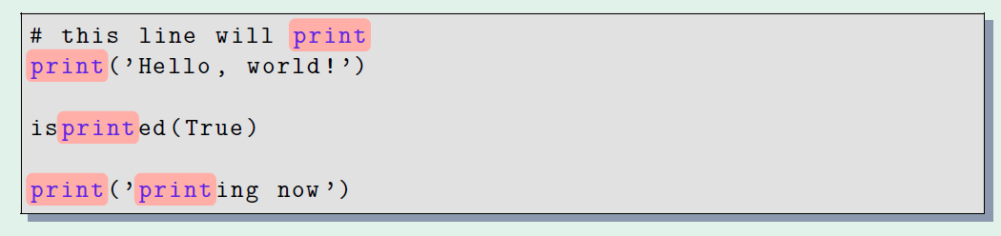
Using grep / syntactic grep
The reason is that grep is not aware of whether each contiguous print is a call or not. It just operates purely based on characters. Put another way, grep is not semantic.
Brandon Wu

Slide 10
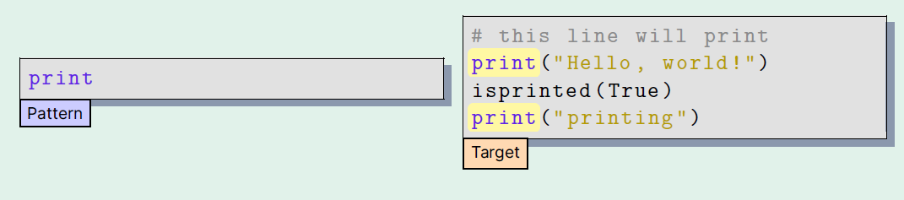
Using semantic grep / semgrep
Note that it is not simply a matter of ignoring the comments and string literals – we also do not match the identifier isprinted, because it is not the same as the identifier print.

Slide 11
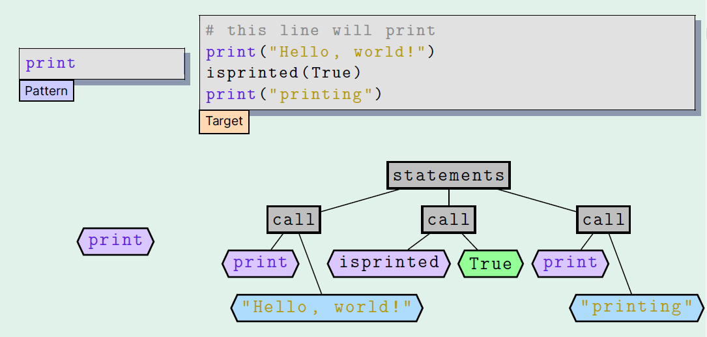
Under the hood: Trees

Slide 12
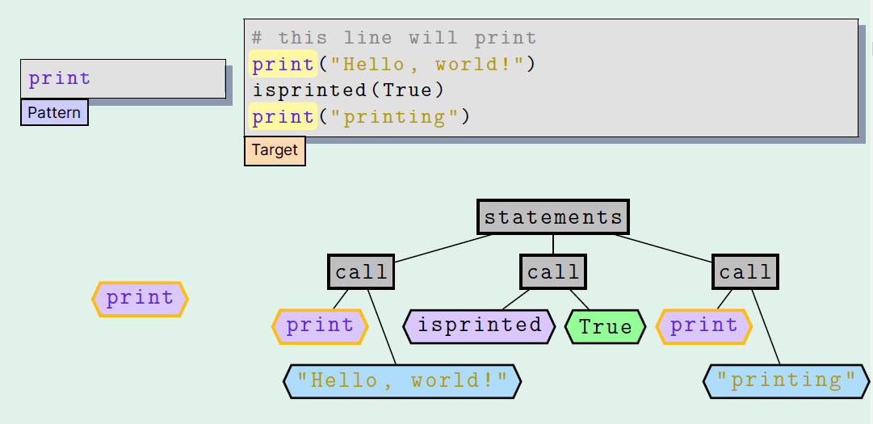
Under the hood: Trees

Slide 13
The semgrep formula
parsing the pattern to an AST (rules contain patterns)
1
parsing the target to an AST (target = source code)
2
matching both against each other
3

Slide 14
Semgrep features
Open-source, with community-contributed language support and rules
Customizable – Semgrep scans for patterns. Anyone can write patterns. Customized to your code, your security requirements.
Multilingual - Semgrep supports over 30 languages (https://semgrep.dev/docs/supported-languages)
No building required - Semgrep only needs source code to run and doesn’t require that the code it is analyzing can build. Hence it is fast.
No DSL (Domain Specific Language) - Semgrep patterns look like source code, meaning no hours of browsing documentation and API references. All you need to be able to do is read and write code.
Rules are written in YAML.

Slide 15
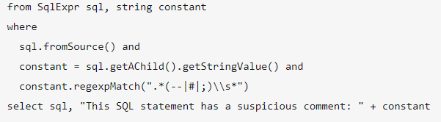
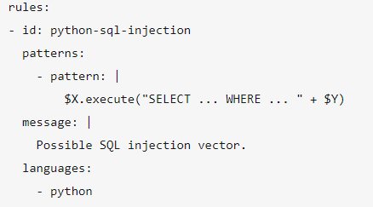
DSL – Domain Specific Language
CodeQL vs Semgrep - https://blog.onsec.io/codeql-vs-semgrep-fun-and-friendly-showdown-of-sast-tools/

Slide 16
Semgrep patterns (rules)

Slide 17
Writing rules
Semgrep rules are written in yaml.
Patterns - what to search for in code.
Test in your browser - https://semgrep.dev/playground or CLI
A good place to start - https://semgrep.dev/learn
Let us write together – using gets example.
https://semgrep.dev/playground/r/AbU9DbD/diptendu_personal.neu_gets_example?editorMode=advanced&view=code
Try detecting “fgets” now.
Click on fork (top right) to add to your directory. Play around with it, make changes and test.

Slide 18
Ellipsis - …
The ellipsis is a placeholder in a Semgrep pattern which matches zero or more occurrences of some element, for instance parameters, arguments, and statements.
Similar to .* in regex. Simply put – it can contain anything.
Examples –
subprocess.Popen(…) – does not consider number or type of arguments. Matches all calls.
https://semgrep.dev/playground/r/0oULnL7/diptendu_personal.ellipsis_usage?editorMode=advanced
palindrome(“…”) or – matches any string argument, will not match any integer argument
https://semgrep.dev/playground/r/KxUvxvb/diptendu_personal.ellipsis_string_usage?editorMode=advanced
Between 2 statements – matches the 2 statements containing 0 or more lines between them.
https://semgrep.dev/playground/r/zdUKzKG/diptendu_personal.ellipsis_code_usage?editorMode=advanced
open(…, “r”, …) vs. open(“r”, …) – “r” needs to be an argument anywhere vs. “r” is the first argument – don’t care what or how many argument comes after that.
https://semgrep.dev/playground/r/pKU1E1N/diptendu_personal.ellipsis_argument_position?editorMode=advanced

Slide 19
Ellipsis is not a silver bullet
def … will not work to match a function declaration
https://semgrep.dev/playground/r/r6UyWyN/diptendu_personal.wrong_ellipsis_usage?editorMode=advanced
Ellipsis is only admissible wherever you could put a sequence of parameters, arguments, or statements.
Semgrep patterns must look like code in the language they are a part of.
What Python construct looks like def ..., where ... is a sequence of arguments, parameters, or statements? The answer is none, and so the pattern is invalid.
You need $METAVARIABLES.

Slide 20
Metavariables
Metavariables are an abstraction that lets you match something even when you don't know exactly what it is you want to match.
A Metavariable is a placeholder in a Semgrep pattern which matches exactly one occurrence of some element, for instance an argument, expression, or identifier.
Use case – we want to match a function say “gets” with only 1 argument, but we don’t know what type of argument. Here gets(…) is not a good solution. gets($ARG) is better.
All metavariables must start with a dollar sign and can only contain uppercase characters, digits, and underscores.
Matching a python function / class using metavariables.
https://semgrep.dev/playground/r/bwUbyb6/diptendu_personal.metavariable_match_function?editorMode=advanced

Slide 21
Metavariables
Metavariables differ from the ellipsis operator because they must match an expression, whereas the ellipsis operator can match zero or more expressions.
Example – match exactly 1/2/3 … arguments , we don’t know what they are.
Let us do some testing –
https://semgrep.dev/playground/r/wdU9Y9v/diptendu_personal.metavariables_class_task_1?editorMode=advanced
https://semgrep.dev/playground/r/x8UK6Kl/diptendu_personal.metavariables_class_task_2?editorMode=advanced

Slide 22
Semgrep Operators (Pattern syntax)
pattern:
looks for code matching its expression.
Use cases – trying to match something single – function, class definition, expression, assignment etc.
Example – print(…), gets(…)

Slide 23
Semgrep Operators (Pattern syntax)
pattern-not:
Opposite of pattern. Finds code that does not match its expression.
pattern-not DOES NOT work alone. Needs a pattern along with it at least.
Use cases – removes false positives, match if the function is called but not with a specific argument.
Example –
pattern: generate_pdf(…)
pattern-not: generate_pdf(… , from_url=True, …)

Slide 24
Semgrep Operators (Pattern syntax)
patterns:
operator performs a logical AND operation on one or more child patterns.
chaining multiple pattern operators or other operators together that all must be true.
patterns: can also contain one or more patterns: as child.
If we were to combine pattern and pattern-not, we would need patterns.
https://semgrep.dev/playground/r/eqU0B0X/diptendu_personal.class_task_3?editorMode=advanced

Slide 25
Semgrep Operators (Pattern syntax)
pattern-either:
Logical OR of one or more child patterns.
Match 2 or more pattern.
Example – both requests.get and requests.post are vulnerable. Match if get OR post in code.
https://semgrep.dev/playground/r/DbU6ERy/diptendu_personal.pattern-either-example?editorMode=advanced
How to write pattern-neither? E.g. Match all other requests methods except get and post.

Slide 26
Semgrep Operators (Pattern syntax)
pattern-inside:
Match findings that reside within its expression. This is useful for finding code inside other pieces of code like functions or if blocks.
Think of it like – pre-condition, cause-effect type.
Use case – vulnerability is valid if some other conditions exist (written before the call)
Example – call under annotated function, sqlquery.execute(…) when using mysqlconnection.
https://semgrep.dev/playground/r/5rUdZdv/diptendu_personal.pattern-inside-example?editorMode=advanced

Slide 27
Semgrep Operators (Pattern syntax)
pattern-not-inside:
Opposite of pattern-inside. useful for finding problematic code that isn't inside code that mitigates the issue.
Use case – vulnerability is valid unless some check is present.
Example – open not inside try block, exec is called without sanitization.
https://semgrep.dev/playground/r/ReUDyDv/diptendu_personal.pattern-not-inside-example?editorMode=advanced

Slide 28
Semgrep Operators (Pattern syntax)
pattern-regex:
searches files for substrings matching the given PCRE2 pattern.
This is like grep – string matching like normal regex.
Use case – search for a string in argument / code.
Example – get calls to “http://” sites are unsafe.
https://semgrep.dev/playground/r/BYUXRxW/diptendu_personal.pattern-regex-example?editorMode=advanced

Slide 29
Semgrep Operators (Pattern syntax)
pattern-not-regex:
Opposite of pattern-regex. Same syntax.
Use case – filter false positives.
Example - https://semgrep.dev/docs/writing-rules/rule-syntax#pattern-not-regex

Slide 30
Semgrep Operators (Pattern syntax)
metavariable-regex:
Substring search but in metavariables only.
useful for filtering results based on a metavariable value.
Use cases – similar function names, argument names. Alternative to lots of pattern-either
Example – functions parsexml, parsexml2json, parsexmltopdf are vulnerable.
https://semgrep.dev/playground/r/lBU4Elz/diptendu_personal.metavar-regex-example?editorMode=advanced

Slide 31
Semgrep Operators (Pattern syntax)
metavariable-comparison:
compares metavariables against a basic Python comparison expression. This is useful for filtering results based on a metavariable's numeric value. Supports Boolean, Arithmetic, Comparison operators.
Use case – specific key sizes, port ranges
Example – socket.open() should not use any port > 10000.
https://semgrep.dev/playground/r/6JUvBZE/diptendu_personal.metavariable-comparison-example?editorMode=advanced

Slide 32
Some tips
“Semgrep rule writing is both an art and science” – Kurt Boberg @ Semgrep
You can debug / print metavariables by adding them to message. Check what it contains.
Start with something simple and then refine to get better matches.
Example – start by checking if all function calls are matching, then filter based on arguments, then filter based on argument content, …
When in doubt consult docs - https://semgrep.dev/docs/writing-rules/rule-syntax
Will get there with practice, takes time to learn anything
I still cannot write rules perfectly and often need help after writing rules for more than a year LOL.

Slide 33
Next week…
Taint mode
Track dataflow, is this variable/data reaching a dangerous function?
How to read and understand an open-source CVE
What is the issue exactly? Which function is affected? Am I using that function?
Applying what we learned to write CVE specific rules
SCA – supply chain rules
Assignment discussion and clarification.

Slide 34
References / Resources
https://brandonspark.github.io/files/finding_bugs.pdf
https://semgrep.dev/blog/2024/sca-reachability-analysis-methods
https://semgrep.dev/blog/2022/a-deep-dive-into-semgrep-supply-chain
https://semgrep.dev/blog/2022/software-supply-chain-security-is-hard
https://semgrep.dev/learn
https://www.youtube.com/@semgrep/videos
https://semgrep.dev/docs/writing-rules/rule-syntax#pattern
Semgrep Academy - https://academy.semgrep.dev/

