Slide 1
CY-6120: Software Security Practices
Module 4: Static analysis and Semgrep

Slide 2
What's the funniest or weirdest bug you have ever encountered in your coding experience?

Slide 3
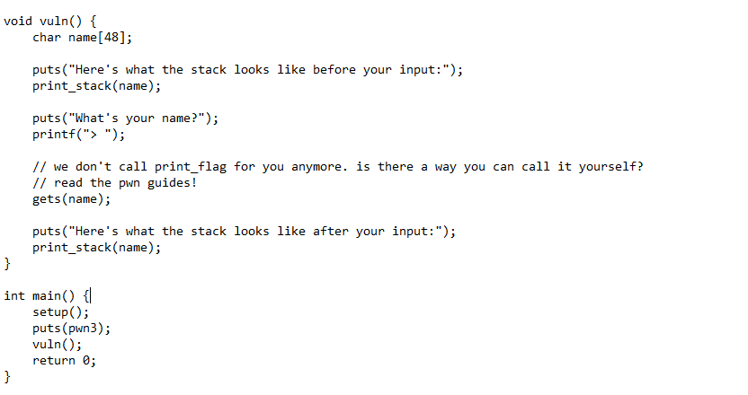
Recall pwn3 demo

Slide 4
Congrats – you just performed static analysis (with your eyes)

Slide 5
Eyes on code?
As of October 2023 –
GitHub hosts over 200 million repositories.
Conservative estimate - 5,000 to 10,000 lines of code per repository.
200 million repositories × 5,000 LOC = 1 trillion lines of code
Based on various industry studies and expert opinions, the average time to review code
a reasonable average for reviewing 1,000 lines of code is approximately 3 to 5 hours.
Using 3 Hours per 1,000 LOC: 3,000,000,000 hours ≈342,465 years
Using 5 Hours per 1,000 LOC: 5,000,000,000 hours ≈570,740 years
Takeaway – not possible to have eyes on code always (sometimes), we need tools.

Slide 6
Static Analysis: Definition & Concepts
"Static analysis is the examination of code without executing it.“
It's like reading through a recipe without actually cooking the dish to spot any missing ingredients or steps.
Key Characteristics:
Code Inspection: Analyzes source code or compiled code.
Early Detection: Identifies potential errors, vulnerabilities, or deviations from coding standards before runtime.
Automated Tools: Utilizes software tools to automate the review process.

Slide 7
Static Analysis: Definition & Concepts
Why It's Useful:
Catch Issues Early:
Finding bugs before execution saves time and resources.
Prevents small issues from becoming big problems down the line.
Improve Code Quality:
Enforces coding standards and best practices.
Enhances readability and maintainability of code.
Think of static analysis as a spell-checker for your code. It won't write your essay for you, but it'll point out that you spelled 'function' as ‘funkcion’.

Slide 8
Static Analysis: Definition & Concepts
Under the hood: Abstract Syntax Tree (AST)
A tree representation of the abstract syntactic structure of code.
Used by static analysis tools to understand code structure.
Semantics and Syntax.
Syntax:
Identifies syntax errors that would prevent the code from compiling or running.
Code Formatting and Style Enforcement.
Semantics:
Type Checking: verify that variables and functions are used with the correct data types, catching type mismatches that could lead to runtime errors.
Data Flow Analysis: how data moves through the code, identifying issues like unreachable code, dead code, or improper variable usage.
Control Flow Analysis: understanding the execution paths within the code to detect potential issues such as infinite loops, improper exception handling, or logic errors.
Notes:
Common Issues Detected:
Syntax Errors: Typos, missing semicolons.
Semantic Errors: Misuse of variables, incompatible types.
Code Smells: Redundant code, overly complex methods.
Security Vulnerabilities: SQL injection points, buffer overflows.

Slide 9
The Why Behind Static Analysis
Importance of Early Bug Detection: The Escalating Cost
Finding a bug during development might cost you a coffee break; finding it after deployment might cost you your job
Studies show that the cost of fixing a bug increases exponentially the later it's found in the development cycle.
Knight Capital Incident – August 2012. $440 Million loss.
https://specbranch.com/posts/knight-capital/
https://www.henricodolfing.com/2019/06/project-failure-case-study-knight-capital.html
In 1999, NASA's Mars Climate Orbiter vanished into the Martian atmosphere. $125 Million.
A mix-up between metric and imperial units.
Takeaway - Small Mistakes, Big Consequences

Slide 10
Benefits of Using Static Analysis
Improving Code Quality and Security
Early Detection: Identifies potential issues before they become real problems.
Consistency and Maintainability:
Enforces coding standards across teams.
Makes the codebase easier to understand for new developers.
Security Enhancements:
Detects vulnerabilities such as SQL injection, cross-site scripting, and buffer overflows.
Cost and Time Efficiency
Reduces Debugging Time: Less time spent on hunting down bugs means more time for developing new features.
Minimizes Risk of Catastrophic Failures: Prevents small issues from snowballing into major disasters.
Because nobody wants their software to be the next headline news—unless it's for winning awards.

Slide 11
Tools of the Trade
Popular static analysis tools
Snyk, SonarQube, Coverity, Veracode, CodeQL, Checkmarx, Aikido security, Endor Labs, … , etc.
Some are commercial, some have limited free usage.
Every tool has pros and cons.
I currently work at Semgrep, another powerful and flexible static analysis tool.
We’ll be discussing its features and benefits in detail next week.
Choosing the right tool often depends on your specific needs—be it the programming languages you're using, the size of your project, or the particular issues you're trying to detect.
Even the best tools can't replace good coding practices, but they can certainly help catch things before they catch you off guard!

Slide 12
Advantages of Static Analysis
Early Bug Detection:
Catch Issues Before They Hatch: Identifies errors, vulnerabilities, and code smells during the development phase.
Cost Savings: Fixing a bug during coding is significantly cheaper than fixing it after deployment.
According to the Systems Sciences Institute at IBM, the cost to fix an error found after product release was 4 to 5 times more than one uncovered during design
Improved Code Quality:
Enforces Coding Standards: Ensures that the codebase adheres to predefined style guides and best practices.
Enhances Maintainability: Clean, consistent code is easier for teams to understand and maintain.

Slide 13
Advantages of Static Analysis
Security Enhancements:
Vulnerability Detection: Identifies common security flaws like SQL injection, cross-site scripting (XSS), and buffer overflows.
Compliance: Helps meet industry standards and regulations like OWASP Top Ten, PCI DSS, and GDPR.
Integration with Development Workflow:
Continuous Integration/Continuous Deployment (CI/CD): Automates code checks in the pipeline, preventing faulty code from being merged.
Real-Time Feedback: Immediate notifications of issues help developers correct them on the spot.

Slide 14
Disadvantages of Static Analysis
False Positives and Negatives:
False Positives: The tool flags code as problematic when it's actually acceptable.
Impact:
Wastes developer time investigating non-issues.
Can lead to "alert fatigue," causing real issues to be overlooked.
False Negatives: The tool fails to detect actual issues.
Impact:
Provides a false sense of security.
Critical vulnerabilities might slip through the cracks.
Over-Reliance on Tools:
Human Judgment is Irreplaceable: Tools can't understand the context or intent behind code.
Not a Silver Bullet: Should be part of a broader quality assurance strategy, including code reviews and dynamic testing.

Slide 15
Disadvantages of Static Analysis
Performance and Resource Usage:
Resource Intensive: Analyzing large codebases can be time-consuming and may require significant computational resources.
Waiting for a scan to fini … …… … … … …
Learning Curve and Configuration:
Configuring the tool to fit the specific needs of a project can be challenging.
Some tools are more complex to use than others (may be using its own custom language).
Potential for Missed Context:
Static analysis tools may not understand the application's intent, leading to irrelevant warnings.
A tool might flag the use of encryption algorithms as insecure without knowing they're used in a secure context.
GPS telling you to turn left into a wall because it doesn't know the road is closed.
Notes:
Kurt - Introducing the concept of "domain specific language" and the acronym DSL would be beneficial to students here - they will encounter it in their careers.

Slide 16
Can static analysis replace human code reviews?
Group Discussion

Slide 17
Thoughts?
Combining automated tools with human expertise yields the best results.
While static analysis is powerful, it complements but doesn't replace human code reviews.
Static analysis is a powerful ally in the quest for bug-free code, but it's not a magic wand.
Balancing automated tools with human insight leads to the best outcomes.
Plus, it gives us more time to focus on the fun parts of coding—like naming variables creatively!

Slide 18
SAST vs. SCA—Decoding the Acronyms
Definition
Static Application Security Testing (SAST) is a white-box testing methodology where the source code is analyzed from the inside out while it's at rest.
It focuses on identifying security vulnerabilities within the custom code written by your development team.
How It Works
Analyzes source code, bytecode, or binary code for coding errors and potential security vulnerabilities.
Checks the code against a set of predefined rules and patterns that represent known weaknesses (like buffer overflows, SQL injections, etc.).
Key Focus
CWE (Common Weakness Enumeration)
In-House Code Analysis

Slide 19
SAST vs. SCA—Decoding the Acronyms
Definition
Software Composition Analysis (SCA) focuses on identifying and managing open-source components and third-party libraries within your application.
It detects known vulnerabilities in these components by referencing databases of disclosed vulnerabilities.
How It Works
Scans the application's dependencies to create an inventory of all open-source components.
Checks these components against vulnerability databases like the NVD (National Vulnerability Database), Github Security Advisory (GHSA), for any reported issues.
Key Focus
CVE (Common Vulnerabilities and Exposures)
Third-Party Components

Slide 20
Comparison Chart: SAST vs. SCA
Aspect | SAST (Static Application Security Testing) | SCA (Software Composition Analysis)
Focus | Custom code developed in-house | Third-party and open-source components
Primary Concern | Detecting coding errors and security weaknesses (CWEs) | Identifying known vulnerabilities (CVEs) in dependencies
Methodology | Analyzes source code or compiled code without executing it | Scans software composition and checks components against CVE DB
Key Benefit | Prevents introduction of new vulnerabilities during development | Manages and mitigates risks from third-party components
Example Issues Detected | Buffer overflows, SQL injection, hardcoded credentials | Outdated libraries with known exploits, license compliance
Analogy | Proofreading your own essay for grammar mistakes | Checking if the quotes you included are from credible sources
Tool Examples | SonarQube, Fortify Static Code Analyzer, Semgrep | Snyk, OWASP Dependency-Check, Semgrep (paid)

Slide 21
“SAST is like checking your home for holes such that rats don’t come in, SCA is like checking if the amazon box contains rats inside.” – Kurt Boberg @ Semgrep

Slide 22
SAST vs. SCA
SAST ensures your code is free from weaknesses (CWEs).
SCA ensures you're not bringing in vulnerabilities (CVEs) through third-party components.
The Software Supply Chain Connection
SCA tools help secure your software supply chain by identifying vulnerabilities in the components you use.
The Equifax breach in 2017 was due to an unpatched Apache Struts vulnerability (CVE-2017-5638). SCA tools could have alerted them to update the component.
SAST tools focus on your own code, ensuring that you're not introducing new weaknesses into the supply chain.
Using both SAST and SCA provides comprehensive coverage, securing both your code and the components you rely on.

Slide 23
If you find a vulnerability labeled as CVE-2021-44228 in your project, which tool likely reported it—SAST or SCA?
Notes:
Log4Shell

Slide 24
The Software Supply Chain
Definition
The software supply chain encompasses all the components, libraries, tools, and processes that go into the development and deployment of a software application.
Components of the Supply Chain
Source Code: The code your team writes.
Third-Party Libraries and Dependencies: Open-source or commercial components integrated into your application.
Development Tools: Compilers, IDEs, build systems, and package managers.
Infrastructure: Servers, cloud services, and CI/CD pipelines.
Human Resources: Developers, testers, DevOps engineers, and even that one guy who only speaks in regex.
“Is coffee a part of Software Supply Chain?” – Kyle Kelly @ Semgrep.

Slide 25
The Software Supply Chain
How Software Components Come Together
Dependency Management: Modern applications often rely on numerous third-party libraries to add functionality and speed up development.
Package Managers: Tools like npm (JavaScript), pip (Python), Maven (Java), and NuGet (.NET) handle these dependencies.
Transitive Dependencies: Dependencies of your dependencies. It's like the 'Inception' of software—you have dependencies within dependencies within dependencies!
The Complexity Factor: A small project can inadvertently include hundreds of third-party packages.
Visualization: call graphs – who is calling what, this can be hard to visualize even for small projects.

Slide 26
Risks and Vulnerabilities in the Software Supply Chain
Why is the Software Supply Chain a Target?
Expanded Attack Surface: Each component is a potential entry point for attackers.
Common Risks
Malicious Packages: Attackers publish packages with hidden malicious code.
Typosquatting: Creating packages with names similar to popular ones to trick developers into installing them. E.g., tensorflow - temsorflow
Outdated Components: Using old versions of libraries with known vulnerabilities (hello, CVEs!).
Compromised Build Tools: Inserting malicious code during the build process.

Slide 27
Famous Supply Chain Attacks
NotPetya Attack (2017)
What Happened?
Attackers compromised the update mechanism of a Ukrainian accounting software called MeDoc.
Distributed malware disguised as legitimate software updates.
Impact
Caused over $10 billion in damages worldwide.
Affected companies like Maersk, Merck, and FedEx.
Lesson Learned
Trust but verify software updates.
Secure update mechanisms are crucial.
It's the ultimate 'the dog ate my homework' excuse, except the dog is malware, and the homework is your entire network.

Slide 28
Famous Supply Chain Attacks
SolarWinds Attack (2020)
What Happened
Attackers infiltrated SolarWinds' build system and inserted malicious code into their Orion network monitoring software.
The tainted updates were downloaded by thousands of customers, including Fortune 500 companies and government agencies.
Impact
One of the most significant cyber-espionage campaigns in history.
Lesson Learned
Even trusted vendors can be compromised.
Highlights the need for zero-trust models and rigorous supply chain security.
The malware was named SUNBURST, but it was more of a "sunburn" for those affected.
Most Recent – XZ backdoor - CVE-2024-3094. Read about it.
Notes:
TODO – add the flatmap-stream attack as suggested by Kurt

Slide 29
The Rise of Dependency Confusion Attacks
Concept
Attackers publish malicious packages to public repositories with names matching internal packages used by companies.
Build systems may inadvertently download these malicious packages.
In 2021, security researcher Alex Birsan demonstrated this technique, successfully injecting code into systems of major tech companies (legally, as part of a security exercise).
https://medium.com/@alex.birsan/dependency-confusion-4a5d60fec610

Slide 30
Mitigating Supply Chain Risks
Implement SCA Tools
Alerts you to vulnerabilities in third-party components.
Provides remediation advice.
Maintain an Accurate Inventory
Software Bill of Materials (SBOM): Keep an up-to-date list of all components, versions, and licenses.
Verify Integrity and Authenticity
Digital Signatures and Checksums: Verify downloads using hashes or signatures.
Monitor and Update Dependencies Regularly
Regularly check for and apply updates to dependencies.
Use tools that automate dependency updates (e.g., Dependabot).

Slide 31
Mitigating Supply Chain Risks
Limit and Control Access
Principle of Least Privilege: Limit permissions in build and deployment systems.
Secure Build Environments: Protect CI/CD pipelines from unauthorized access.
Educate and Train Your Team
Awareness: Train developers on supply chain risks and secure coding practices.
Policies: Establish guidelines for introducing new dependencies.

Slide 32
Quiz
Scenario:
You notice that a dependency has suddenly increased in size significantly after an update.
What should you do?
A) Celebrate—more code means more features!
B) Ignore it—size doesn't matter.
C) Investigate the changes before updating.

Slide 33
Quiz
Scenario:
A colleague suggests downloading a package from a random GitHub repository to fix a bug quickly.
How do you respond?
A) Agree—time is money!
B) Suggest checking the package's credibility and scanning it for vulnerabilities.
C) Flip a coin.

Slide 34
Quiz
Scenario:
Your build system is configured to pull dependencies from both public and private repositories.
What's a potential risk here?
A) Dependency confusion attacks.
B) Faster build times.
C) Running out of disk space.

Slide 35
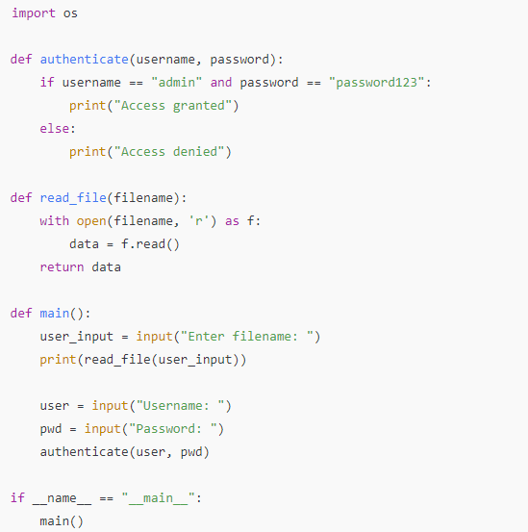
What are the issues?

Slide 36
Future Outlook
AI-Powered Static Analysis
Enhanced Detection Capabilities
Natural Language Processing (NLP)
Reduction of False Positives/Negatives
Intelligent Code Completion and Suggestions
Context-Aware Assistance: Tools like GitHub's Copilot use AI to suggest code snippets
Shift-Left Security Becoming Mainstream
Embedding Security Early: Integrating security practices into every stage of the software development lifecycle
Continuous Integration/Continuous Deployment (CI/CD) Enhancements:

Slide 37
Future Outlook
Increasing Importance of Open-Source Security
Community Collaboration
Security in Package Repositories
Regulatory and Compliance Factors
Emerging Standards: The U.S. Executive Order on Improving the Nation's Cybersecurity emphasizes software supply chain security.
Software Bill of Materials (SBOM): Transparency in Components
Notes:
Kurt feedback - Important to note that AI code assistants have been trained on *code with bugs* and should be reviewed for correctness - copilot output should be untrusted!

Slide 38
Reading and practice for next week
https://semgrep.dev/learn
https://semgrep.dev/docs/writing-rules/rule-syntax

