Slide 1
CCD LAB PROJECT / OCTOBER 2026
CPU Object
Detection Serving
Platform
YOLOv8n ONNX • FastAPI • Kubernetes HPA
LOCAL LAB DELIVERY | CPU INFERENCE
Single-node Minikube evidence; not AWS or production acceptance.

Slide 2
A real image API, not the original sentiment demo
The project intentionally replaced the text-sentiment example with object detection.
REQUEST
RESPONSE
POST /api/detect
Objects + coordinates
• Raw JPEG, PNG, or WebP bytes
• YOLOv8n ONNX model on CPU
• Confidence, IoU, and detection-count controls
• Optional API key protects /api/* and /metrics
• COCO class labels and confidence scores
• Boxes in EXIF-oriented original-image pixels
• Decode, inference, and postprocess timing
• Bounded bytes/pixels, concurrency, and timeout
Raw image upload → validated detections; no text or base64 JSON endpoint.
Source: docs/SCOPE_RECONCILIATION.md • docs/API_CONTRACT.md
02

Slide 3
One Service, bounded Pods, CPU-driven HPA
Local request path and the separate, optional AWS path.
LOCAL MINIKUBE — ONE NODE
OPTIONAL AWS
EC2 + k3s
private endpoint
OIDC / SSM path
Client
→
Service
→
Serving Pods
Studio / API
NodePort :30080
1 → 3 replicas
Metrics Server
→
HPA • 70% CPU
Not deployed or accepted in this project evidence.
CPU metrics → desired replicas
Replicas share one node; scaling adds no node CPU and provides no HA.
Source: docs/ARCHITECTURE.md • docs/RUNBOOK.md
03

Slide 4
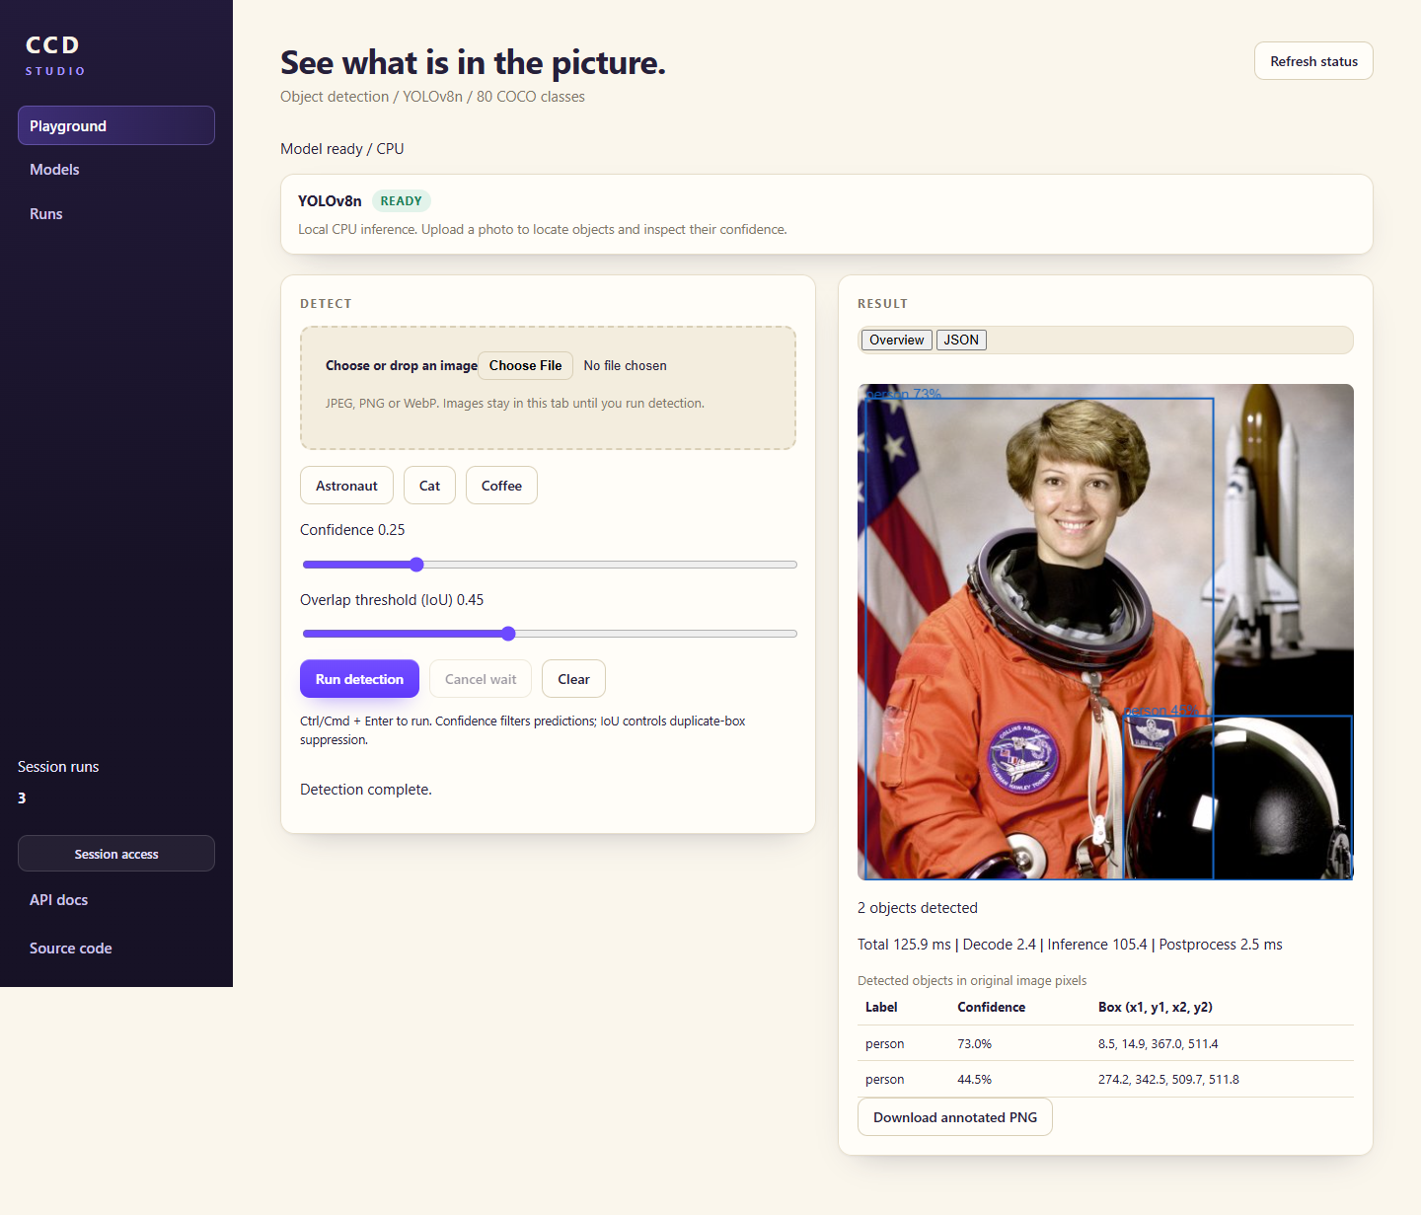
The Studio makes predictions inspectable
Real browser acceptance: samples/upload, overlays, table, downloads, mobile layout.
LIVE DEMO CUES
• Choose the cat sample
• Run detection and read confidence
• Inspect the original-coordinate box
• Open the accessible detection table
• Download annotated PNG
• Keys and history stay in the tab session
Functional sample only — not an accuracy benchmark.
Source: results/evidence/detection-20261023/studio-mobile.png • docs/CI_CD.md
04

Slide 5
Sustained load reached three replicas — with heavy rejection
Three local runs • 1 baseline VU • 8 sustained VUs • 180 seconds • validated k6 responses.
10.726
483 ms
128,547
successful req/s
mean sustained goodput
mean per-run
successful p95 latency
HTTP 429 capacity
rejections (separate)
ATTEMPT ACCOUNTING
INTERPRETATION
134,363 attempts
95.689% unsuccessful attempts
This was saturation, not an SLA.
5,792 successful detections
24 interrupted • 0 invalid 200 • 0 unexpected 4xx • 0 5xx
429s are rejected work, not successful inference throughput.
Baseline: 1.922 req/s mean goodput • 129.183 ms mean successful p95.
Source: results/ANALYSIS.md • results/performance.csv
05

Slide 6
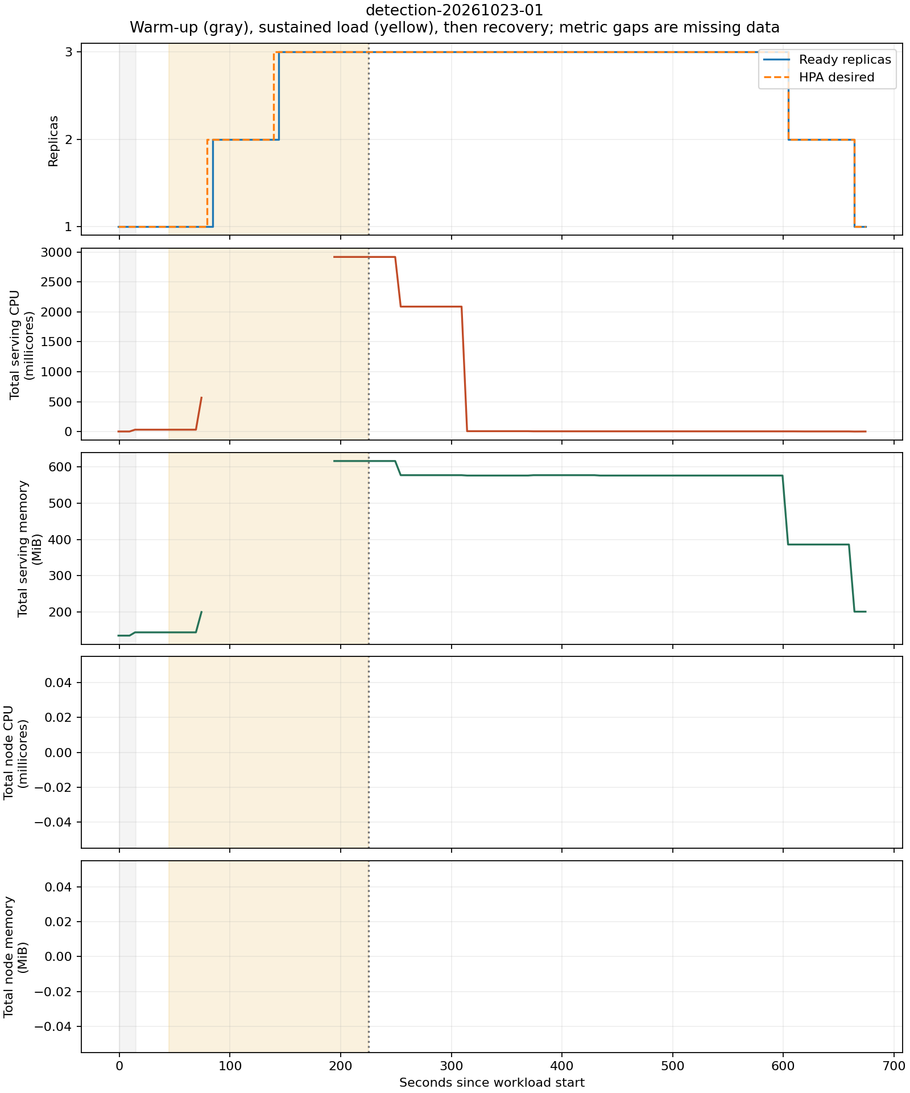
Scale-out is quick; scale-in follows stabilization
Historical samples contain replica and Pod metrics, but no node metrics.
OBSERVED
• 1 → 3 ready Pods in 39–84 seconds
• Return to one in 424–439 seconds
• 300-second HPA scale-down stabilization
• Complete sustained Pod metrics: 14/36, 16/36, 16/36
• Single node: no HA or linear-capacity claim
Historical gaps are unknown, not zero. New recorder tracks node + Pod reasons.
Source: results/figures/detection-20261023-01.png • results/ANALYSIS.md
06

Slide 7
Bounded, hardened, and locally tested
Evidence distinguishes local implementation checks from hosted/cloud acceptance.
RUNTIME CONTROLS
VERIFICATION
• Non-root container (UID 10001)
• Read-only root; capabilities dropped
• Image byte/pixel limits and content checks
• Bounded inference slots and timeout
• Optional API key; no key persistence in Studio
• Pinned model digest and CPU-only runtime
277
Python tests passed
60
frontend contract tests passed
Edge browser gate passed; screenshots retained.
Terraform 1.9.8 local checks passed; CI pins 1.15.8 (not hosted-verified).
No hosted CI result or AWS deployment is claimed.
Source: docs/EVIDENCE.md • docs/FINAL_REPORT.md
07

Slide 8
What the evidence supports — and what remains
A reproducible local object-detection lab; external acceptance is clearly identified.
SUPPORTED
NOT YET ACCEPTED
• Real image detections on CPU
• Hardened local container and API checks
• HPA changed replicas under bounded load
• Compact evidence replays byte-for-byte
• Exact-commit hosted CI (needs push)
• Fresh Minikube deployment (Docker unavailable)
• AWS deployment / cloud HPA / billing
• Individual member contribution split
Roster in source specification: Hrit Singh • Aditya Vikram Manocha • Yoovan Pattnaik
Sources: docs/FINAL_REPORT.md • docs/DEMO.md • docs/EVIDENCE.md
08

