Slide 1

SAMSUNG PRISM
Generative AI
Hackathon
3rd Edition 2026 – 27
Theme ID – Theme 4: Streaming Live RAG
Team Name – Bill Hates
College Name - MSRIT
Member Name & Email 1- Arnav Vivek Bansal 1ms25cs028@msrit.edu
Member Name & Email 2- Arya Vardhan Pandey 1ms25cs030@msrit.edu
Member Name & Email 3- S. Hrithik 1ms25cs163@msrit.edu
Member Name & Email 4- Arpan Ranjan 1ms25me021@msrit.edu
Submission Github link - https://github.com/hrithik160/samsung_RAG

Slide 2
Theme
Streaming, session-aware retrieval-augmented generation for real-time conversational AI
Problem: conversational assistants receive transcripts as they arrive, and must decide in real time whether to wait, retrieve, or simply respond — without calling retrieval on every utterance.
Goal: a retrieval pipeline that knows WHEN to search, WHAT to search for when a request bundles several intents, and how to keep multi-turn answers grounded, cited, and consistent.
Applied here to Samsung device-support conversations, grounded in the official Galaxy A-series user guide — the same five-stage pipeline generalizes to any closed, enterprise knowledge base.

Slide 3
Existing Solutions & Gaps
Typical RAG chatbot approach | Gap it leaves open
Retrieve on every user turn | Wastes calls on chit-chat, acknowledgements, and incomplete input
Treats each query as one intent | Compound, multi-part questions get partial or merged answers
Single retrieval pass (dense or keyword only) | No fusion, reranking, or uncertainty check — weak matches slip through
Stateless, turn-by-turn generation | Follow-ups re-retrieve from scratch; can't cheaply reformat a cached answer
No structured evaluation | Hard to tell if answers are grounded, or to track retrieval quality over time

Slide 4
Our Solutions & Architecture Diagram
1. Controller
2. Decomposer
3. Retriever
4. Session
Synthesizer
5. Telemetry
& Eval
WAIT / RETRIEVE /
NO_RETRIEVAL gate
Splits multi-intent
queries into sub-queries
Hybrid dense + BM25,
RRF fusion, rerank
Versioned, cited
answers per turn
JSONL traces,
ablations, gates
Pipeline: WAIT / NO_RETRIEVAL / RETRIEVE → decomposition → hybrid retrieval & fusion → session synthesis → telemetry.
Session state is keyed by session_id; the closed local corpus (Samsung Galaxy device guides) is the only allowed evidence source — uncited or unsupported answers fail closed.

Slide 5
Demo & Product Walkthrough
A single terminal session streams transcript turns through Controller → Decomposer → Retriever → Synthesizer → Telemetry:
WAIT & early retrieval — an incomplete turn returns WAIT; a stable-but-not-final question (e.g. an S24 battery query) triggers provisional retrieval.
Compound request & citations — a bundled cancellation-and-catering request is decomposed into sub-queries; fused evidence is shown with [Doc_ID §Section] citations.
Late refinement — a new constraint is added to the same session; the answer version increases while the prior supported fact and its citation remain available.
Presentation-only ask — "put that in bullets" restyles the cached answer with no new retrieval call and unchanged citations.
Uncertainty & telemetry — a question unsupported by the corpus returns an explicit uncertainty response; the generated JSONL trace is opened to show decision, trigger, citations, version, latency, and cost.

Slide 6
Tools and tech stack used
Layer | Tools & Libraries
Language & automation | Python 3.10 / 3.11, PowerShell setup & run scripts (run.ps1)
API & serving | FastAPI, Uvicorn, Pydantic, httpx
LLM & embeddings | Gemini 3.6 Flash (decomposition + generation), gemini-embedding-001 (Google AI Studio)
Retrieval models | Hybrid dense + BM25 with Reciprocal Rank Fusion; optional BAAI/bge-large-en-v1.5 embeddings + BAAI/bge-reranker-large cross-encoder via sentence-transformers
Data & storage | NumPy, Pandas, SQLite (checkpointed embeddings), pypdf, local cached vector index
Testing & evaluation | pytest, custom JSONL telemetry schema, Pillow-rendered benchmark charts

Slide 7
Impact & Use case
Primary use case: a Samsung device-support copilot that answers live chat/voice questions about Galaxy A-series phones with grounded, cited answers.
42% fewer retrieval calls than an always-retrieve baseline (14 vs 24 in the offline eval), without losing recall — lower latency and inference cost per session.
100% decision accuracy and 100% cache reuse on cosmetic turns — consistent answers that don’t redo work for a reformatting request.
Zero fabricated citations across every evaluated turn — safer for customer-facing support.
The same modular pipeline generalizes beyond phones: any support desk, in-store kiosk, or internal knowledge assistant built on a closed corpus.

Slide 8
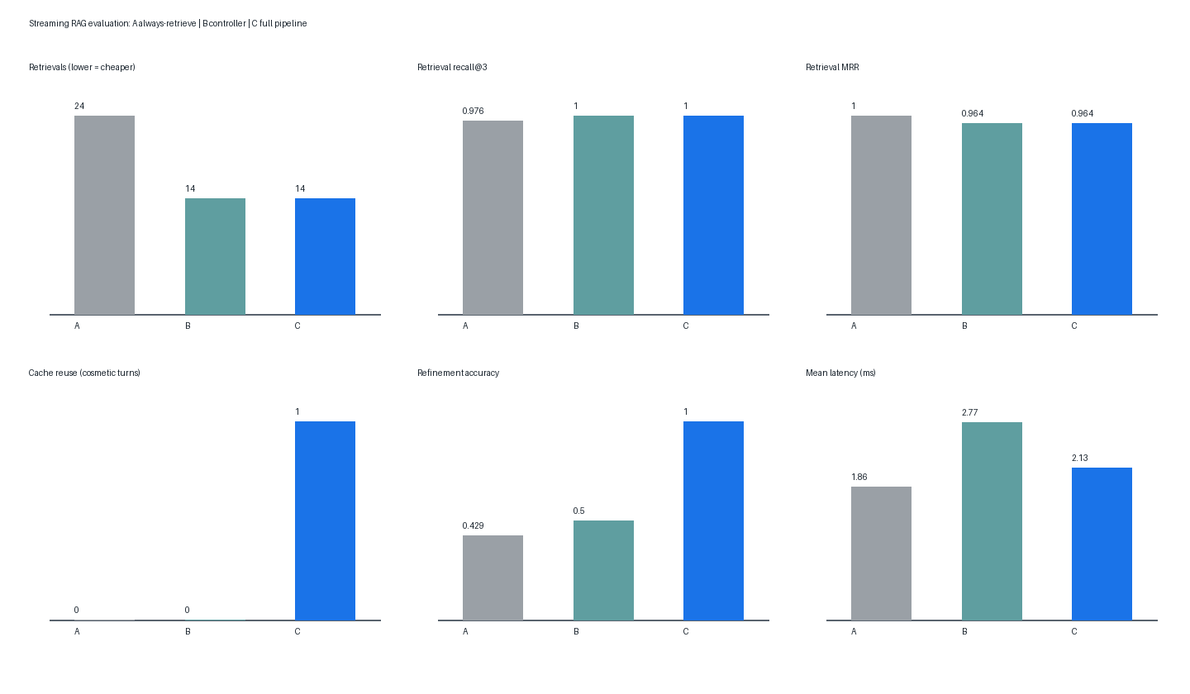
Innovation highlights, results and limitations
Highlights
Decision gating (WAIT / RETRIEVE / NO_RETRIEVAL) cuts retrieval calls ~42% vs. always-retrieve, without losing recall.
Entity-propagating decomposition fixes compound follow-ups that used to lose their subject.
Uncertainty gate + citation allow-list → zero fabricated citations, explicit fallback.
Versioned session synthesis: cosmetic edits reuse cached, cited answers.
Limitations
Reported benchmark uses offline stand-ins (hashing embedder, token-overlap reranker), not the production Gemini/BGE path.
Eval set is 7 sessions / 24 turns — smoke-test scale, not a full benchmark.
Session memory is in-process and ephemeral; no multi-worker store yet.
Clean-machine reproducibility (gate G1) is still pending replay.
Results: 5 of 6 acceptance gates PASS (offline fixture harness)
A: always-retrieve · B: controller-only · C: full pipeline. Fixture evidence, not a production benchmark.

Slide 9
What’s next
Swap the benchmark stand-ins (hashing embedder, token-overlap reranker) for the production path — Gemini embeddings/generation plus a BGE reranker — and re-run the same harness for real numbers.
Grow the evaluation set past 7 sessions / 24 turns and add human-reviewed citation entailment checks.
Move session memory from an in-process cache to a persistent, multi-worker store (e.g. Redis).
Close acceptance gate G1 with a clean-machine reproducibility replay.
Add OCR for scanned manuals and broaden past the Galaxy A-series demo corpus.
Record and ship the five-minute live product demo.

Slide 10
Brownie points slide( differentiation)
Every LLM-backed stage ships a deterministic offline fallback — the whole pipeline runs, tests, and evaluates end to end with zero API keys or downloads.
A genuine ablation study, not one config: hybrid vs. dense-only vs. sparse-only retrieval, each with reranking on and off.
Six explicit, named acceptance gates instead of a single "it works" claim.
The benchmark report documents its own fixture limits and lists three real bugs found — and fixed — during integration, with root cause and correction for each.
Full turn-level telemetry against a published JSON Schema: decision, trigger, citations, answer version, latency, and token/cost estimate for every single turn.

Slide 11
Checklist- Updated on Public GitHub
Working prototype code — public or shared GitHub repo (Y/N)
README with reproducible setup instructions (Y/N)
Demo video, max 5 minutes (YouTube or Drive link)
Presentation file (PPT or PDF) (Y/N)

Slide 12
Thank you
Organised by the Language AI Team and the PRISM Team, Samsung R&D Institute India
Notes:
Closing slide. Add the Google Form URL and a contact email before sharing. Edition 2 organising team for reference: Language AI - Sourabh Tiwari, Gaurav, Sanjeeth Pothireddy, Gorang Maniar; PRISM - Binny Lakra, Prakhar Chandrakar, Vishu Kumar; Kick-off and mentors - Giridhar Jakki, Deepraj Prabhakar Patkar (Language AI), Srimanu Prasad Nagaraju, Ashish Kumar (Tech Strategy).

