Slide 1

HRITHIK YADAV
RACHEL FARINAS
PREDICTING EMOTION IN MUSIC
SPOTIFY’S VALENCE AND AROUSAL MODEL

Slide 2
THE SPOTIFY
ECOSYSTEM
02
Platform offers 100M tracks, 7M podcast titles, and 500K audiobooks globally
Revenue grew from $16.96B in 2024 to $19.44B by early 2026
Spotify has an industry gold standard recommendation engine that analyzes not just what you like, but why. This valuable feature contributes to its global success and wide-reaching presence.
Spotify has a presence in 184 markets globally

Slide 3
HOW THE ENGINE WORKS
03
The Spotify recommendation engine utilizes a model called the Circumplex Model of Affect, which allows it to place a song on a 2D map. The song’s position on the map determines its mood, which the engine matches to your current activity and listening history.

Slide 4
04
THE CIRCUMPLEX MODEL OF AFFECT
Activated
This model behind the Spotify recommendation system treats emotions as coordinates on a continuous 2D map instead of as discrete buckets (e.g., "Sad," "Happy," "Angry").
Afraid
Excited
The model operates on two main dimensions: valence (the x-axis) and energy (the y-axis). Valence determines how pleasant/happy a song is, and energy determines the intensity.
Unpleasant
Pleasant
Gloomy
Calm
z
z
z
Deactivated

Slide 5
THE CHALLENGES
05
A high-energy track could be a joyful dance anthem (high valence) or chaotic heavy metal (low valence)
Relationship between audio features and emotion is often non-linear
Music is inherently multi-dimensional with non-linear feature relationships requiring machine learning. Other factors like the need for sophisticated ML and the subjectivity of emotion make it challenging to predict emotion in music.
Sophisticated ML needed for high accuracy
Valence prediction is historically more difficult than arousal

Slide 6
RESEARCH QUESTIONS
06
Can high-level audio features predict valence across diverse genres with machine learning models?
To what extent can Spotify's high-level audio features accurately predict valence across diverse genres?
Which specific audio characteristics like danceability versus energy serve as strongest predictors for positive sentiment?
How do non-linear models like KNN and Trees compare to linear regression?
Can accessible ML models outperform industrial datasets at large scale?

Slide 7
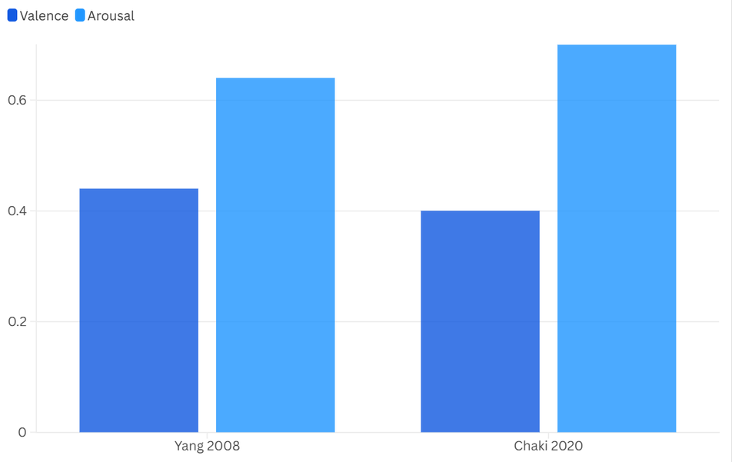
STATE OF THE ART
07
THE “VALENCE GAP”
Prior research (Yang 2008 and Chaki 2020) shows Energy is easier to predict (R^2: 0.55–0.75) than Valence (R^2: 0.30–0.50). This is because volume and speed are objective, while "happiness" is subjective.

Slide 8
08
DEEP LEARNING ADVANTAGE
CULTURAL CONTEXT
Prior research (Yang 2008 and Chaki 2020) shows Energy is easier to predict (R^2: 0.55–0.75) than Valence (R^2: 0.30–0.50). This is because volume and speed are objective, while "happiness" is subjective.
A 2025 GlobalMood study used non-linear math to handle complex human factors. This accounted for how different cultures might perceive the same song as either "sad" or "peaceful."
LYRICS BOOST ACCURACY
Laurier et al. (2009) shows that adding Lyrical Analysis (text AI) to audio data can help models better understand the mood of a song. This can improve valence scores by up to 0.08 in R^2.

Slide 9
DATASET OVERVIEW
09
9K
Tracks analyzed
17
Variables per track
Dataset includes 6 categorical and 11 numerical variables per track.
Key features include danceability, energy, loudness, tempo, valence, acousticness, and instrumentalness.
3
Genre groups studied

Slide 10
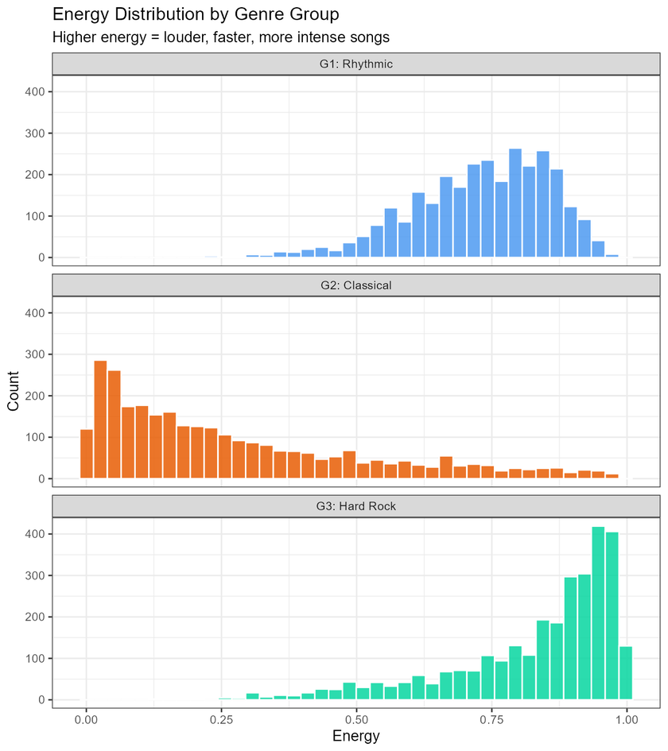
10
DATA LOSS
There were minimal missing values with negligible data loss after cleaning.
GENRE GROUPS
Tracks were grouped into one of 3 groups: rhythmic (salsa, latin, reggaeton), Classical (opera, classical, piano), Hard
Rock (punk-rock, heavy-metal, punk)

Slide 11
DEFINED AUDIO FEATURES
11
Danceability: Tempo, rhythm stability, beat strength combination (0.0–1.0 scale)
Energy: Intensity and activity level measure (0.0–1.0 scale)
Loudness: Overall volume in decibels (dB)
Tempo: Speed or pace in beats per minute (BPM)
Valence: Musical positiveness conveyed (0.0–1.0 scale)
Acousticness: Confidence measure for acoustic nature (0.0–1.0 scale)
Instrumentalness: Likelihood of no vocals (0.0–1.0 scale)
Speechiness: Presence of spoken words detection
Liveness: Identifies the presence of an audience in the recording
duration_ms: Specifies the length of the track
Popularity: Rates the popularity of a track

Slide 12
GENRE GROUP CHARACTERISTICS
12
G1 Rhythmic: Highest valence (0.696), cheerful music, very low
instrumentalness (0.008), predominantly vocal
G2 Classical: Lowest valence (0.303), subdued emotional tone,
highest acousticness (0.807), longest duration
G3 Hard Rock: Moderate valence (0.504), highest energy (0.831),
intense powerful music, fastest tempo

Slide 13
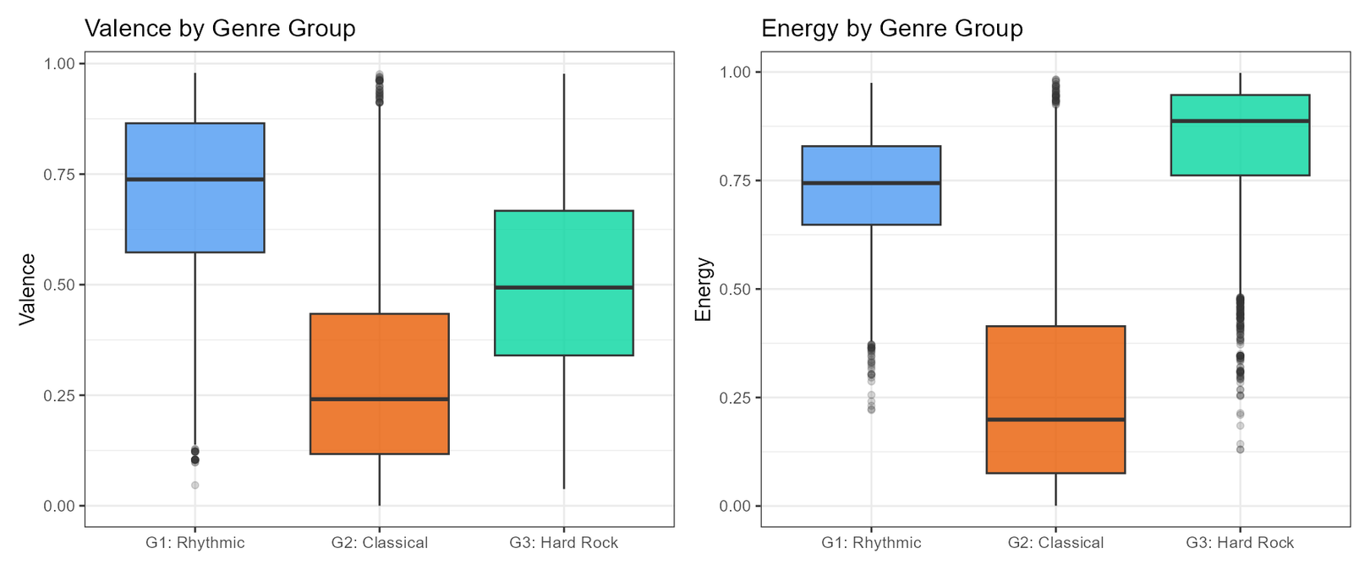
13

Slide 14
CORRELATIONS
14
0.83
G2 Loudness-Energy
G1 Rhythmic shows moderate positive correlation between acousticness and valence (0.25)
G2 Classical exhibits very strong correlations with loudness-energy (0.83) and
acousticness-energy (-0.83)
G3 Hard Rock demonstrates moderate danceability-valence correlation (0.40) and
strong loudness-energy (0.63)
0.53
G2 Danceability-Valence
0.63
G1/G3 Loudness-Energy

Slide 15
METHODOLOGY OVERVIEW
15
All models implemented in R with 75/25 train-test split
Features scaled for distance-sensitive models using z-score standardization
5-fold cross-validation for hyperparameter tuning across all approaches
Three evaluation metrics: RMSE, MAE, and R².

Slide 16
16
1
4
LINEAR MODEL
RANDOM FOREST
Baseline with interactions tested
300 bagged decision trees
2
5
ELASTIC NET
XGBOOST
L1+L2 regularization for stability
Gradient boosting with regularization
3
6
KNN
STACKED
Instance-based lazy learning approach
Meta-learner combining all models

Slide 17
LINEAR MODEL
17
Energy consistently well-predicted but valence shows weak
linear relationships.
We used 5 combinations of predictors separately and these are the best results we got.
G2 Classical achieved strongest energy results with R² = 0.891 using full feature set
G1 Rhythmic showed weakest valence starting point with danceability alone R² = 0.012
Loudness proved indispensable for energy prediction across all groups
Tempo and danceability carry little linear signal for energy prediction

Slide 18
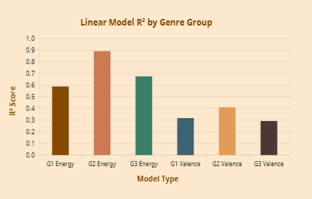
18

Slide 19
ELASTIC NET
19
Elastic Net outperforms plain linear regression.
Limited gains for valence confirm weak linear signal.
It had particularly strong gains for energy prediction.
G2: Classical energy had approx. 0.87 R² which was very good and valence reached 0.41 R² for G2.
Valence still remained a challenge to predict using Elastic Net.

Slide 20
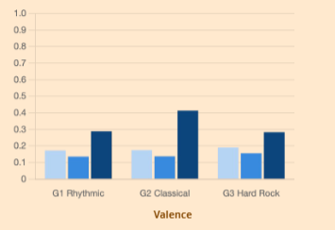
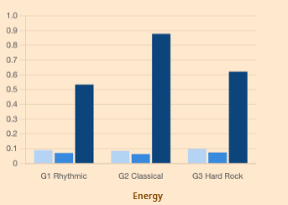
20

Slide 21
KNN VS KNN + PCA
21
-0.057
Largest PCA loss G2
Largest performance loss occurred for G2 Classical energy ( 0.057 R²)
With only 10 features, curse of dimensionality is not significant
PCA projection discards locally relevant structure for KNN
Standard KNN outperformed PCA-preprocessed across all genres
10
Feature count

Slide 22
RANDOM FOREST
23
Random Forest outperformed the previously tested models.
G3 Hard Rock achieved strongest RF valence result with R² = 0.648
G2 Classical energy reached R² = 0.918, highest RF result
More than doubles linear model R² for G1 Rhythmic valence
Bagging handles high-variance valence better than gradient boosting

Slide 23
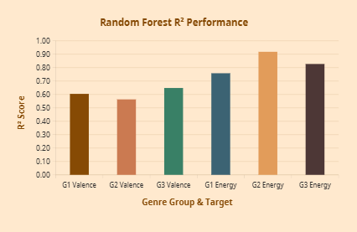
24

Slide 24
XGBOOST
25
0.920
Best Energy R^2
Sequential error-correcting nature optimized for strong learnable signals like energy
Matches Random Forest within 0.003 for all other energy prediction targets
Underperforms Random Forest for valence in 2 out of 3 groups
Gradient boosting appears to overfit noisy valence signal versus RF averaging
G2 CLASSICAL
Top Performance

Slide 25
STACKED ENSEMBLE
27
Stacked Ensemble wins 5 of 6 comparisons with highest overall R² = 0.922
Combines Linear Regression, Elastic Net, KNN, Random Forest, and XGBoost base learners
Uses 5-fold out-of-fold prediction preventing data leakage in meta-learner training
Largest gain achieved for G3 Hard Rock valence with +0.014 improvement
Meta-learner learns optimal weighting to compensate individual model weaknesses

Slide 26
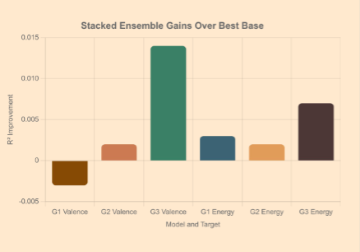
28

Slide 27
OVERALL MODEL COMPARISON
29
Stacked Ensemble – most consistent winner (5/6 tasks)
Random Forest – best single model for valence
XGBoost – best single model for energy
KNN – strong but sensitive to preprocessing
Maximum valence R² approximately 0.60–0.66 compared to 0.76–0.92 for energy
Tree-based models substantially outperform linear models with R² gains up to +0.24
Energy driven by non-linear interactions between loudness, acousticness, and danceability

Slide 28
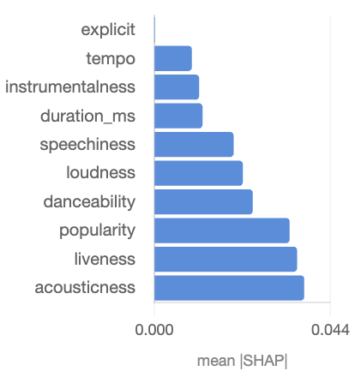
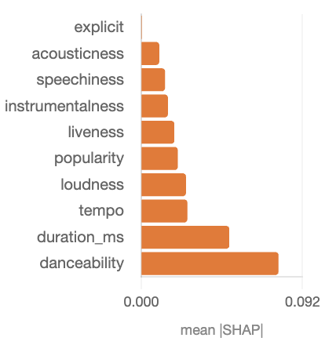
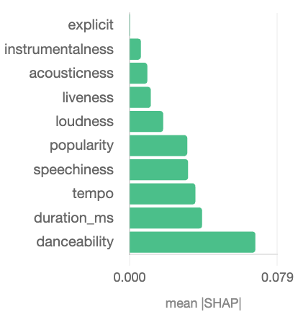
SHAP
30
G1: Rythmic
G2: Classical
G3: Hard Rock
Danceability shows highest cross-group divergence for valence prediction.
0.054
Danceability 3× more important for G2 Classical and G3 Hard Rock than G1 Rhythmic
Acousticness and liveness drive G1 Rhythmic valence prediction
Tempo and speechiness most critical for G3 Hard Rock sentiment
Explicit content has zero importance in every genre group tested
Danceability Divergence
G2
Danceability Dominant

Slide 29
KEY INSIGHTS
31
Genre stratification reveals distinct feature-emotion mappings that would be obscured in pooled models
Acousticness and liveness drive G1 Rhythmic valence prediction
Danceability and duration drive G2 Classical valence prediction
Tempo and speechiness drive G3 Hard Rock valence prediction
Music emotion recognition systems should be genre-aware rather than genre-agnostic
Increasing model complexity does not always help, feature selection matters more

Slide 30
CONCLUSION
32
Energy reliably predictable from audio features with best R² = 0.922 for G2 Classical
Valence prediction challenging with best R² = 0.662 confirming the valence problem
Stacked Ensemble most consistently best model winning 5 of 6 comparisons
Genre stratification reveals distinct feature-emotion mappings: acousticness and liveness drive G1 Rhythmic valence; danceability and duration drive G2 Classical valence, tempo and speechiness drives G3 Hard Rock valence

Slide 31
NEXT STEPS
33
Explore inclusion of lyrical features for improved valence prediction
Test raw audio deep learning representations beyond hand-crafted features
Incorporate listener demographic data to address subjective interpretation
Cross-cultural validation of emotional perception variations

