Slide 1
POD2
Plan of the Day — the Entry touchpoint, rebuilt on the real product-owner data
Real data only
Avra's construct
Entry-only scope
Built solely on the datasets Avra shared
Seats × load factor → show-up → demand → lanes
Replicated to other touchpoints after sign-off
Bhogapuram / VTZ · S26 season · July 2026
Notes:
POD2 rebuilds the Entry touchpoint end-to-end using only the product-owner datasets, following Avra’s construct. Scope is Entry-only until Avra confirms.

Slide 2
HOW WE DID IT
A six-step build, one dataset question at a time
1
Isolate June
2
Analyse June
3
HYD e-boarding
Clean real load actuals (30 days)
Volume & load-factor patterns
Real Entry show-up profile
4
Digital twin
5
Compare
6
Finalise
Twin’s Entry show-up profile
What matches, what doesn’t
The Entry dataset for Avra
No machine learning at this stage — every step is a simple, auditable calculation.

Slide 3
THE INPUTS
Three datasets, three roles in Avra’s construct
REAL
REAL
MODELLED
June load actuals
HYD e-boarding
Digital twin
Daily load factor & passenger volume
By aircraft category (C / B / A)
Supplies the volume + load-factor layer
No scan times → no show-up timing
Passenger-level terminal-entry scans
minutes early = FLIGHT − ENTRY_SCAN
Supplies the show-up profile
PII — raw file never committed
Generated VTZ schedule & passengers
Seats × LF → show-up → demand
Meant to reproduce the two real layers
Where we test if the model matches
Note: Avra’s own dashboard is only a style template for how analysis should look — not a dataset, not compared against.

Slide 4
WHAT EACH DATASET CAN ANSWER
Not every dataset can speak to every Entry dimension
Dimension (Entry) | June loads | HYD e-boarding | Digital twin
Passenger volume | Real (daily) | Real, 2 days | Modelled
Load factor | Real | — | Modelled
Aircraft mix | Real | Per-flight | Modelled
Entry show-up profile | None | Real | Modelled
Entry hourly demand | None | Real | Modelled
Consequence: June loads has no scan times, so it cannot join the Entry show-up / timing comparison at all. That comparison is two-way — HYD e-boarding (real) vs digital twin. June’s only role at Entry is the volume + load-factor input.

Slide 5
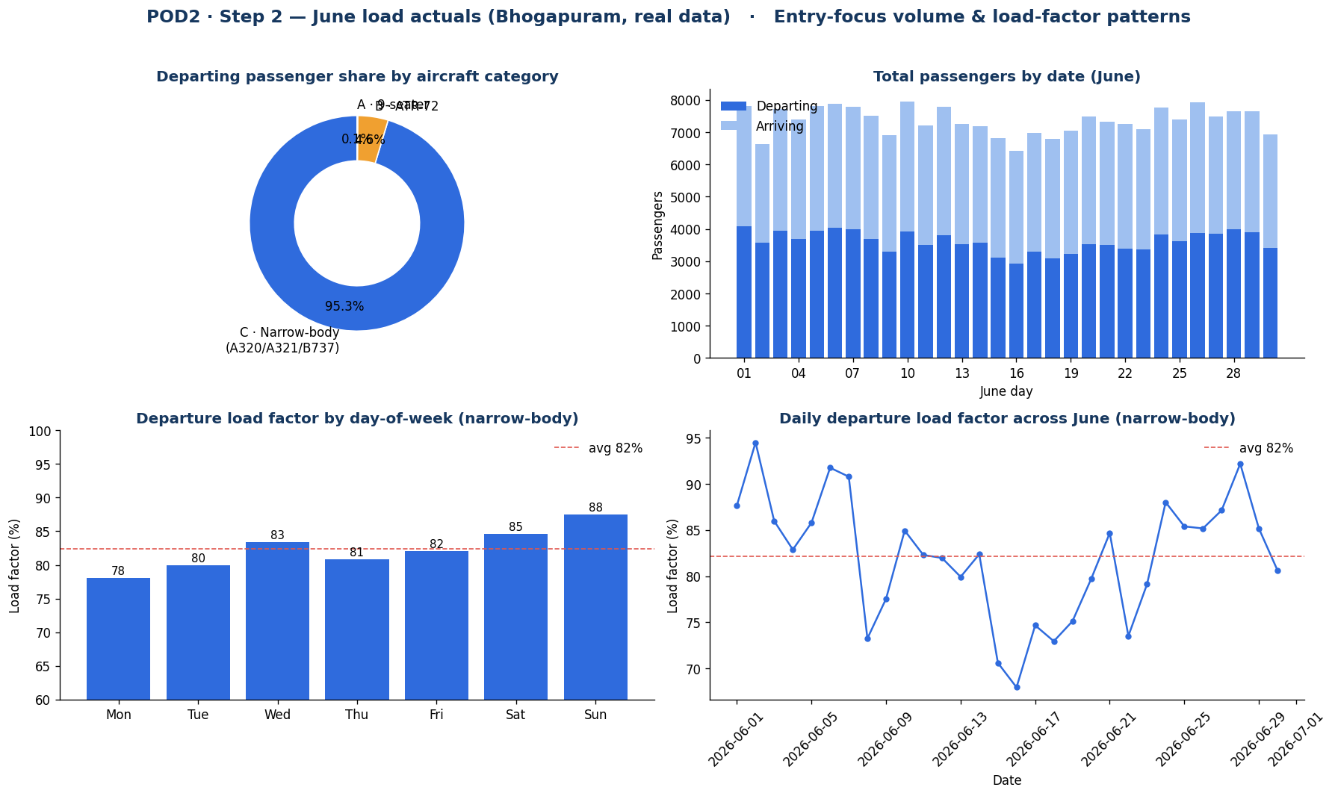
STEPS 1–2 · JUNE LOAD ACTUALS (REAL)
What the real June data shows
220,886
total June passengers (30 days)
82%
narrow-body load factor (68–94% range)
88% ↓ 78%
busiest Sunday vs quietest Monday
Category C narrow-body = 95.3% of departing passengers.
Step 2 dashboard — volume & load-factor patterns from the real June data.

Slide 6
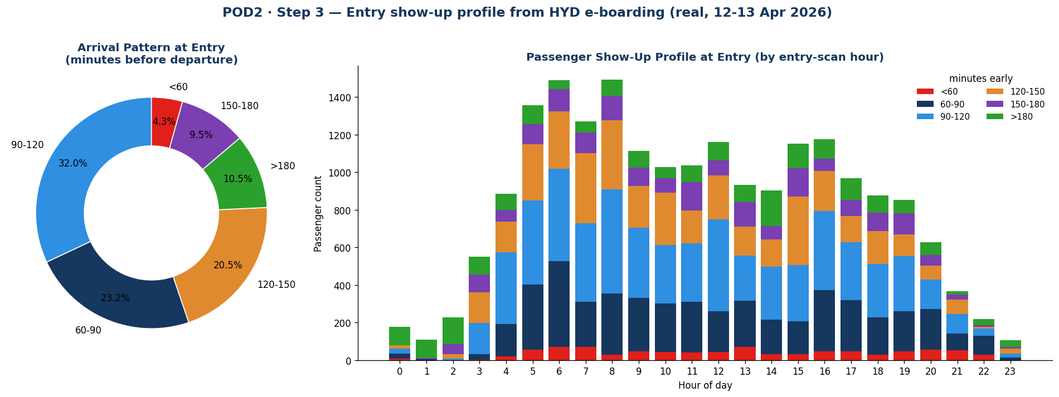
STEP 3 · HYD E-BOARDING (REAL)
The real Entry show-up profile
20,079
32%
08:00
valid entry records
peak bucket: 90–120 min early
busiest entry hour
minutes early = FLIGHT_TIME − TRML_ENT_SCAN_TIME, bucketed. Raw PII file not committed — only aggregates.

Slide 7
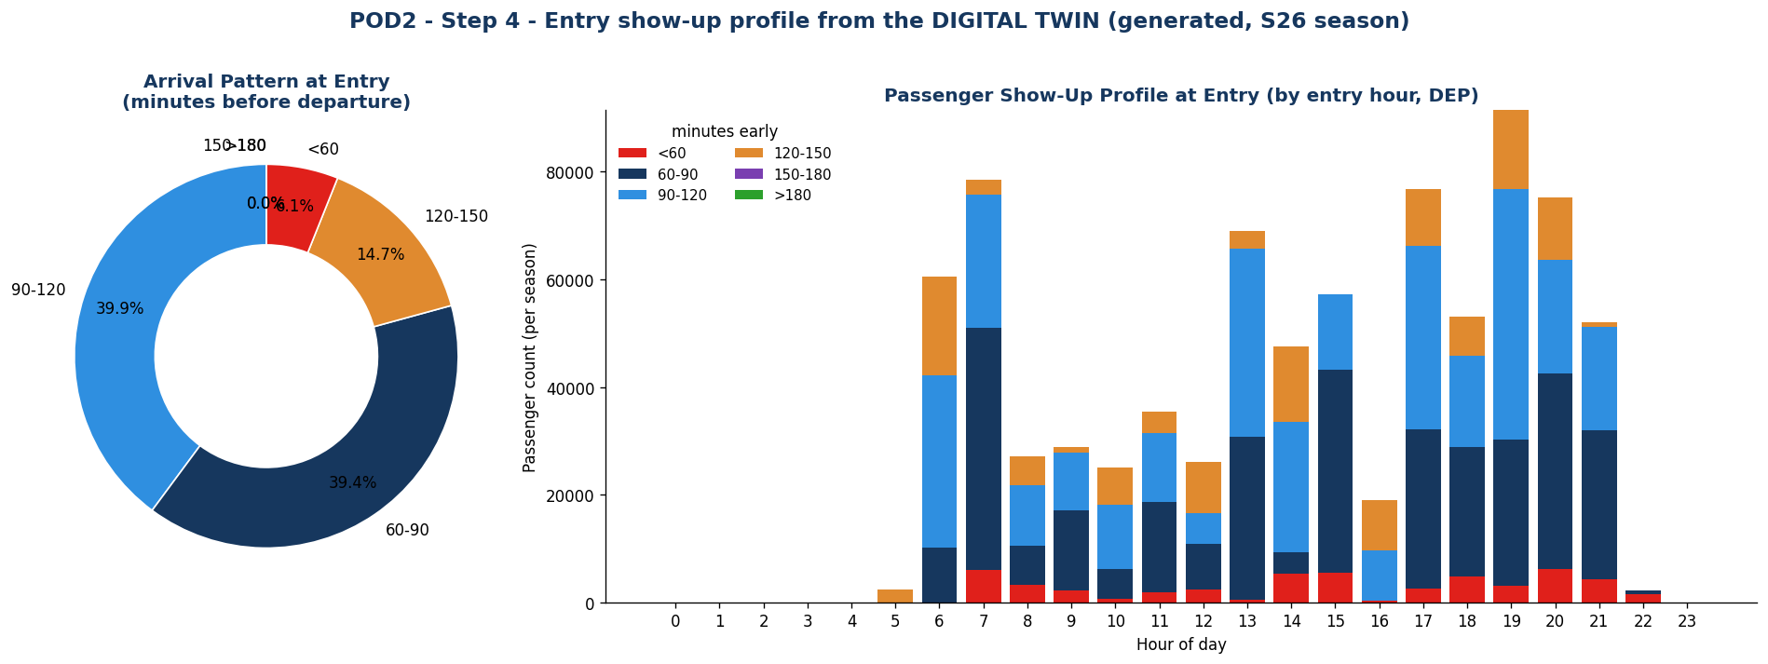
STEP 4 · DIGITAL TWIN (MODELLED)
The twin’s Entry show-up — first sign of trouble
0%
79%
–85 min
passengers show up >150 min early
crammed into 60–120 min (real: 55%)
triangular peak, capped at 150
Reconstructed from the twin’s DEP_ENTER window, bucketed the same way as Step 3 for a like-for-like view.

Slide 8
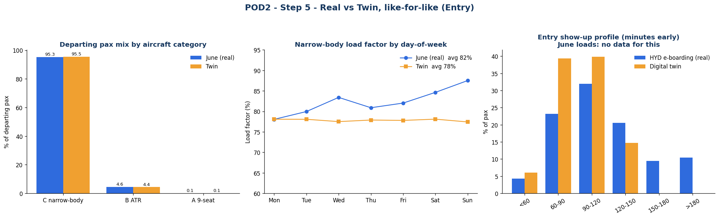
STEP 5 · REAL VS TWIN, LIKE-FOR-LIKE
The twin matches the fleet, misses two behaviours
Comparison is strictly June ↔ HYD ↔ twin. Show-up panel is two-way (June has no data for it).
Aircraft mix
Load factor
LF by weekday
Show-up tail
95.3 vs 95.5%
82.1 vs 77.8%
rises vs flat
20% vs 0% >150m
MATCH
~4 pt low
misses shape
mis-calibrated

Slide 9
THE FIX
Two recalibrations, folded into the finalised dataset
1
Show-up window
2
Load factor
Drive Entry from the MEASURED e-boarding buckets instead of the twin’s triangular window. Restores the >150-minute tail automatically — exactly how Avra does it.
Use the REAL June load factor by category and day-of-week (narrow-body ~82%, rising into the weekend) instead of a flat ~78% draw.
Both are pure inputs to a deterministic calculation — no model training involved.

Slide 10
STEP 6 · THE DELIVERABLE
The finalised Entry dataset (Bhogapuram / VTZ)
seats × LF[cat, weekday]
→
measured show-up buckets
→
entry demand (5-min)
→
30-min projection
→
lanes = ⌈demand / 60⌉
5,820
~873,500
4
229
departures across the season
season entry passengers (~4,159/day)
peak entry lanes required
peak 30-min demand (busiest day, 17:25)
Season entry pax rose from the twin’s 827k because the real ~82% load factor replaced the flat ~78%.

Slide 11
THE DELIVERABLE · FINALISED_ENTRY_DATASET.XLSX
Built on their schedule — and proven to match it
“Entry by Flight” sheet — the same 5,820 flights, with 3 columns appended
MATCHES YOUR DATA
Dep Flight | Aircraft | Cap | LF % | Entry Pax | Their est.
6E6426 | A320N | 186 | 87.5 | 163 | 163.1
6E845 | A320 | 186 | 87.5 | 163 | 163.1
IX2745 | B737 | 189 | 87.5 | 165 | 165.7
Same 5,820 flights, aircraft & capacity — read straight from your schedule
Load factor = your real June actuals; show-up = real HYD e-boarding
Per-flight passenger numbers track your own estimate (0.993)
Green = columns we add. Blue = the passenger estimate already in your schedule — our figure lands on it.
MAKES IT OPERATIONAL
Time-phased entry demand every 5 minutes — your schedule has none
30-minute projection → lanes required (peaks at 4)
Load factor varies by weekday — captures the Sunday peak, not a flat factor
0.993
correlation between our per-flight Entry Passengers and the estimate already in your schedule — across all 5,820 flights. Season totals agree within 6.5%.

Slide 12
TO CONFIRM WITH AVRA
Open questions before sign-off
?
E-boarding = 2 days only
Great for the overall show-up profile, but a full month is needed for day-of-week splits.
?
June sheet ambiguity
The workbook’s second sheet is a July-labelled calculated copy; we used the clean June sheet only — confirm.
?
Throughput assumption
ATRS 180 trays/hr and 1.5 trays/pax → 120 pax/hr/lane (60 per 30 min). Confirm the rate.

Slide 13
WHERE WE ARE
Entry is built, consistent, and ready for Avra
Fleet & volume match the real data; the two behavioural gaps are corrected.
The finalised Entry dataset is a pure, auditable calculation — ready to review.
Next: on Avra’s confirmation, replicate the six-step build for Security, Boarding and Belt.
Modelling begins only once real touchpoint scan data accumulates after go-live.
All code and outputs live in POD2/ — one sub-folder per step, plus the consolidated Word write-up.

