Slide 1

AgriIntelligence – End-to-End Crop, Weather & Market Analytics Platform
DATA SCIENCE (24AD3107) Project Review-1
Date& Time
 | Under the Guidance of Ms. Bonagani Prathusha Assistant Professor, Department of Computer Science and Engineering, KLH CSE Bowrampet Campus
Team Members P. Sree Bhuvaneswari – 2420030519 M. Sheranya – 2420030747 B. Hrithik – 2420030502

Slide 2
Outline of Project Work
Focus
Introduction
Literature Survey
Challenges
Research Objectives
Conclusion & Future Work
References
Publications Details

Slide 3
Problem Statement
Agricultural data such as crop yield, weather conditions, and market prices is available from different sources and is often analyzed separately.
This makes it difficult to understand:
How weather affects crop yield
How crop yield changes affect market prices
How these factors are connected
Therefore, there is a need for an integrated analytics platform that combines crop, weather, and market data to generate useful agricultural insights.

Slide 4
Objectives
To collect crop yield, weather, and market price data.
To clean and preprocess the collected data.
To integrate the three different data sources.
To analyze the relationship between weather and crop yield.
To analyze crop and market price trends.
To forecast future crop prices using historical data.
To provide an interactive dashboard for visualizing agricultural trends.
To support data-driven decision-making.

Slide 5
Literature Survey
Authors | Title of the Paper | Methodology | Inferences | Limitation/Future work
M. Khaki et al. | Deep Neural Networks for Crop Yield Prediction | Deep Learning | Predicts crop yield using agricultural and environmental factors | Focuses mainly on yield prediction
Jeong et al. | Random Forests for Global and Regional Crop Yield Predictions | Random Forest | Uses weather and agricultural data for yield prediction | Does not focus on market prices
Agricultural Data Analytics Studies | Weather and Crop Analysis | Statistical / ML methods | Identifies relationships between weather and crop production | Usually analyzes individual data sources

Slide 6
Problem Gap Identification
Existing systems:
Crop Data
↓
Separate Analysis
↓
Weather Data
↓
Separate Analysis
↓
Market Data
↓
Separate Analysis
Identified Gap:
Most existing approaches do not provide a single integrated platform connecting:
Weather → Crop Yield → Market Price
Crop Data
↓
Weather Data
↓
Market Data
↓
Integrated Analytics
↓
Patterns & Relationships
↓
Price Forecasting
↓
Agricultural Insights

Slide 7
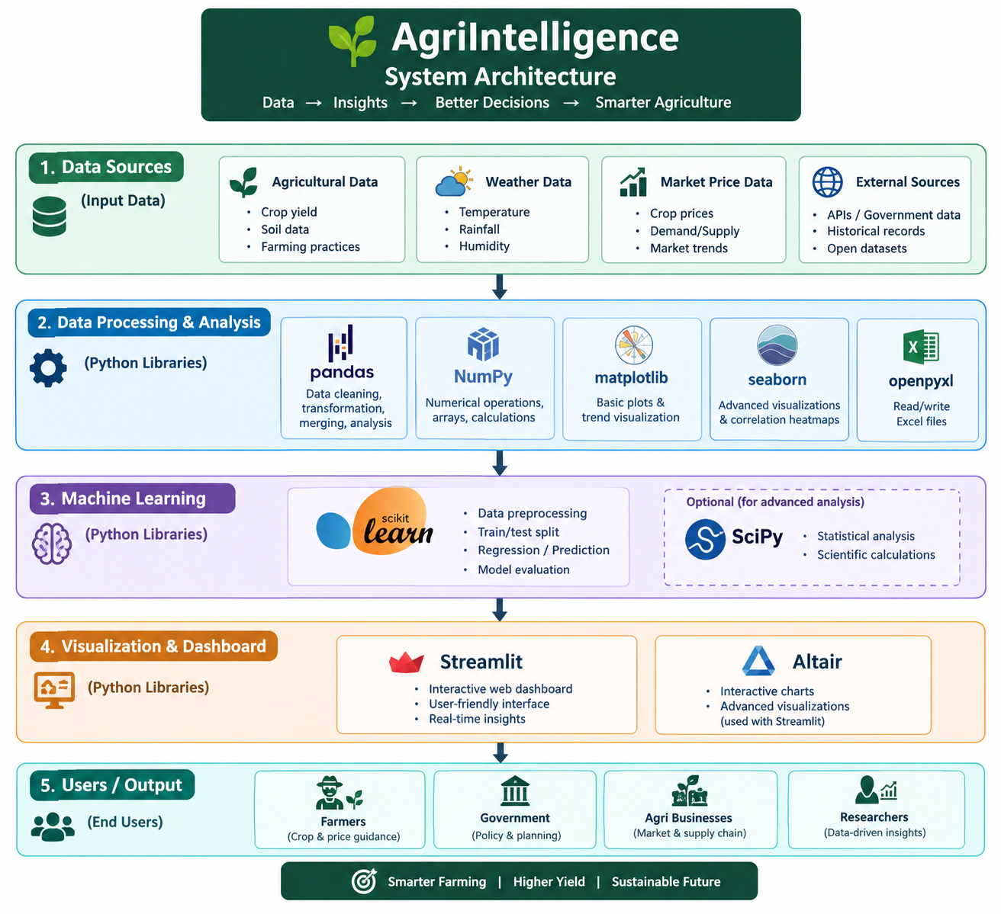
System Architecture

Slide 8
Innovation, Creativity, and Novelty
Innovation:
Combines three different agricultural data sources.
Connects agricultural, climatic, and economic information.
Studies the relationship between weather and crop yield.
Analyzes how yield changes may relate to market-price changes.
Provides crop-price forecasting.
Presents the results through an interactive dashboard.
Novelty:
The main novelty is the integration of crop yield + weather + market price data in one analytics platform, instead of analyzing each dataset separately.

Slide 9
Feasibility and Project Plan
Technical Feasibility
The project can be developed using commonly available Data Science technologies such as:
Python
Pandas
NumPy
Matplotlib / Seaborn
Scikit-learn
Time-series forecasting
Streamlit
Data Feasibility
The project uses publicly available sources:
data.gov.in – Crop data
IMD – Weather data
Agmarknet – Market price data
.

Slide 10
Methods used in the project
Data Collection
  Collect crop yield data from data.gov.in
  Weather data from IMD
  Market price data from Agmarknet.
Data Cleaning & Preprocessing
  Remove missing or incorrect values
  Convert data into a common format
  Prepare the datasets for analysis.
Data Integration
  Combine the crop, weather, and market datasets.
  This is an important part of our project because the three datasets are originally separate.
Exploratory Data Analysis (EDA)
  Study crop yield trends
  Study weather patterns
  Study market price trends
  Use graphs and visualizations to understand the data.
Correlation Analysis
  Find relationships between weather conditions and crop yield.
  For example, study whether changes in rainfall or temperature are associated with changes in yield.
Time-Series Forecasting
  Use historical market-price data to predict future crop prices.
Interactive Dashboard
  Display crop-wise, region-wise, weather, and market trends in an easy-to-understand visual form.

