Slide 1

Web-Based Healthcare Storage and Analysis System
A Presentation for CSE303,
Done By Team Database Managers
1910626 | Rivu Bhattacharjee
2020113 | Sarara Akbar
1910001 | Abu Ahamed Rafi
2030310 | Safwan Sulaiman Sadi
2222526 | Khatune Jannat Orpa
2120357 | Tausif Ertiza Sameer

Slide 2
The Issue in Hand
Many healthcare consumers face challenges in obtaining transparent and easily accessible information about the costs of various healthcare services.
The absence of a centralized platform for comparing healthcare prices contributes to confusion and hampers informed decision-making.
High healthcare costs often lead to financial strain on individuals and families, impacting their ability to make optimal healthcare choices.
The current healthcare landscape witnesses inefficient resource utilization as patients may resort to trial-and-error approaches to find cost-effective healthcare services. This inefficiency can lead to unnecessary healthcare expenses, overuse of medical resources, and a strain on the overall healthcare system.

Slide 3
The Solution Devised
The main goal of the web-based application is to store numerous healthcare cost information and make them accessible to website viewers.
It will provide easy-to-use interface to website viewers and allow them to select their desired healthcare process and compare from several healthcare providers from where they can compare the cost of healthcare to choose accordingly.
The website will access the name and cost of healthcare services from a database which is stored in the Backend of the website and display them to the user when they search for them

Slide 4
Planning and Execution
To build a web-based application it is critical to ensure that Data Integrity and Consistency is maintained throughout the development.
Rich Picture, EERD, Relational Schema, Normalization and a Data Dictionary are made to make sure that the developers can follow and well understand what is happening and what should be altered or improved to maintain integrity throughout the development process.
A look into these attributes are shown in the following slides.

Slide 5
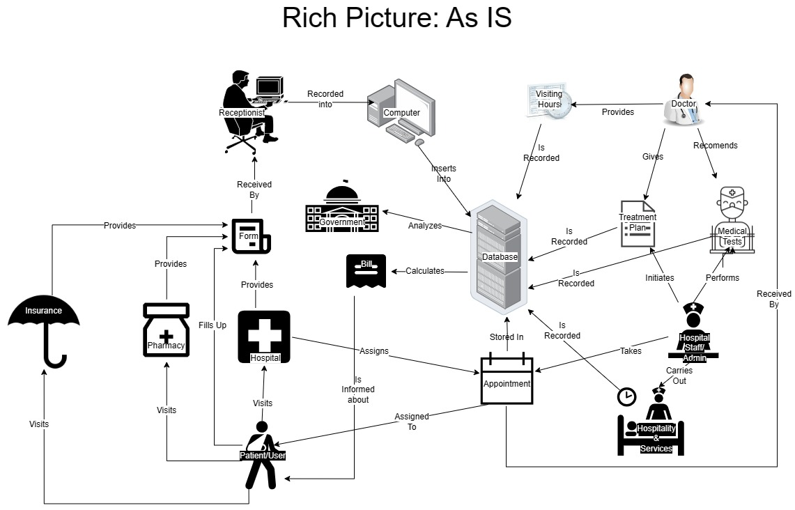


Rich Picture: As is

Slide 6
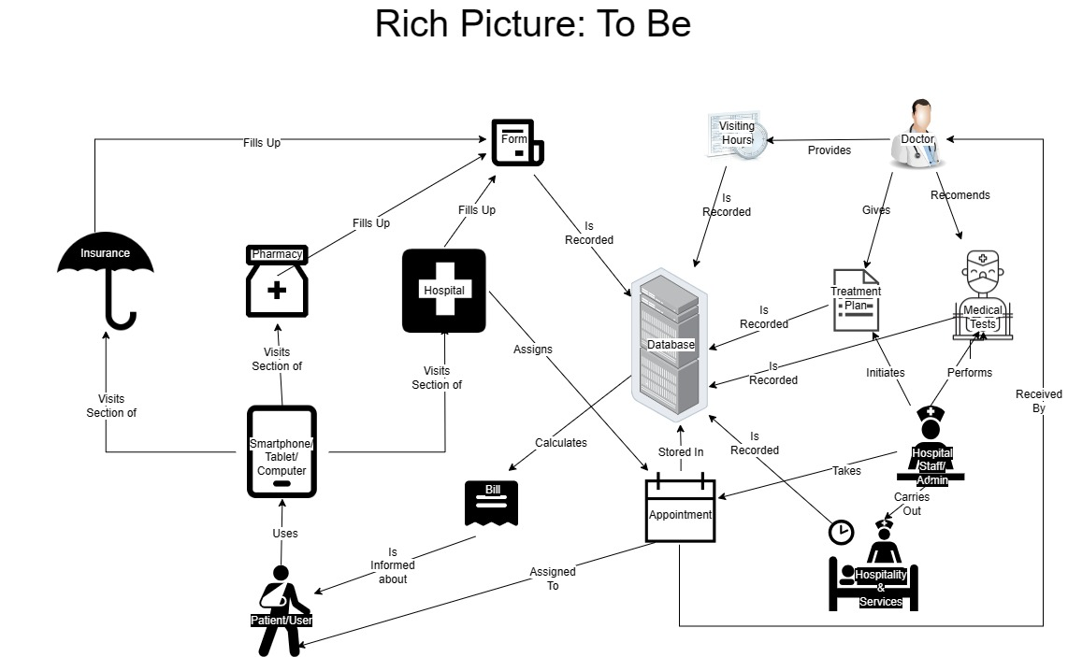

Rich picture: to be

Slide 7
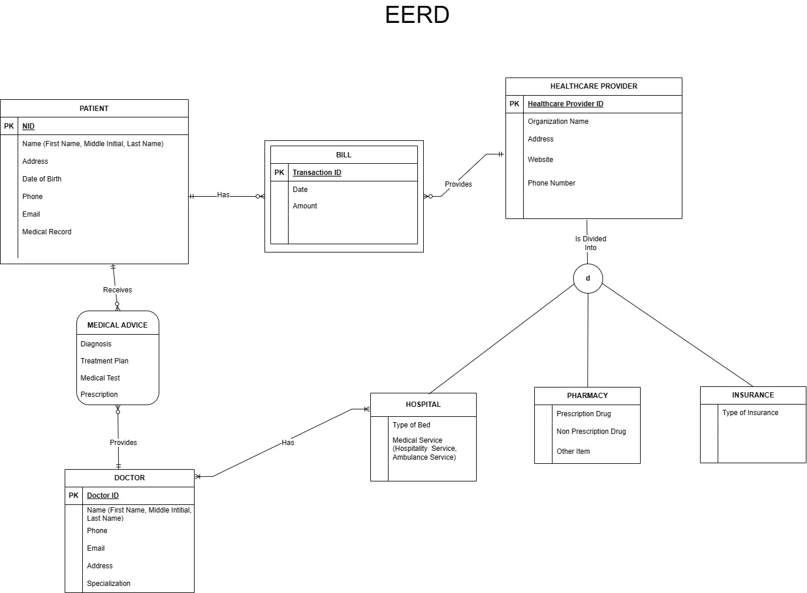


EERD

Slide 8
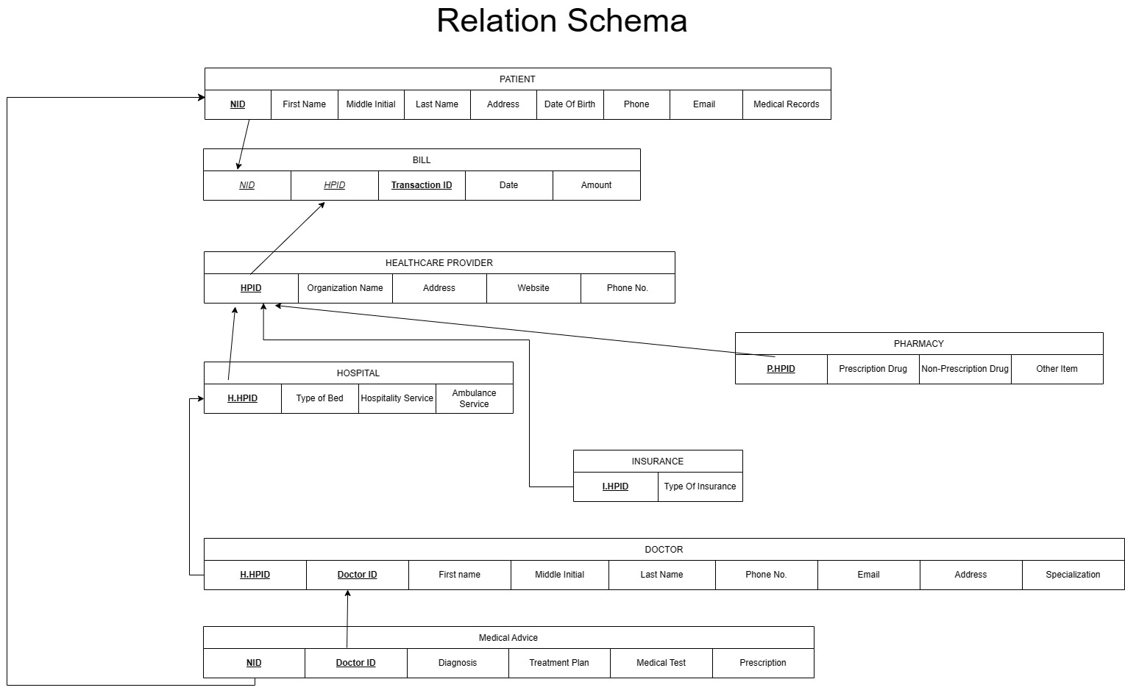

Relational Schema

Slide 9
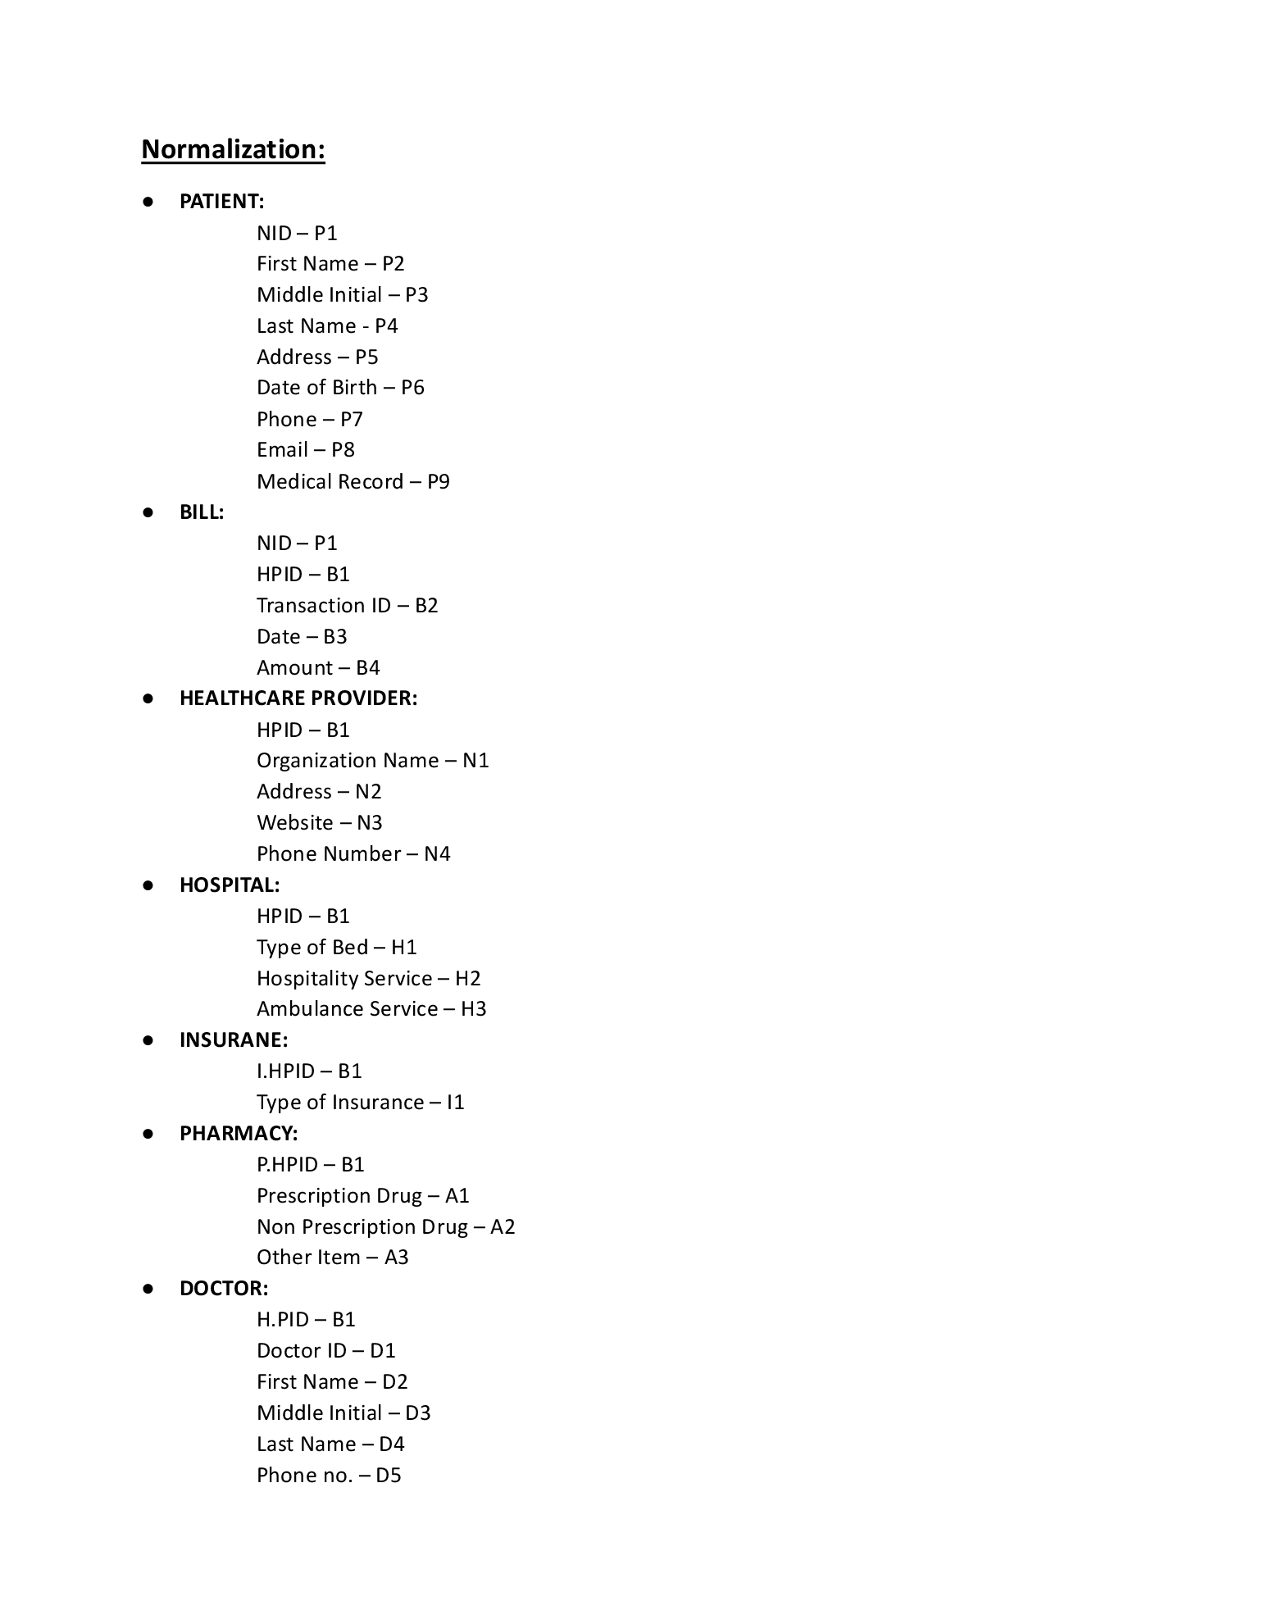
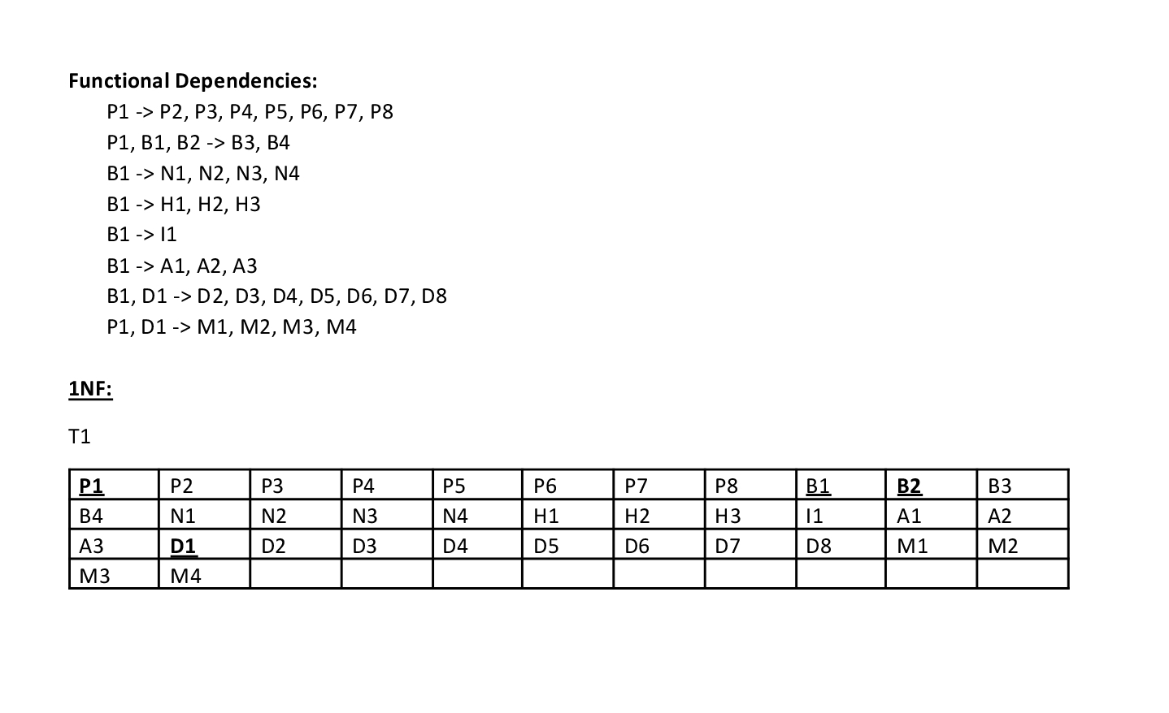
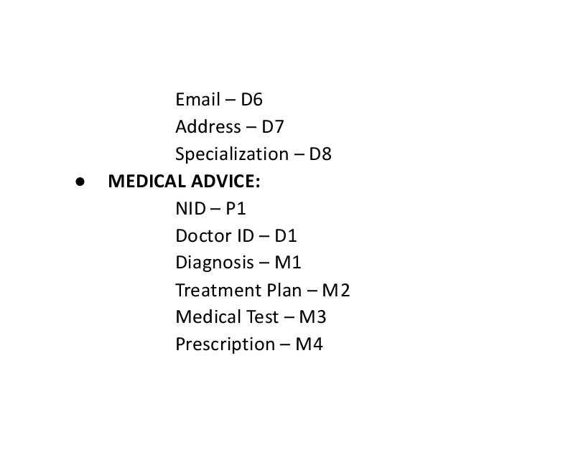
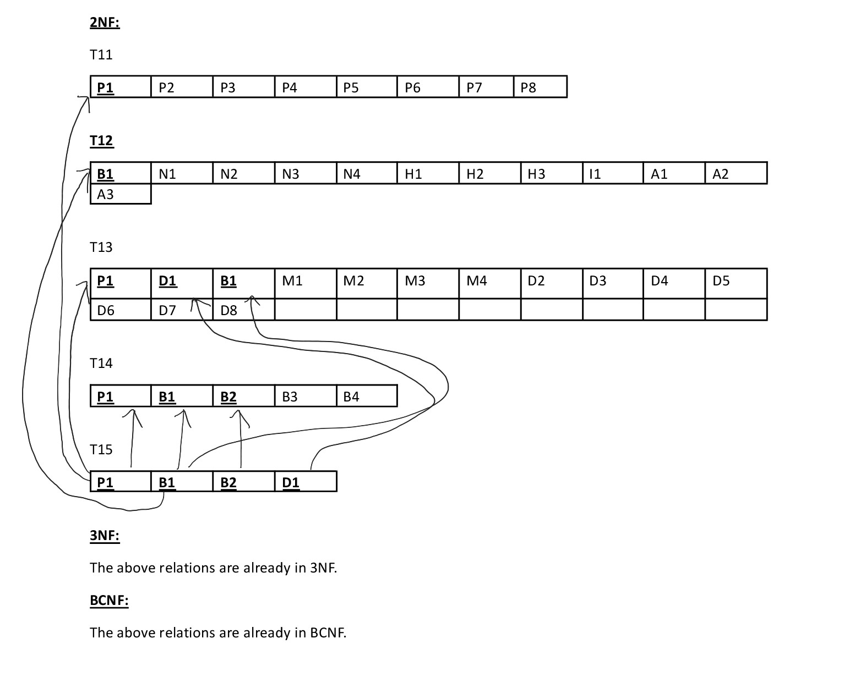
++++++++++
Normalization

Slide 10
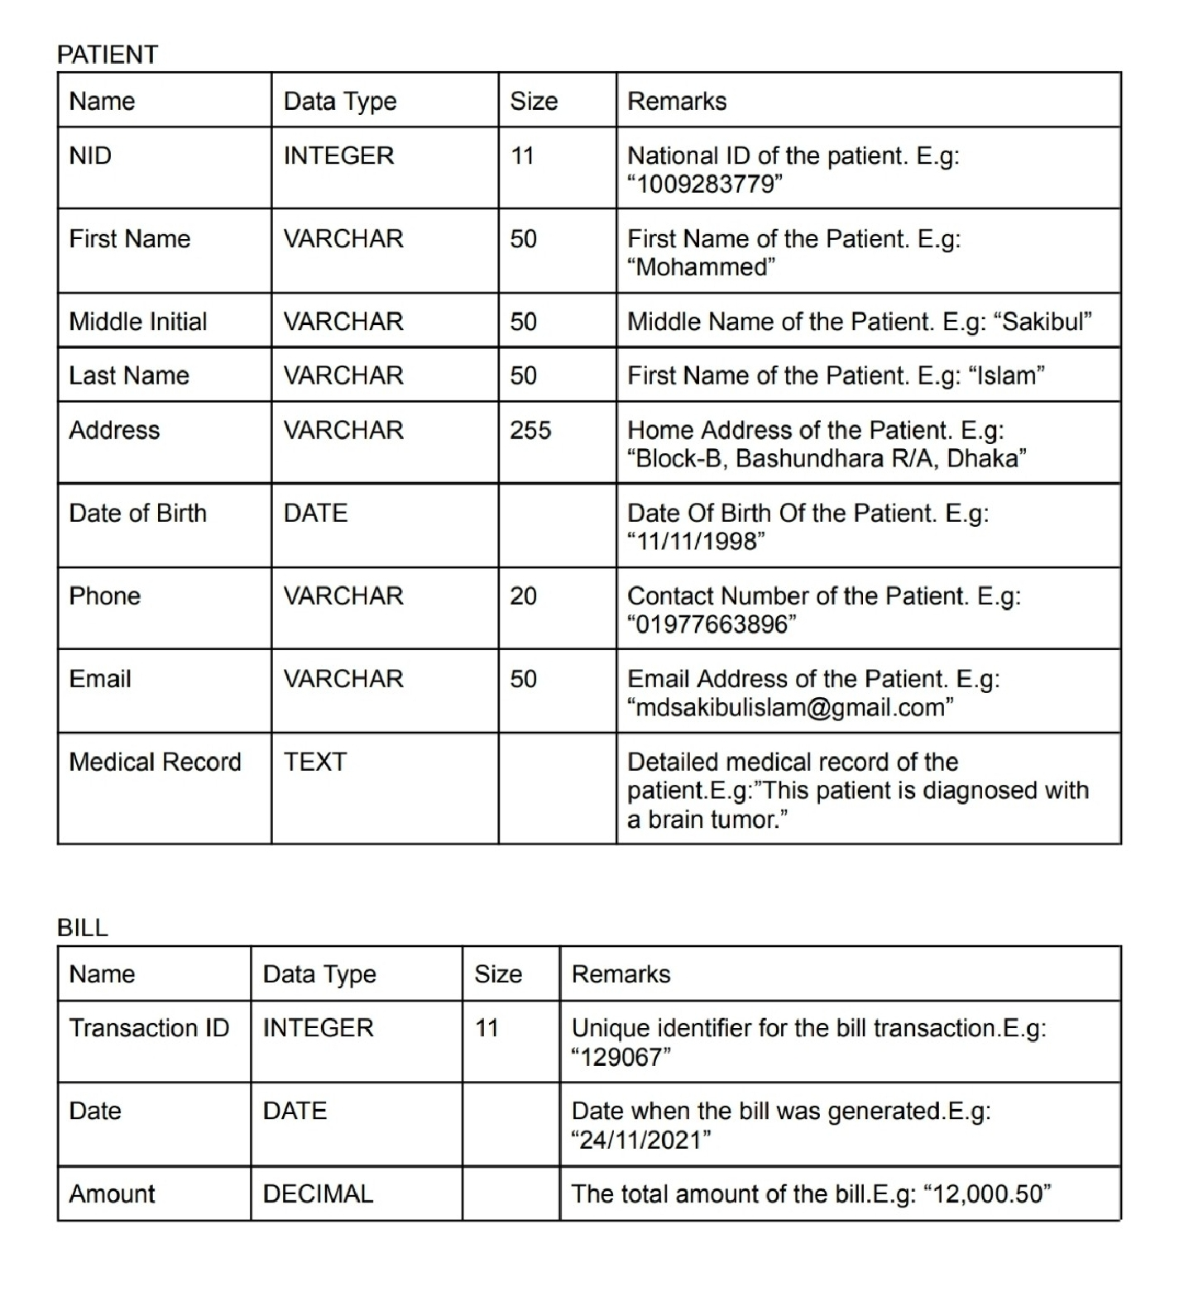
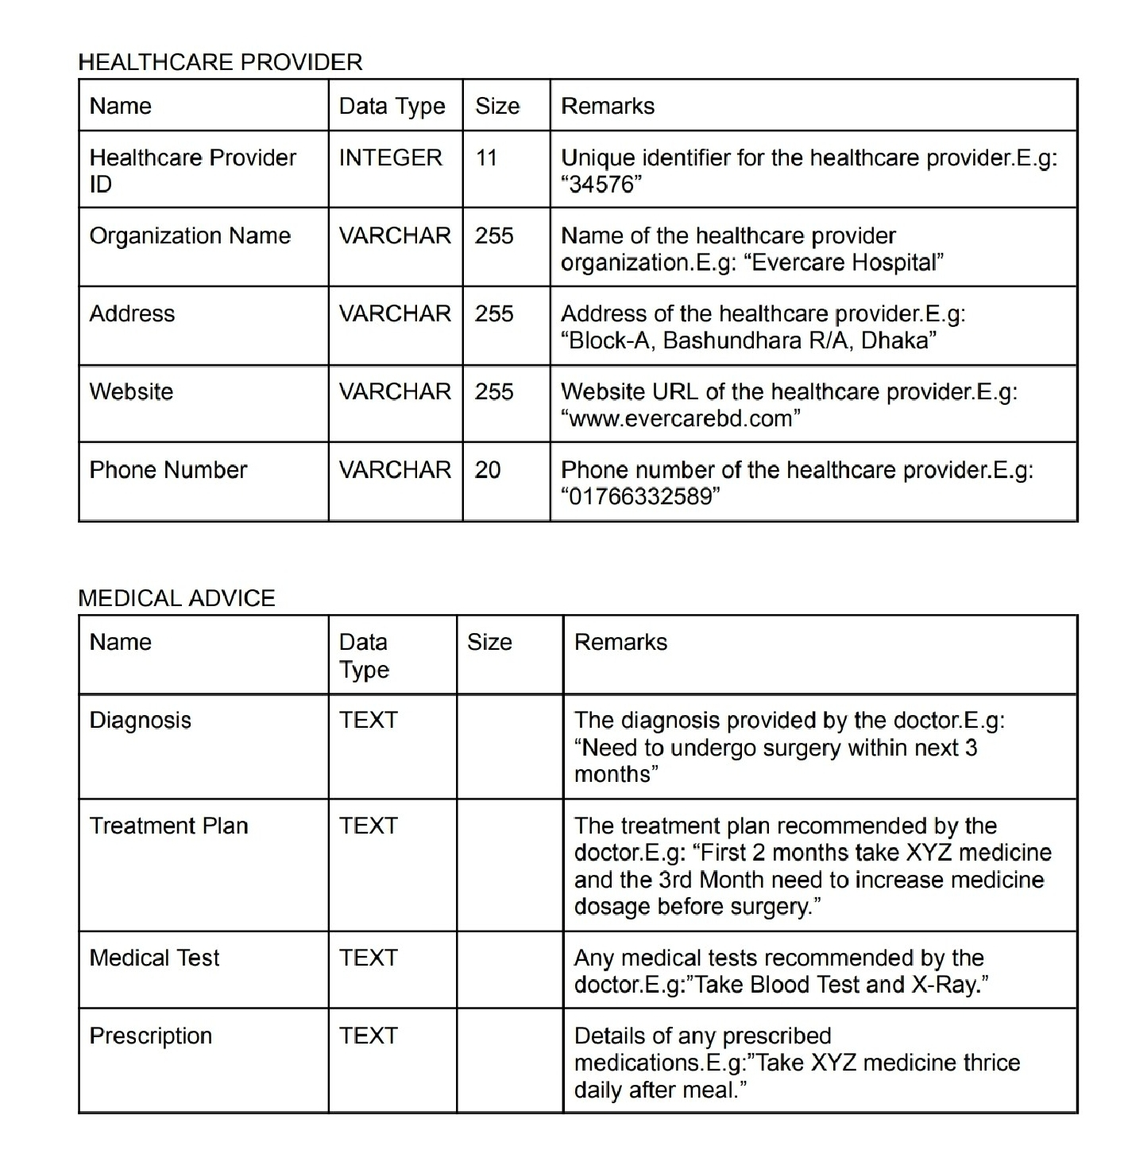

Data Dictionary

Slide 11
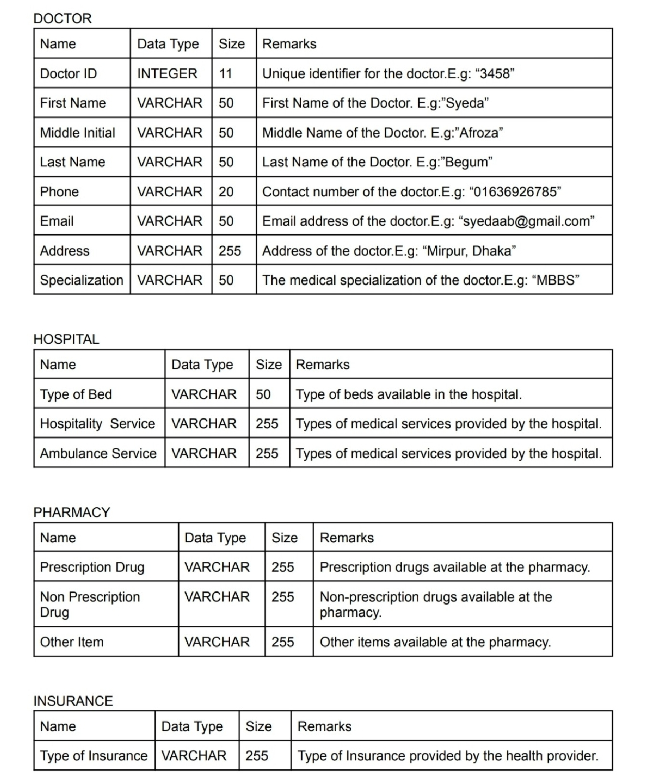


Slide 12
In Conclusion
Using the web-based application has a positive impact on reducing out-of-pocket expenses for users, fostering economic sustainability in the healthcare sector.
It also has an indirect impact on environmental sustainability as digital platform is used rather than written forms and processes.
The potential cost savings contribute to overall social well-being by easing the financial burden on individuals and families, fostering a more sustainable and equitable healthcare system.
Overall, the web-based system is mostly beneficial for economical, environmental and social sustainability and wellbeing.

Slide 13

Thank You

