Slide 1
Results
Hrithik Sagar, 2023900021
Subhadeep Biswas, 2022201039

Slide 2
Task
Find a path for robot from start point to goal, considering the obstacles and avoiding them.
Deliverables:
Trajectory Path for Holonomic robot
Wheels Path for Holonomic robot
Trajectory Path for Non-Holonomic robot
Wheels Path for Non-Holonomic robot

Slide 3
Algorithm
For solving this problem we used RRT algorithm (Rapidly-Exploring Random Tree)
Using Python Programming language

Slide 4
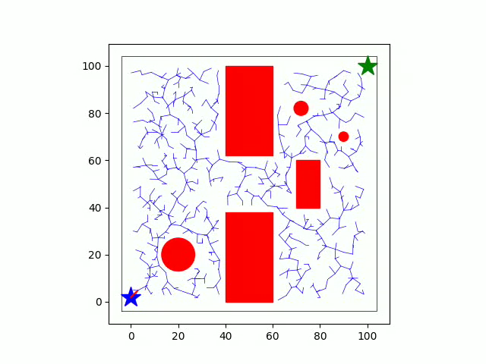
Holonomic Path
25 Frames

Slide 5
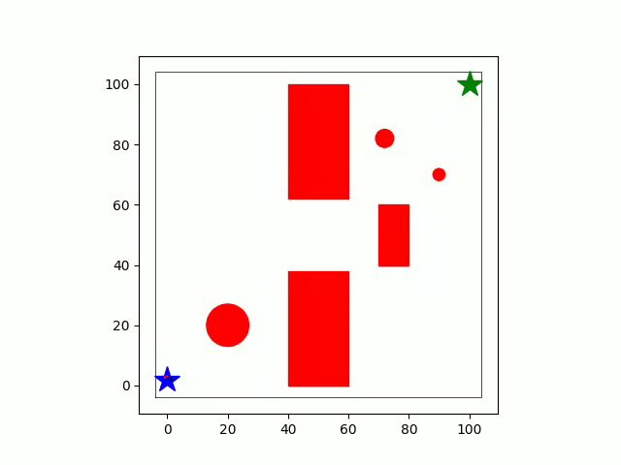
Holonomic Wheels
10 Frames

Slide 6
Non-Holonomic Path

Slide 7
Non-Holonomic Wheels

