Slide 1
What Do Head Scans Reveal
About Depression?
Insights from 360° Psychomotor Assessment in VR
Rachakonda Hrithik Sagar | Aryan Jain | Vidhi Rathore
Roll Nos: 2023900021 | 2025701055 | 2023121002
IIIT Hyderabad | Behavioral Research & Statistical Methods | Report 1

Slide 2
Motivation & Research Gap
The Problem
Proposed Solution
280M+
people affected by depression worldwide PHQ-9 is widely used but relies entirely on self-report — prone to:
Recall bias
Social desirability effects
Limited patient insight
Need for objective, behavioural biomarkers
Psychomotor retardation
is a core DSM-5 criterion for depression — slowing of both physical and mental activity Srivastava & Lahane (2025)
showed that 360° VR head-scanning speed is a valid biomarker:
Slower yaw scanning in higher-depression groups
Effect holds even when valence ratings match
Used HTC Vive Pro + 60s clips
We replicate this with Meta Quest 3 at IIIT Hyderabad
IIIT Hyderabad | BRSM Report 1 | 2026

Slide 3
Study Design
Participants
5 VR Videos (Meta Quest 3)
N = 40
Age: M = 22.77 (SD = 1.80), range 19–27
36 male, 4 female
24 no VR experience, 16 some prior experience
V1
Abandoned Buildings
Neutral/Eerie · ~62s
V2
Evening at Beach
Positive/Calm · ~61s
Measures
V3
Campus
PHQ-9 Depression (self-report) GAD-7 Anxiety (self-report) STAI-T Trait anxiety (self-report) PANAS Affect pre & post VR ← NEW Valence / Arousal / Immersion per video Yaw Angular Speed (deg/s) head-tracking
Neutral/Positive · ~61s
V4
The Nun (Horror)
Negative/Arousing · ~122s
V5
Tahiti Surf
Positive/Exciting · ~184s
IIIT Hyderabad | BRSM Report 1 | 2026

Slide 4
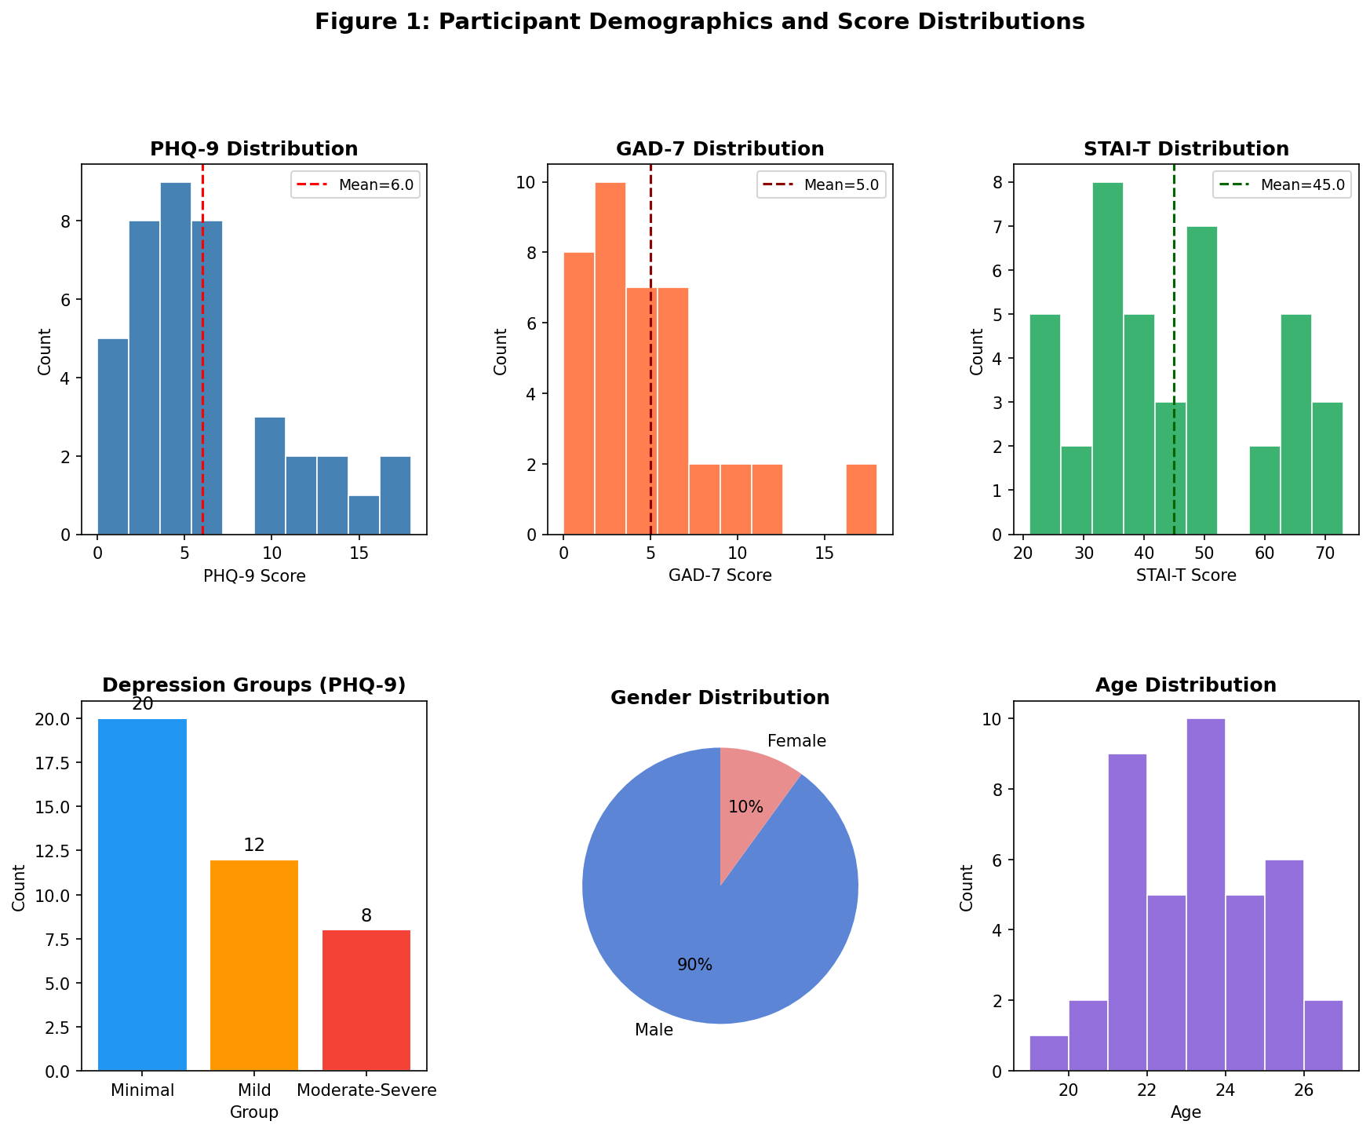
Sample Overview & Key Statistics
40
22.77
36M / 4F
50 Hz
Participants
Mean Age (SD=1.80)
Gender Split
Head Tracking Rate
PHQ-9, GAD-7, STAI-T distributions | Depression groups | Age & gender
IIIT Hyderabad | BRSM Report 1 | 2026

Slide 5
Normality Tests & Outlier Detection
Measure | SW p | Normal?
PHQ-9 | p = .002 | ✗ No
GAD-7 | p < .001 | ✗ No
STAI-T | p = .045 | ✗ No
PANAS Pos (Pre) | p = .214 | ✓ Yes
PANAS Neg (Pre) | p = .003 | ✗ No
Outlier Analysis
Two methods used:
IQR method (Q₁ − 1.5×IQR to Q₃ + 1.5×IQR)
Z-score threshold (|z| > 2.5) PHQ-9 flagged:
IQR → 3 participants (scores 16, 17, 18) z-score → 1 participant (score 18) Decision: RETAIN ALL 40
• Scores are clinically valid • Represent the most important group (Mod-Severe) • Removal would destroy the high-depression cell (n=8) • Supported by Tabachnick & Fidell (2019)
→ Non-normality in clinical scales justifies
non-parametric tests (Kruskal-Wallis, Wilcoxon, Spearman)
IIIT Hyderabad | BRSM Report 1 | 2026

Slide 6
PHQ-9 Depression Groups
Minimal
Mild
Moderate-Severe
PHQ-9: 0–4
PHQ-9: 5–9
PHQ-9: ≥ 10
20
12
8
participants (50%)
participants (30%)
participants (20%)
M = 2.60 (SD = 1.47)
M = 6.58 (SD = 1.31)
M = 13.75 (SD = 2.92)
No or minimal depressive symptoms
Mild symptoms; watchful waiting
Clinically significant depression
Cut-offs: Kroenke et al. (2001) — three groups preferred over binary split to preserve ordinal information and detect dose-response patterns
IIIT Hyderabad | BRSM Report 1 | 2026

Slide 7
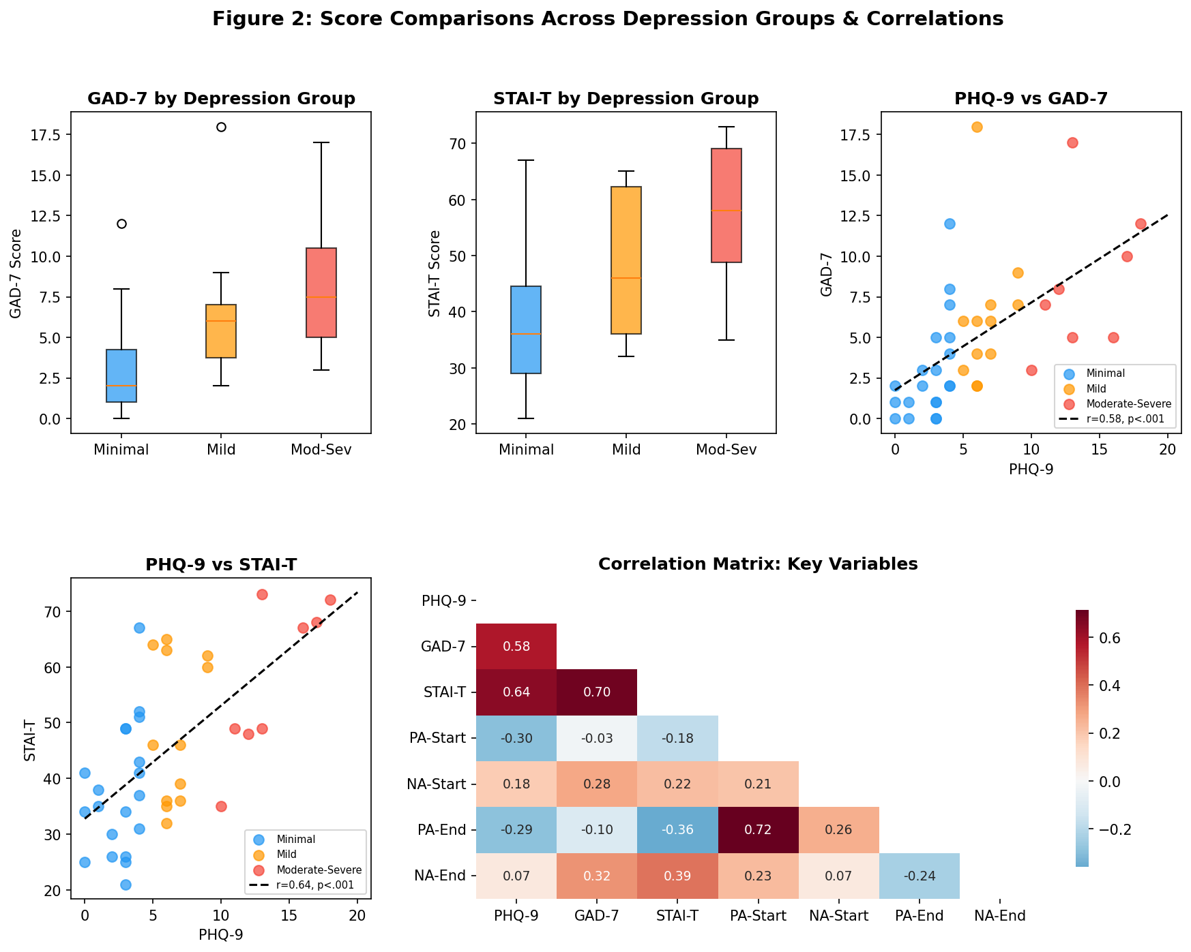
Depression–Anxiety Covariance
Pearson Correlations
PHQ-9 & GAD-7
r = .579
p < .001
PHQ-9 & STAI-T
r = .642
p < .001
GAD-7 & STAI-T
r = .697
p < .001
Kruskal-Wallis confirms groups differ on anxiety:
GAD-7: H = 12.81, p = .002 ** STAI-T: H = 10.63, p = .005 **
IIIT Hyderabad | BRSM Report 1 | 2026

Slide 8
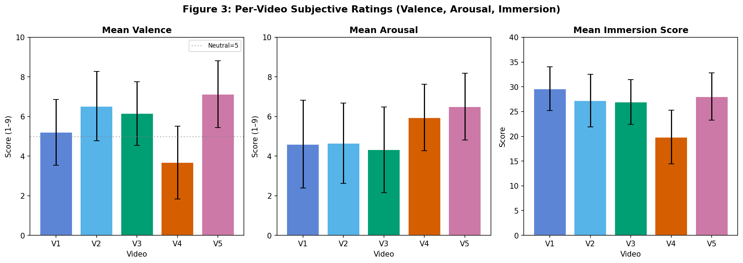
Per-Video Subjective Ratings
V1
V2
V3
V4
V5
Val 5.20 | Aro 4.60
Imm 29.6
Val 6.53 | Aro 4.65
Imm 27.3
Val 6.15 | Aro 4.33
Imm 27.0
Val 3.67 | Aro 5.95
Imm 19.9
Val 7.12 | Aro 6.50
Imm 28.0
Friedman χ²(4) = 52.47, p < .001 for valence | V4 Horror lowest valence (3.67) & lowest immersion (19.9) despite highest arousal
IIIT Hyderabad | BRSM Report 1 | 2026

Slide 9
The Horror Video (V4: The Nun)
A Unique Stimulus Among the Five
3.67
5.95
19.9
Lowest Valence
Highest Arousal
Lowest Immersion
(out of 9 — significantly below V2 Beach, Wilcoxon p < .001)
(highest of all 5 videos)
(paradoxically low despite longest duration ~122s)
Key insight: High arousal does NOT automatically produce high immersion.
The threatening horror content likely triggered
threat-induced avoidance behaviour — suppressing
exploratory head movement and reducing sense of presence despite longer viewing time.
IIIT Hyderabad | BRSM Report 1 | 2026

Slide 10
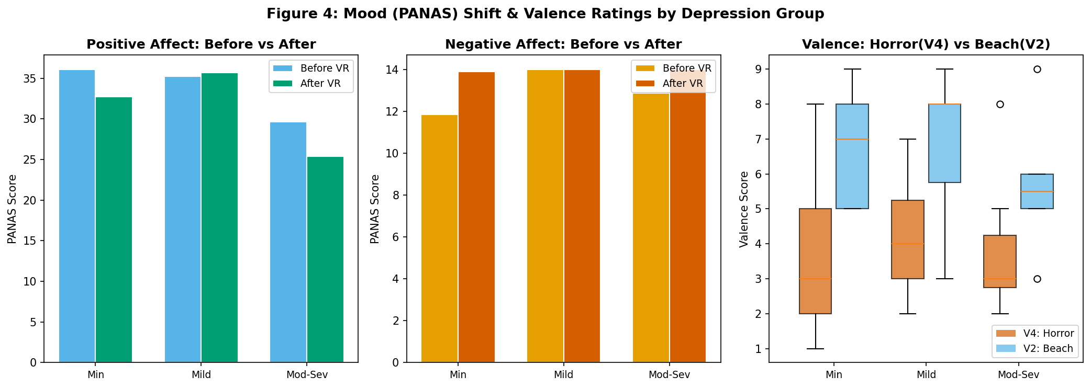
Mood Change: PANAS Pre vs Post VR
Paired-Samples t-test Results
Positive Affect ✓ Significant
Pre: M = 34.52 → Post: M = 32.15 t(39) = 2.09, p = .043, Cohen's d = 0.27
Negative Affect ✗ Not Significant
t(39) = −1.06, p = .294 (no change)
Group trend (Positive Affect Δ):
Minimal: −2.45 Mild: −1.67 Moderate-Severe: −4.25 ← largest drop
IIIT Hyderabad | BRSM Report 1 | 2026

Slide 11
Head-Tracking Data
Primary Behavioural Metric: Mean Yaw Angular Speed (deg/s)
What is Yaw Speed?
Recording
Paper Prediction
RotationSpeedY (deg/s)
How fast the participant scans left-right during a video.
Higher = more active head exploration.
Meta Quest 3 at ~50 Hz
One CSV per participant per video
200 total files (40 × 5 videos)
Srivastava & Lahane (2025):
Depression ↑ → Head Scanning ↓
Psychomotor retardation hypothesis
IIIT Hyderabad | BRSM Report 1 | 2026

Slide 12
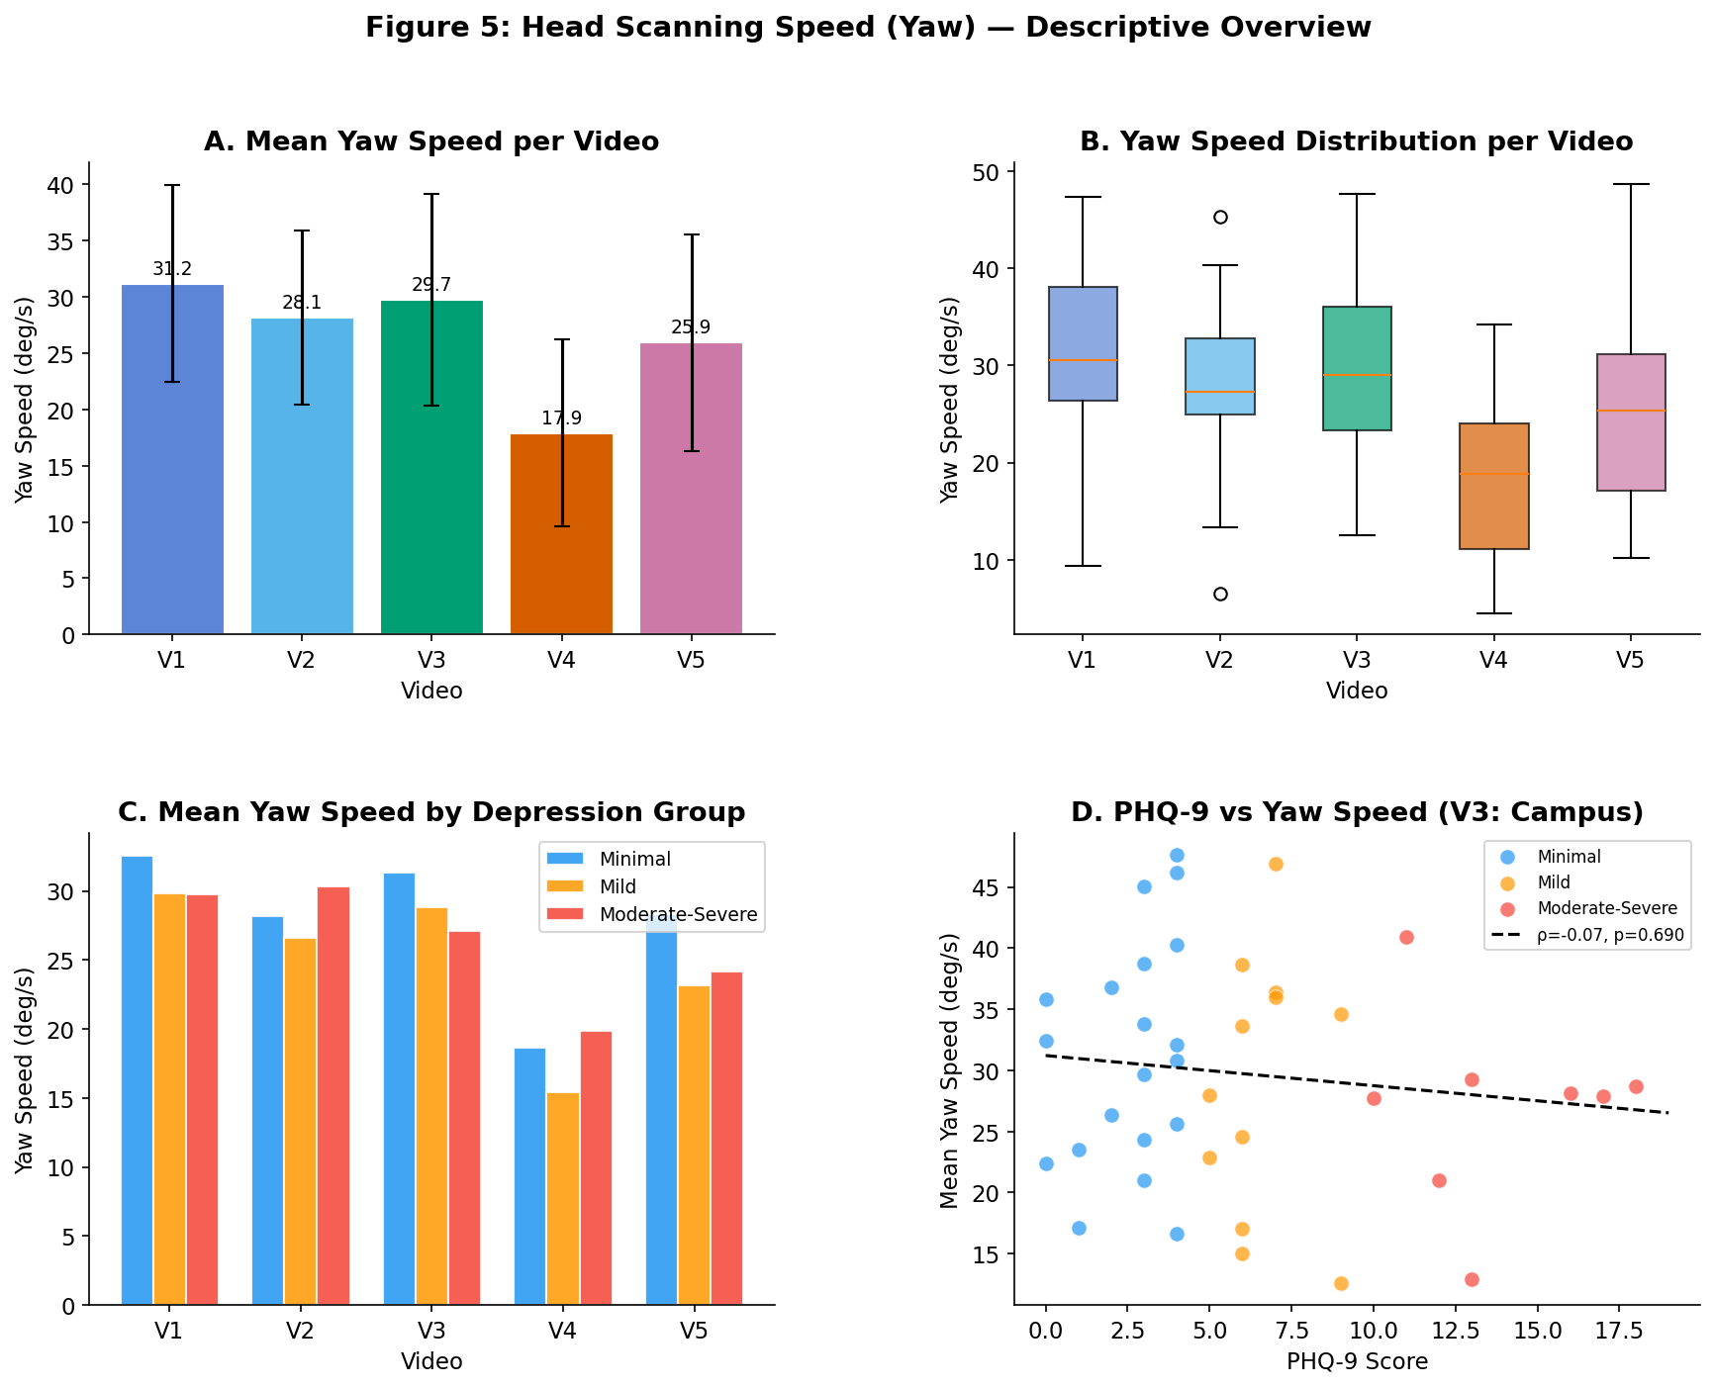
Head Scanning Speed — Key Findings
Video | Mean (deg/s) | SD | Duration
V1 Abandoned Buildings | 31.19 | 8.77 | ~62s
V2 Evening at Beach | 28.14 | 7.73 | ~61s
V3 Campus | 29.73 | 9.39 | ~61s
V4 The Nun (Horror) | 17.92 | 8.28 | ~122s
V5 Tahiti Surf | 25.95 | 9.64 | ~184s
V4 Horror is ~43% slower than V1 (31.19 → 17.92 deg/s)
Kruskal-Wallis (groups):
All videos: p > .30 (ns) Direction correct for V1, V3, V5: Mod-Severe numerically < Minimal Spearman PHQ-9 vs speed:
All |ρ| < .12, p > .48 (not sig.)
IIIT Hyderabad | BRSM Report 1 | 2026

Slide 13
Scanning Speed by Depression Group
Observations
V4 (Horror) stands out:
All groups scan dramatically slower — stimulus effect dominates V1, V3, V5 show expected direction:
Minimal > Mod-Severe (consistent with psychomotor retardation) V2, V4: Reversed direction
Mod-Severe >= Minimal — stimulus type may override group effect No test reaches significance (p > .30)
Small n per group (8–20) limits power
IIIT Hyderabad | BRSM Report 1 | 2026

Slide 14
Key Findings Summary
1
Non-normal distributions
2
Strong clinical covariance
PHQ-9, GAD-7, STAI-T all violate normality (SW p ≤ .045) → non-parametric tests justified throughout
PHQ-9, GAD-7, STAI-T are highly intercorrelated (r = .58–.70). Anxiety groups differ significantly across depression groups (KW p < .005)
3
Videos produce distinct emotions
4
VR dampens positive mood
Friedman χ²(4)=52.47, p<.001. V4 Horror: lowest valence (3.67) AND lowest immersion (19.9) despite highest arousal (5.95)
Positive Affect significantly decreased post-VR (t(39)=2.09, p=.043, d=0.27). Largest drop in Moderate-Severe group (ΔM=−4.25)
5
Horror suppresses head scanning
6
Direction consistent with paper
V4 yaw speed (M=17.92) is ~43% lower than other videos. All participants freeze — stimulus dominates over depression group
V1, V3, V5: Mod-Severe scans slightly slower than Minimal. However, KW p > .30, Spearman |ρ| < .12 — no statistical significance
IIIT Hyderabad | BRSM Report 1 | 2026

Slide 15
Limitations
Unequal Group Sizes
Minimal n=20 vs Mod-Severe n=8. Cannot control assignment — depression severity is a natural variable. Limits statistical power particularly for the clinically important high-depression group.
Hardware Difference
Original paper used HTC Vive Pro; this study used Meta Quest 3. Different tracking accuracy, display, and controller design may affect head movement patterns and presence ratings.
Video Duration Mismatch
V4 (~122s) and V5 (~184s) are substantially longer than V1–V3 (~61s). V5 being longest may introduce fatigue effects; direct comparison of immersion and scanning speed is confounded by duration.
Sample Demographics
36 male, 4 female; mean age 22.77. Near-homogeneous student sample from one institution limits generalisability. Depression base-rate may differ from general population.
IIIT Hyderabad | BRSM Report 1 | 2026

Slide 16
Conclusion
Report 1 establishes the empirical foundation for this replication study:
✓ Clinical scales are non-normal → non-parametric inference is appropriate ✓ PHQ-9 groups differ significantly on anxiety — an important confound to note ✓ 360° videos reliably elicit distinct emotional responses (Friedman p < .001) ✓ VR exposure significantly decreased positive affect (d = 0.27), especially in Mod-Severe group ✓ Horror video (V4) produced dramatically lower scanning speed — ~43% below other videos ~ Depression group differences in head scanning exist directionally but are not yet statistically significant
IIIT Hyderabad · Hrithik Sagar · Aryan Jain · Vidhi Rathore · 2026
IIIT Hyderabad | BRSM Report 1 | 2026

