Slide 1

Capstone Project
Rossmann Sales Prediction

Slide 2

Problem Statement:
Rossmann store managers are tasked with predicting their daily sales for up to six weeks in advance.
We were provided with historical sales data for 1,115 Rossmann stores and were asked to predict the same

Slide 3

Description of data provided
We are provided with 2 data sets:
1. Rossmann Stores Data.csv - This dataset includes the historical data including Sales. This dataset contain features like Sales, Customers,
Open, StateHoliday, SchoolHoliday.
2. store.csv - This includes supplemental information about the stores. This dataset contain features like Assortment, CompetitionDistance, CompetitionOpenSince[Month/Year], Promo, Promo2,
Promo2Since[Year/Week]

Slide 4
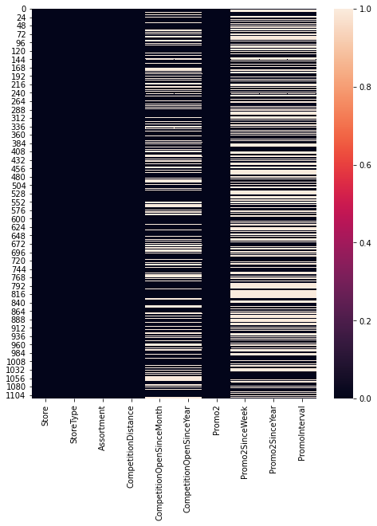
Missing Values in the Datasets

Slide 5
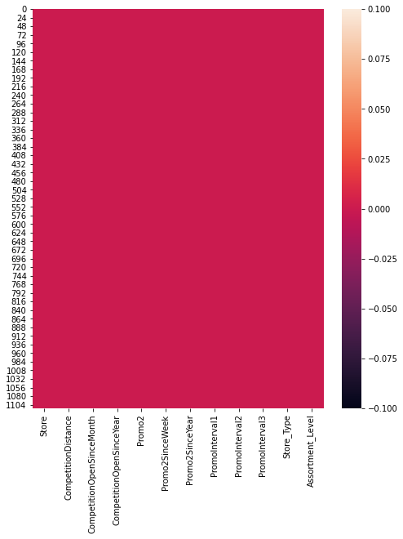
After filling NaN Values in the Datasets

Slide 6
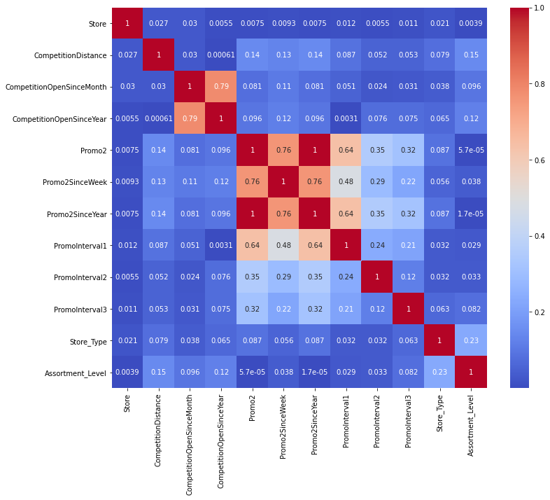
Correlation of variables with each others

Slide 7
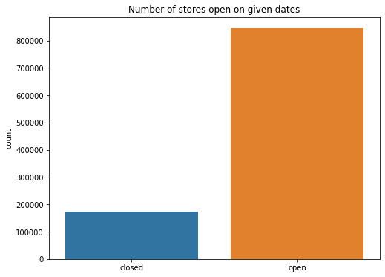
Numbers of stores open on a given Dates

Slide 8
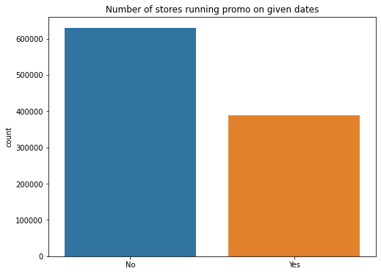
Number of stores running promo on given Dates

Slide 9
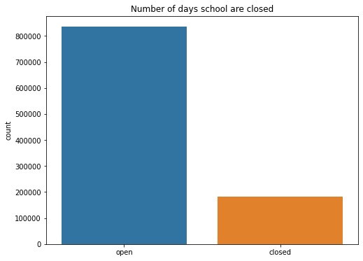
Number of school Holidays

Slide 10
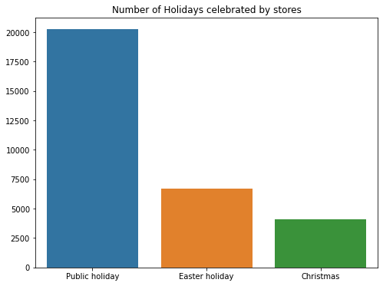
Number of Holidays celebrated by stores

Slide 11
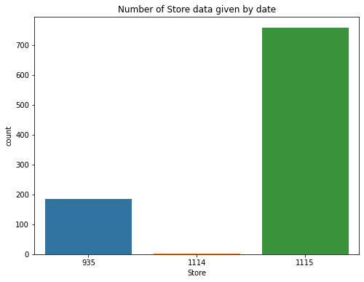
Number of store data given by Date

Slide 12
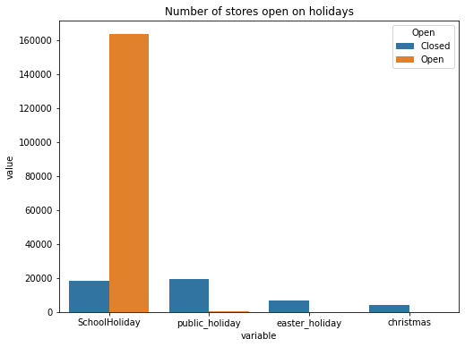
Number of stores open on Holidays

Slide 13
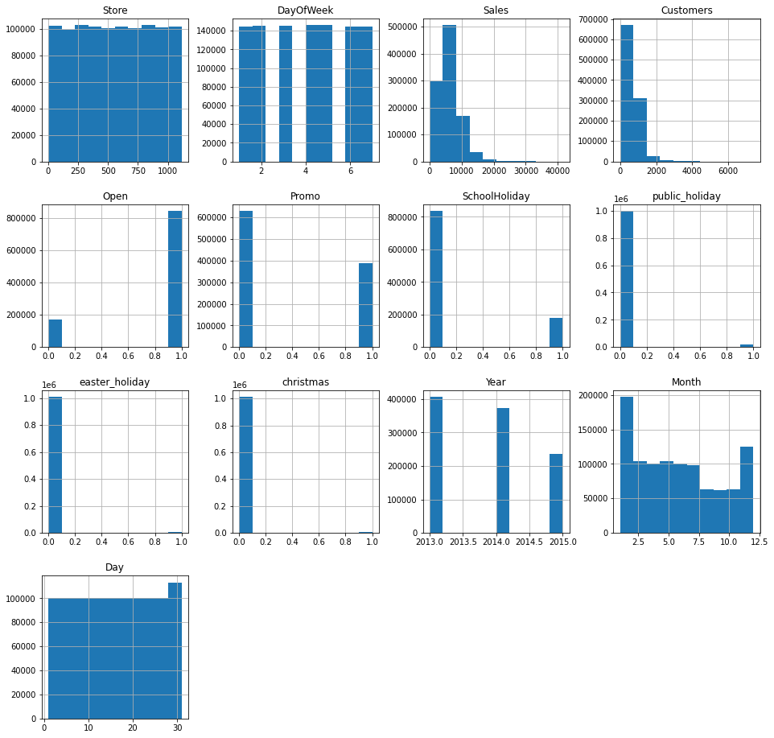
Distribution of values

Slide 14
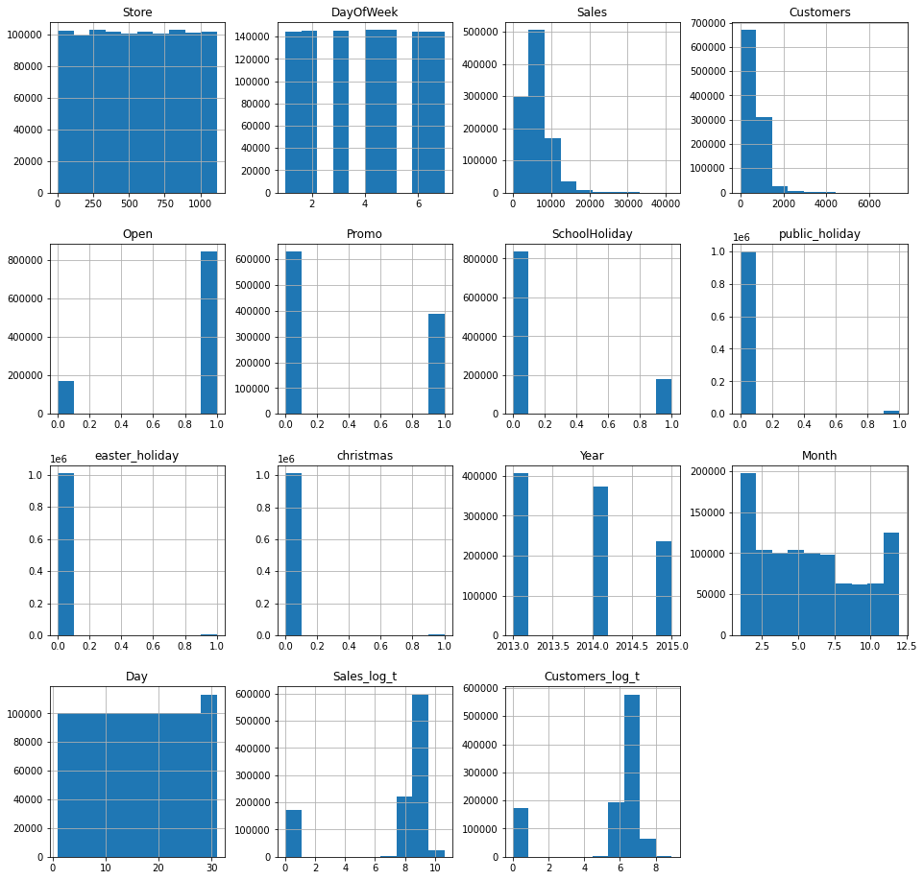
After removing the skewness

Slide 15
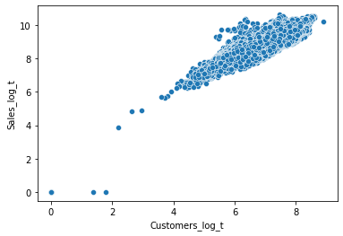
Relationship between sales and customer data

Slide 16
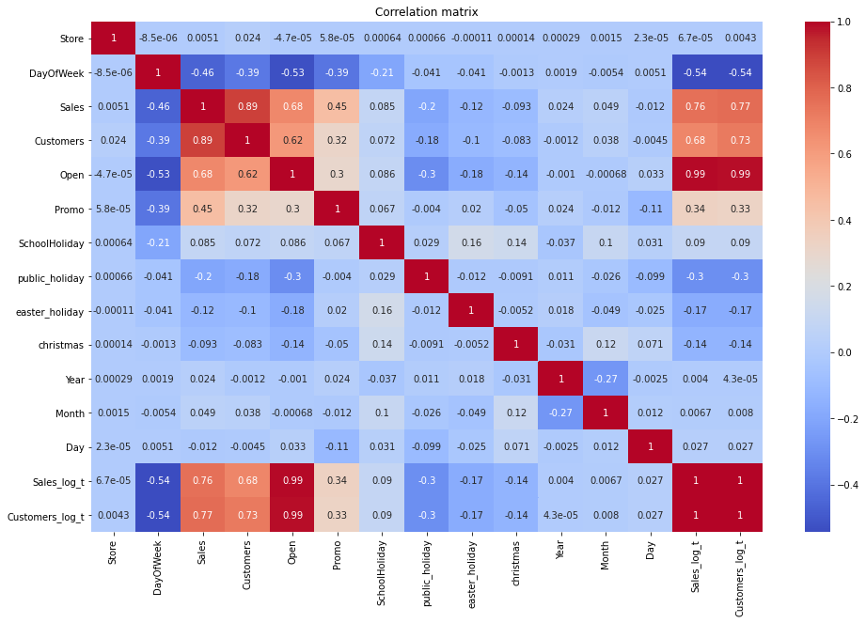
Correlation matrix of Rossmann’s Dataset

Slide 17
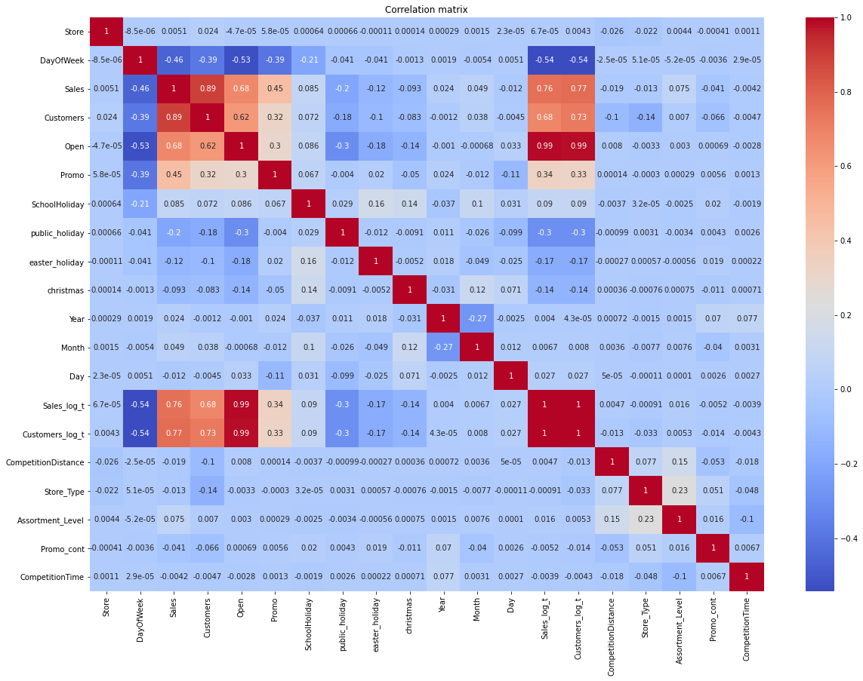
Correlation after merging the two dataset

Slide 18
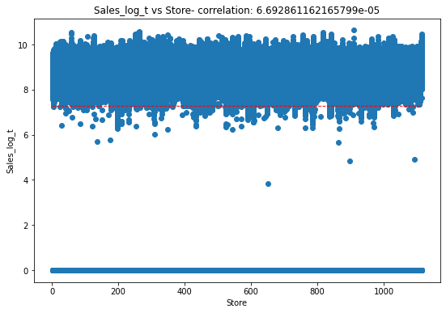
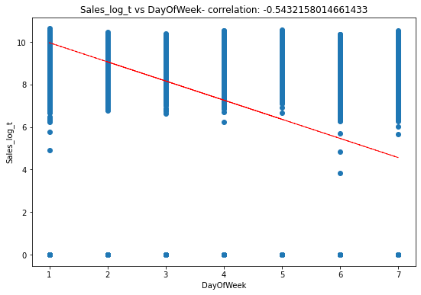
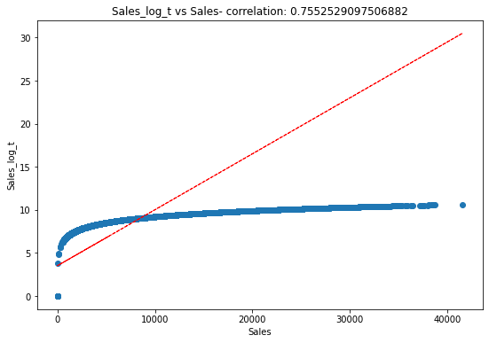
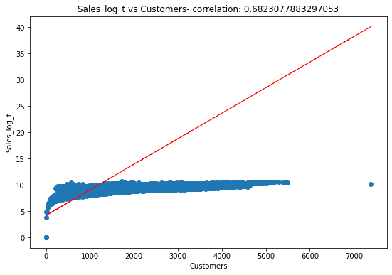
The scatter plot for sales_log_t with other Variables:

Slide 19
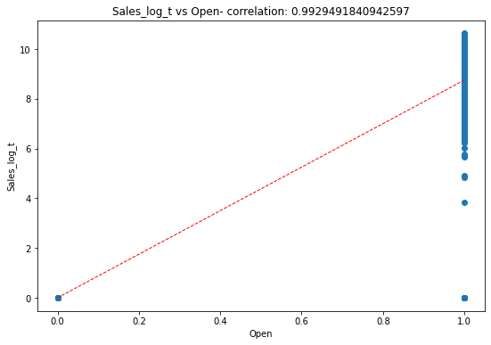
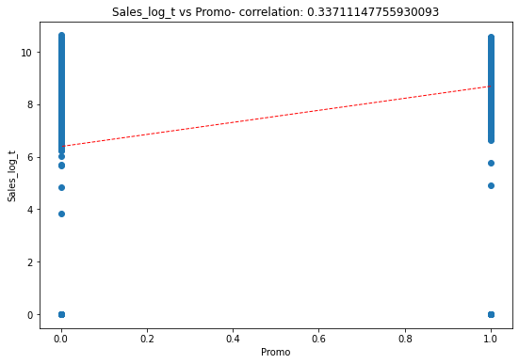
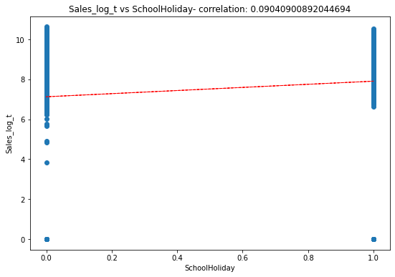
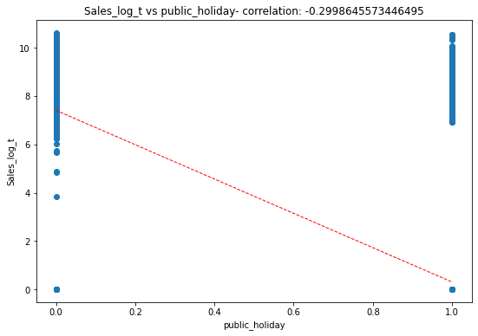
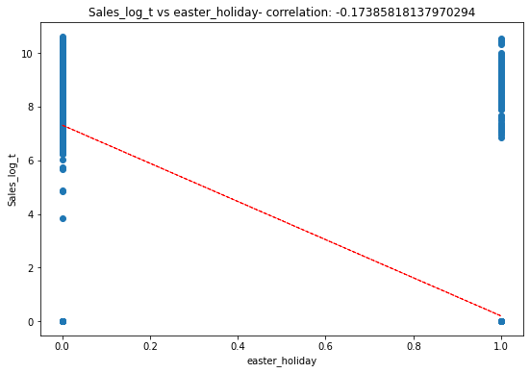
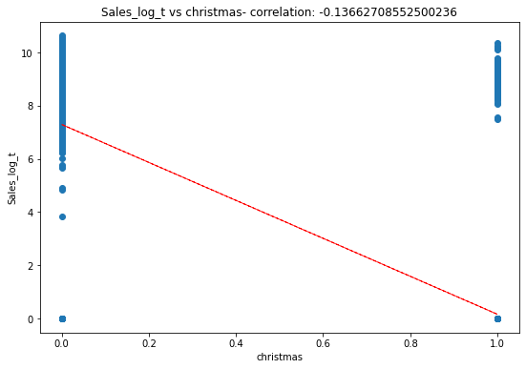
The scatter plot for sales_log_t with other Variables:

Slide 20
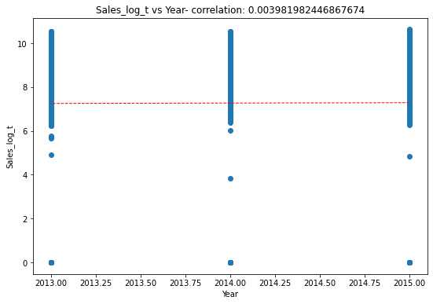
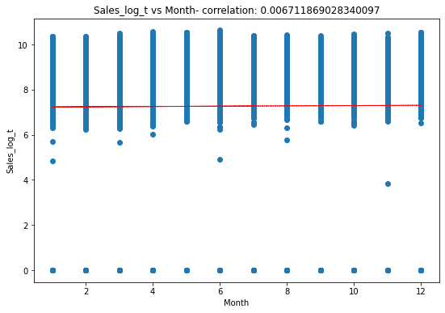
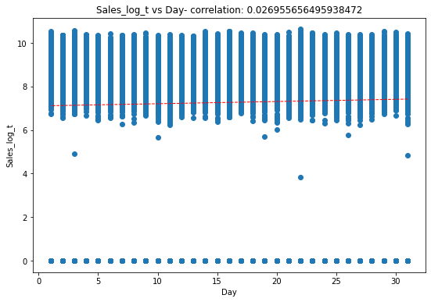
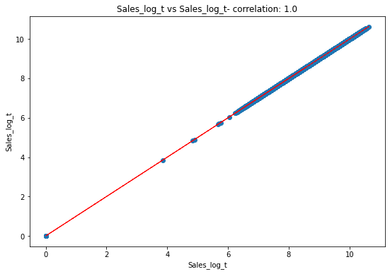
The scatter plot for sales_log_t with other Variables:

Slide 21
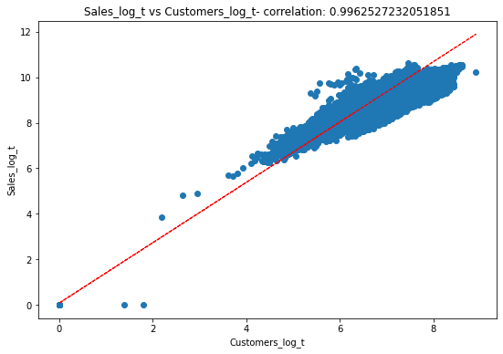
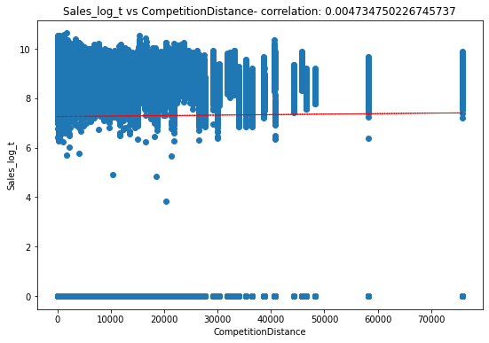
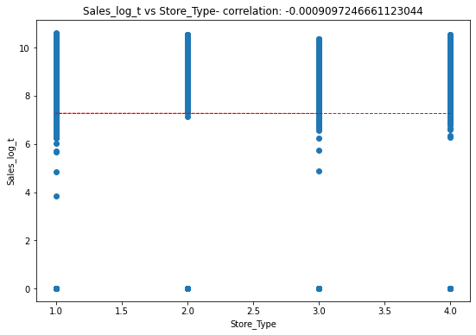
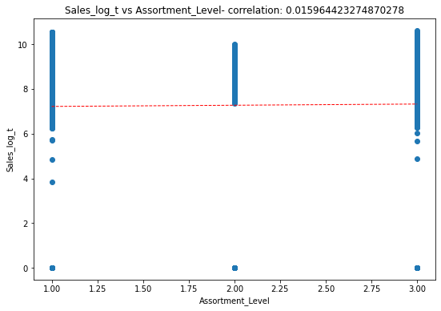

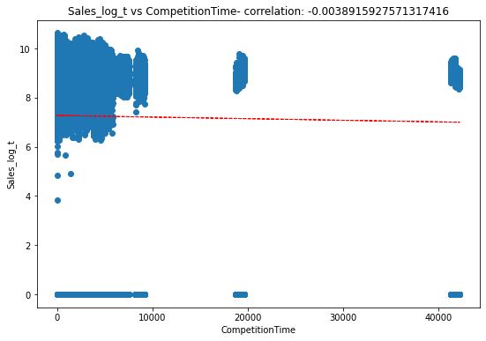
The scatter plot for sales_log_t with other Variables:

Slide 22
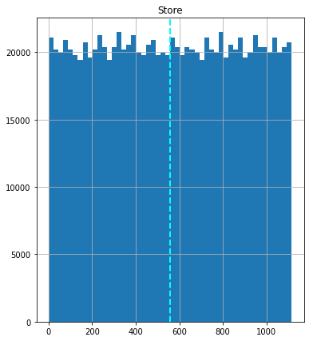
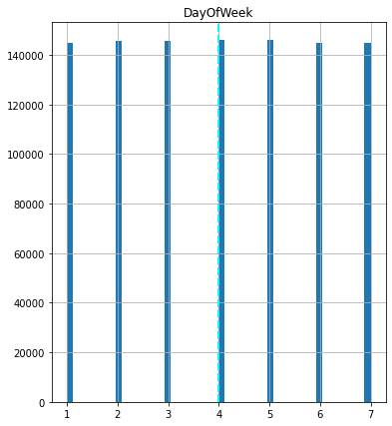
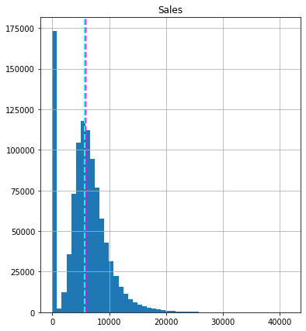
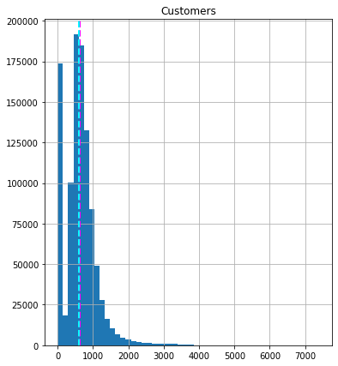
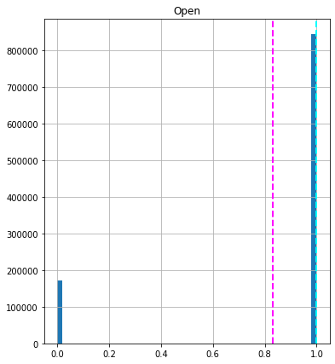
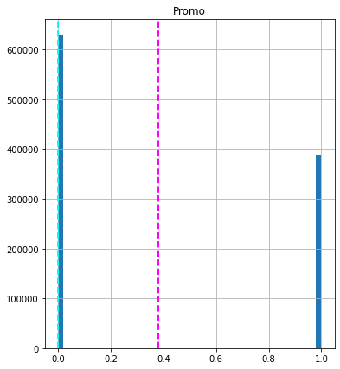
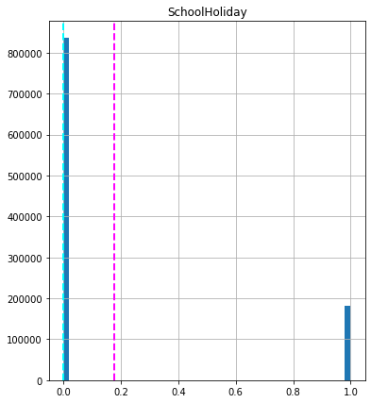
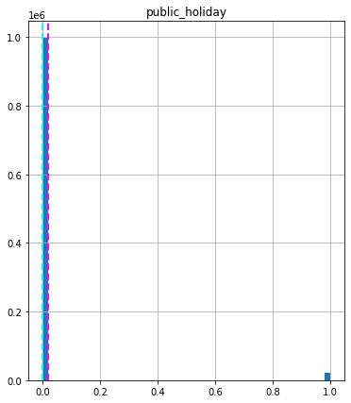
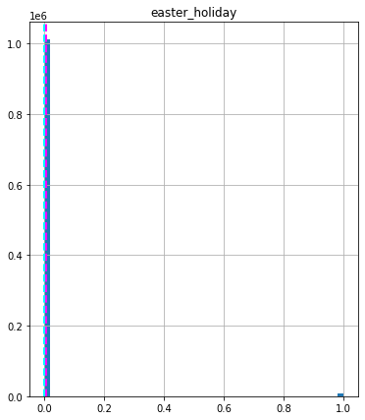
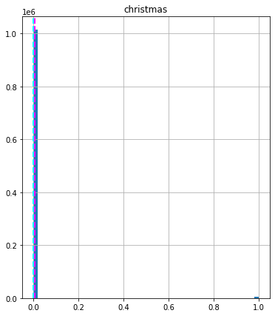
Plot of all the variables:

Slide 23
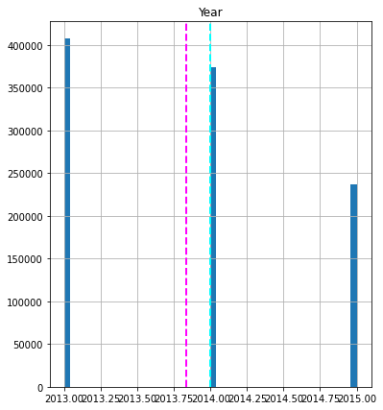
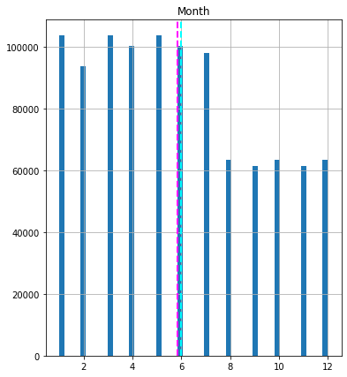
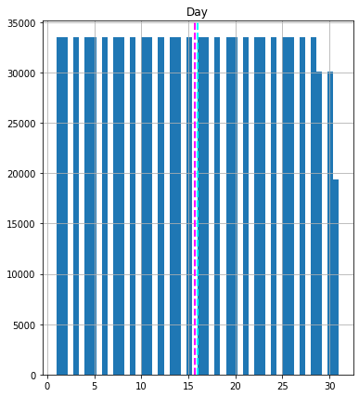
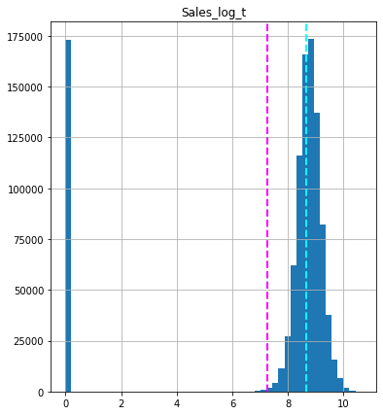
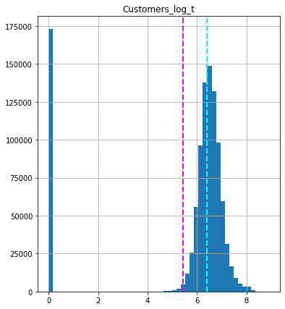
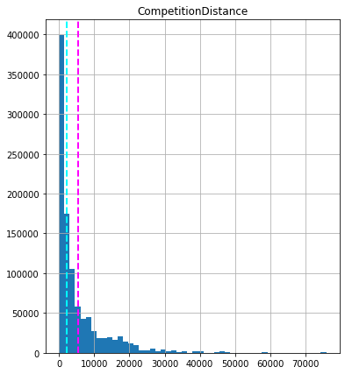
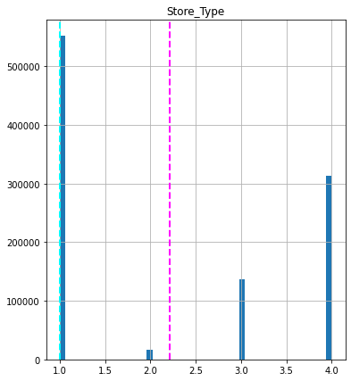



Plot of all the variables:

Slide 24

Plot for first 100 observations between actual and predicted after building the linear regression model:

Slide 25
We are using linear regression model so, we need to check 4 basic assumptions of linear regression. 1.There should to be linear relationship between independent and dependent variables. 2.The sum of residuals/error should be near to 0. 3.There should not be multicollinearity. 4.There should not be heteroscedasticity.

Slide 26




Plotting the assumptions graph:

Slide 27
Running Grid Search Cross Validation for Lasso Regression
Note: We can see that tuning the learning rate increases the evaluation scores.

Slide 28
Running Grid Search Cross Validation for Ridge Regression

Slide 29
Running Grid Search Cross Validation for Elastic Net Regression
Note: We have made 4 models. Sometimes it's useful to predict data on different models to increase accuracy of prediction and raise our confidence level.
Stacking is a good way to combine all the predictions from different models into one. We can adjust weights for each model in stacking.

Slide 30
Here are some values of the factors observed in model building:
Linear Regression model:
Mean Squared Error : 0.11 Root Mean Squared Error : 0 Mean Absolute Error : 0.25 Mean Absolute Percentage Error : 3.41 % R-Square : 0.99 Adjusted R-Square : 0.99
Lasso Regression with cross validation:
Mean Squared Error : 0.11
Root Mean Squared Error : 0
Mean Absolute Error : 0.25
Mean Absolute Percentage Error : 3.41 %
R-Square : 0.99
Adjusted R-Square : 0.99
ElasticNet Regression:
Mean Squared Error : 0.11
Root Mean Squared Error : 0
Mean Absolute Error : 0.25
Mean Absolute Percentage Error : 3.41 %
R-Square : 0.99
Adjusted R-Square : 0.99
Ridge Regression with cross validation:
Mean Squared Error : 0.11
Root Mean Squared Error : 0
Mean Absolute Error : 0.25
Mean Absolute Percentage Error : 3.41 %
R-Square : 0.99
Adjusted R-Square : 0.99

Slide 31
Stack Model:

Slide 32

Predicting Sales for next six weeks: Now that we have linear regression models performing well. we need to predict Sales for next 6 weeks in Advance. This is what our problem statement states and hence we have considered the last 42 days as our test data.

Slide 33

Predicting Sales for next six weeks:

Slide 34

Conclusion: In the above project to we applied log transform to a lot of columns to avoid skewness which helped us to predict our values well. We also applied regularization techniques like Lasso, Ridge and Elastic Net to Avoid Overfitting. As we were doing Logistic Regression we took care of all the 4 assumptions. The above graph is what our final model looks like at the end. As per our model prediction we can conclude that Total revenue of Predicted Sales in next 6 weeks will be: 250,776,406 euros By 1115 Rossmann stores.

