Slide 1
Ad-Hoc XML Retrieval
Members:
Shubham Srivastava 200901114
Rini Joshi 200901135
Anupama Panchal 200901236
Prateek Agarwal 200901112
Aman Agarwal 200901091

Slide 2
XML-Extensible Markup Language
Shubham Srivastava

Slide 3
XML –EXTENSIBLE MARKUP LANGUAGE
What is XML?
Why XML ?
Application of XML?
XML Structure
XML DOM
XML Xpath , Schema

Slide 4
XML Retrieval
Why needed ??
Structured document retrieval principle
indexing unit : non-overlapping pseudo-documents , top down ,bottom up , all
Challenges in XML retrieval

Slide 5
INEX – Initiative for Xml retrieval
CO topics
CAS topics
orthogonal dimensions of relevance- component coverage , topical relevance
Our main focus of presentation : ad hoc information retrieval

Slide 6
Dynamic Element Retrieval
Rini Joshi
References:
Query Processing in a Flexible Retrieval Environment
A thesis submitted to the faculty of the graduate school
of the University of Minnesota by Satyanarayana Murthy Ganapathibhotla
Dynamic Element Retrieval in a Semi-structured Collection
Carolyn J. Crouch, Donald B. Crouch, Murthy Ganapathibhotla, and Vishal Bakshi
The Dynamic Retrieval of XML Elements
Carolyn J. Crouch, Sudip Khanna, Poorva Potnis, and Nagendra Doddapaneni

Slide 7
Flexible Retrieval/ Dynamic Retrieval
the process of dynamically returning the most highly correlated elements from documents is flexible retrieval
it promotes the retrieval of more focused elements – elements that relate to the information need.

Slide 8
Dynamic element retrieval on structured data
Why dynamic retrieval?
The system-Flex model
Structured versus semi structured

Slide 9
Why Dynamic Retrieval
This approach allows the system to return a rank ordered list of elements based on a single indexing of the collection at the paragraph level
Experimental show that it can produce results competitive with those produced by retrieval on an all-element index of the collection

Slide 10
The System- Flex Model Based on 2005 Track
Background:
The system is based on the vector space model, extended vector space model and Lnu-Ltu term weighing.
A basic model in information retrieval is the vector space model, wherein documents and queries are represented as weighted term vectors.
In extended vector space model, a document vector consists of a set of subvectors, where each subvector represents a different class of information. Our current representation of an XML document/query consists of 18 subvectors.

Slide 11
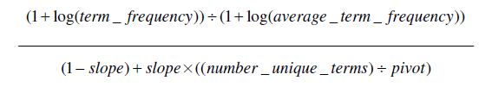
Background
Lnu term weights are defined below:
where tf represents term frequency, slope is an empirically determined constant, and pivot is the average number of unique terms per document, calculated across the entire collection.

Slide 12
The Flex model
System Description:
Parsing:
The documents and queries are translated into Smart format and indexed by Smart as extended vectors.
Initial Retrieval:
Retrieval takes place by running the topics against the paragraph indexing of the collection using Smart. the result is a list of elements (paragraphs) ordered by decreasing similarity to the query. Each such element represents a terminal node (e.g., paragraph) in the body of a document with some relationship to the query.

Slide 13
System Description
Flexible Retrieval:
The flexible retrieval module, Flex takes as input a list of elements (i.e., paragraphs), rank-ordered by similarity to the query as determined by Smart in the initial retrieval stage. Each such element represents a leaf of a tree; each tree represents an article in the document collection.
Generation of element and query vectors

Slide 14
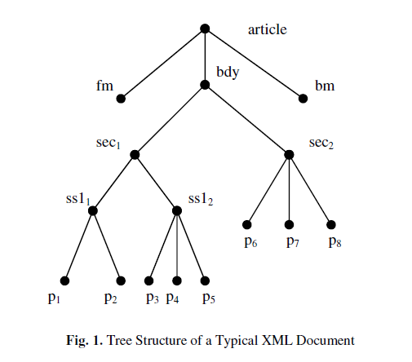
The root of the tree is the article itself, whereas the leaf nodes are the paragraphs.
Flexible retrieval should return relevant document components (e.g., <sec>, <ss1>,
<ss2>, <p>, <bdy>, <article>). In order to determine which elements of a tree to return, the system must
(1) build the tree, and
(2) assign a value to each non-terminal node in the tree by correlating the query with that element.

Slide 15
System Description
Flex takes a bottom-up approach.
All leaf elements having non-zero correlations with query Q have already been assigned similarity values by Smart.
Consider the set of n (say 1000) top-ranked elements associated with Q. Trees are constructed for all articles with leaves in this set.
To construct a tree, information about its structure and its terminal nodes must be known. Information about the structure of the tree is available as a by-product of the initial parsing of the documents. Information about its terminal nodes is found in the paragraph indexing of the collection.

Slide 16
Generating Element Vectors
Suppose for example in Figure 1 that p1, p2, and p7 were retrieved as leaf elements of the same tree. Flex would then build the tree represented in Figure 1. Each leaf is represented by a term-frequency weighted vector.
Each element vector (parent) is generated by merging the terms which appear in its children and updating the frequency of each term. This process continues until the body element (bdy) is generated.

Slide 17
Term Weighing
After the indexing phase, the vectors can be altered by choosing an appropriate weighing scheme(here tnu-ltu).
Lnu term weights for a particular element vector are based on information available within the vector itself along with collection dependent values of slope and pivot.
Once values of slope and pivot are determined at the element level, each element can be Lnu-weighted and correlated with the ltu- weighted query to produce a rank value for the element.(ltu weighing scheme in upcoming slides).

Slide 18
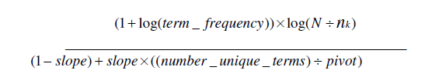
Generating Query Vectors
formula for the ltu termweighting of the query,
This formula is dependent on both N (the collection size) and nk (the number of elements that contain the term). N can be estimated but nk is generally available only through an element indexing of the collection.

Slide 19
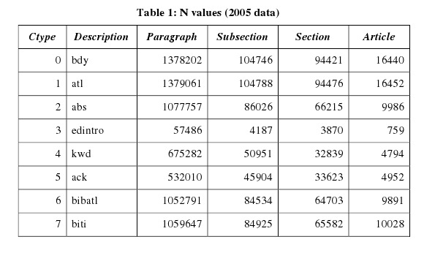
Determining N:
N , is a global statistic. There are eight subvectors identified in the IEEE journal article collection, body, article title, abstract, editor’s introduction, keywords, acknowledgements, bibliographic article title and bibliographic titles.

Slide 20
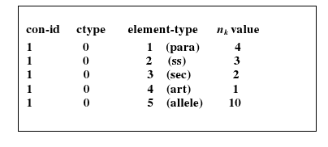
Determining nk:
The parameter nk refers to the number of elements in which a term appears. Smart uses the collection statistic files or the inverted index to find the correct value of nk to use during term weight computation. These files are produced at the time of indexing.
After indexing the paragraphs, we calculate nk for every term that appears in the inverted file and store it in a vector form (known as the n_stats vector).
A typical n_stats vector for one term

Slide 21
Structured versus Semi structure
Problems were encountered for dynamic element retrieval to the INEX Wikipedia collection. The IEEE collections are well structured where as the Wikipedia collection is semi-structured.
Dynamic element retrieval depends on having all the terminal nodes of a document represented in the paragraph index.
The Wikipedia collection, on the other hand, contains untagged text which is distributed throughout the documents at the body and section levels. This untagged text cannot be retrieved except as a component of its parent element.

Slide 22
Dynamic Element Retrieval in semi-structured data collection
Tagged and Untagged elements present
Elements represented as vector space model
execution time building of document trees of interest s to the query
Dynamic element retrieval on paragraph node
Ranking algorithm
A tree representation is formed for the top n elements

Slide 23
Is untagged text important?
Structuring the untagged text
Enhancements

Slide 24
Methodology for Producing Improved Focused Elements
Prateek Agarwal
References:
Finding Good Elements for Focused Retrieval
Carolyn J. Crouch, Donald B. Crouch, Salil Bapat, Sarika Mehta and Darshan Paranjape Dynamic Element
A Methodology for Producing Improved Focused Elements
Carolyn J. Crouch, Donald B. Crouch, Dinesh Bhirud, Pavan Poluri, Chaitanya Polumetla and Varun Sudhakar

Slide 25
The Aim for Focused Retrieval
The main aim of Focused Retrieval is to utilize the ability of dynamic retrieval to generate a rank ordered list of elements.

Slide 26
Issues with Focused Task Methodology
The first relates to how the document of interest (i.e. with respect to a specific query) are identified.
The method by which focused elements are selected from the document.

Slide 27
Focusing or Overlap Strategies
Section Strategy chooses as the focused element the highest correlating element along a path which is not a body.
Correlation Strategy chooses the highest correlating element along a path as the focused element, without restriction on element type.
Child Strategy chooses the terminal element along a path as the focused element.

Slide 28
Method used for Focused Retrieval in 2008
For each query retrieve n articles or documents.
Use Dynamic Retrieval to produce the rank-ordered list of all elements having a positive correlation with the query.
A parameter, m representing the upper bound on the number of focused elements after overlap is removed.

Slide 29
Result of 2008
The main agenda was centered on producig focused elemets.
Child Strategy for focusing technique was used as in 2007 but the ranking dropped from 4 to 19 in 2008.

Slide 30
Aim for 2009
Produce exceptionally good focused elements which consistently rank near or above those listed at the top official ranking

Slide 31
Method used for Focused Retrieval in 2009
For each query retrieve n articles or documents.
Use Dynamic Retrieval to produce the elements themselves.
The lists are merged and on of the three focusing strategy applied to remove overlap.
Set of focused elements ≤ m in size are then reported.

Slide 32
Result of 2009
Section Strategy for focusing technique was used and the ranking increased from 19 in 2008 to 10 in the official 2009 Focused task results

Slide 33
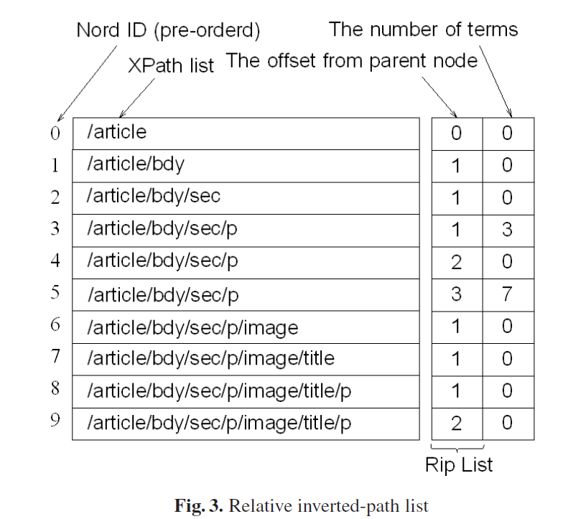
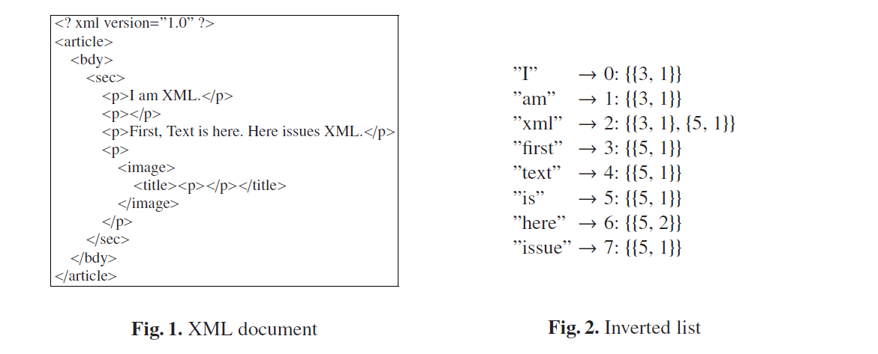
Optimizing IR in Large Scale XML data
The general way of retrieval in Large Scale XML data is using inverted file lists,it can be optimized and made faster using RIP(Relative Inverted Path list)
Notes:
<number>

Slide 34
The system can use TF-IDF scoring function for retrieval.
Hiroki Tanioka had proposed this method. The results that he received clearly showed the benefits of this result.
The system took 3.92 second per topic using RIP while Inverted File List took 66.2 second per topic.
Reference
A Fast Retrieval Algorithm for Large-Scale XML Data by Hiroki Tanioka
Notes:
<number>

