Slide 1
IoT Based Solar-Powered Smart Home Automation System
Name: Hritik Kumar
Roll: 1901EE26

Slide 2
What is IoT?
The main concept of smart devices was discussed as early as 1982. A Coca-Cola vending machine.
It describes the network of physical objects, that are embedded with sensors, software, and other technologies for the purpose of connecting and exchanging data with other devices.
Application Of IoT:
Smart Home
Medical and healthcare
Transportation
Agriculture

Slide 3
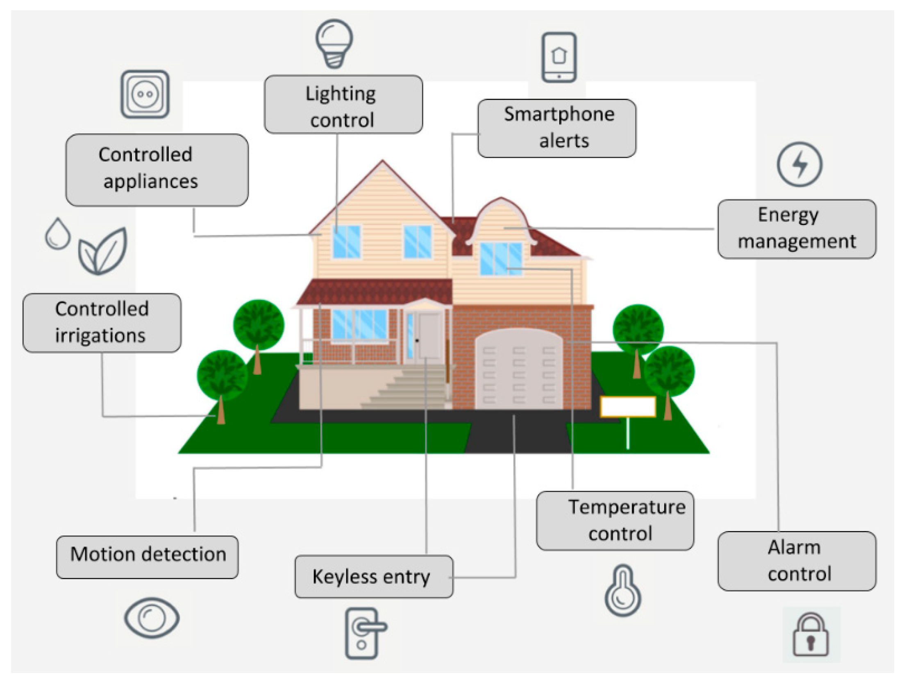
A smart Home?
A convenient home setup where appliances and devices can be automatically controlled, remotely from anywhere with the internet.
Functionalities :
Remote Access
Advanced Security
Appliances Control
Smart Energy Consumption

Slide 4
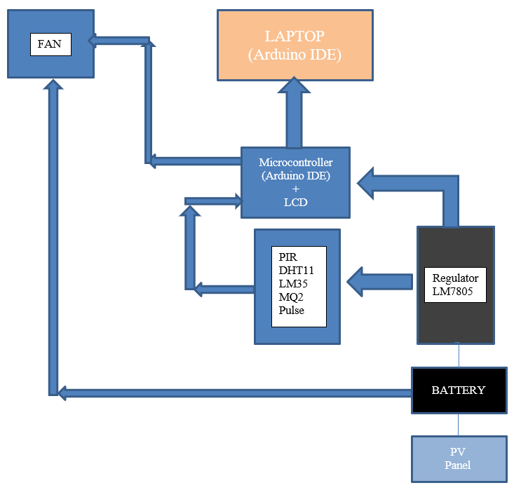
Smart home Implementation
Block Diagram of Overall Circuit for implementation.

Slide 5
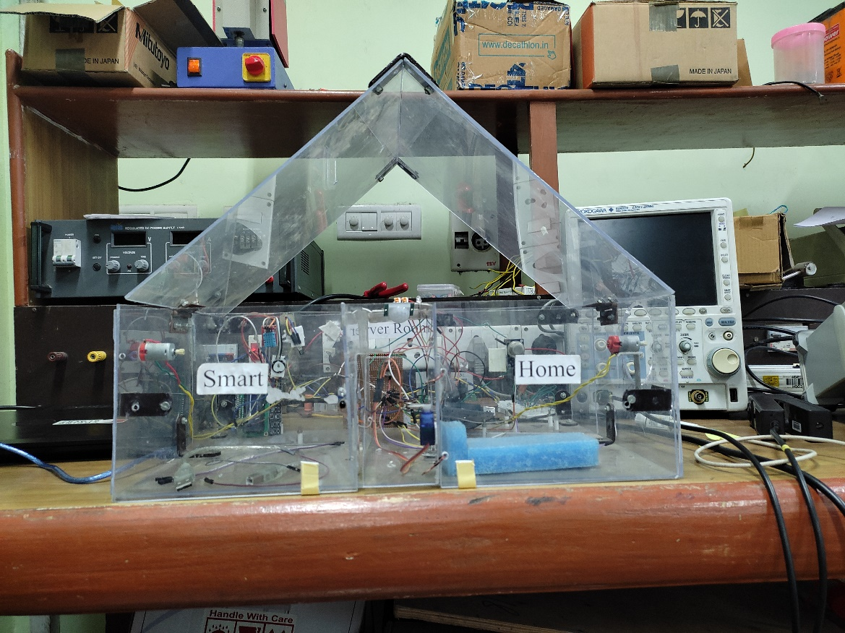
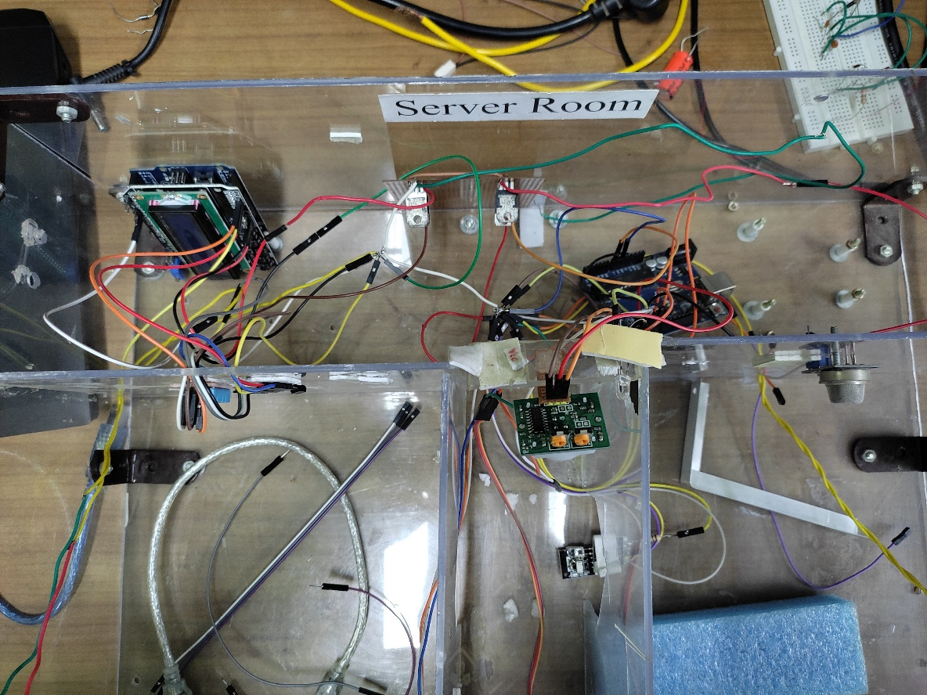
Hardware Implementation
Fig: 1 Complete implementation of the Smart Home
Fig: 2 Internal Circuits.

Slide 6
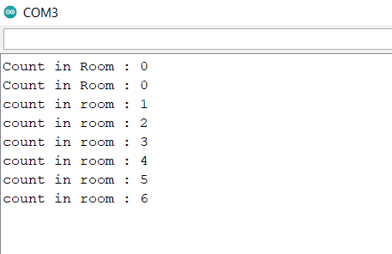
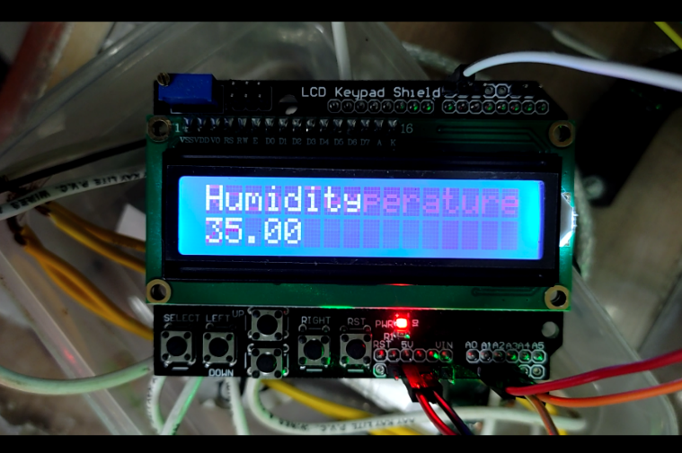
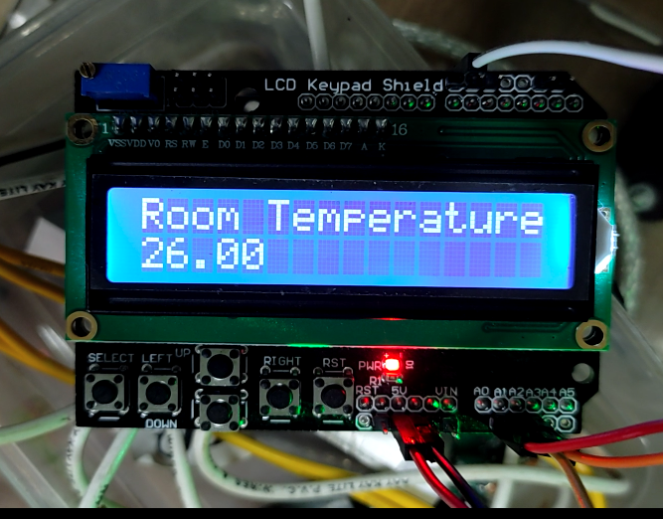
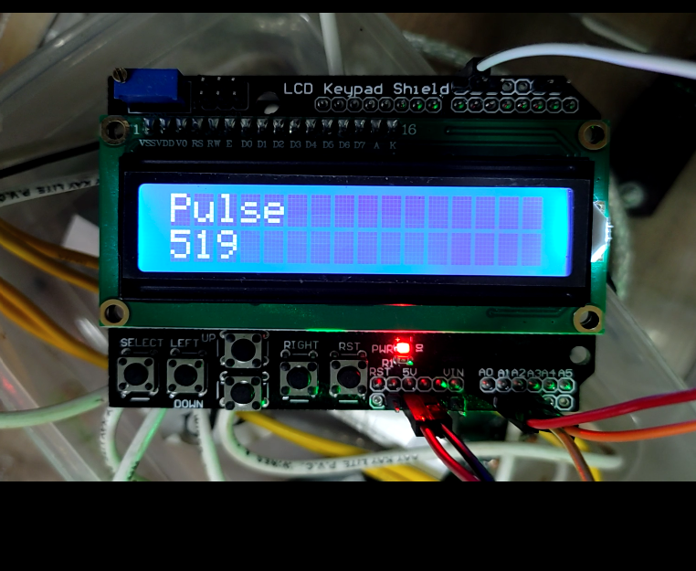
Results
Fig: 3 Representing a number of individuals present in the house.
Fig: 4 Reading humidity on the LCD
Fig: 5 Reading pulse on the LCD
Fig: 5 Reading pulse on the LCD

Slide 7
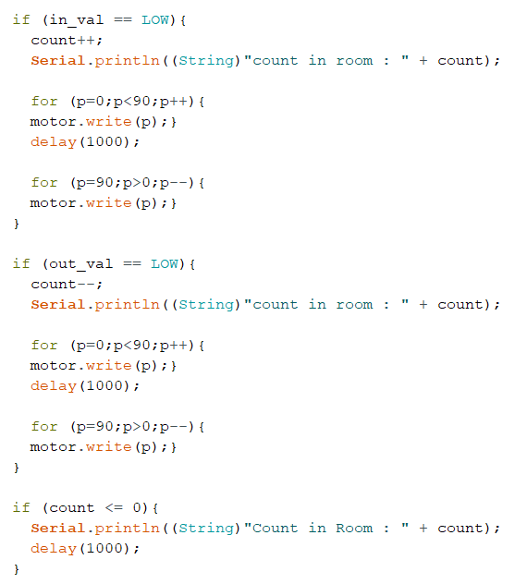
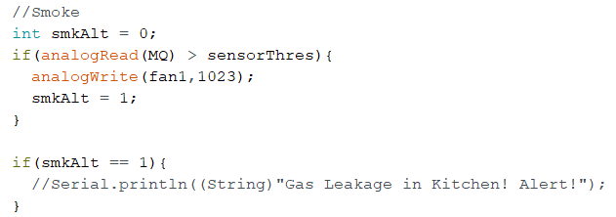
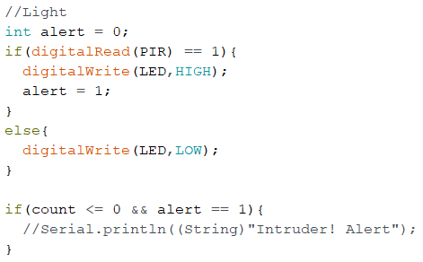
Code snippet
Gas Leakage Alert to owner
Individuals Present Inside Room
Light Control in the corridor.

Slide 8
Thank you

