Slide 1

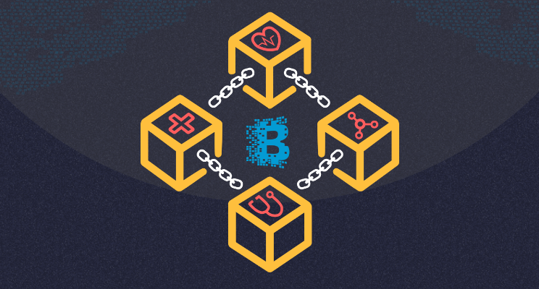
GIET UNIVERSITY, GUNUPUR
SCHOOL OF COMPUTER SCIENCE & ENGINEERING
MAJOR PROJECT REPORT
ON
IMPLEMENTATION
OF
BLOCKCHAIN ARCHITECTURE
MENTOR:-
GROUP MEMBERS:-
HRITIK KUMAR
SURENDRA BISOYI
AISHIK BHATTACHARJEE
A LAKSHMI NARASIMHA
Dr. Raghavendra Kumar
raghvendra@giet.edu

Slide 2
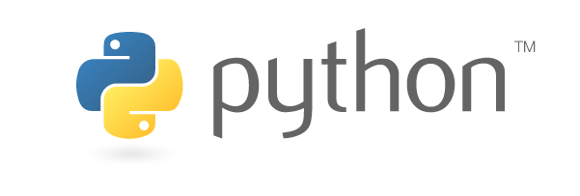
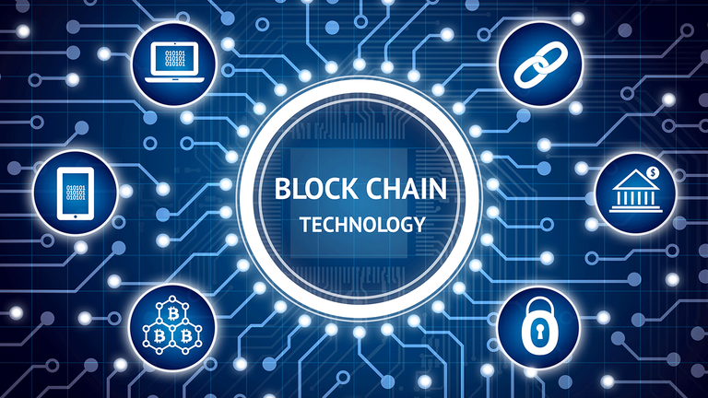

TECHNOLOGY STACK
PYTHON3 LANGUAGE
BLOCKCHAIN
FLASK

Slide 3
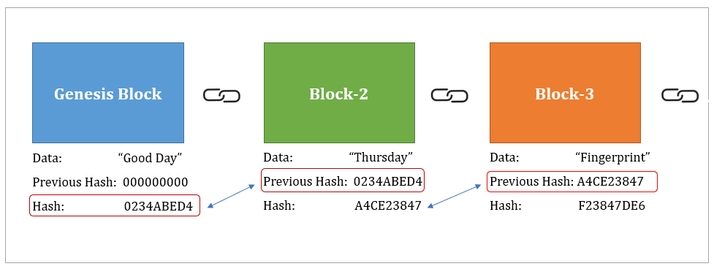
INTRODUCTION
A Blockchain is a continuously growing list of records called blocks, which are linked and secure using Cryptography.
Each Block has
Data
Hash
Hash of the previous block
What is Blockchain?
Key Points of Blockchain
Genesis Block: The first block in the chain is called the Genesis block. Each new block in the chain is linked to the previous block.

Slide 4
SHA256 – Hash:
A cryptographic hash (sometimes called ‘digest’) is a kind of ‘signature’ for a text or a data file. SHA-256 generates an almost-unique 256-bit (32-byte) signature for a text.
A block also has a hash. It can be understood as a fingerprint which is unique to each block. It identifies a block and all of its contents, and it's always unique, just like a fingerprint. So once a block is created, any change inside the block will cause the hash to change.
Immutable Ledger:
The word Immutable means “cannot be changed.” Therefore an Immutable Ledger is a record that cannot be changed.
In the digital age we need data security and proof that the data has not been altered -- that’s the only way we can trust the digital data.
P2P Distributed Networks:
Blockchain is the concept of a P2p distributed network. This is the physical architecture that allows Blockchain to work and provides a blockchain with redundancy.

Slide 5
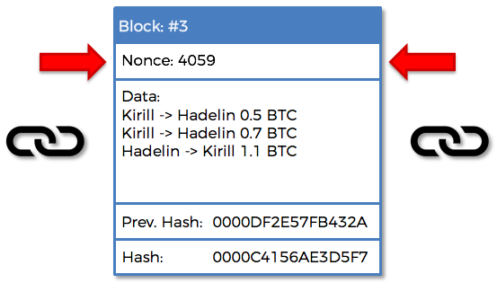
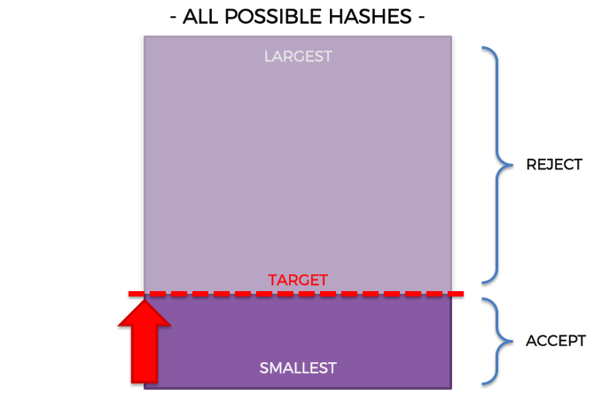
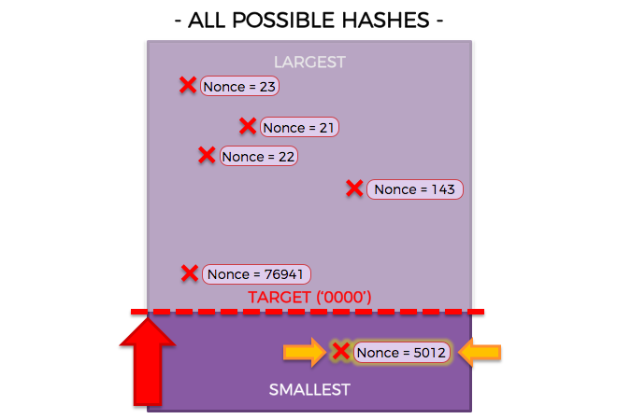
Consensus Algorithm:
A consensus algorithm is a mechanism in computer science used to establish agreement on a single data value across distributed processes or systems. A consensus algorithm is a protocol through which all the parties of the blockchain network come to a common agreement (consensus) on the present data state of the ledger and be able to trust unknown peers in a distributed computing environment.
How Mining Works?
Mining, at its simplest form, just means successfully adding a new block to the blockchain.

Slide 6
BLOCKCHAIN TECHNOLOGY BENEFITS
Better Transparency
With blockchain, an organization can go for a complete decentralized network where there is no need for a centralized authority, improving the system’s transparency.
Enhanced Security
Blockchain networks are also immutable, which means the data, once written, cannot be reverted by any means. This is also the right choice for systems that thrive on immutable data, such as systems that citizens age.
Reduced Costs
By using blockchain, organizations can bring down a lot of costs associated with 3rd party vendors and there is less interaction needed when it comes to validating a transaction.
True Traceability
With blockchain, the supply chain becomes more transparent than ever. It enables every party to trace the goods and ensure that it is not being replaced or misused during the supply chain process.
Improved Speed and Highly Efficient
Blockchain solves the time-consuming process and automates them to maximize efficiency. It also eradicates human-based errors with the help of automation.

Slide 7
USE CASES OF BLOCKCHAIN
Money Transfer
Personal Identity Security
Digital Media
Internet of Things(IoT)
Smart Contracts

Slide 8
CREATION OF BLOCKCHAIN USING PYTHON
Mining a new Block:
The mining of the new block is done by finding the answer to the proof of work.
To make mining hard the proof of work must be hard enough to get exploited.
Mining a new Block means successfully adding a new block to the Blockchain.
We keep iterating the nonce until you get the hash below the target.
Once nonce gets below the target the block gets accepted.

Slide 9
Displaying a Block:
The data will be stored and displayed in JSON format which is very easy to implement and easy to read.
Each Block contains multiple transaction/data.
Each and every minute multiple block are added and to differentiate one from other we will use fingerprinting.
The fingerprinting is done by using hash and to be particular we will use the SHA256 hashing algorithm.
Every block will contain its own hash and also the hash of the previous function so that it cannot get tampered.
This fingerprinting will be used to chain the blocks together.

Slide 10
Checking the Validity of the Block:
After mining several blocks the validity of the chain must be checked in order to prevent any kind of tampering with the blockchain.
If the blockchain shows invalid as a output it means that tampering of blockchain has been done.
If the blockchain shows valid as a output it means that no tampering of blockchain has been done.
Then the web app will be made by using Flask and deployed locally.
Now by HTTP request we call the different GET method and display the output.

Slide 11
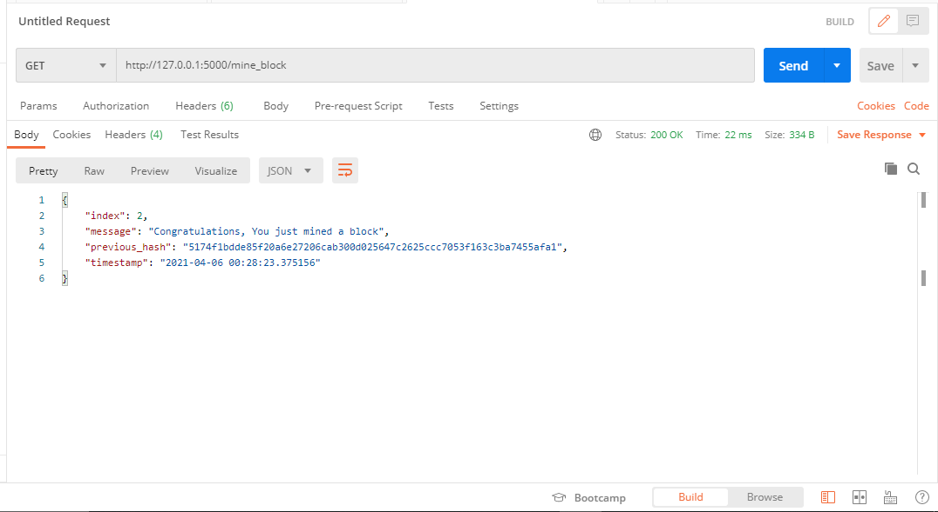
SNAPSHOT OF OUTPUT-1
In this image, we have mined the first block of the blockchain using “mine_block” HTTP request.

Slide 12
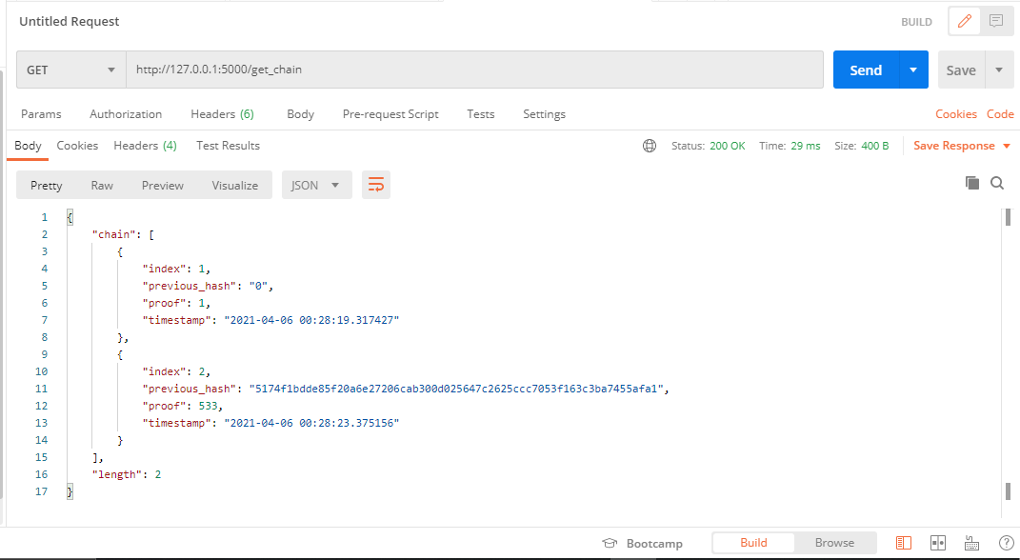
SNAPSHOT OF OUTPUT-2
In this image, we are displaying the Genesis Block and first block which he have mined previously using “get_chain” HTTP request.

Slide 13
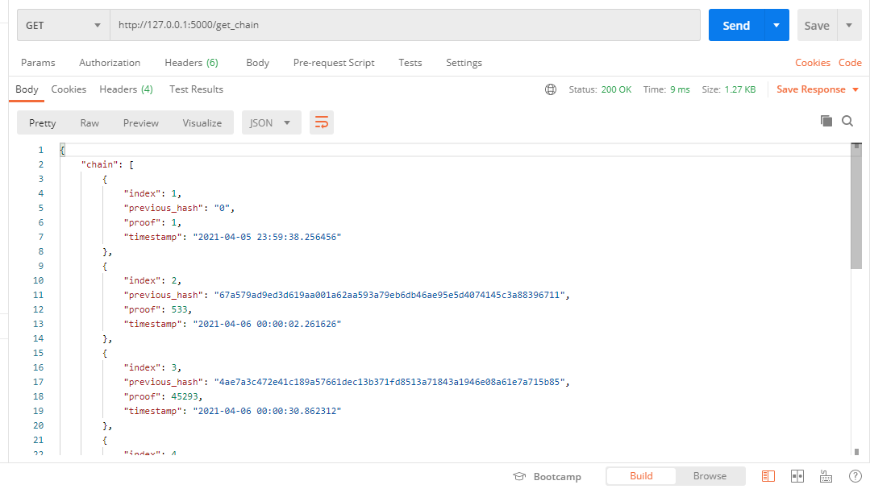
SNAPSHOT OF OUTPUT-3
In this image, we are displaying the N number of Blocks in a blockchain using “get_chain” HTTP request .

Slide 14
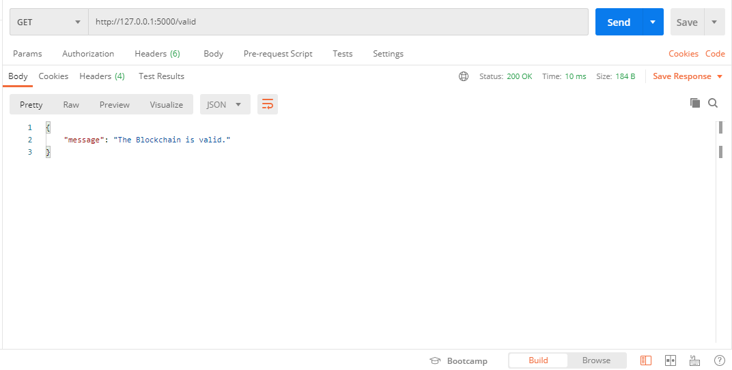
SNAPSHOT OF OUTPUT-4
In this image, we are verifying the blockchain is valid or not as it get linked up using Hashing algorithm using “valid” HTTP request.

Slide 15
Thank You..!!

