Slide 1

Predict Income
Data analysis on the “adult” dataset set archived in the UCI Machine Learning Repository.

Slide 2
About the dataset ...
Area :
Dataset characteristics :
Attribute Characteristics :
Number of Instances :
Number of Attributes :
Missing Values ? :
Date Donated :
Number of Web Hits :
Social
Multivariate
Categorical , Integral
48842
14
YES
1996-05-01
502328
Associated Tasks : Classification

Slide 3
Dataset Information :
Extraction was done by Barry Becker from the 1994 Census database. A set of reasonably clean records was extracted using the following conditions:
((AAGE>16) && (AGI>100) && (AFNLWGT>1)&& (HRSWK>0))
Prediction task is to determine whether or not a person makes over 50K a year.

Slide 4
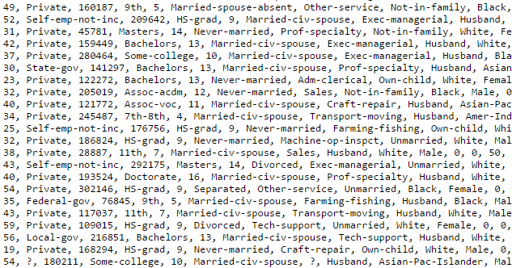
Preview

Slide 5
Attribute Information
Categorical
workclass
education
Continuous
capital-gain
capital-loss
marital-status
occupation
relationship
race
sex
native-country
fnlwgt
education-num
hours-per-week

Slide 6
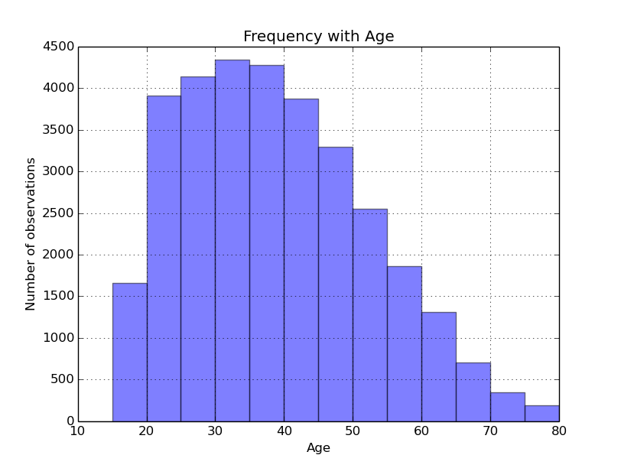
Some insight into the dataset ...

Slide 7
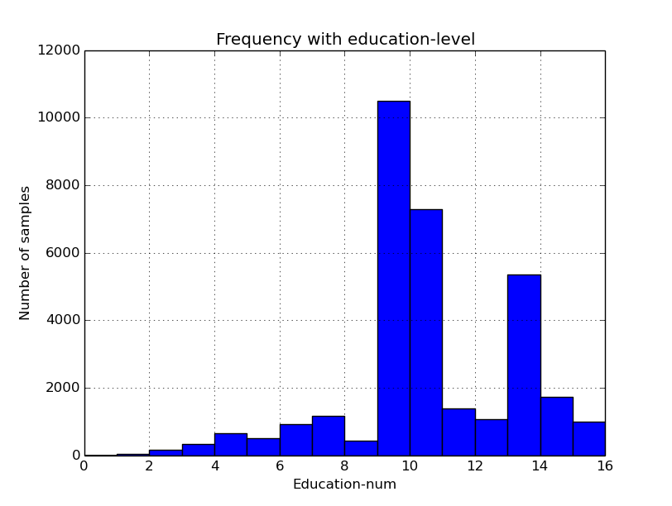

Slide 8
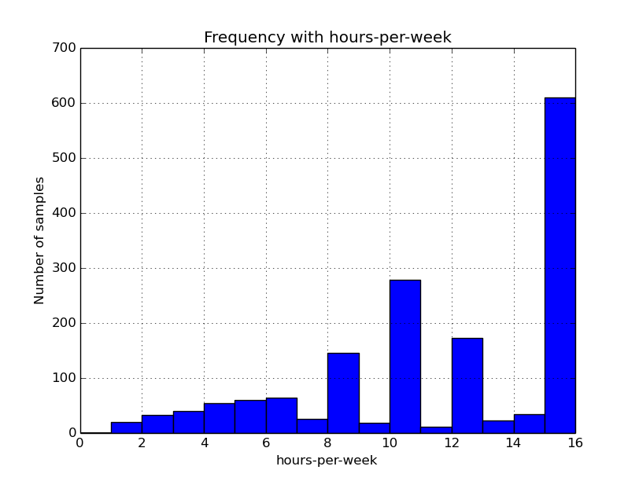

Slide 9

Choosing a classifier
Naive Bayes
k-Nearest Neighbours
Logistic Regression
SVMs
Decision Trees

Slide 10
Of course, if you really care about accuracy, your best bet is to test out a couple different ones (making sure to try different parameters within each algorithm as well), and select the best one by cross-validation.
But if you’re simply looking for a “good enough” algorithm for your problem, or a place to start, here are some general guidelines which have been found to work well over the years ...

Slide 11
How large is your training set?
If your training set is small, high bias/low variance classifiers (e.g., Naive Bayes) have an advantage over low bias/high variance classifiers (e.g., kNN), since the latter will overfit.
But low bias/high variance classifiers like kNN start to win out as your training set grows (they have lower asymptotic error), since high bias classifiers aren’t powerful enough to provide accurate models.

Slide 12
What do we have ?
We have a fairly large dataset , so kNN is an obvious choice .
Slight interactions exist between features .

Slide 13
Advantages of Naive Bayes
Super simple, you’re just doing a bunch of counts.
If the NB conditional independence assumption actually holds, a Naive Bayes classifier will converge quicker than discriminative models like logistic regression, so you need less training data.
And even if the NB assumption doesn’t hold, a NB classifier still often does a great job in practice.
Its main disadvantage is that it can’t learn interactions between features.

Slide 14
Advantages of Decision Trees
Easy to interpret and explain.
They easily handle feature interactions and they’re non-parametric,
So we don’t have to worry about outliers or whether the data is linearly separable.

Slide 15
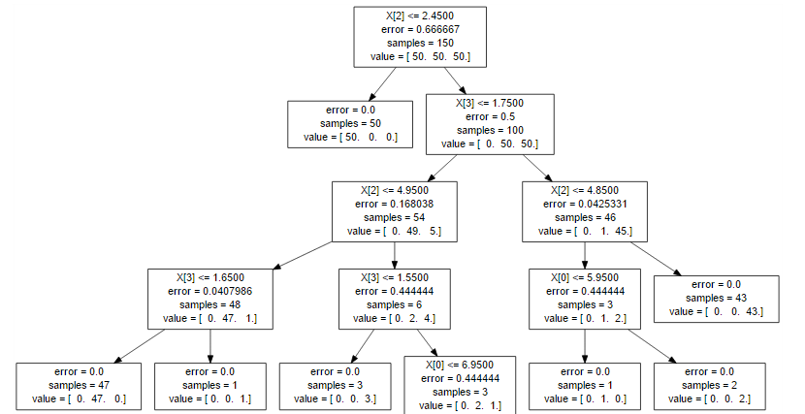
A decision tree example

Slide 16
Evaluating the performance of the three classifiers ....
The SciKit–Learn Library (A Machine Learning toolkit written in python )was used to implement the models for each class .
The training set was divided into a train-set and a cross-validation set in the ratio of 2:1 .

Slide 17
1.Decsion tree classifier

Slide 18
Performance
The decision tree classifier did well on the cross-validation set.
The classifier did not perform very well on the test set .
The decision tree classifier is prone to overfitting which was probably the case here.

Slide 19

2.Naive Bayes Classfier
Some points to be considered while implementing Naive Bayes Classification :
For categorical type features , Multinomial Naive Bayes is used ,which implements the naive Bayes algorithm for multinomially distributed data, and is one of the two classic Naive Bayes variants used in text classification.
For continuous type features , Gaussian Naive Bayes is used , where the likelihood of the features is assumed to be Gaussian
Since SciKit-Learn does not provide functionality to implement Naive Bayes on mixed-type data (continuous as well as categorical) , the model had to be implemented manually.

Slide 20
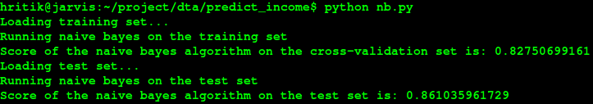
Performance of Naive Bayes
Performed well on cross-validation set .
Performed even better on the test-set .
Despite not being able to learn interactions among features like decision trees , the naive bayes algorithm performed decently well on the dataset.

Slide 21
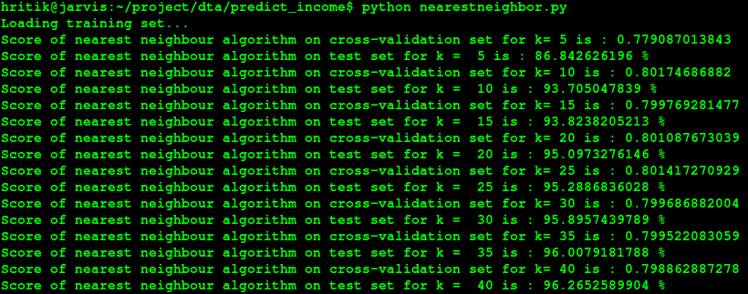
k - Nearest Neighbours
In the range of 5 to 40 for the parameter k (no. of neighbours to be taken for prediction) , the best accuracy was achieved with k in the range 30 to 40.

Slide 22
Performance of k-Nearest Neighbours
The classifier performed fairly well on the cross-validation set .
It performed remarkably on the test set !
Due to the large size of the dataset , the kNN classifier, had the best-fit model for the dataset among the three classifiers, and outperformed them with considerable margins.

Slide 23
Thank you.

