Slide 1
Twitter Sentiment Analysis

Slide 2


RNS INSTITUTE OF TECHNOLOGY
BENGALURU - 98
DEPARTMENT OF INFORMATION SCIENCE & ENGINEERING
Presentation on Internship
TWITTER SENTIMENT ANALYSIS
Catherine Winslet
1RN16IS024
Under the guidance of
Mrs. Vanishri V S
Asst. Prof, Dept. of ISE, RNSIT

Slide 3
Agenda
Abstract
About the Company
Introduction
Literature Survey
Requirements
Design
Approach
Implemented Method
Conclusion and Future Enhancements
References

Slide 4
Abstract
In today’s day and age, brands of all shapes and sizes have meaningful interactions with customers, leads, and even competition on social networks like Facebook, Twitter, and Instagram.
Sentiment analysis is a machine learning technique that detects polarity (e.g. a positive or negative opinion) within text, whether a whole document, paragraph, sentence, or clause.

Slide 5
Company
Vision Digital India in association with Imperial Group inspired to provide digital, analytical and app developing skills in the present generation to meet the corporate needs.
Vision Digital India’s vision is to offer first in its kind of most innovative programs on Digital Marketing and started this journey with the interaction of college students across India on topic “Digital Marketing –Future”
This company provide the best information to the Students, encouraging them to learn, understand and perform better and always strive our best to provide the strategic development programs as per the latest trends in Digital Marketing.

Slide 6
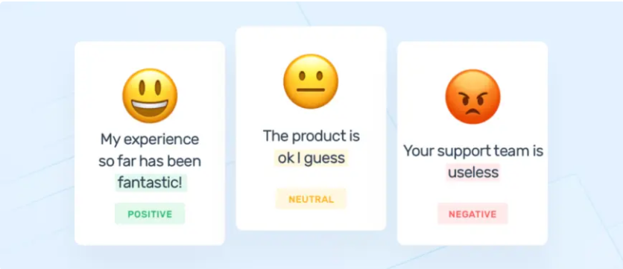
Introduction
Sentiment analysis is the interpretation and classification of emotions (positive, negative and neutral) within text data using text analysis techniques. Sentiment analysis tools allow businesses to identify customer sentiment toward products, brands or services in online feedback.

Slide 7
Problem Statement
A digital journalism company is working with the twitter audience to get coverage for a certain event as the people are expressing their feelings on twitter with the hashtag of the event. But for the company, it is difficult to manually categorize tweets and emotions behind them. Our Goal is to build a system which filters the tweets based on the hashtags of that event, classify them and provide us a general analysis of what the people are feeling about that event.

Slide 8
Objective
This type of sentiment analysis aims at detecting emotions, like happiness, frustration, anger, sadness, and so on. Many emotion detection systems use lexicons (i.e. lists of words and the emotions they convey) or complex machine learning algorithms.
It’s estimated that 80% of the world’s data is unstructured, in other words it’s unorganized. Huge volumes of text data (emails, support tickets, chats, social media conversations, surveys, articles, documents, etc), is created every day but it’s hard to analyze, understand, and sort through, not to mention time-consuming and expensive.
Understanding people’s emotions is essential for businesses since customers are able to express their thoughts and feelings more openly than ever before. By automatically analyzing customer feedback, from survey responses to social media conversations, brands are able to listen attentively to their customers, and tailor products and services to meet their needs.

Slide 9
Literature Survey
Hassan Saif, Yulan He and Harith Alani, Knowledge Media Institute, The Open University, United Kingdom in a paper Semantic Sentiment Analysis of Twitter in Nov 2012 they have introduce a novel approach of adding semantics as additional features into the training set for sentiment analysis. For each extracted entity (e.g. iPhone) from tweets, we add its semantic concept (e.g. “Apple product”) as an additional feature, and measure the correlation of the representative concept with negative/positive sentiment.
Subhabrata Mukherjee1, Akshat Malu1, Balamurali A.R.12, PushpakBhattacharyya1,1Dept. of Computer Science and Engineering, IIT Bombay,2IITB-Monash Research Academy, IIT Bombay on a paper on TwiSent: A Multistage System for Analysing Sentiment in Twitter in Feb 2013 they have presented TwiSent, a sentiment analysis system for Twitter. Based on the topic searched, TwiSent collects tweets pertaining to it and categorizes them into the different polarity classes positive, negative and objective. However, analysing micro-blog posts have many inherent challenges compared to the other text genres.

Slide 10
Requirements
HARDWARE | SOFTWARE
Windows or Ubuntu | Python 3.0 or above
Keyboard or mouse or compatible pointing devices | Anaconda Framework and Jupyter Notebook
Nvidia 940 MX or above | Libraries: Scikit-learn Library
RAM: 8GB or above Hard disk: 20 GB or above | Twitter API

Slide 11
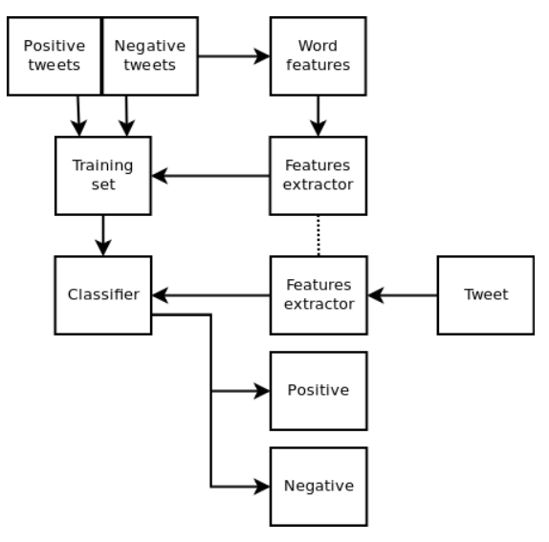
Design

Slide 12
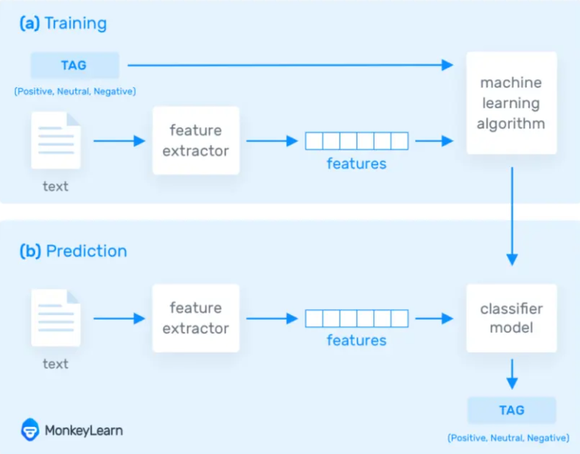
Approach
In the training process, our model learns to associate text to the corresponding output based on the test samples used for training. The feature extractor transfers the text input into a feature vector and are fed into the machine learning algorithm to generate a model.
In the prediction process, the feature extractor is used to transform unseen text inputs into feature vectors. These feature vectors are then fed into the model, which generates predicted tags.

Slide 13
DATA PRE-PROCESSING
REMOVING PUNCTUATIONS
TOKENIZATION
STEMMING & LEMMATIZATION
COUNT VECTORIZER
TFIDF TRANSFORMER

Slide 14
Implemented Methods
Decision trees
Decision tree is the most powerful and popular tool for classification and prediction. A Decision tree is a flowchart like tree structure, where each internal node denotes a test on an attribute, each branch represents an outcome of the test, and each leaf node (terminal node) holds a class label.
Decision trees perform classification without requiring much computation.
Decision trees are able to handle both continuous and categorical variables.

Slide 15

K-nearest neighbors (KNN) algorithm is a type of supervised ML algorithm which can be used for both classification as well as regression predictive problems.
K-nearest neighbors (KNN) algorithm uses ‘feature similarity’ to predict the values of new datapoints which further means that the new data point will be assigned a value based on how closely it matches the points in the training set.

Slide 16
Random Forest Classifier
Random forest, like its name implies, consists of a large number of individual decision trees that operate as an ensemble.
Each individual tree in the random forest spits out a class prediction and the class with the most votes becomes our model’s prediction.
The fundamental concept behind random forest is a simple but powerful one : A large number of relatively uncorrelated models (trees) operating as a committee will outperform any of the individual constituent models.

Slide 17
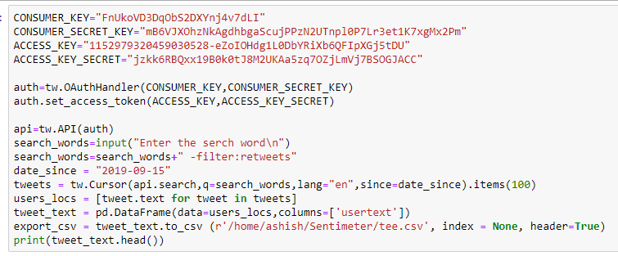
Code Snippets
Scraping the web

Slide 18
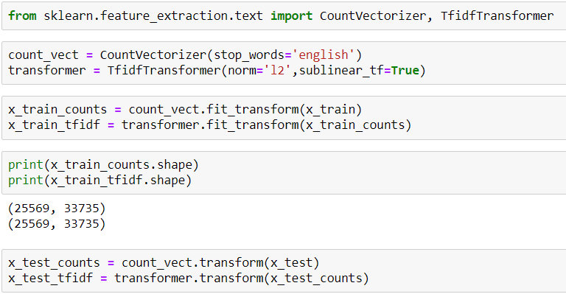
Data pre-processor

Slide 19
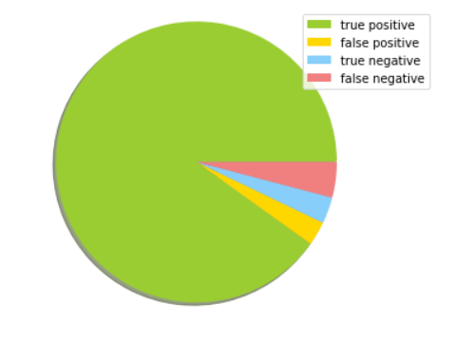
Results
DECISION TREE
Accuracy achieved = 94.19%
Confusion matrix
[[5760 177]
[ 194 262]]

Slide 20
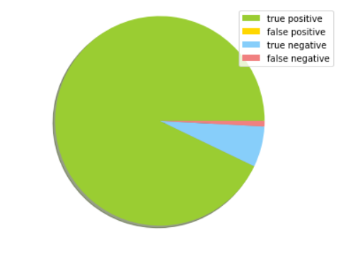
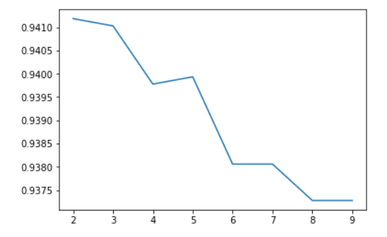
K NEAREST NEIGHBOURS
Accuracy achieved = 94.19%
Confusion matrix
[[5937 0]
[ 401 55]]

Slide 21
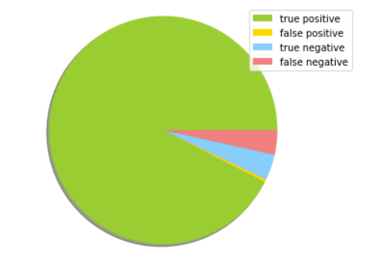
RANDOM FOREST CLASSIFIER
Accuracy Score : 95.9%
Confusion matrix:
[[5910, 27]
[ 233, 223]]

Slide 22
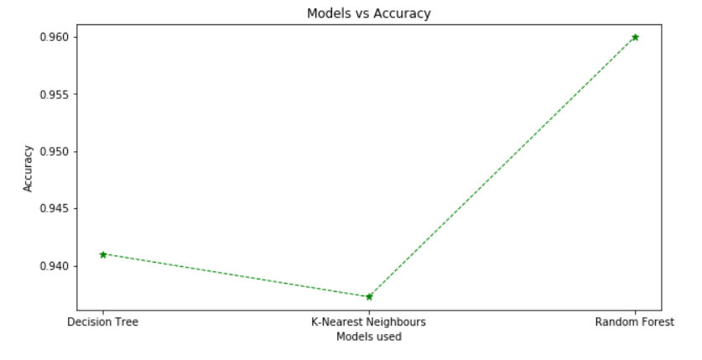

Slide 23
Conclusion
Sentiment analysis helps businesses process huge amounts of data in an efficient and cost-effective way.
Consistent criteria It’s estimated that people only agree around 60-65% of the time when determining the sentiment of a particular text. Tagging text by sentiment is highly subjective, influenced by personal experiences, thoughts, and beliefs.

Slide 24
Future Enhancements
One of the downsides of using lexicons is that people express emotions in different ways. Some may express sarcasm and irony in the statements.
Multilingual sentiment analysis.
Making the model automatic. Automatic methods, contrary to rule-based systems, don't rely on manually crafted rules, but on machine learning techniques. A sentiment analysis task is usually modeled as a classification problem, whereby a classifier is fed a text and returns a category
Can take emoticons into account to predict better.
Apart from the positive and negative category, the model could be developed to learn to classify neutral tweets.

Slide 25
Thank you

