Slide 1
Metro Station Connectivity Analysis
Using GraphX and Visualization
Lovely Professional University

Slide 2
Agenda
Problem statement and objectives
Dataset and graph modeling approach
GraphX implementation and metrics
Dashboard visualizations and insights
Limitations, future scope, and conclusion

Slide 3
Problem Statement
Metro systems are complex, interconnected transport networks.
Need to identify critical hubs, weak links, and station importance.
Traditional tabular analysis misses graph-level behavior.
Graph analytics enables scalable, data-driven network insights.

Slide 4
Project Objectives
Build directed graph from metro routes
Compute degree centrality (busiest/least connected)
Detect isolated stations
Compute PageRank for station influence
Visualize connectivity with dashboard panels
Demonstrate Random Forest traffic prediction workflow

Slide 5
Dataset Overview
Source: metro.csv
Columns: Station ID, Station Name, Metro Line, Distance, Latitude, Longitude, Layout, Opened Year
Preprocessing: numeric conversion, null removal, coordinate filtering
Station names normalized for interchange consistency

Slide 6
Methodology Pipeline
1) Read and clean station data
2) Build vertices from normalized station names
3) Build directed edges line-wise by station distance order
4) Create GraphX graph and compute degree / in-degree / out-degree
5) Run PageRank for global station influence
6) Generate dashboard and panel-wise PNG outputs

Slide 7
GraphX Implementation (Scala)
Uses Spark GraphX with hashed VertexId from normalized station key
Edge creation: consecutive station pairs per metro line
Metrics: degree centrality, in-degree, out-degree, PageRank
Outputs top busiest, least connected, isolated, and top PageRank stations
Script file: metro_gx.scala

Slide 8
Key Results Snapshot
Busiest hubs are interchange-rich stations (e.g., Kashmere Gate, Rajiv Chowk, Hauz Khas).
Least connected stations are mostly terminal/end stations.
Isolated station check reports no isolated nodes in constructed network.
PageRank highlights globally influential stations beyond local degree counts.

Slide 9
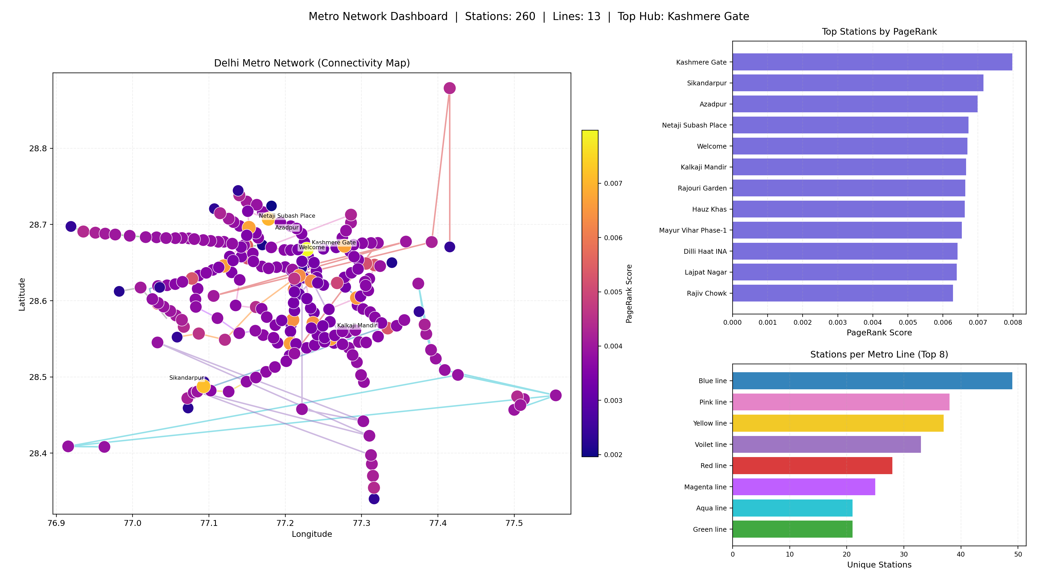
Dashboard: Combined View
Map + topology + ranking + line distribution in a single dashboard.

Slide 10
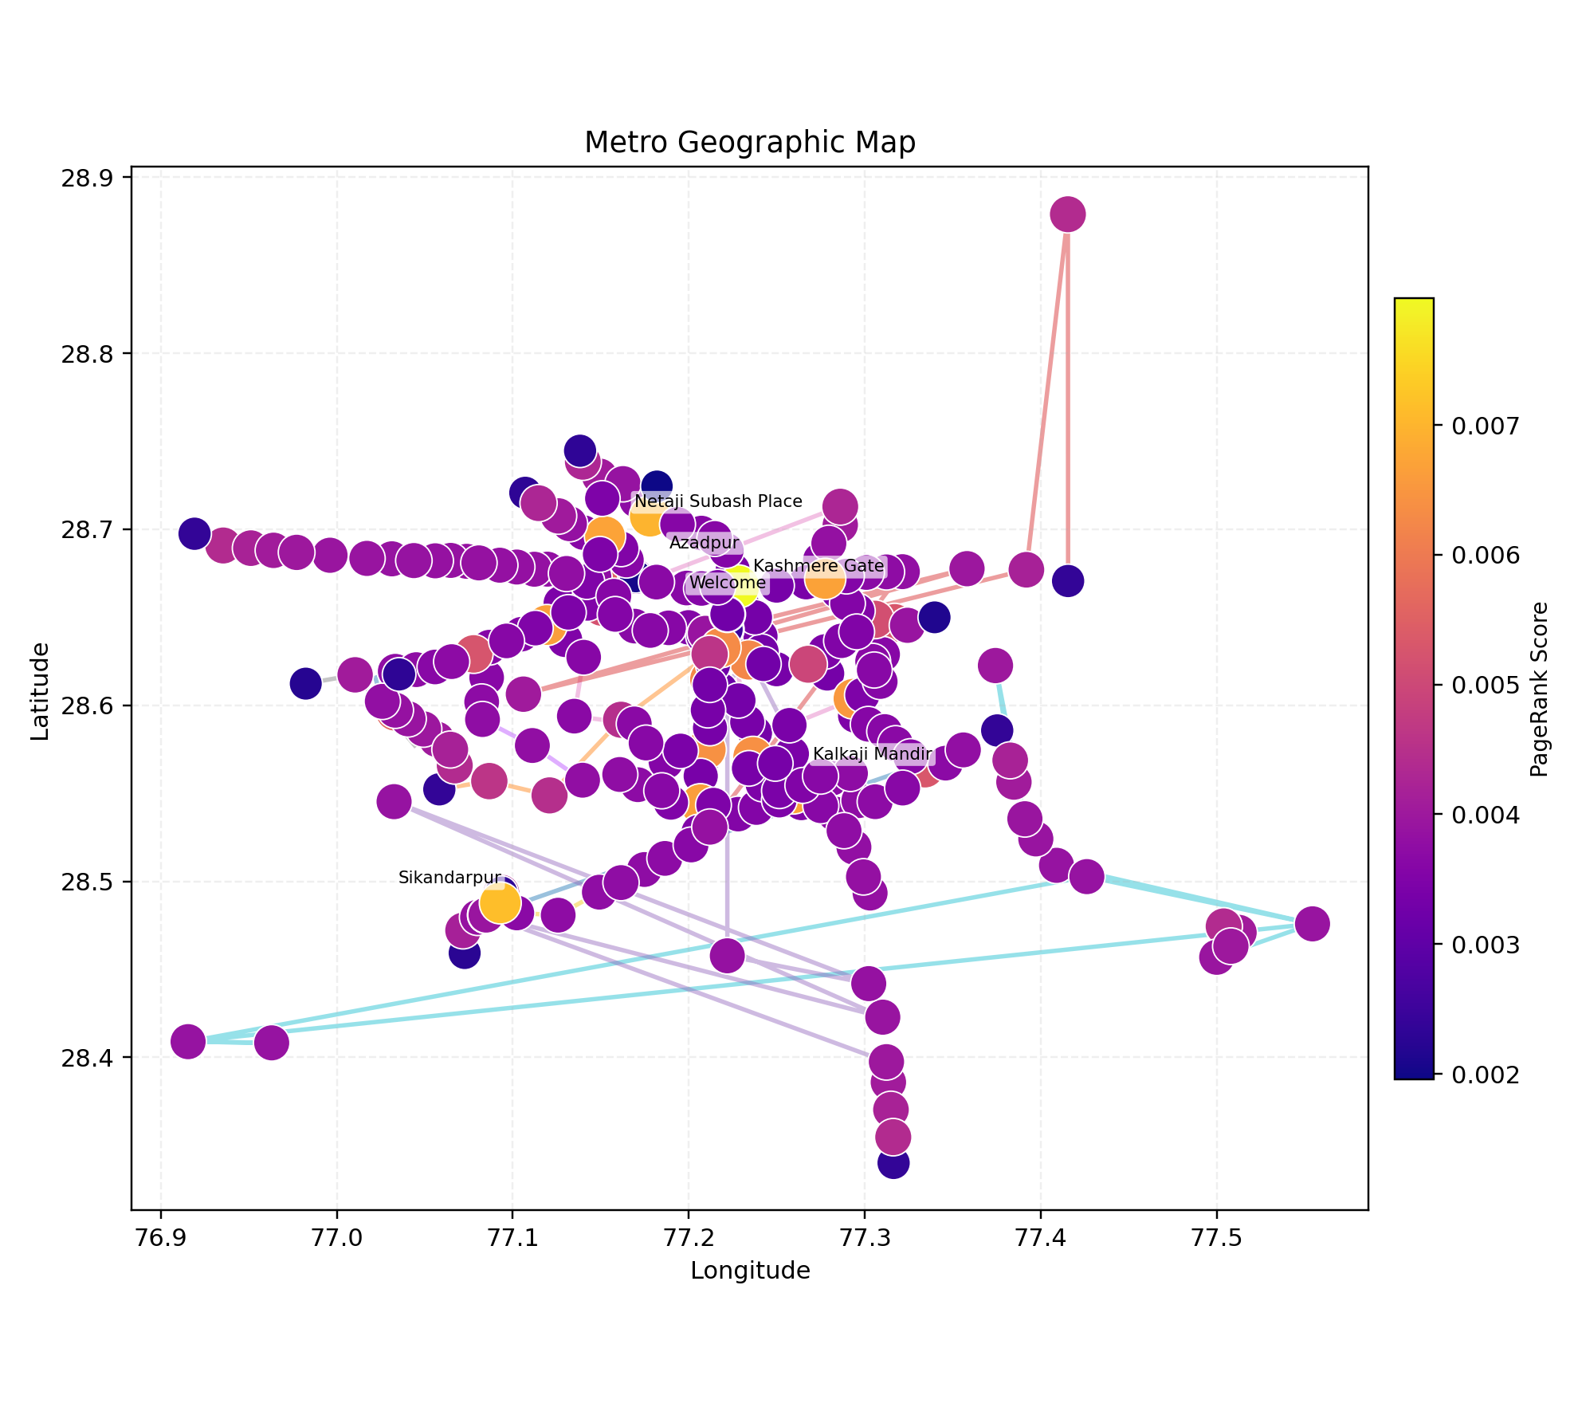
Panel 1: Geographic Network Map
Geo map with route lines and PageRank-encoded station markers.

Slide 11
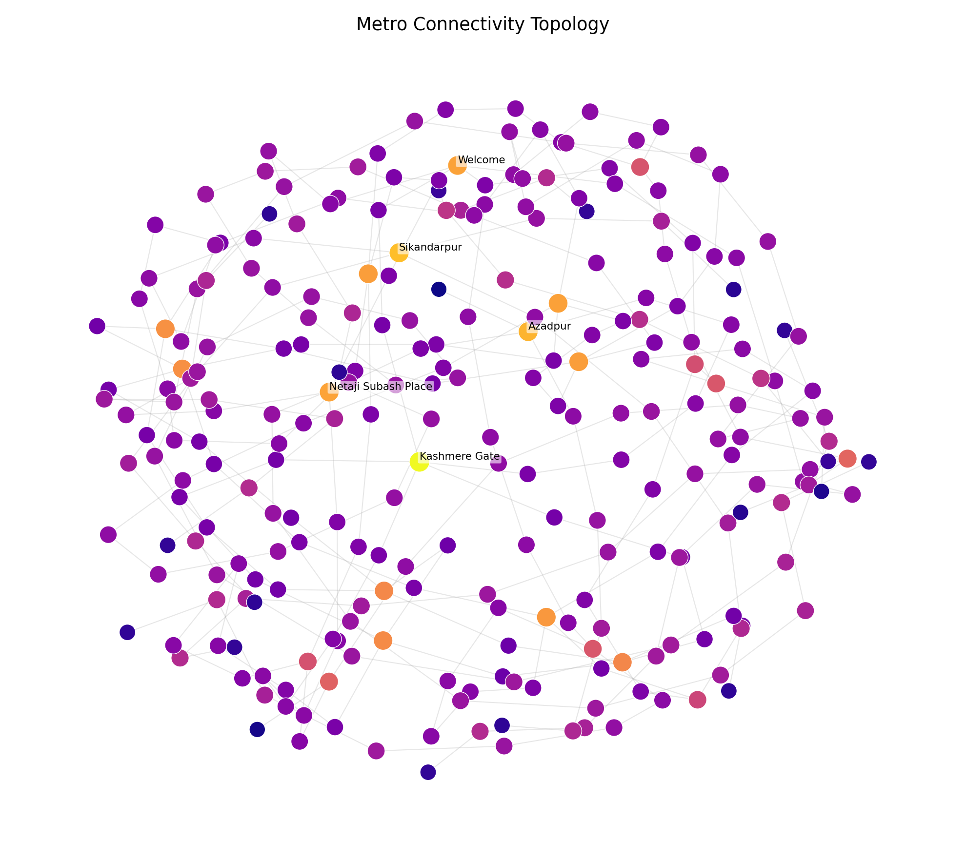
Panel 2: Connectivity Topology Graph
Non-geographic graph layout for structural connectivity interpretation.

Slide 12
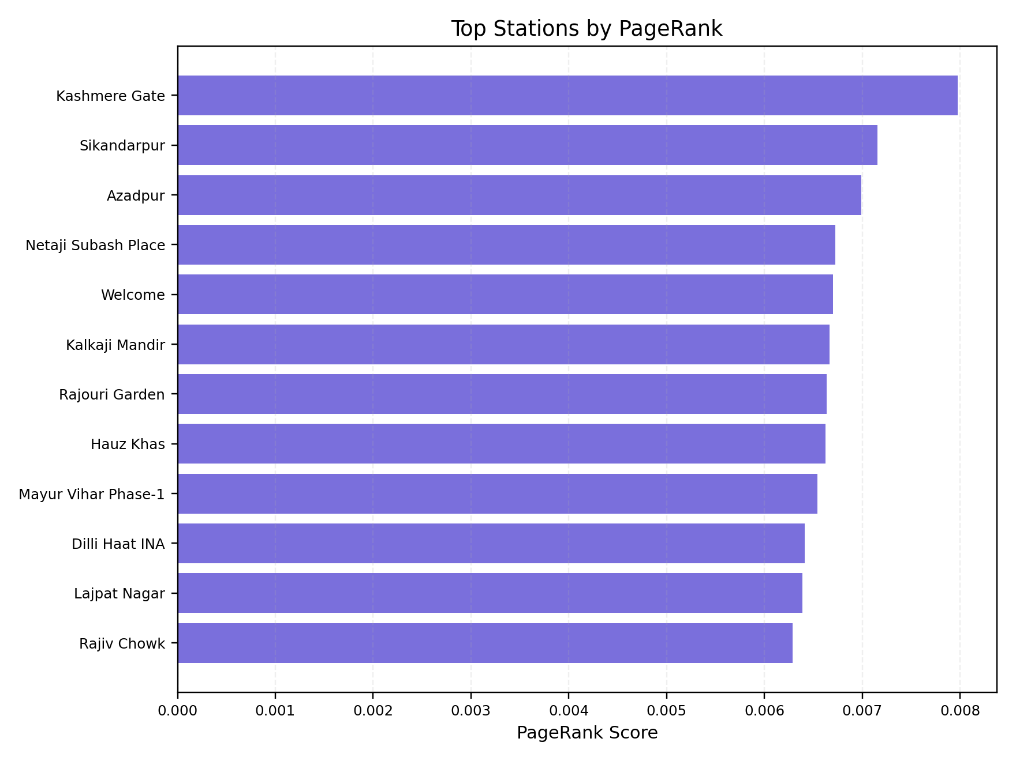
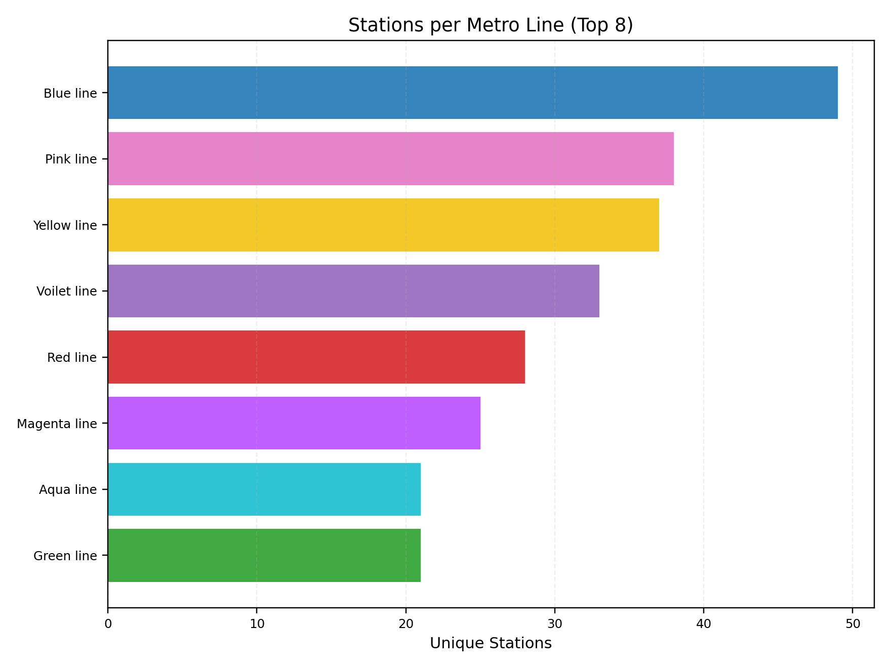
Panel 3 & 4: Ranking and Line Distribution
Top stations by PageRank.

Slide 13
Machine Learning Extension
Random Forest model uses graph-derived features: degree, in-degree, out-degree, PageRank, num_lines.
Current dataset has no real passenger labels; proxy target used for assignment demonstration.
Pipeline still demonstrates feature engineering, training, and prediction export.
Output file: station_analysis_with_predictions.csv

Slide 14
Limitations and Future Enhancements
No real-time train operations and delay feeds in current dataset
No true passenger-count labels for supervised forecasting
Future: temporal graph modeling, live data integration, demand forecasting
Future: interactive web dashboard and scenario simulation for planning

Slide 15
Conclusion
Graph-based metro analysis reveals critical stations and route structure effectively.
GraphX + visualization provides scalable and interpretable workflow.
Framework is ready for extension to real-world transport intelligence systems.

Slide 16
Thank You
Questions?
Repository: https://github.com/hritu1701/Metro-Network-Analysis

