Slide 1
TRAVEL PLANNER

Slide 2
INTRODUCTION
Basic introduction about the topic of project-
Algorithm-1 project: The Travel Planner which is based on the famous Dijkstra's Algorithm.

Slide 3
MOTIVATION
The people who travel a lot due to various reasons face a lot of problems in deciding which path is optimal for them if they are travelling from one city to another.
We have come up with a program based on Djikstra’s Algorithm which takes input as-
No. of cities
Names of these cities
Distance and Cost between each pair of cities.
It outputs the optimal path for 2 cases-
If the traveller wants to minimize the cost incurred.
If the traveller wants to minimize the distance covered.

Slide 4
FORMAL PROBLEM DEFINITION
An effective travel planner will not only save time but also will help you to spend minimum cost on travelling to your final destination through various routes and modes. A person wants to travel to destination city through various connecting or direct flights. Sometimes an indirect, connecting route is much more effective than a direct approach. Design and implement an algorithm that helps the user to travel to final destination in a cost effective and time effective manner.

Slide 5
Input specification
Enter no. of Cities: 5
Enter the cities – Delhi, Chennai, Jaipur, Mumbai etc
Enter the distance adjacency matrix: N*N Matrix
Enter the Cost adjacency matrix: N*N Matrix
Enter the starting node: u
Enter the ending node: v
Can be stored as information database and need not be directly obtained from user

Slide 6
Output specification
For minimum distance:
Total = 19 // distance
Path = gurgaon<-chennai
For minimum cost:
Total =13 // cost
Path = gurgaon<-delhi<-chennai

Slide 7
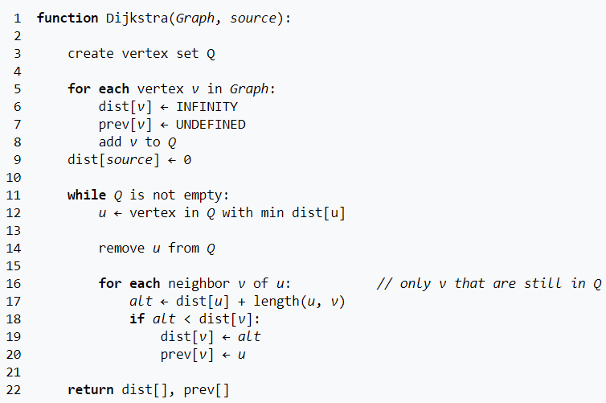
PSEUDOCODE OF THE ALGORITHM

Slide 8
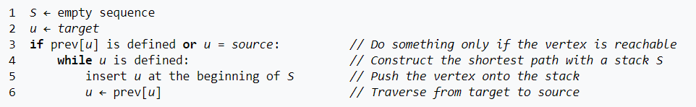
PSEUDOCODE OF THE ALGORITHM
If we are only interested in a shortest path between vertices source and target, we can terminate the search after line 15 if u = target. Now we can read the shortest path from source to target by reverse iteration:

Slide 9
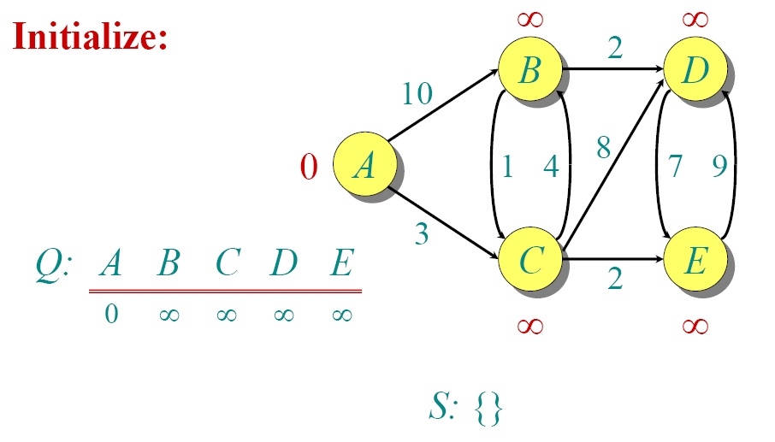
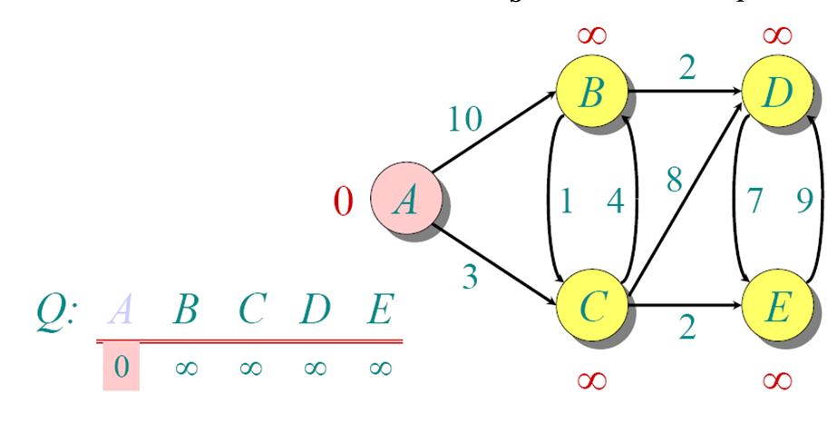
Explanation using diagrams -

Slide 10
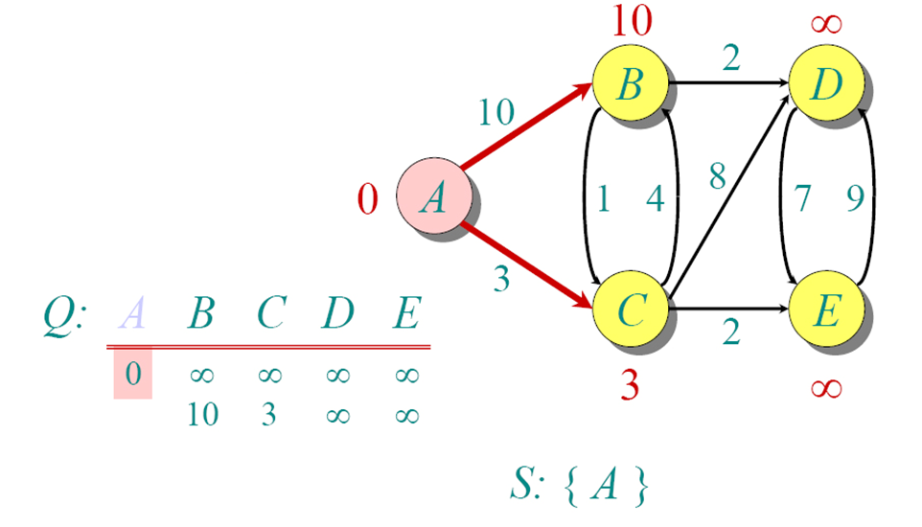
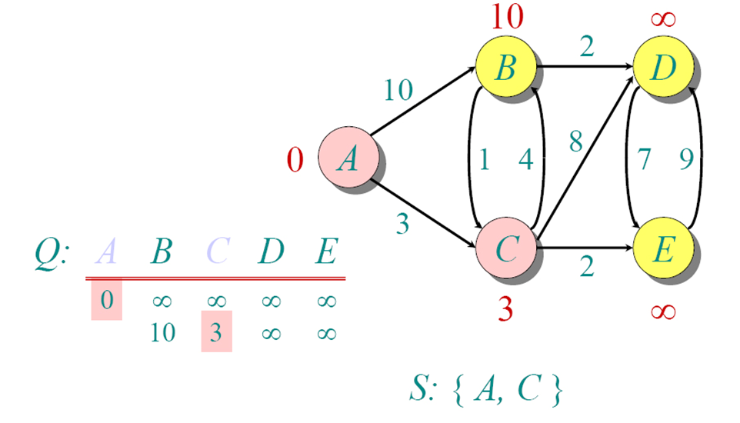

Slide 11
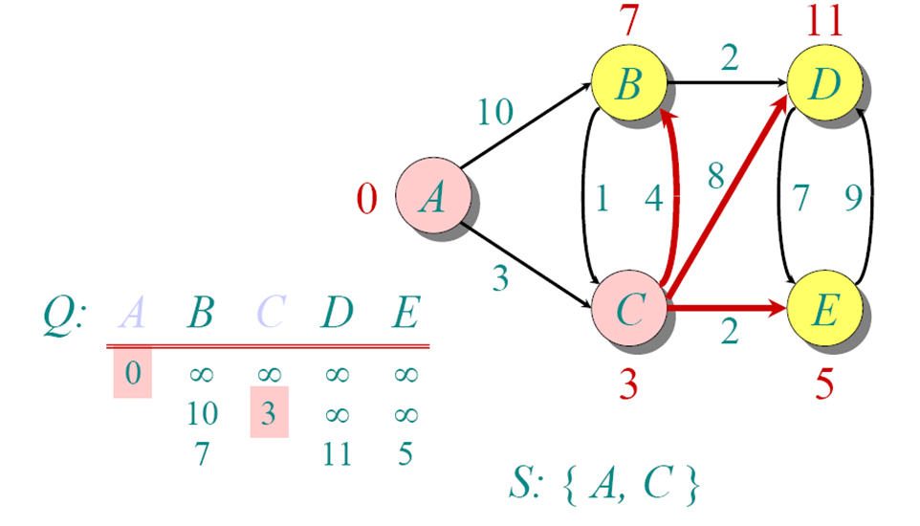
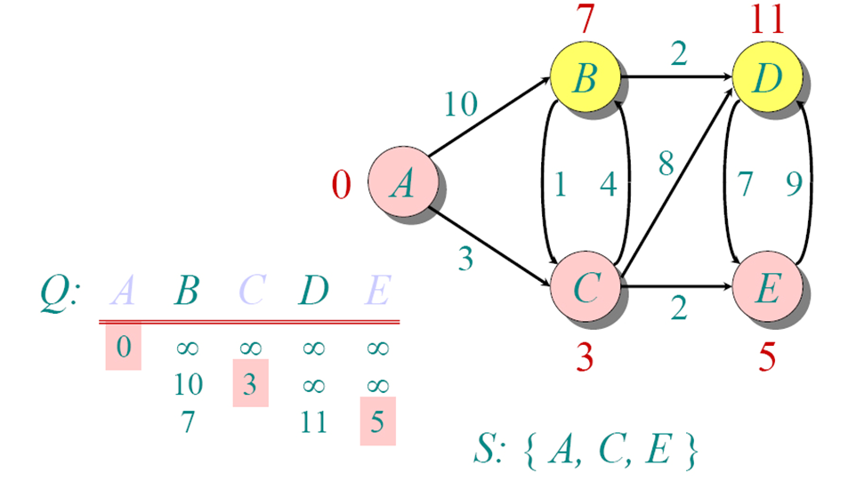

Slide 12
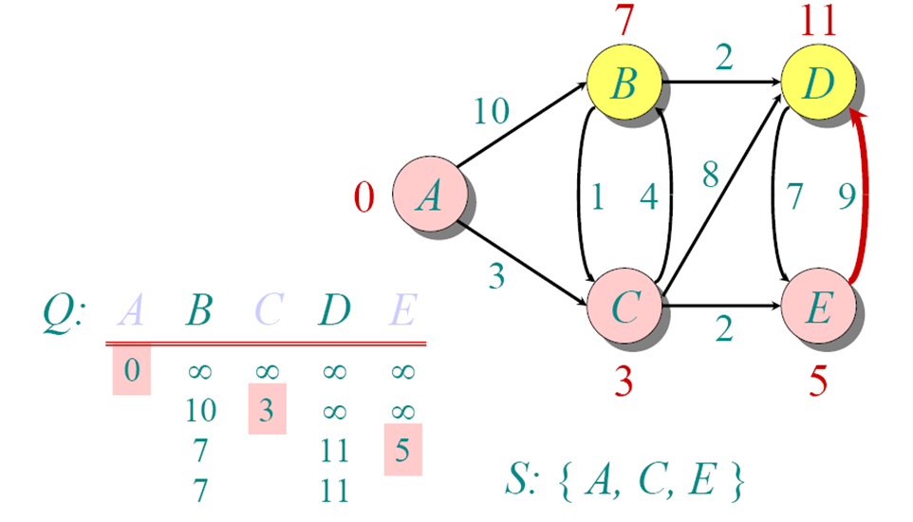
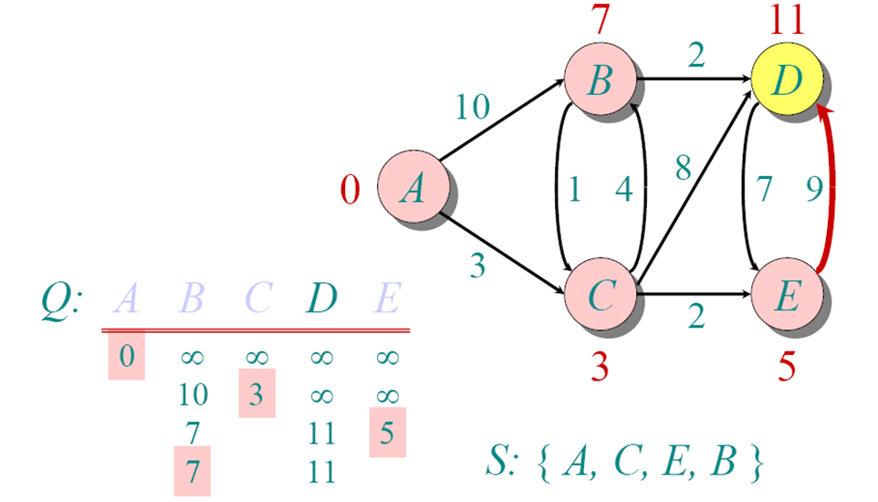

Slide 13
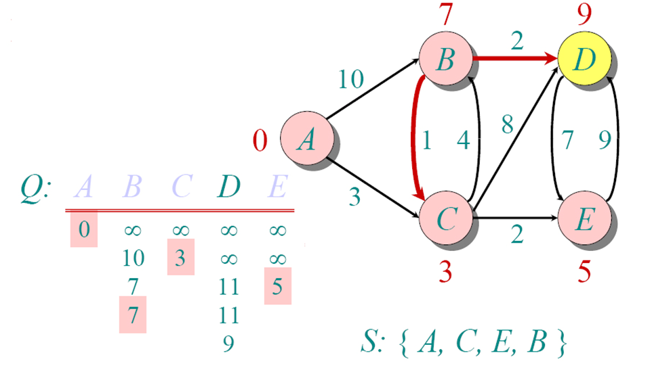
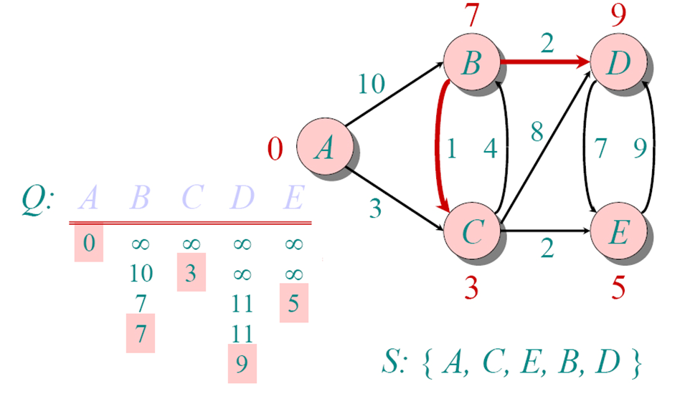

Slide 14
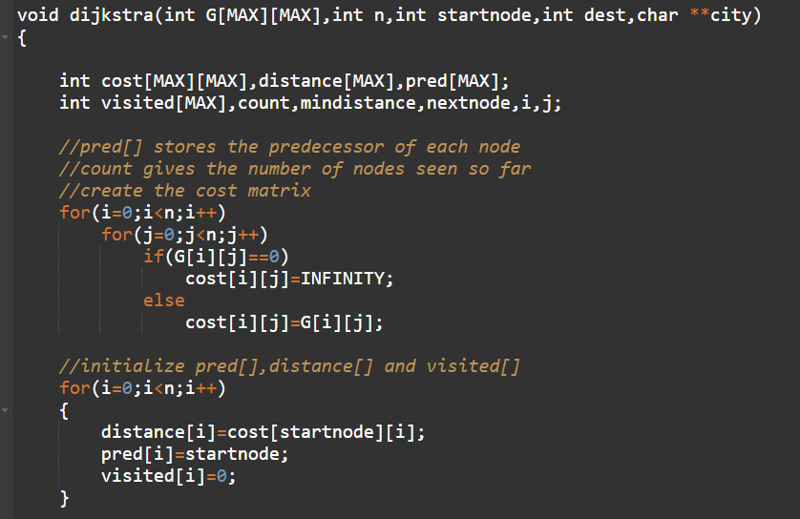
IMPLEMENTATION OF THE ALGORITHM

Slide 15
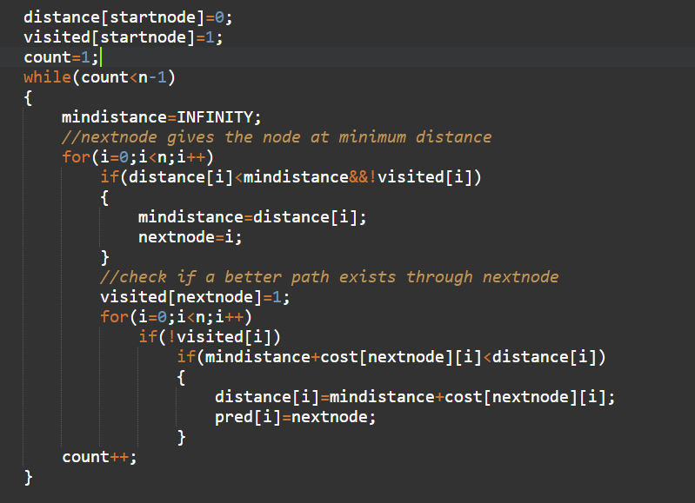
IMPLEMENTATION OF THE ALGORITHM

Slide 16
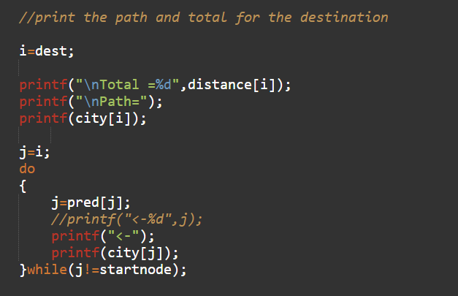
IMPLEMENTATION OF THE ALGORITHM

Slide 17
ANALYSIS OF THE ALGORITHM
The Time complexity of our program is-
O(n^2)
The Space complexity of our program is-
O(n^2)

