Slide 1
A Coalgebraic Semantics Framework for Quantum Systems
Ai Liu Meng Sun
Peking University, China
ICFEM 2019

Slide 2
Motivations
“Classical control, quantum data”
to study a variant of quantum labeled transition systems
“Universal coalgebra: a theory of systems”
to develop a coalgebraic framework for quantum transition systems

Slide 3
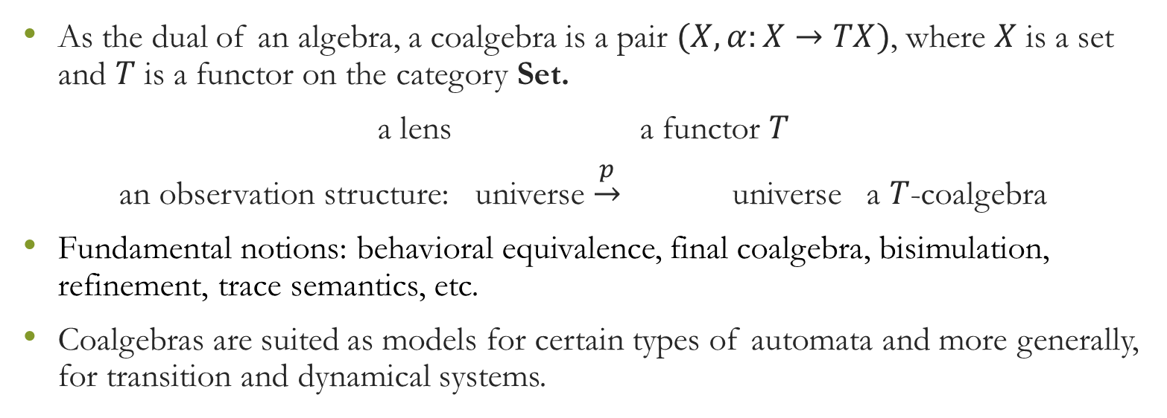
Coalgebra theory
As the dual of an algebra, a coalgebra is a pair $(X,α:X→TX)$, where $X$ is a set and $T$ is a functor on the category Set.
a lens a functor $T$
an observation structure: universe $\underset{→}{p}$ universe a $T$-coalgebra
Fundamental notions: behavioral equivalence, final coalgebra, bisimulation, refinement, trace semantics, etc.
Coalgebras are suited as models for certain types of automata and more generally, for transition and dynamical systems.

Slide 4
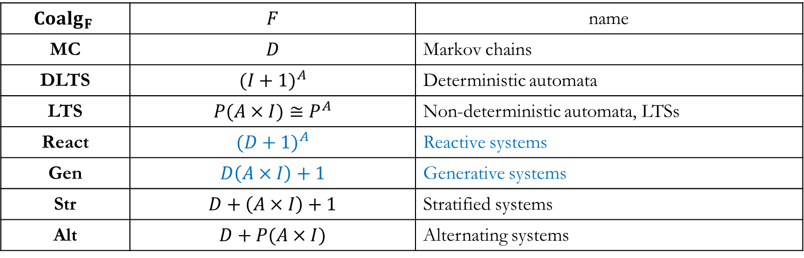
Coalgebraic analysis of probabilistic systems
$${Coalg}_{F}$$ | $$F$$ | name
MC | $$D$$ | Markov chains
DLTS | $${(I+1)}^{A}$$ | Deterministic automata
LTS | $$P(A×I)≅P^{A}$$ | Non-deterministic automata, LTSs
React | $${(D+1)}^{A}$$ | Reactive systems
Gen | $$D\left(A×I\right)+1$$ | Generative systems
Str | $$D+\left(A×I\right)+1$$ | Stratified systems
Alt | $$D+P(A×I)$$ | Alternating systems

Slide 5
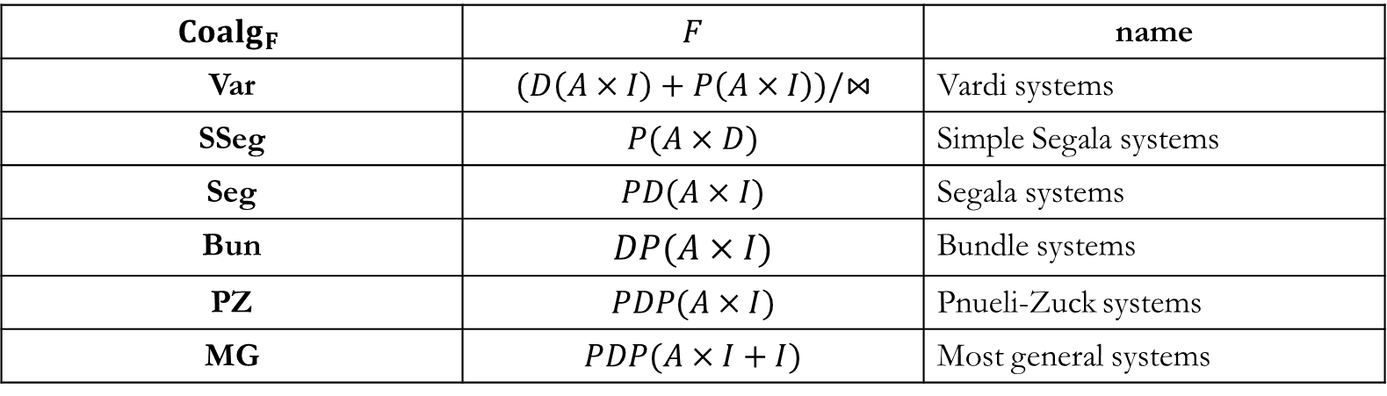
Coalgebraic analysis of probabilistic systems
$${Coalg}_{F}$$ | $$F$$ | name
Var | $$(D\left(A×I\right)+P\left(A×I\right))/⋈$$ | Vardi systems
SSeg | $$P(A×D)$$ | Simple Segala systems
Seg | $$PD(A×I)$$ | Segala systems
Bun | $$DP(A×I)$$ | Bundle systems
PZ | $$PDP(A×I)$$ | Pnueli-Zuck systems
MG | $$PDP(A×I+I)$$ | Most general systems

Slide 6
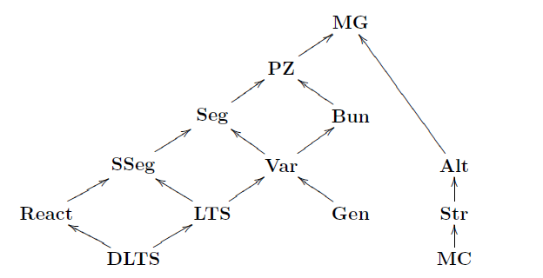
The hierarchy of probabilistic systems

Slide 7
Quantum transition systems
Quantum Turning machine
Quantum Markov chains
Quantum finite automata: MO-QFA, MM-QFA, Latvian QFA, hybrid QFA, open QFA (QFA with open time evolution), etc.
Quantum labeled transition systems (QLTS) and reactive quantum systems (RQS)
…

Slide 8
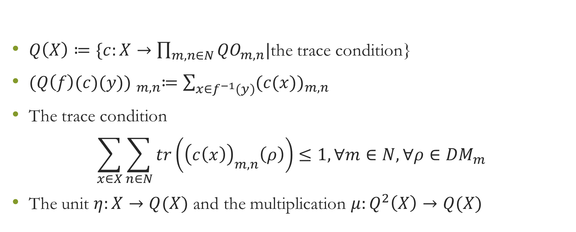
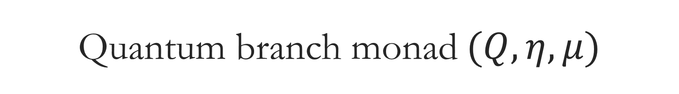
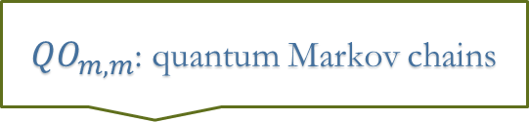
Quantum branch monad $(Q,η,μ)$
${QO}_{m,m}$: quantum Markov chains
$Q\left(X\right)≔\{c:X→\prod_{m,n∈N}{{QO}_{m,n}|}$the trace condition}
${(Q\left(f\right)(c)(y)) }_{m,n}≔\sum_{x∈f^{−1}(y)}{{(c(x))}_{m,n}}$
The trace condition
$$\sum_{x∈X}{\sum_{n∈N}{tr\left({\left(c\left(x\right)\right)}_{m,n}\left(ρ\right)\right)≤1,∀m∈N,∀ρ∈{DM}_{m}}}$$
The unit $η:X→Q(X)$ and the multiplication $μ:Q^{2}\left(X\right)→Q(X)$

Slide 9
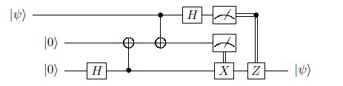

Quantum labeled transition systems
QLTS: $(X,s:1→Q\left(X\right),c:X→Q(Σ×X+1))$
The trace semantics: ${trace}_{s,c}:1→Q(Σ^{∗})$
Example: quantum teleportation protocol

Slide 10
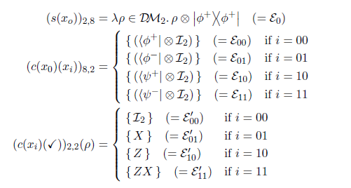
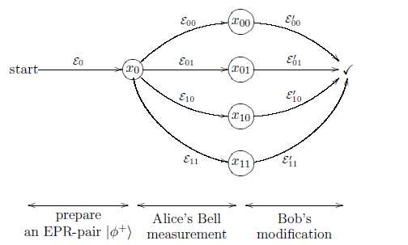
Quantum teleportation protocol

Slide 11
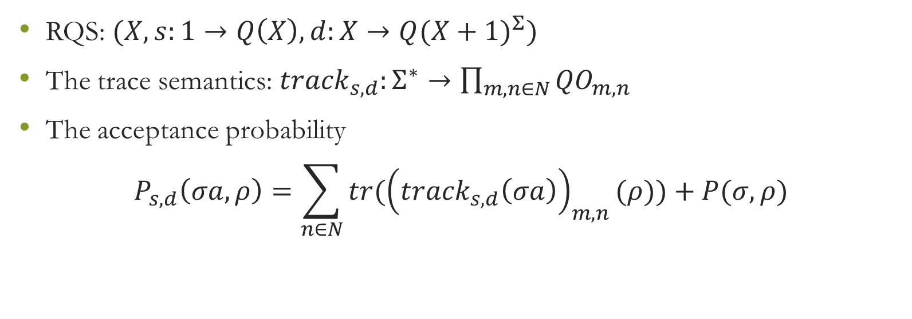
Reactive quantum systems
RQS: $(X,s:1→Q\left(X\right),d:X→{Q(X+1)}^{Σ})$
The trace semantics: ${track}_{s,d}:Σ^{∗}→\prod_{m,n∈N}{{QO}_{m,n}}$
The acceptance probability
$$P_{s,d}\left(σa,ρ\right)=\sum_{n∈N}{tr({\left({track}_{s,d}\left(σa\right)\right)}_{m,n}(ρ))}+P(σ,ρ)$$

Slide 12
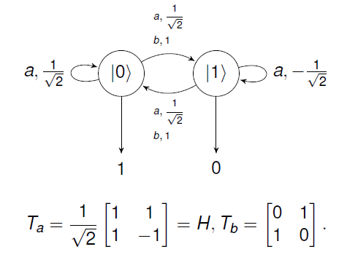
An MM-QFA

Slide 13
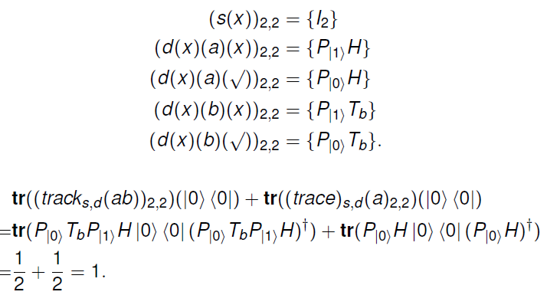
The corresponding RQS

Slide 14
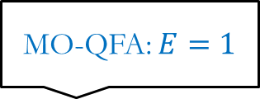
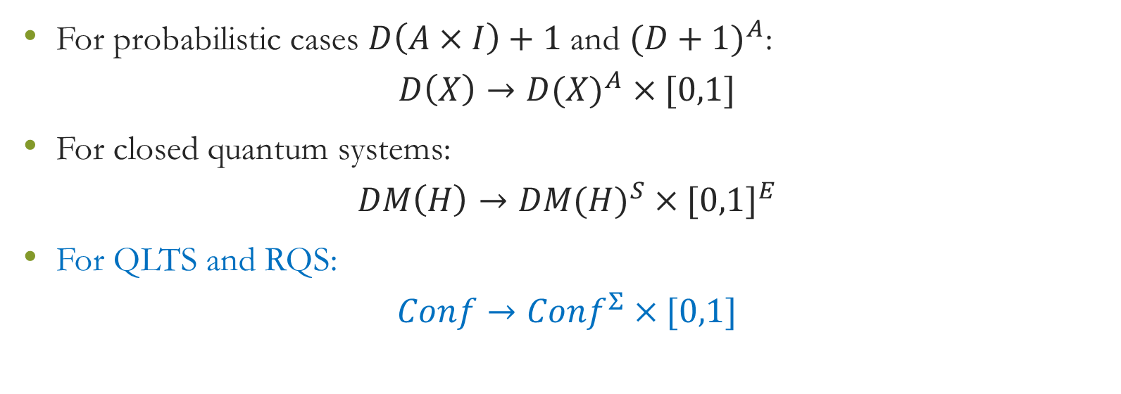
The coalgebraic perspective on the category of convex sets and convex maps
For probabilistic cases $D\left(A×I\right)+1$ and ${(D+1)}^{A}$:
$$D\left(X\right)→{D(X)}^{A}×[0,1]$$
For closed quantum systems:
$$DM\left(H\right)→{DM(H)}^{S}×{[0,1]}^{E}$$
For QLTS and RQS:
$$Conf→{Conf}^{Σ}×[0,1]$$
MO-QFA: $E=1$

Slide 15

Configurations for QLTS and RQS
For QLTS
$$Conf=\prod_{x∈X}{(\prod_{n∈N}{{DM}_{n}})}$$
For RQS
$$Conf=\prod_{x∈X∪1}{(\prod_{n∈N}{{DM}_{n}})}$$

Slide 16
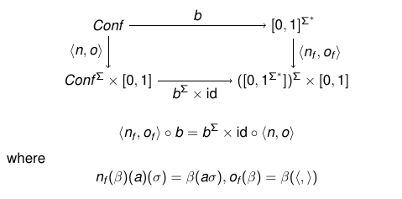

Final coalgebra
$$D\left(Σ^{∗}\right)→{D(Σ^{∗})}^{Σ}×[0,1]$$

Slide 17
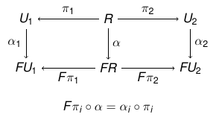
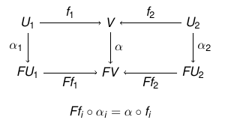
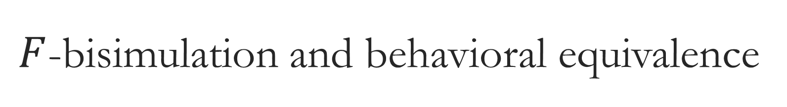

$F$-bisimulation and behavioral equivalence
$$R⊆U_{1}×U_{2}$$

Slide 18
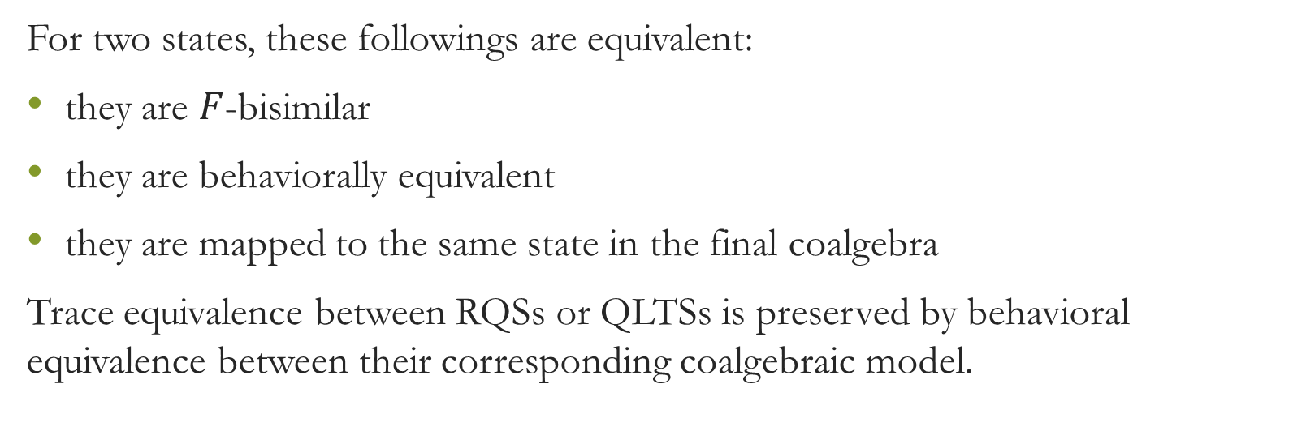
Main results
For two states, these followings are equivalent:
they are $F$-bisimilar
they are behaviorally equivalent
they are mapped to the same state in the final coalgebra
Trace equivalence between RQSs or QLTSs is preserved by behavioral equivalence between their corresponding coalgebraic model.

Slide 19
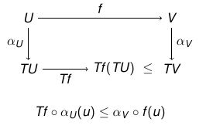
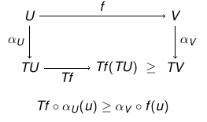

Simulation
A pre-order
$$Forward morphism$$
Backward morphism

Slide 20
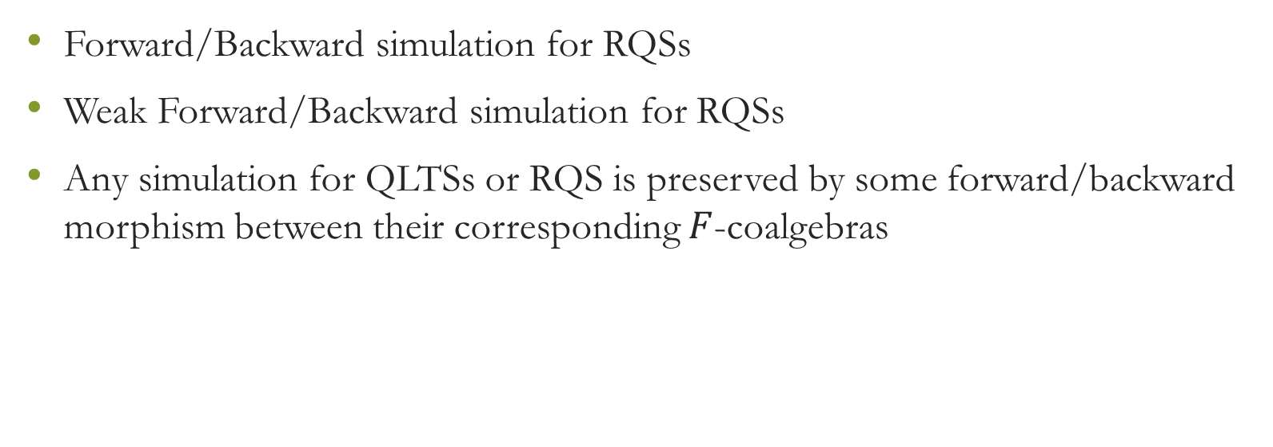
Main results
Forward/Backward simulation for RQSs
Weak Forward/Backward simulation for RQSs
Any simulation for QLTSs or RQS is preserved by some forward/backward morphism between their corresponding $F$-coalgebras

Slide 21
Summary and future work
Summary:
RQS is suitable for quantum systems interacting with the environment and involving multiple measurements.
Coalgebraic methods provide a uniform framework for probabilistic systems, closed quantum systems, QLTS and RQS.
Future work
Integrate more types of quantum systems into the coalgebraic framework.
Study the hierarchy for quantum systems.

Slide 22
Thanks!

