Slide 1
QuanFuzz: Fuzz Testing of Quantum Program
https://arxiv.org/abs/1810.10310

Slide 2
What is fuzzing?
Fuzzing – Fuzz Testing
The key idea is to feed the target program with a large amount of (random) data, and then observe for abnormal behaviors (crash, exceptions …).

Slide 3
What is fuzzing?
Fuzzing – Fuzz Testing
The key idea is to feed the target program with a large amount of (random) data, and then observe for abnormal behaviors (crash, exceptions …).
Need to go through the checks.
Need to have oracles.

Slide 4
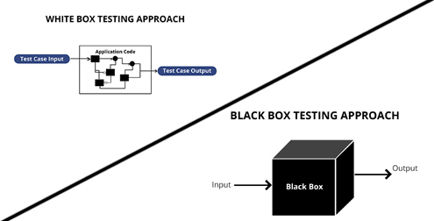
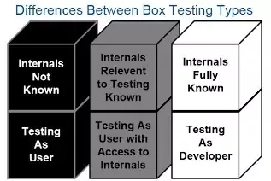
Greybox Fuzzing

Slide 5
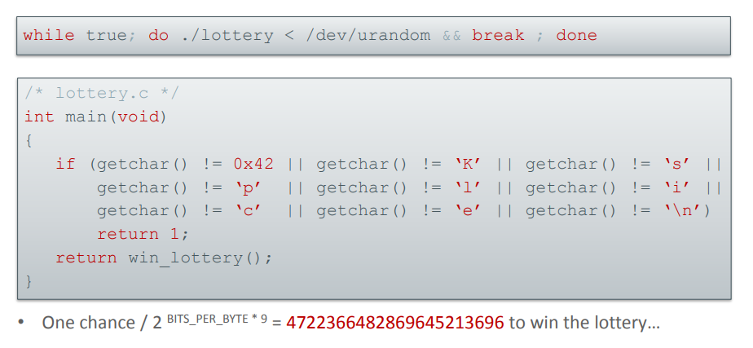
Advantage of Greybox Fuzzing

Slide 6
Advantage of Greybox Fuzzing
2 ^ (8 * 9) possiblities

Slide 7
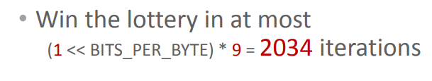
Advantage of Greybox Fuzzing

Slide 8
Advantage of Greybox Fuzzing
9 * 2 ^ 8 possiblities

Slide 9
What about greybox fuzzing?
Fuzzing – Fuzz Testing
The key idea is to feed the target program with a large amount of (random) data, and then observe for abnormal behaviors (crash, exceptions …).
Greybox fuzzing use light-weight instrumentations to collect runtime information for guidance.
Need to go through the checks. – How to mutate the data?
Need to have oracles. – How to define error?
Need to collect runtime information – What to collect? Collect how much information?

Slide 10
What is Quanfuzz?
A search-based test input generator for quantum program.
Based on “Q|SI>: A Quantum Programming Environment”.
The first greybox fuzzer for quantum programs.
Need to go through the checks. – How to mutate the data?
Need to have oracles. – How to define error?
Need to collect runtime information – What to collect? Collect how much information?

Slide 11
What is Quanfuzz?
A search-based test input generator for quantum program.
Based on “Q|SI>: A Quantum Programming Environment”.
The first greybox fuzzer for quantum programs.
Need to go through the checks. – How to mutate the data?
Need to have oracles. – How to define error?
Need to collect runtime information – What to collect? Collect how much information?

Slide 12
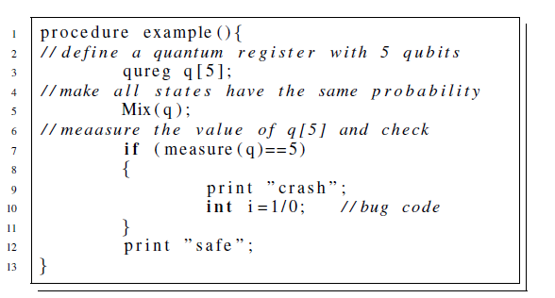
Motivation Example

Slide 13

Motivation Example
Goal: Find the best q to pass the if condition in line 7.
A quantum register containing n qubits can be
represented as a 2^n * 1 matrix as

Slide 14
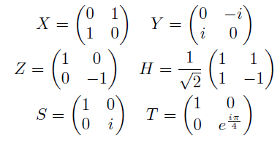

Motivation Example
Goal: Find the best q to pass the if condition in line 7.
We can use matrix operations as “gates” to modify the register value.
Below are the matrices for mutating one-qubit registers.

Slide 15
Motivation Example
Goal: Find the best q to pass the if condition in line 7.
First, we extract quantum sensitive information measurement operations on those quantum registers and the sensitive branches associated with those measurement results, from the quantum source code.
Then, we use the sensitive information guided
algorithm to mutate the initial input matrix and select those matrices which improve the probability weight for a value of the quantum register to trigger the sensitive branch.

Slide 16
Approach
Goal: Find the best q to pass the if condition in line 7.
First, we extract quantum sensitive information measurement operations on those quantum registers and the sensitive branches associated with those measurement results, from the quantum source code.
Then, we use the sensitive information guided
algorithm to mutate the initial input matrix and select those matrices which improve the probability weight for a value of the quantum register to trigger the sensitive branch.

Slide 17
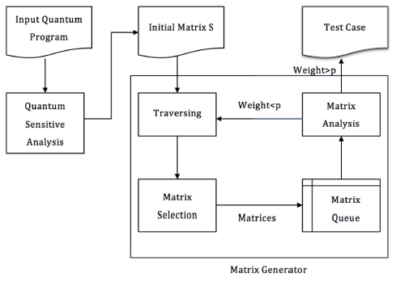
Approach
1
2

Slide 18
Approach
Extracted information:
ket information
measurement information (i.e. measurement operator)
oracle information (i.e. sensitive results and operations on the measurement value)
Instrumented Location:
input matrix read
transform ket with input matrix
ket before measurement output
measurement result output
1
2

Slide 19
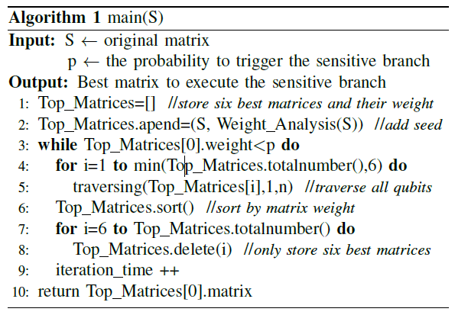
Approach
1
2

Slide 20
Approach
Function traversing(S; k; n) traverses matrix S from kth
qubit to nth qubit.
For each qubit, we randomly apply 2 gates.
1
2
After traversing all qubits of matrix S, we put the new matrices with their corresponding probability weight in Top_Matrices.

Slide 21
Approach
To calculate the probability weight, it reads the input matrix, and starts a process to execute the quantum
program.
Then it reads ket data before the measurement operation and returns the oracle’s probability, denoted by the
probability weight for the sensitive value of the quantum
register.
Finally, if the probability weight is larger than threshold p,
we stop the iteration and return the corresponding matrix.
1
2

Slide 22
Approach
To calculate the probability weight, it reads the input matrix, and starts a process to execute the quantum
program.
Then it reads ket data before the measurement operation and returns the oracle’s probability, denoted by the
probability weight for the sensitive value of the quantum
register.
Finally, if the probability weight is larger than threshold p,
we stop the iteration and return the corresponding matrix.
Will this algorithm converge?
How to calculate the probability?
1
2

Slide 23
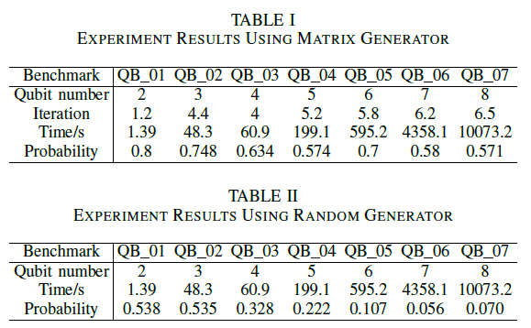
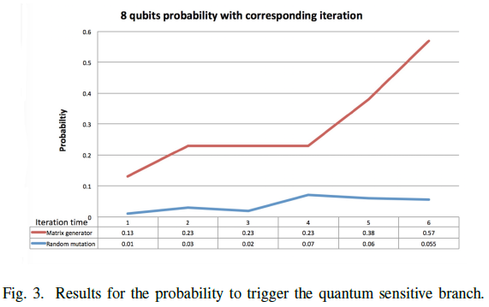
Evaluation

Slide 24
Thanks!
Q & A

