Slide 1
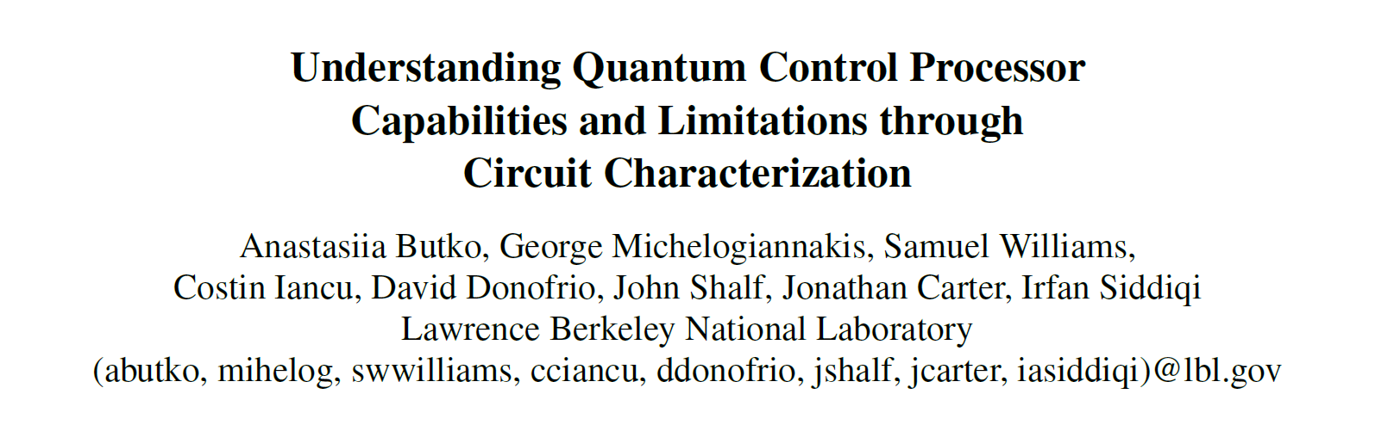
Journal Club Oct. 22
付祥

Slide 2
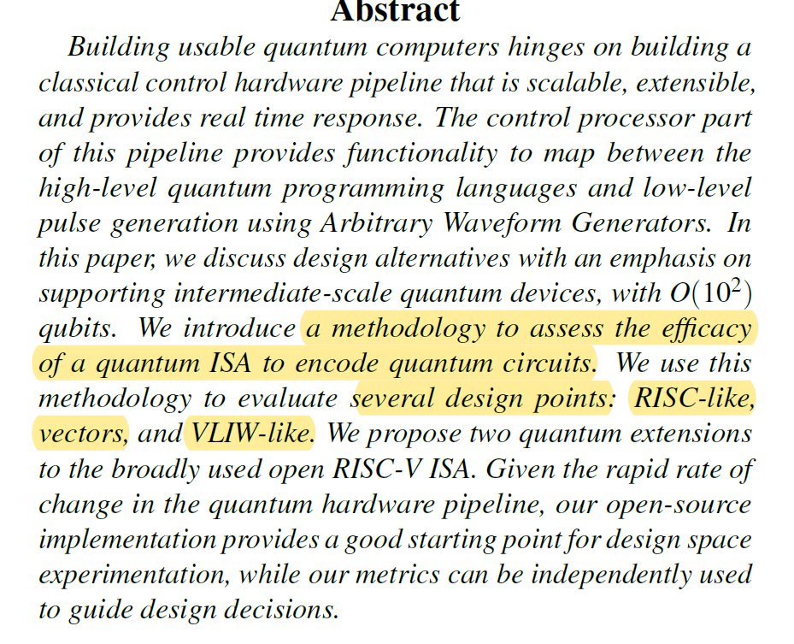
文章主要内容
衡量量子指令集功效的方法
研究指令集的信息密度(Byte数）
设计空间探索是研究ISA的重要方法
RISC-like指令集（基准线）
eQASM
基于RISC-V
QUASAR
qV

Slide 3
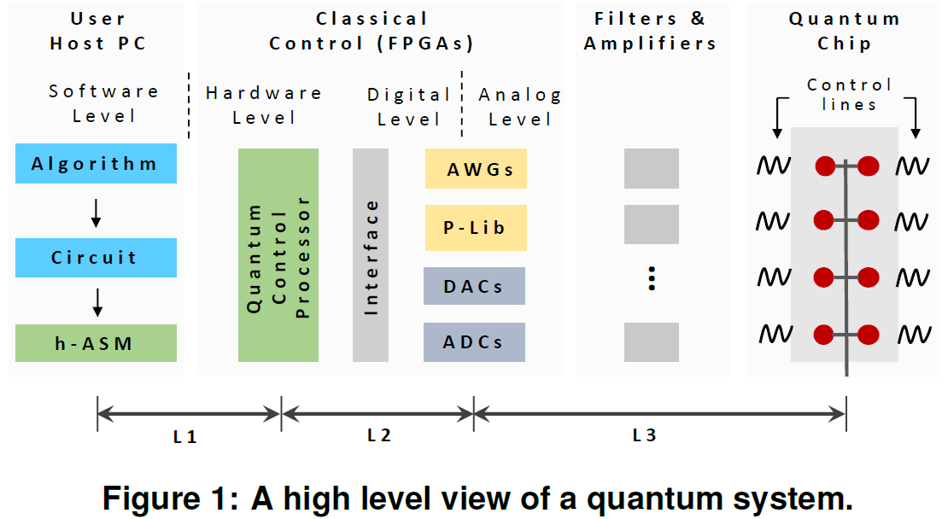
Background
high-level quantum program
A “CPU Host” compiles it the into a sequence of instructions
Quantum Control Processor (QCP) translates these instructions into commands
Commands trigger Arbitrary Waveform Generators (AWG).
AWG controls the execution of the Quantum Processing Unit (QPU).

Slide 4
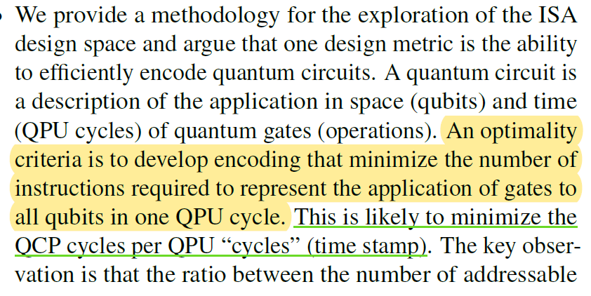
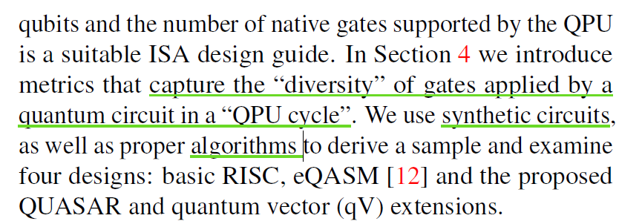
Contribution
Optimality criteria
Minimize the number of instructions to represent the application
gate diversity/gate density/distribution balance
Two extensions to RISC-V
QUASAR, quantum vector (qV)
Summary about capability & limitation of ISAs

Slide 5
ISA Design Requirements
Physical implementation
of the quantum device, and the related control electronics
To support at least the native QPU gates
we expect only a small number of opcodes
To address all qubits
The QCP is required to maintain gate application timings
To support basic control and data flow operations
classical instructions are essential in a QISA
Quantum circuit structure

Slide 6

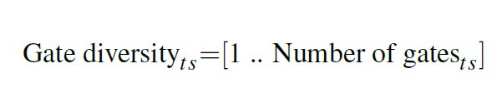
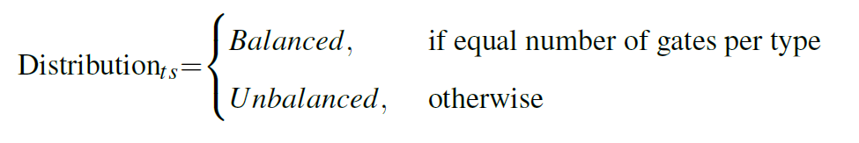
ISA Design Requirements
Physical implementation
Quantum circuit structure
Gate density per per single time stamp (ts)
Gate diversity per ts (No. gate types)
Distribution balance

Slide 7
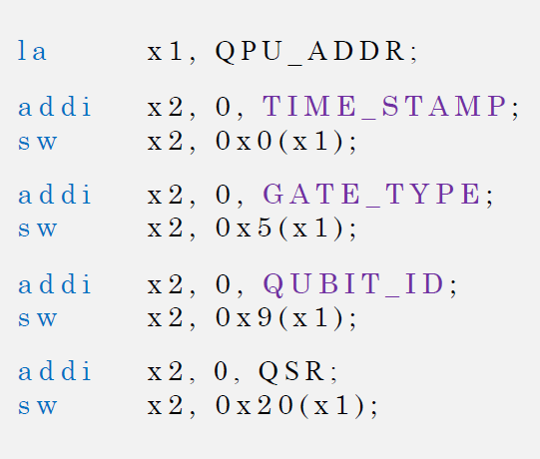
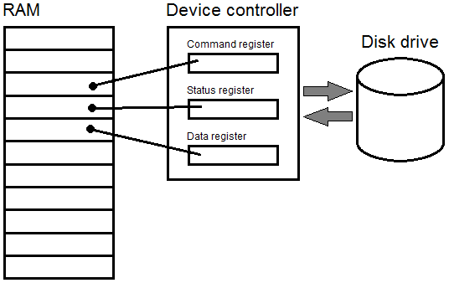
ISA Design Space - RISC-like ISA
QPU_ADDR: the base address for QCP
QCP
QPU
CPU

Slide 8
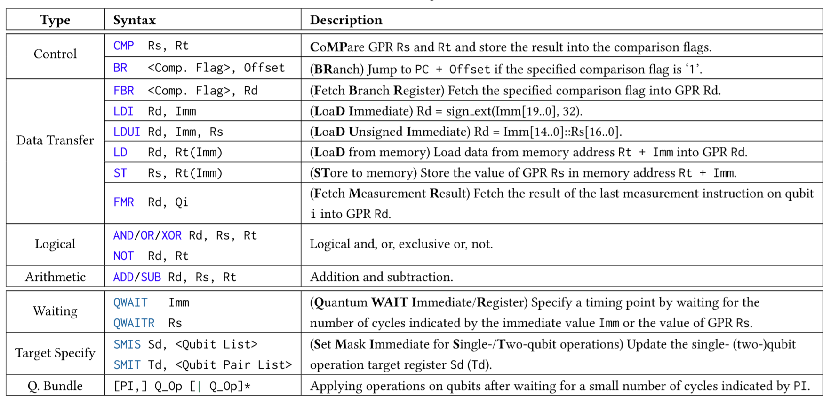
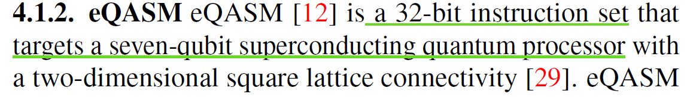
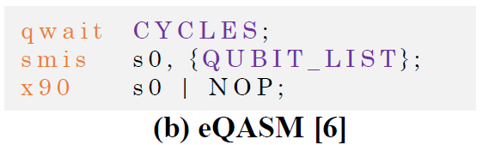
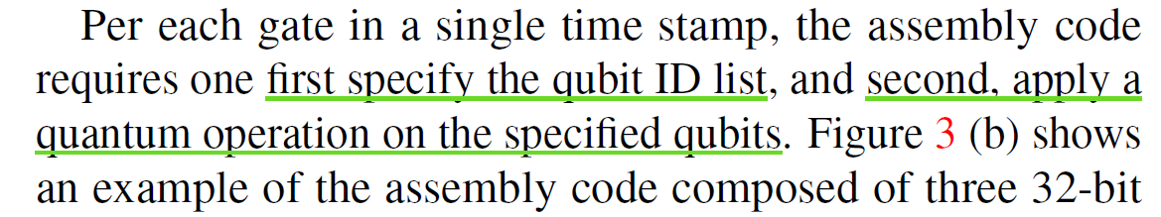
ISA Design Space -eQASM

Slide 9
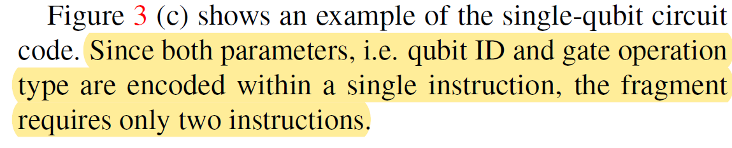
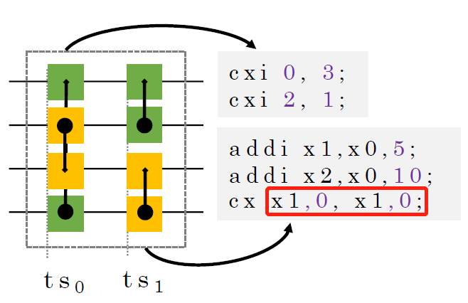
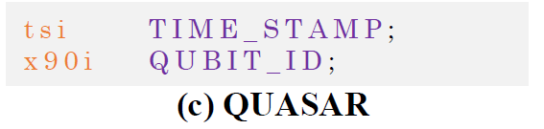
ISA Design Space - QUASAR
An extension to RISC-V, 32-bit
Four types of quantum instructions
single-qubit gates
two-qubit gates
measurement
timing control
Addressing
9-bit immediate (512 qubits)
32-bit mask + 4-bit immediate offset (do not fully understand it)

Slide 10
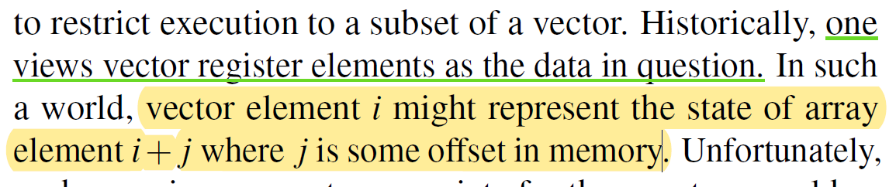
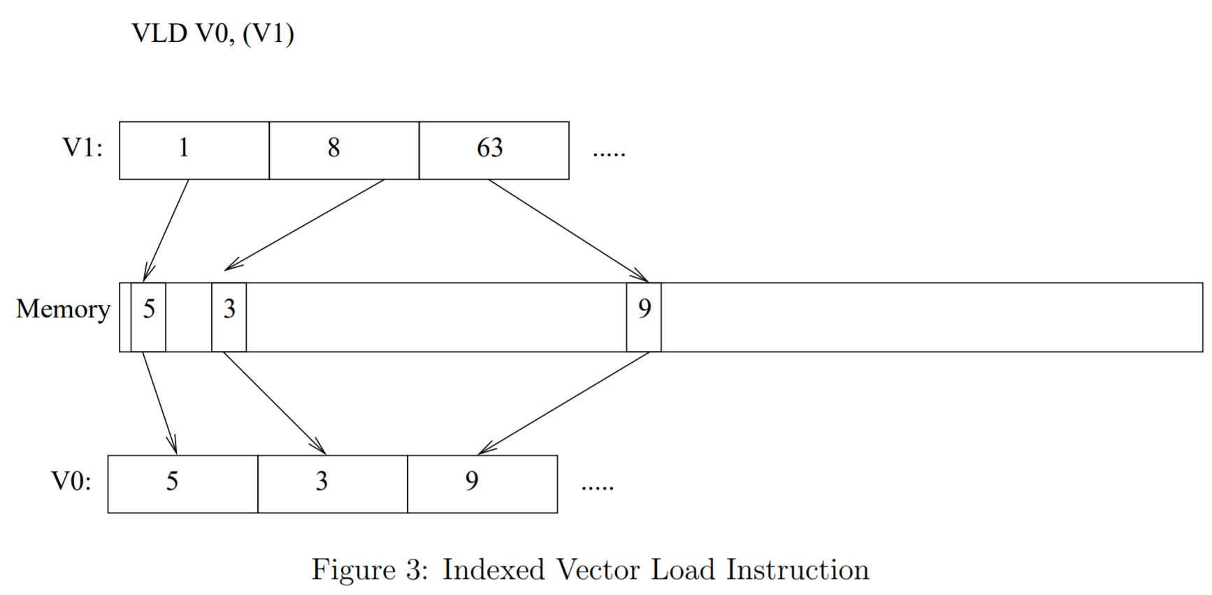
ISA Design Space - Double Index Quantum Vector (qV)
Quantum circuits express both
SIMD: same gate, multiple qubits
MIMD: multiple gates, multiple qubits

Slide 11
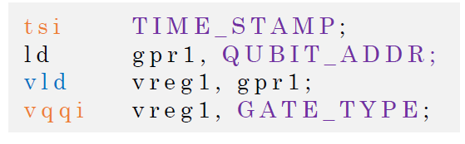
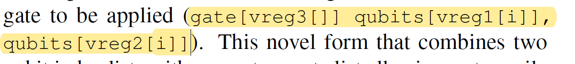
ISA Design Space - Double Index Quantum Vector (qV)
描述与代码不匹配
vqqi: two-register format with an op field
each register: a vector of qubit indices
op: the same operation applied on these two vectors of qubits
vld, vld, vqqi
vqqg: three-register format
two registers, each a vector of qubit indices
third register: a list of quantum gates
mask: nop in vreg3, or 0 bit in vreg 1
Question: which quantum gate to which qubit(s) in vreg1 and/or vreg2?
vld, vld, vld, vqqg

Slide 12
Evaluation
Encoding efficiency (in Bytes)
Execution time
Benchmarks
Synthetic circuits with different characteristics
Gate density, gate diversity, distribution balance
Algorithm: 32-qubit QFT + Grover operator
Processor characteristics: ICE
32-bit, 5-stage

Slide 13
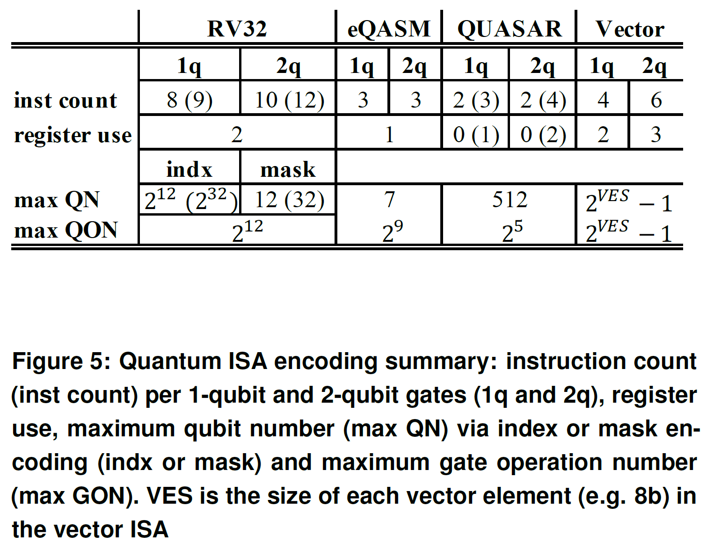
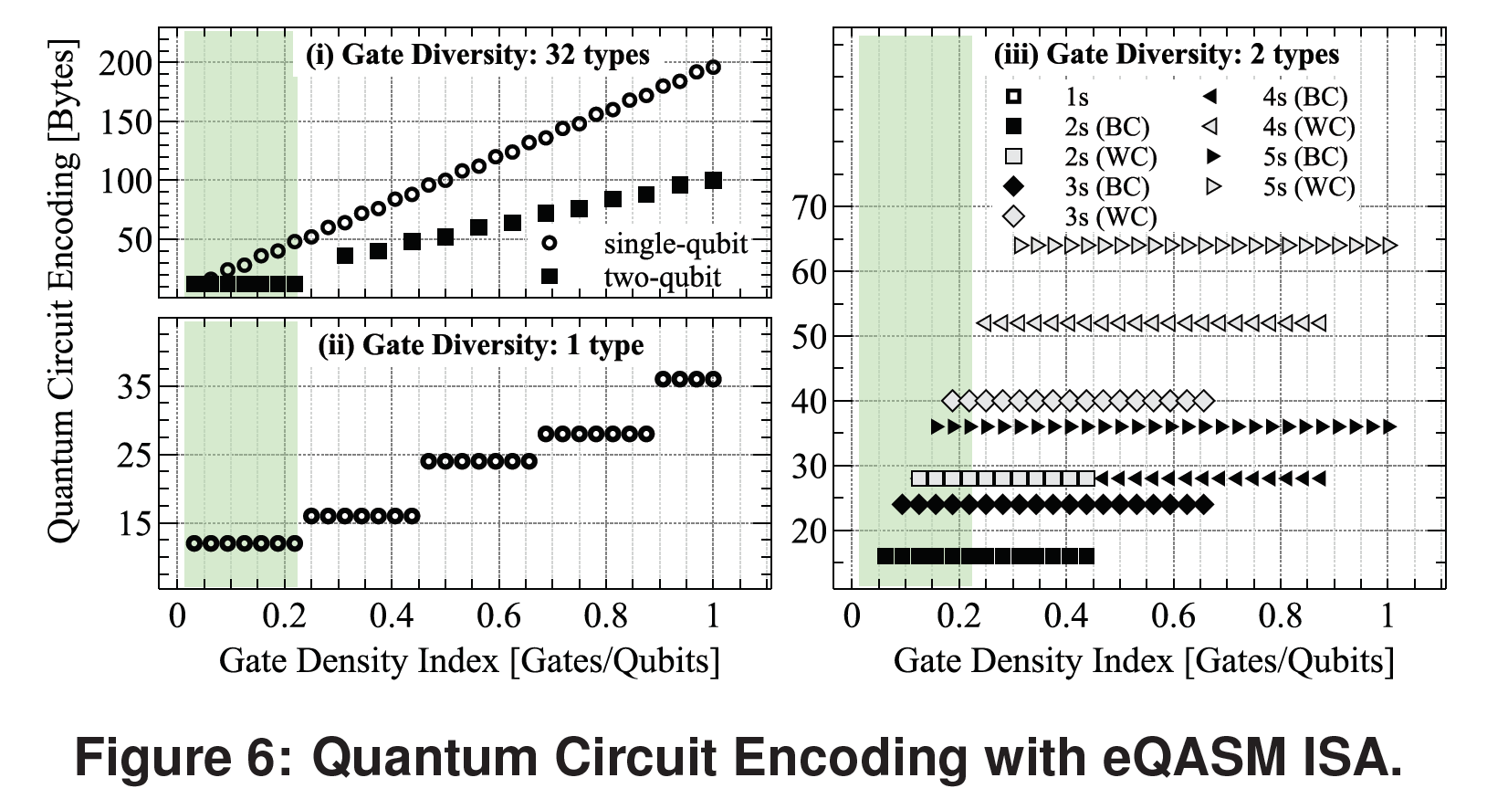
Experiment Result 1
Hard to understand where these numbers are from

Slide 14
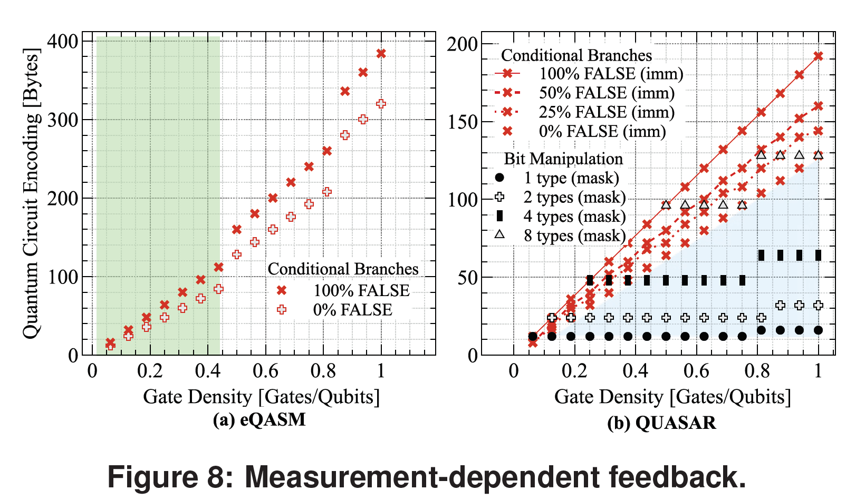
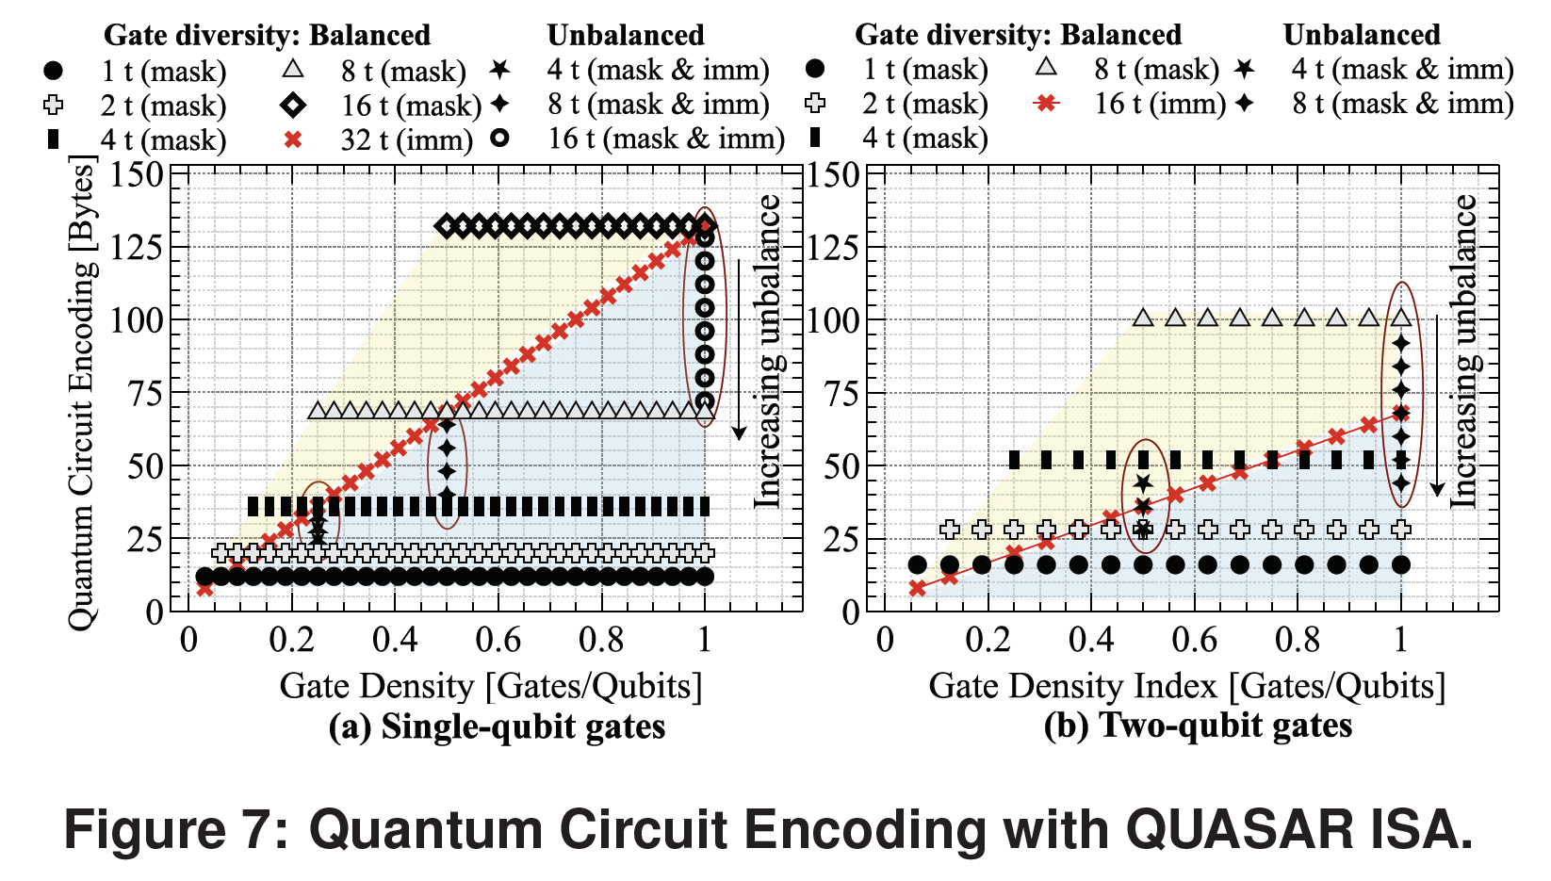
Experiment Result 2

Slide 15
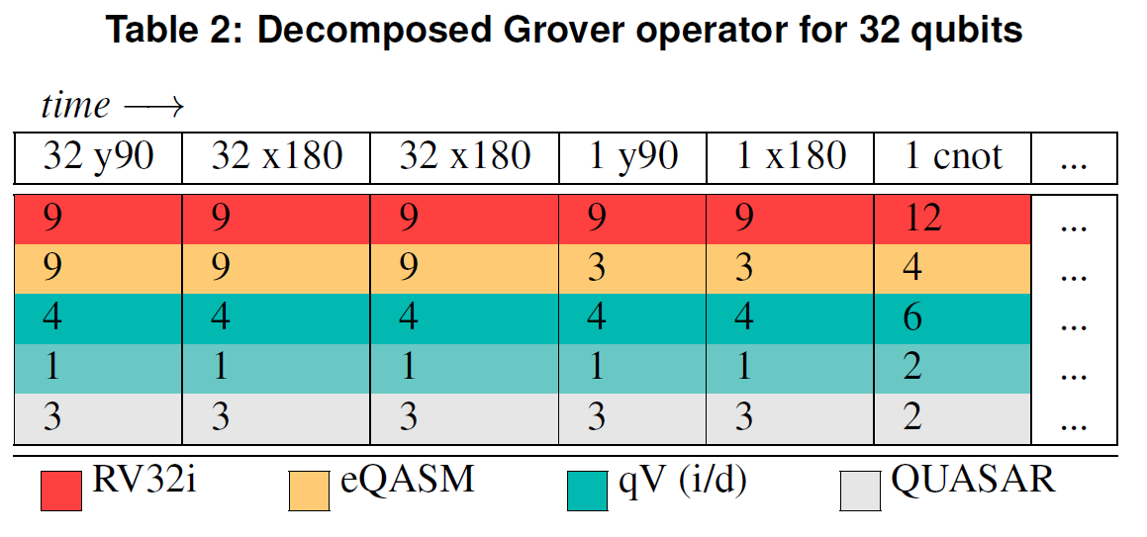
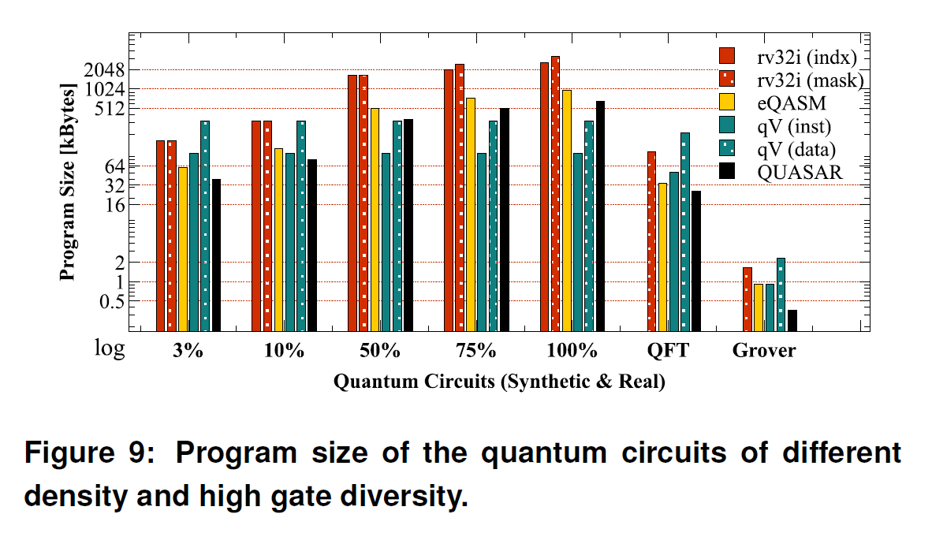
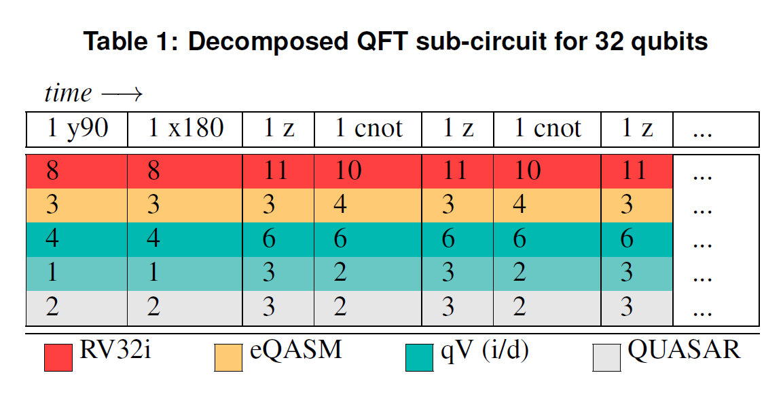
Experiment Result 3

Slide 16
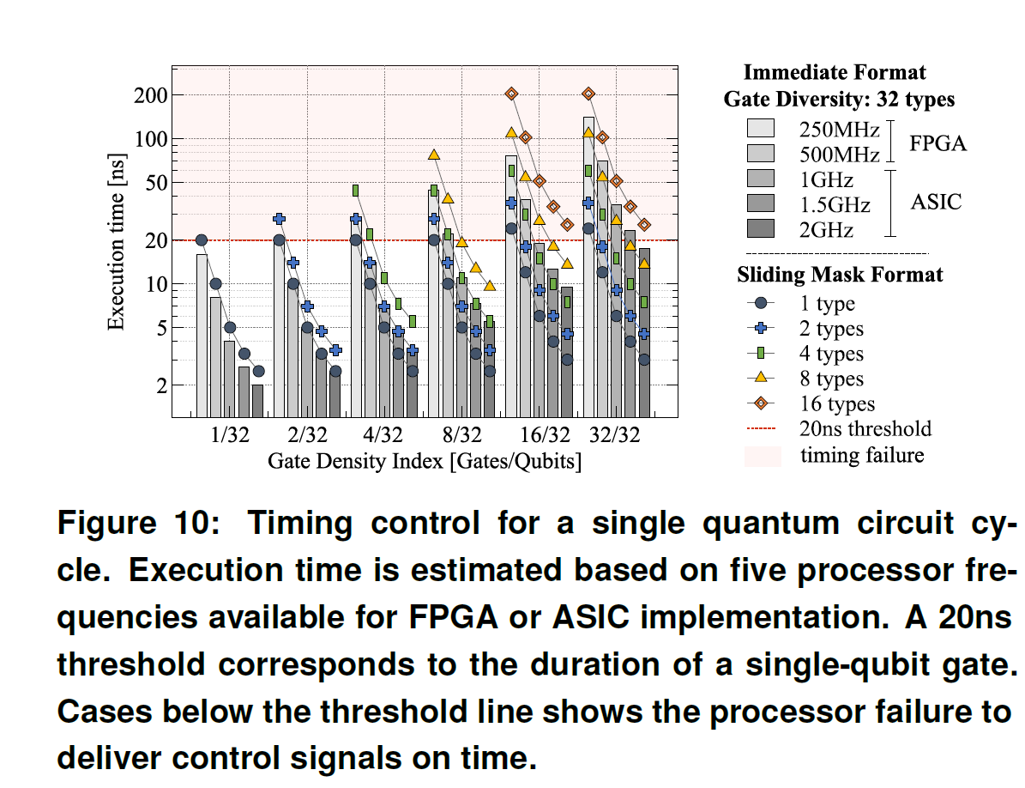
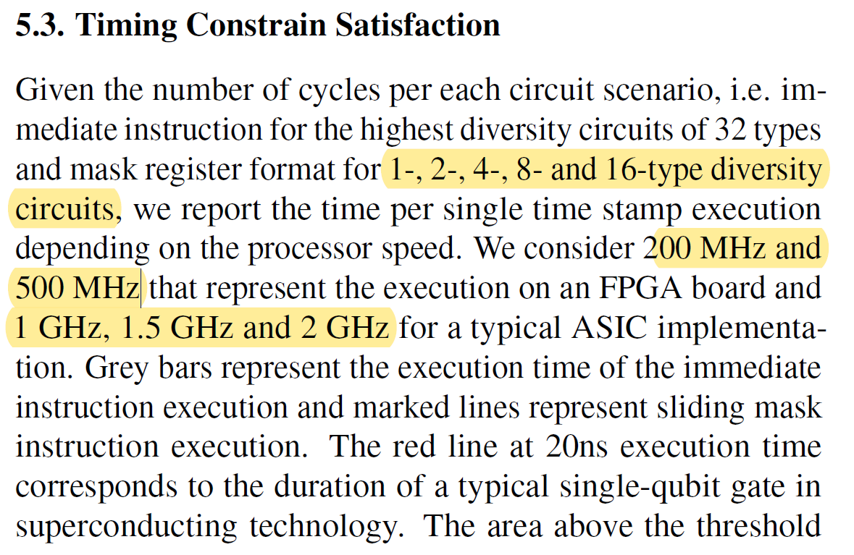
Experiment Result 4
Limited consideration in
Pipeline flushing
Memory access miss
Pipeline stall

Slide 17
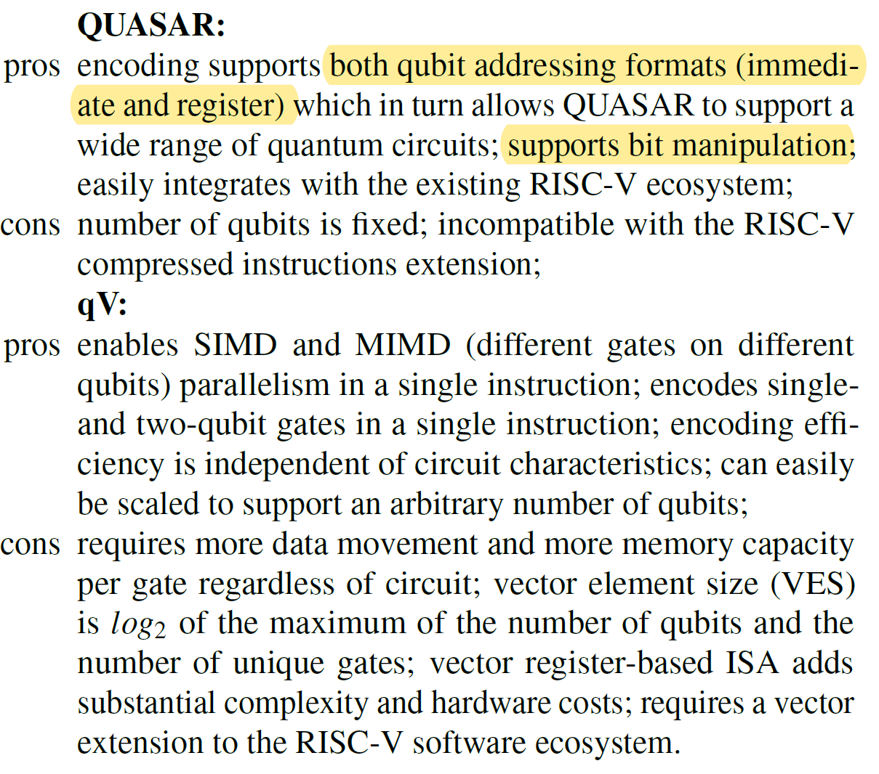
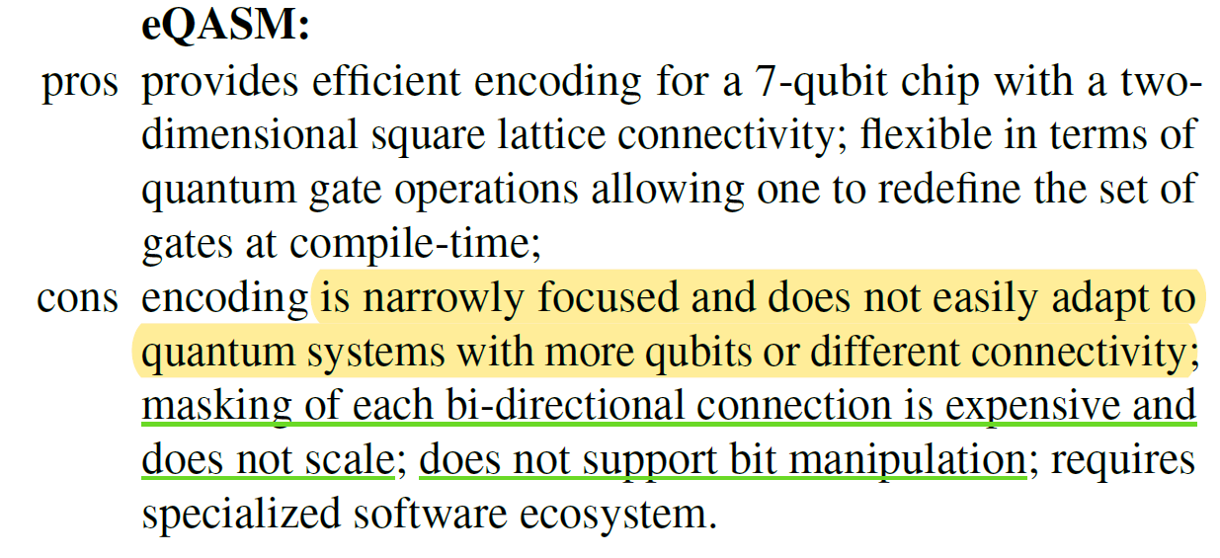
Author’s Summary

