Slide 1
VOQC
史文君

Slide 2
Introduction
Reason : Qubits will be scarce, and the risk of decoherence
means that gate pipelines will need to be short.
Manner : optimizing compilers automatically, even by hand
But we cannot test and debug, Why?
indeterminacy of quantum algorithms
and the substantial expense involved in executing or simulating them.
(So it may be impossible to test an optimizer by comparing runs of the source program to its optimized version.)
But we can apply rigorous formal methods to prove that a optimization or algorithm is correct likely CompCert, a certified compiler for C programs.

Slide 3
Introduction-VOQC
利用小电路特性减少电路的总栅极数
转换SQIR程序以满足量子比特交互的约束
peephole optimizations
circuit mapping algorithm
VOQC
architecture
specification
(source) SQIR
SQIR (target)
基于量子电路的
低级量子编程语言
遵守目标量子框架所施加的约束的等效程序
Coq中表现为Coq函数，可提取到Ocaml
OpenQASM量子电路(高级)的标准格式(未验证)
允许我们再各种生成的电路上运行VOQC
而无需用户到Coq中编程
syntax,
semantics
(denotation)
Unitary
General(Measurement)
实验结果：on a benchmark of 29 circuit programs developed by Nam et al.
意义：第一个基于实际量子电路语言的已验证正确的优化器(verified compilation of Boolean circuits and verified optimization of ZX terms ,or no optimize, or no verified )
未来：研究高级语言到SQIR的更多转换

Slide 4
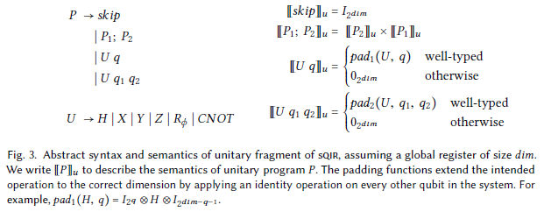
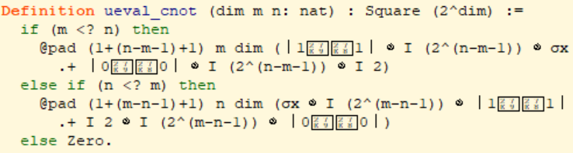
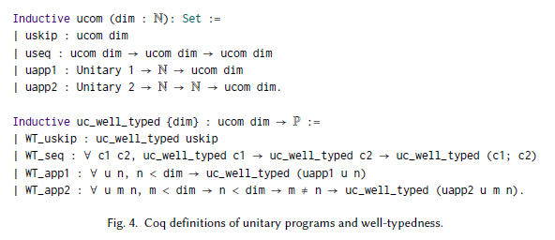
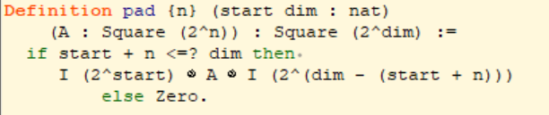
SQIR-Unitary
可扩展到派生门
指称可以在不确定良好类型是讨论，否则要假设并保证良好类型
Z
通过索引到全局寄存器的自然数引用量子比特，使指称函数变得更简单。

Slide 5
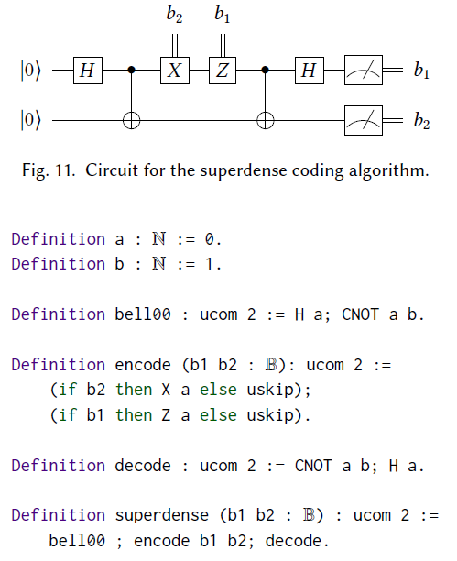

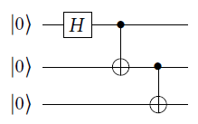
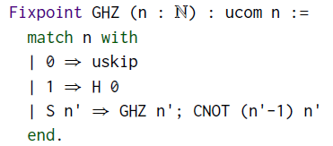
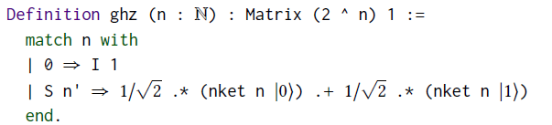
SQIR-Unitary-Example

Slide 6
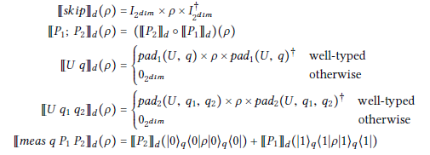
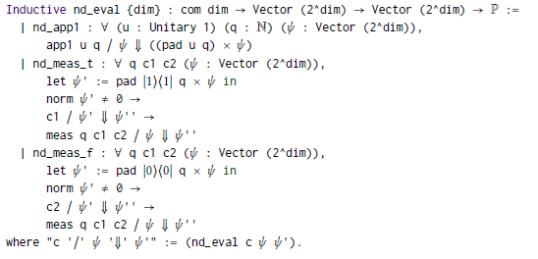

SQIR-General
Density Matrix Semantics.
Nondeterministic Semantics
如果将第q个量子位投影到|1><1|子空间的结果不是零矩阵（意味着可以投影到该子空间）
With unitary fragment

Slide 7
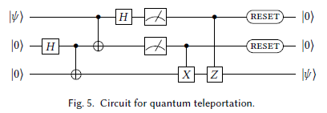


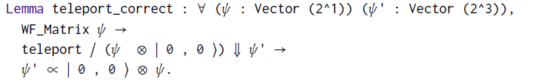
SQIR-General-Example
We can then take both measurement steps,
leaving us with four different cases to prove correct.
In each of the four cases,
we can use the outcomes of measurement to correct the final qubit, putting it into a deterministic state.
semantics does not rescale outcomes
(Probability :scaling factors.)

Slide 8
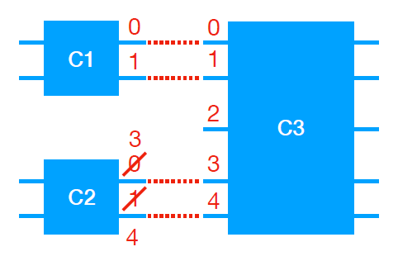
编程VS验证
Concrete wires vs. abstract variables
高阶抽象变量，方便编程，可以任意分配和释放量子位，组合小电路构建大电路。而实际电路，简化验证，不需要担心丢弃量子比特或转移剩余的量子比特，但牺牲了组合性（手动重命名）
Single wires vs. data structures
构建在量子数据结构上计算电路而不是单个量子比特，故需要基于n个量子位的索引列表（由任意n的2^n的方阵表示）来验证，例如使用依赖类型的关系。关于量子位（用长度为2的矢量或2×2密度矩阵表示）的推理要比对量子位的索引列表（用任意n的2n×2n矩阵表示）的推理要容易得多。产生列表的电路包含一个树，虽然列表和树是等价的，但仍需要一个小工具来连接这两个，然后证明这个小工具使两个在语义上等价。而SQIR中没有量子数据类型也没有类型电路，就不用研究这个。
Single measurements vs. dynamic lifting
动态提升允许测量量子位并将结果用作主语言中的布尔值来计算电路的剩余部分，但会使程序语义取决于主语言语义，使指称语义变得复杂。假设任意宿主语言都具有操作语义，并且仅当提升的电路的两个分支都能有效缩减。SQIR中测量结果不用于计算新电路，所以不用宿主语言来进行计算，它是一种完全独立的语言，可以单独推理。
Near-term programming.
硬件限制，技术限制，期望限制，SQIR更接近现实，注意量子位的数量和连接性。

Slide 9
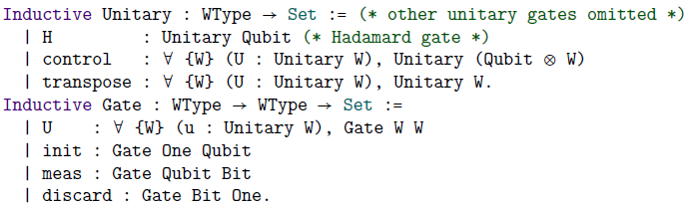
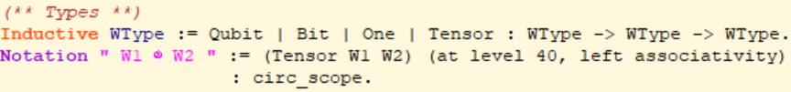
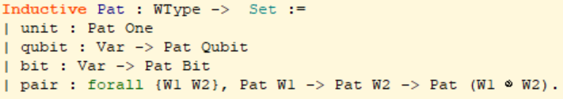
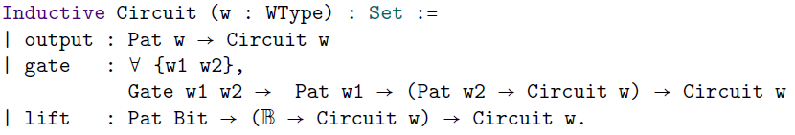
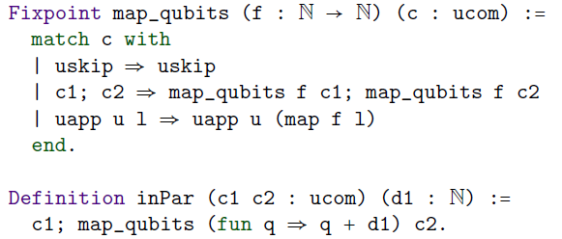
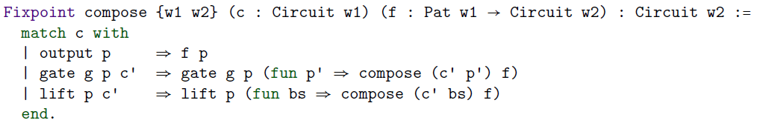
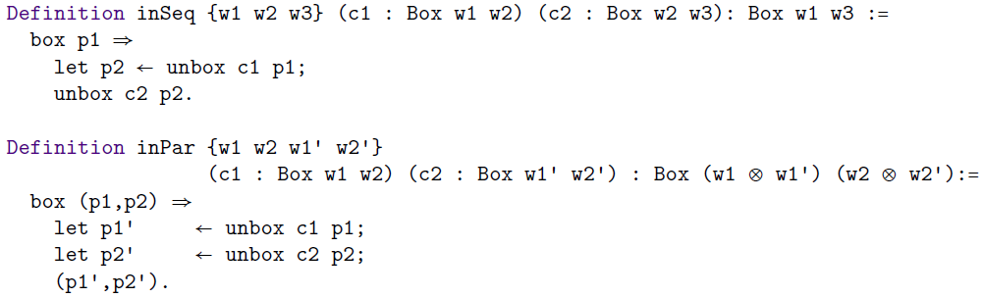

QWIRE VS SQIRE
全局寄存器的使用大大简化了关于sQIRe程序的证明，因为寄存器索引直接对应于sQIRe程序表示的矩阵中的索引。 相比之下，QWIRE的变量根据本地上下文映射到不同的索引，这使得很难对程序片段进行精确的声明。

Slide 10
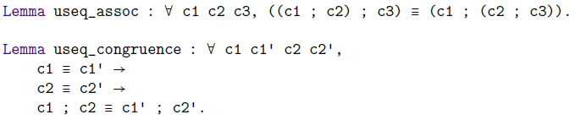

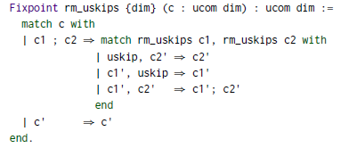

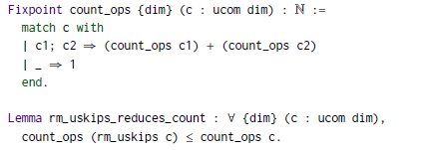

Verifying Transformations- Equivalence
由于只能在退相干生效之前进行小型计算，所以需要优化，但测试困难模拟困难，所以用形式化验证。
SQIR程序的等价性验证--保语义的(sound)
以及其他语义衍生性质验证
either a single skip operation,
or contains no skip operations
no more skip operations
or unitary applications

Slide 11
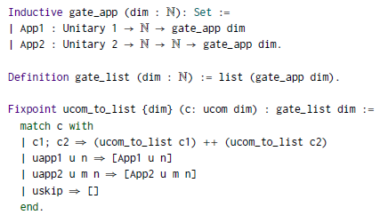
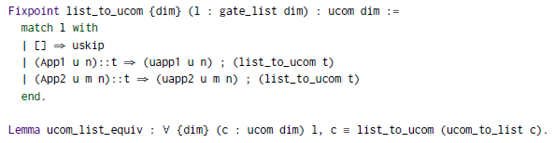
Verifying Transformations- Representation
VOQC的程序表示
voqc的优化通常使用程序的列表表示，更容易搜索门模式。

Slide 12
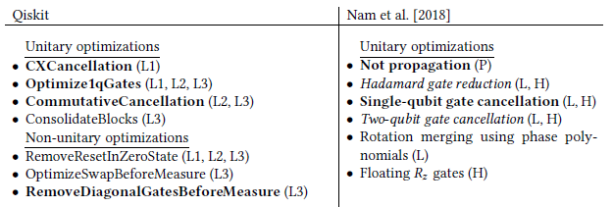
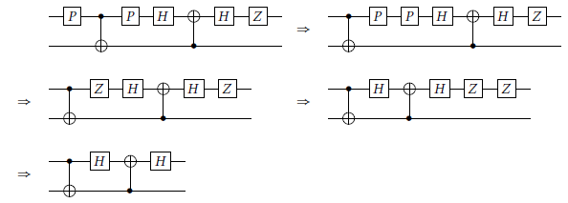
Verifying Transformations- Optimizations
Optimizations of Unitary Programs
peephole optimizations:利用小电路特性减少电路的总栅极数
self-cancelling，z-axis rotation gates are merged， cancellation with commutation等 ( a subset of the commutation rules presented in Nam et al.)

Slide 13
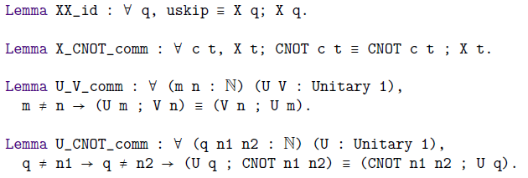
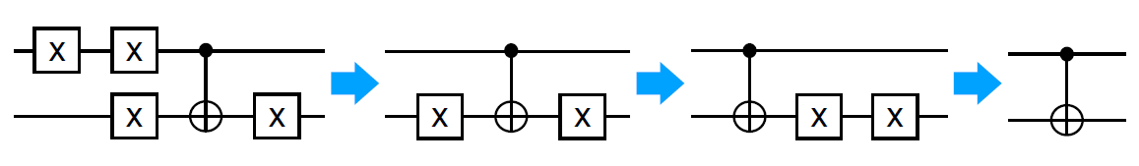
Verifying Transformations- Optimizations
Not Propagation
For each X gate in the circuit, this optimization will propagate the gate as far right as possible, and found cancelling X gates and remove. If not, then the propagated gate is returned to its original position.

Slide 14



Verifying Transformations-Optimizations
Optimizations of Non-Unitary Programs
performing a measure or reset after a reset is equivalent to simply performing the reset.
perform z-axis rotations can be removed before measurement without affecting the measurement result.
Other optimizations that Qiskit
performs on non-unitary programs include removing resets applied toqubits in an initial zero state (using reasoning similar to our reset_reset lemma),
and removingSWAP operations before measurement.

Slide 15
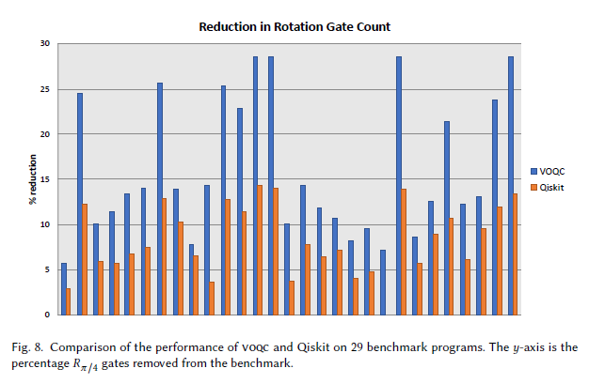
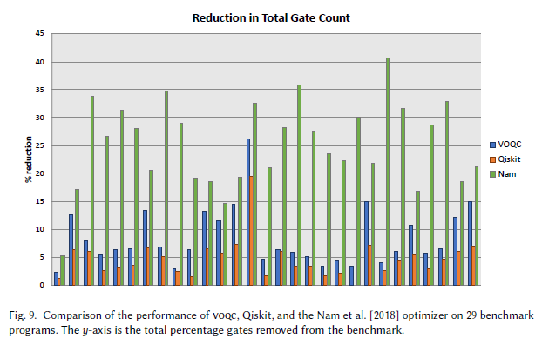

Verifying Transformations-Experimental Evaluation
Compare with Qiskit and Nam.et al
The benchmarks contain between 45 and 61,629 gates and use between 5 and 192 qubits, and the benchmarks are all unitary programs
Ran both optimizers on randomly-generated circuits.
voqc uses a fixed set of rules designed by Nam.et al
Qiskit performs matrix multiplication to determine whether two gates commute (not real benchmarks)
because Nam.el contains more optimizations that voqc. However, the optimizations performed by voqc are all verified in Coq.

Slide 16
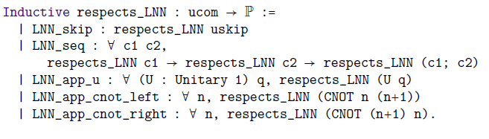
Verifying Transformations-Circuit Mapping
Circuit mapping algorithms take as input an arbitrary circuit and output a circuit that respects the connectivity constraints of some underlying architecture.
Linear nearest neighbor(LNN) architecture qubits are connected to adjacent qubits in the global register
For example: A program will be able to run on our LNN architecture if all CNOT operations occur between connected qubits
Constraint:

