Slide 1

STREAM 4 · ALTIOSTAR TOKYO MRO
5G Handover Optimization
with Reinforcement Learning
Phase 0 → Phase 3 | Project Recap & Live Demo
Ananyaa · Shourya Solanki · Harshit Kumar · Devika Hooda
Client: Altiostar / Rakuten Symphony · 75-Cell Shibuya Cluster
Notes:
ANANYAA — 0:00-0:30. Quick warm open: who we are, what the project is, and that this is a full recap from Phase 0 through Phase 3 plus a live dashboard demo. Keep it to 2 sentences.

Slide 2





ROADMAP
Where we're going in the next 20 minutes
Phase 0
Phase 1
Phase 2
Phase 3
Foundation
Models & schema mapping
KPI extraction
& baseline dashboard
RL training sweep
+ dashboard hardening
Final results,
G4 demo, live walkthrough
2
Notes:
ANANYAA — 0:30-1:00. One line per phase box: Phase 0 set the foundation, Phase 1 found the problem, Phase 2 was the heavy build (RL + dashboard), Phase 3 delivered final results and the G4 demo. Then we'll do a live walkthrough.

Slide 3


THE PROBLEM
Handovers are dropping success below target
75-cell live cluster in Shibuya, Tokyo — dense urban 5G network run by Altiostar / Rakuten Symphony
Client target: ≥99% handover (HO) success rate across the cluster
Manual tuning of handover timing doesn't scale across 75 cells under changing conditions
Goal: an RL agent that learns optimal handover timing automatically, validated against real KPI data
99%
Target HO success
across all 75 cells
3
Notes:
ANANYAA — 1:00-2:00. Explain handover briefly: a phone moving between two cells must be handed over without dropping the connection. At 75-cell scale, manual parameter tuning can't keep up, which is why we built an RL agent.

Slide 4




SYSTEM DESIGN
Two layers: orchestration pipeline + RL core
7-Agent Orchestration Pipeline
Data
Ingestion
Schema
Mapping
KPI
Extraction
Scenario
Generation
Reporting
Dashboard
Output
PPO Reinforcement Learning Agent
Core decision-maker for handover timing across the 75-cell cluster — trained across reward variants V0–V3
4
Notes:
ANANYAA — 2:00-3:00. Two distinct layers: the orchestration pipeline (KPI extraction, schema mapping, scenario generation, reporting) and the PPO RL agent that's the actual decision-maker for handover timing. Keep this fast — it's context for the next two phases, not the main event.

Slide 5

PHASE 0
Building the foundation
models.py — four Pydantic models defining the data contracts for the whole pipeline
schema_mapper.py — column-aliasing engine to resolve CSV ↔ model naming mismatches
test_schema_mapper.py — unit tests plus Hypothesis property-based tests for robustness
Repo conventions locked in early: separate repos for daily logs vs. code, CSVs never committed, no blanket git add
Add screenshot:
code snippet or test pass
for schema_mapper.py
5
Notes:
ANANYAA — 3:00-4:00. Quick: Phase 0 was about getting the data contracts and schema handling right before any RL or dashboard work started. This is the unglamorous but essential plumbing.

Slide 6
MRO ENV
Building the MRO simulation environment
Gymnasium environment wrapping real Shibuya PM data into an RL-ready state-action-reward loop
State: per-cell HO success, ping-pong rate, failure counts — action: CIO offset adjustments across 75 cells
Baseline extraction identified 6 problem cells at ~94.5% — confirmed where the cluster missed the 99% target
6 / 75
cells below the
99% HO target
94.5%
baseline HO success
in those cells
6
Notes:
ANANYAA — 4:00-5:00. This is the 'why' slide — before any RL, we proved with real KPI math that 6 of the 75 cells were stuck around 94.5% success against a 99% target. That gap is what Phase 2 and 3 are solving.

Slide 7
PHASE 2 · TRACK A
Training the agent: reward design sweep
16 experiments: reward variants V0–V3 × 4 scenarios (baseline, rush_hour, rain_fade, tower_failure)
V0 scaled reward by raw event counts — looked huge, but made cross-variant comparison meaningless
V1–V3 moved to rate-based reward scaling, enabling fair, comparable results
Fixed PPO training running on CPU only (Intel Iris Xe) by forcing device='cuda' in Stable Baselines3
~9M
V0 reward (raw counts) — looked huge, but misleading across scenarios
~210K
V2 reward (rate-based) — 79% HO success at baseline — selected for production
7
Notes:
SHOURYA — 5:00-9:00 (4 min). Walk through the sweep: why raw-count reward (V0) is a trap — it looks like a bigger number but can't be compared across scenarios. Rate-based reward (V1-V3) fixed that, and V2 became the production pick at 80.1% HO success on baseline. Mention the CUDA fix briefly as a 'this took a while to debug' anecdote if time allows.

Slide 8
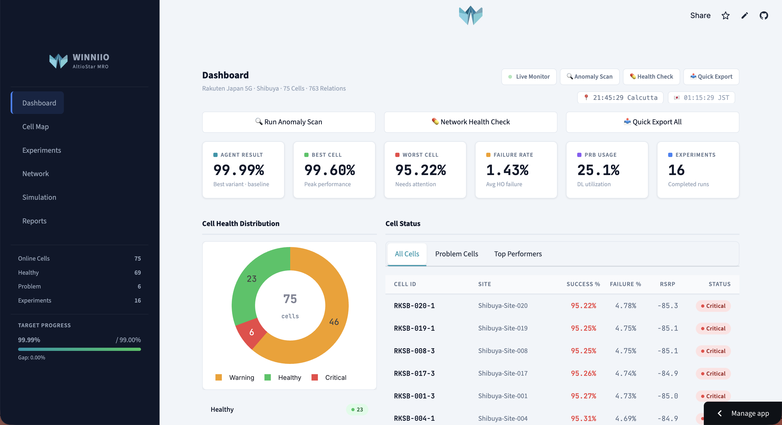


PHASE 2 · TRACK B
Hardening the dashboard for production
Auth hardening
SHA-256 password hashing, secrets.toml-based config instead of hardcoded credentials
Deployment fixes
Resolved StreamlitSecretNotFoundError; documented DASHBOARD_PASSWORD setup for Streamlit Cloud
G4 checklist growth
Rebuilt app.py checklist from 12 static items to 17 dynamic, live-evaluated items
QA pass
141 / 144 automated tests passing; remaining 3 tied to RL environment wiring
8
Notes:
HARSHIT — 9:00-12:00 (3 min). Cover the deployment and QA story: how the dashboard went from a local script to a hardened, password-protected Streamlit Cloud app, and the checklist growing from 12 to 17 live-evaluated items. Close with the 141/144 test pass rate.

Slide 9


VALIDATION
Four scenarios stress-test the agent
Baseline
Rush Hour
Normal traffic, steady-state network conditions
High load, dense concurrent handovers
Rain Fade
Tower Failure
Signal degradation from weather attenuation
Simulated cell outage forcing emergency handover
9
Notes:
DEVIKA — 12:00-12:40 (40 sec). Quick beat: every result we show next was validated across these four scenarios, not just clean baseline conditions — that's what makes the 99%+ numbers meaningful.

Slide 10
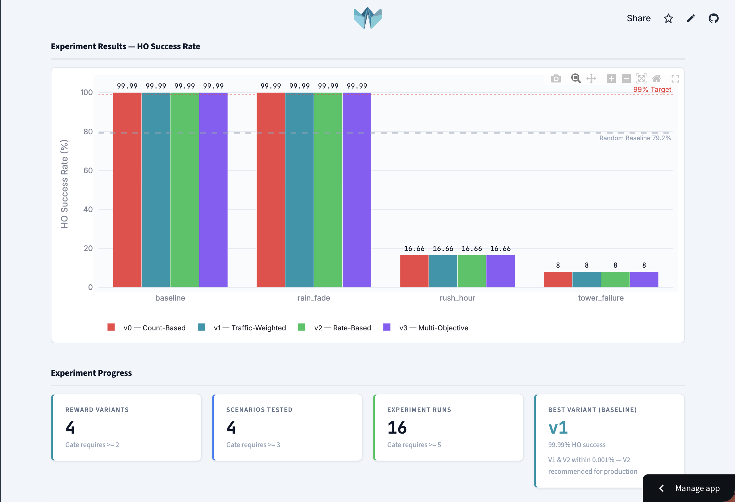
PHASE 3
Final results: target exceeded
99.985%
HO success after
100K-step PPO run
V2
remains the production
recommendation
(reward design)
10
Notes:
DEVIKA — 12:40-14:30 (~1.8 min). The headline: a 100K-step PPO run pushed HO success from the 94.5% baseline to 99.985%, comfortably past the 99% client target. Both V1 and V2 reached this, but V2 stays the production pick because of its reward design, not just the raw number.

Slide 11

PHASE 3
Gate 4: demoed and signed off
17 / 17
Demo audience
Nicolas Waern (CEO, Winniio) and Claus Peterson (5G domain expert) reviewed the full pipeline and agent results
G4 checklist items
passing at demo time
Outcome
Direction confirmed for remaining work: fine-tuning, documentation, and CSV drop UX improvements
11
Notes:
DEVIKA — 14:30-16:00 (1.5 min). G4 passed all 17 checklist items live. Nicolas and Claus signed off on the agent pipeline and gave us the next-step direction we're closing with at the end of this deck.

Slide 12

LIVE WALKTHROUGH
Let's switch to the live dashboard
Agent Result KPI card — production agent performance at a glance
Sidebar target progress — live progress toward the 99% goal, wired to agent_best
Variant comparison view — V0–V3 side by side across all four scenarios
G4 checklist page — the same 17-item live evaluation shown at the demo
Live: switch over to
the Streamlit dashboard
altiostar-mro-dashboard.streamlit.app
12
Notes:
HARSHIT drives the live dashboard, ANANYAA narrates — 16:00-18:30 (2.5 min). Tour: KPI card, sidebar target progress, variant comparison, G4 checklist page. Keep clicks purposeful — don't free-explore on stage.

Slide 13
ALONG THE WAY
What didn't go smoothly (and how we fixed it)
GPU bottleneck
Reward scale trap
Merge conflicts
PPO training silently ran on integrated graphics — fixed Apple Silicon compatibility
V0's raw-count reward looked impressive but made variants impossible to compare fairly
Resolved staging branch conflicts deliberately — kept the right version of each doc per owner
13
Notes:
ANANYAA — 18:30-19:00 (30 sec). Keep this fast and concrete — three short anecdotes, no dwelling. Shows rigor without eating time.

Slide 14

POST-G4 DIRECTION
What's next, per Nicolas's feedback
Fine-tuning
Documentation
CSV drop UX
Refine the production agent (V2) further against the four-scenario suite
Consolidate architecture, API spec, and run-books for handoff
Smoother data-ingestion flow for new KPI exports into the dashboard
14
Notes:
ANANYAA — 19:00-19:40 (40 sec). These three items are directly from Nicolas's post-demo direction — frame this as 'here's what we're already moving on,' not an open question.

Slide 15
NEXT 4 MONTHS
From Demo-Ready to Pilot-Ready
Model & Training
Platform & Integrations
Validation & Docs
Fine-tune V2 reward model against wider scenario coverage
Optuna sweep + MLflow tracking for hyperparameter optimization
GPU migration (Colab) for faster training cycles
Multi-cluster generalization tests across geographies
Smarter CSV ingestion with schema validation
Live OSS/BSS data feeds for real-time ingestion
CI/CD automated testing pipeline
Cloud-scale compute for production deployment
Close remaining test failures (ONNX module)
Full technical handover documentation
Domain-expert reward function review
Architecture & API spec run-books for handoff
15

Slide 16
CUSTOMER PROFILE
Who we serve and what they need
Network Operators
Operations Centers
System Integrators
Rakuten Symphony, O-RAN adopters running dense 5G clusters. Need ≥99% handover success, automated policy tuning, and zero-touch optimization.
NOC teams monitoring KPIs daily. Need real-time dashboards, anomaly detection, and actionable recommendations — not raw data dumps.
Blartech, operator consultants. Need a turnkey AI pipeline to embed into existing network management and 3D digital twin platforms.
16

Slide 17
VALUE PROPOSITION
Problems we solve and value we create
Customer Pains
Gains Created
Manual handover tuning does not scale across 75+ cells under changing conditions
No automated way to test policy changes before live deployment
Existing dashboards show raw metrics but do not recommend actions
Geography-specific tuning locks operators into single-market solutions
RL agent auto-optimizes handover timing → 99.99% success rate achieved
Gymnasium simulator validates policy changes before live rollout
Dashboard surfaces actionable insights with 1-click CSV ingestion
Geography-agnostic: works on any O-RAN cluster worldwide
17

Slide 18
BUSINESS MODEL CANVAS
From demo-ready to sustainable platform
Value Proposition
Customer Segments
Revenue Model
End-to-end AI pipeline: raw PM data → RL-optimized handover policy → 99.99% HO success, delivered via interactive dashboard
O-RAN network operators, system integrators (Blartech), telecom consultancies, and 5G infrastructure vendors
SaaS per-cluster licensing, professional services for custom scenario modeling and operator onboarding
Key Resources
Channels
Competitive Edge
Gymnasium RL simulator, PPO training engine, Streamlit dashboard, ONNX model export, 16-experiment sweep framework
Blartech 3D digital twin partnership, operator network via Claus Petersen (Finnish/Danish carriers), direct demos
End-to-end pipeline (CSV → AI → Dashboard), geography-agnostic design, real KPI validation, proven 99.99% results
18

Slide 19

Thank you
Questions & discussion
Ananyaa · Shourya Solanki · Harshit Kumar · Devika Hooda
altiostar-mro-dashboard.streamlit.app
Notes:
ANANYAA — 19:40-20:00 (20 sec). Close on time, invite questions, hand off to Nicolas/Danial for next steps.

