Slide 1
K-Nearest Neighbor (KNN) for Wine Classification
Supervised Learning Final Project

Slide 2
Overview
Project Topic
About Data
Process of Creating Models
Installing Libraries
Importing Data
Describing and Cleansing Data
Splitting Data for Train and Test
Creating Models
Model Analysis
Conclusion

Slide 3
Project Topic
The goal:
To create a model with K-Nearest Neighbor(KNN) for wine classification
Red Wine Data
？
White Wine Data
A KNN Model

Slide 4
About Data
For more information: “Modeling wine preferences by data mining from physicochemical properties” https://www.sciencedirect.com/science/article/abs/pii/S0167923609001377?via%3Dihub
The variable quality is sensory data. The others are data collected by physicochemical tests.
fixed acidity
volatile acidity
citric acid
residual sugar
chlorides
free sulfur dioxide
total sulfur dioxide
Density
pH
sulphates
alcohol
quality (sensory data, score between 0 and 10)
+ type (0: red wine, 1: white wine)
the size of dataset
red wine: 1599
white wine: 4898

Slide 5
Process of Creating Models

Slide 6
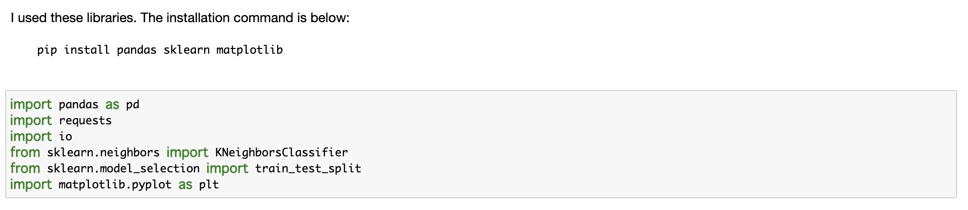
Installing Libraries

Slide 7
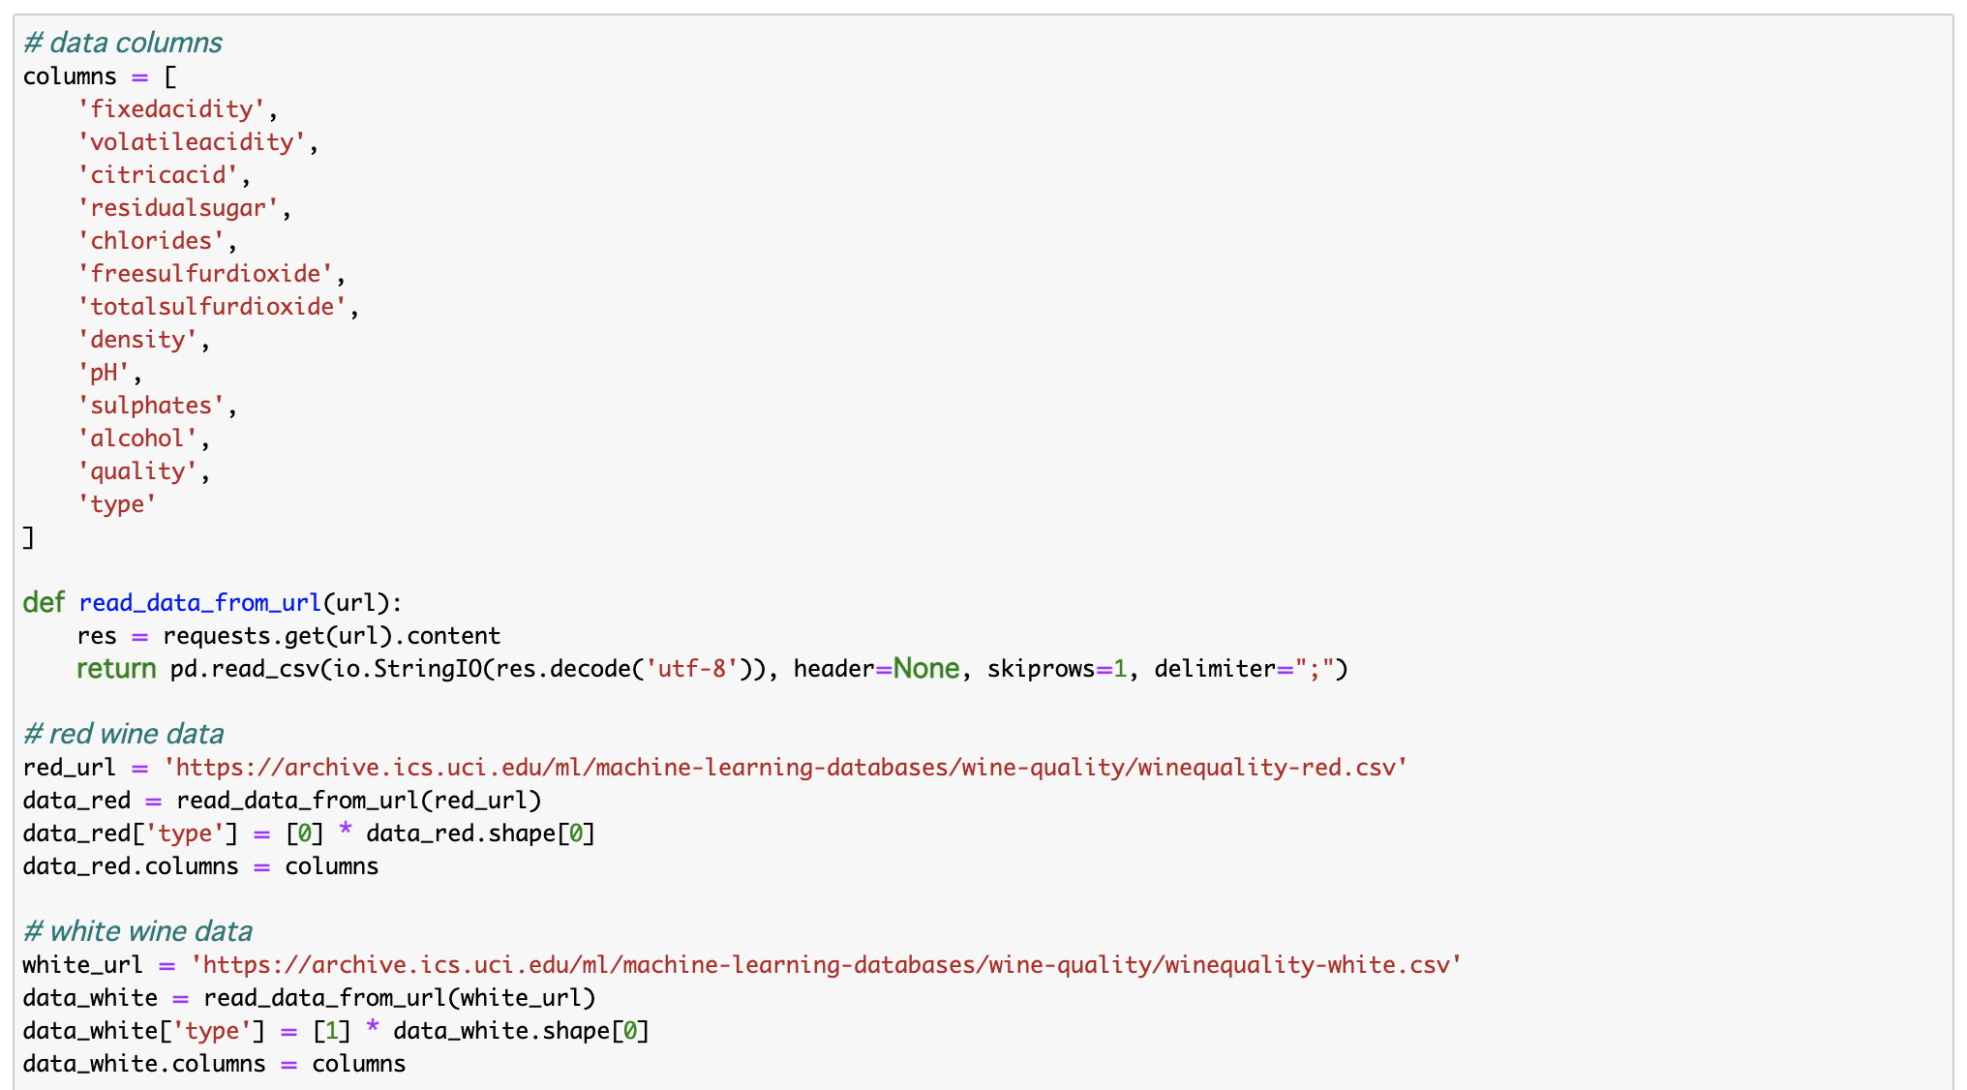
Importing Data
The column “type” added

Slide 8
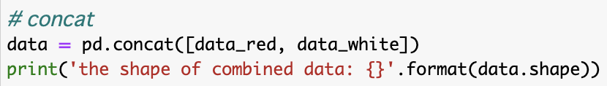
6,497 data in total

Slide 9
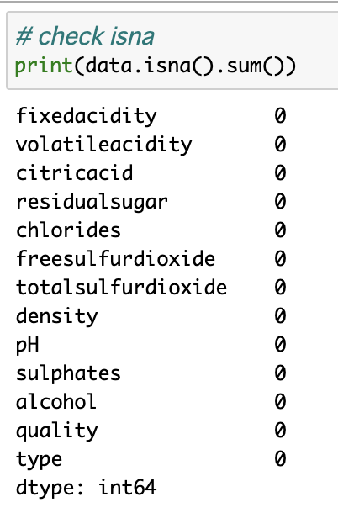
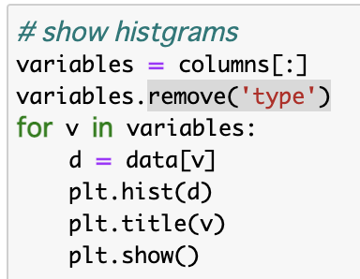
Describing and Cleansing Data

Slide 10
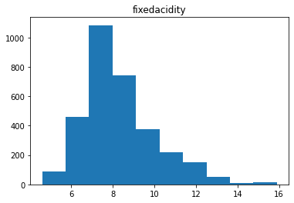
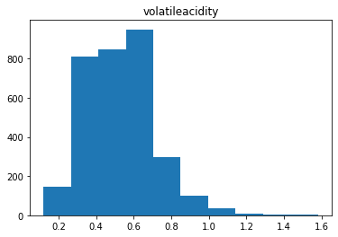
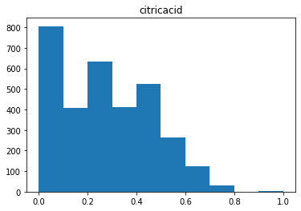
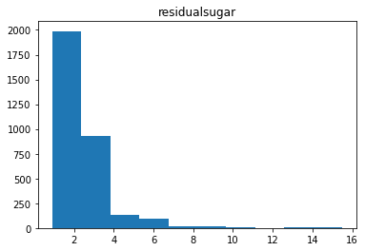

Slide 11
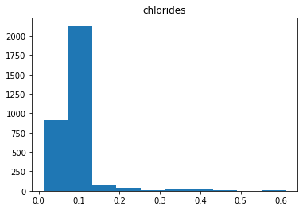
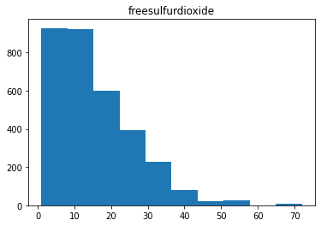
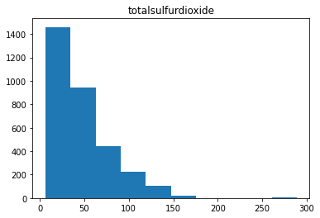
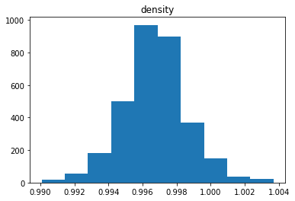

Slide 12
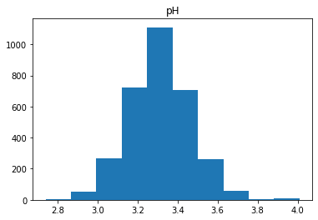
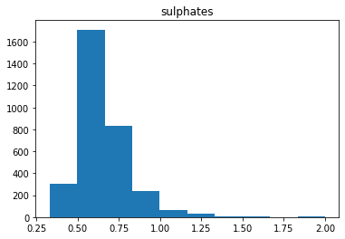
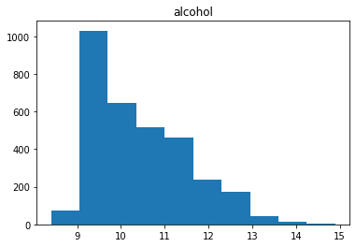

Slide 13
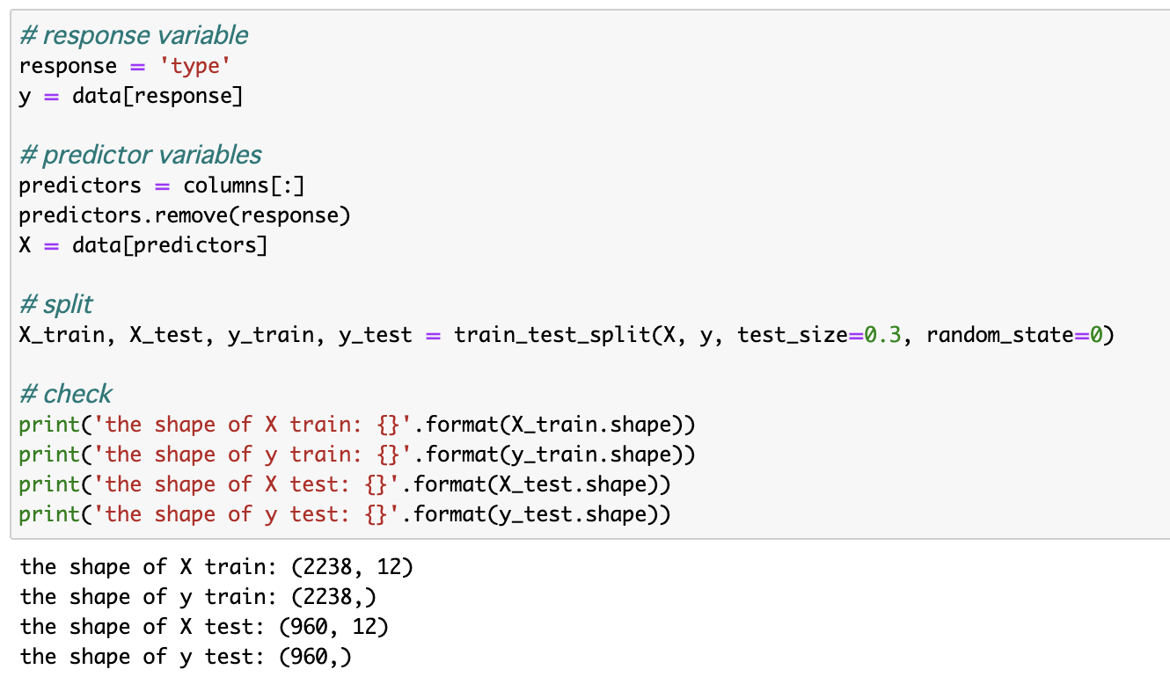
Splitting Data for Train and Test
train: 70%
test: 30%

Slide 14
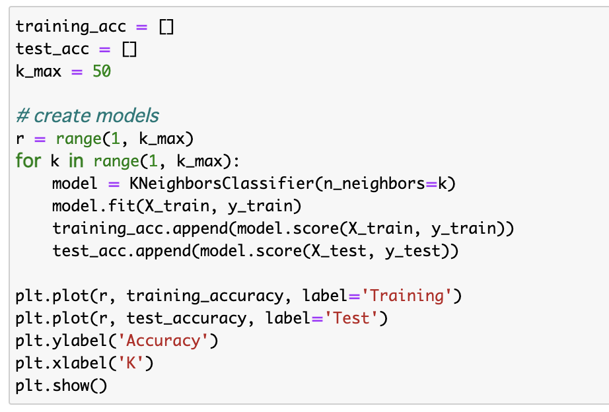
Creating Models

Slide 15
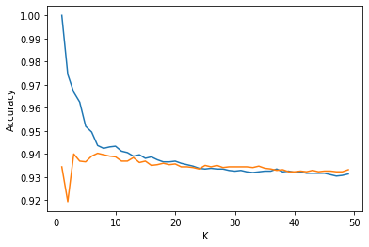
Around here looks the best

Slide 16
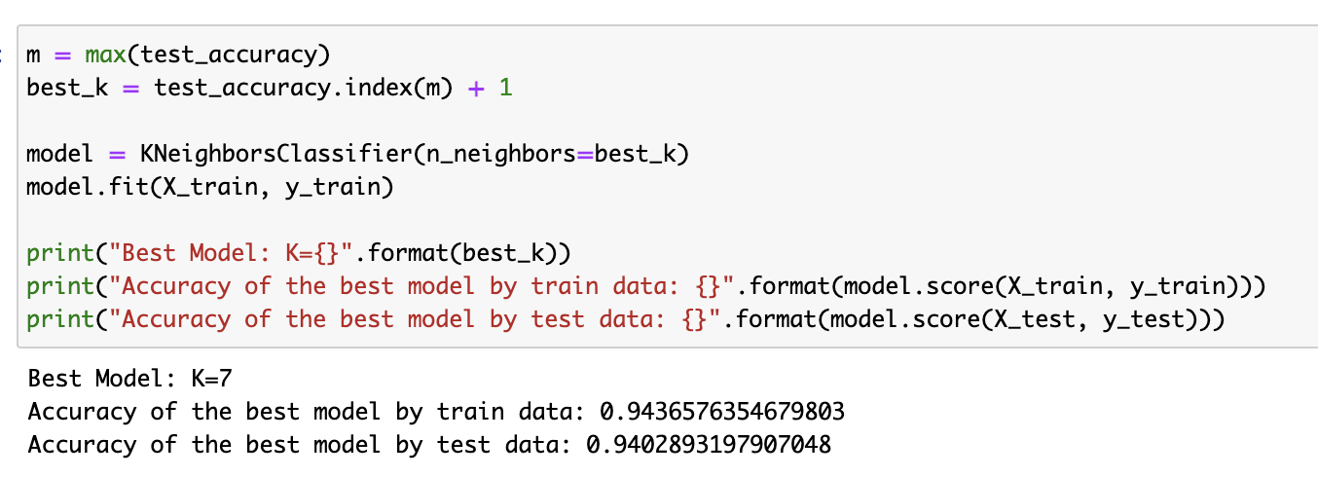
Model Analysis

Slide 17
Conclusion
As we can see, the best model is K=7 and its accuracy is about 0.940 for test data.

