Slide 1


HELEN KOWALEWSKA
ESRC POSTDOCTORAL FELLOW
UNIVERSITY OF SOUTHAMPTON
Bringing Women on Board? Family Policies, Quotas, and Gender Diversity in Top Jobs
ESA Annual Conference, Manchester
21 August 2019
@helenkowalewska
H.R.Kowalewska@soton.ac.uk

Slide 2
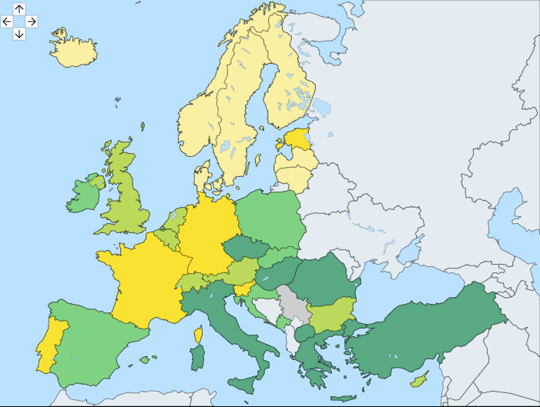
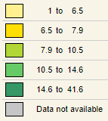

Fig. 1 Gender employment gap by country (percentage points), 2017
Generous welfare states bring women into employment
Scandinavian countries = gender equality ‘leaders’ (e.g. Esping-Andersen, 2002; Gornick & Meyers, 2009; Mahon, 2002):
Well-developed leaves and childcare services
Family-friendly public-sector jobs
Source: Eurostat

Slide 3
The welfare state ‘paradox’
Mandel & Semyonov, 2006
Policies that bring women into employment also hamper women’s progress to managerial jobs in the private sector
Public-sector employment is dominated by women
Women’s human capital deteriorates during leaves
Fig. 2 Share of working women who are managers, 2017
US
US
9.2%
UK
8.6%
Finland
2.3%
Strict employment protection worsens the problem (Estévez-Abe, 2005, 2006)
Statistical discrimination
Sweden
4.9%

Slide 4

But existing research does not consider women’s access to board positions…

Slide 5
Paradox theory can’t explain cross-national patterns of women’s board membership
USA: 23%
Fig. 3 Women’s share of board seats, 2018
Sources: EIGE; MSCI; Spencer Stuart

Slide 6



Policy approaches to women on boards across 24 OECD countries (2018)
‘Hard’ quotas
(5)
‘Soft’ regulation
(9)
No regulation
(10)
Belgium (33% by 2017)
France (40% by 2017)
Germany (30% by 2016)
Italy (33% by 2015)
Norway (40% by 2008)
Australia
Austria
Denmark
Finland
Japan
Netherlands
Spain
Sweden
UK
Czech Republic
Estonia
Hungary
Ireland
Luxembourg
Poland
Portugal
Slovakia
Slovenia
US

Slide 7


Gender-diverse boards can benefit everyone
Trickle-down benefits for other women (Kowalewska, 2019)
Improved company outcomes

Slide 8
This study
To identify the conditions under which gender-diverse boards are achieved.
AIM
Fuzzy-set Qualitative Comparative Analysis of 24 OECD countries using fsQCA software 3.0 (+ sensitivity analyses).
METHOD
Eurostat, OECD’s Family Database, Government at a Glance Database, and Employment and Labour Market Statistics, Deloitte, EIGE, Multilinks Database, national sources
DATA SOURCES

Slide 9
Fuzzy-set QCA: an illustration
Conditions
X
Outcome, Y
B
Y is present
A
Y is absent
Therefore:
X+B OR A => Y

Slide 10
This study
Condition #3
Condition #1
Condition #4
Condition #2
Outcome

Slide 11
Condition #1
Condition #3
Welfare State Intervention Index
Condition #4
Condition #2
Outcome

Slide 12
Table 1. Measures used in the Welfare State Intervention Index.
 | Max. ‘women-friendliness’ (Index score = 100) | Min. ‘women-friendliness’ (Index score = 0)
Leave policies
Duration of paid leave for mothers | 52 weeks | 14 weeks
Average replacement rate | 100% | 20%
Childcare services
Spending on childcare per capita (US$ PPP), average across 0-4 age groups Enrolment rates of under-5s Elder care services Share of 65+ in home/residential care | $9,589 90% 22% | $0 10% 0%
Welfare state as employer
% of workforce employed in general government | 35% | 10%

Slide 13
Condition #2
Condition #3
Welfare State Intervention Index
Condition #4
Strict employment protection
Outcome

Slide 14
Condition #3
Strict employment protection
Welfare State Intervention Index
Condition #4
‘Hard’ quota
Outcome

Slide 15
Condition #4
Strict employment protection
Welfare State Intervention Index
‘Hard’ quota
‘Soft’ regulations
Outcome

Slide 16
Outcome
Strict employment protection
Welfare State Intervention Index
‘Hard’ quota
‘Soft’ regulations
≥30% women on boards
Women must comprise a ‘critical mass’ of ≥30% of board members to exert power and influence (e.g. Konrad et al., 2008; Krook, 2009; Torchia et al., 2011)

Slide 17
Results
Strict employment protection
CZE, EST
Welfare State Intervention Index
‘Hard’ quota
‘Soft’ regulations
AUS, IRE,JPN, NLD, UK
FRA, NOR
DEN, FIN, SWE
‘Hard’ quota
LUX
BEL, DEU, ITA
AUT, PRT, ESP
≥30% women on boards
HUN, POL, SVK, SVN, US
<30% women on boards

Slide 18
Results
Strict employment protection
CZE, EST
Welfare State Intervention Index
‘Hard’ quota
‘Soft’ regulations
AUS, IRE,JPN, NLD, UK
Two pathways to the outcome:
‘Hard’ quota OR
‘Soft’ regs + generous welfare state + weak employment protection
FRA, NOR
DEN, FIN, SWE
‘Hard’ quota
LUX
BEL, DEU, ITA
AUT, PRT, ESP
≥30% women on boards
HUN, POL, SVK, SVN, US
<30% women on boards

Slide 19
Take-home message
‘Hard’ quotas work, but so can policy ‘soft’, voluntary regulations – though government intervention is required
‘Soft’ quotas can work…
Soft quotas only work under certain conditions. Elsewhere, hard quotas may be necessary
…But not everywhere
Soft quotas can ‘offset’ the negative effects of generous welfare states
Highly-skilled women’s access to top jobs need not forever be blocked by generous family policies

Slide 20
Thank you for listening!
@helenkowalewska
H.R.Kowalewska@soton.ac.uk

Slide 21
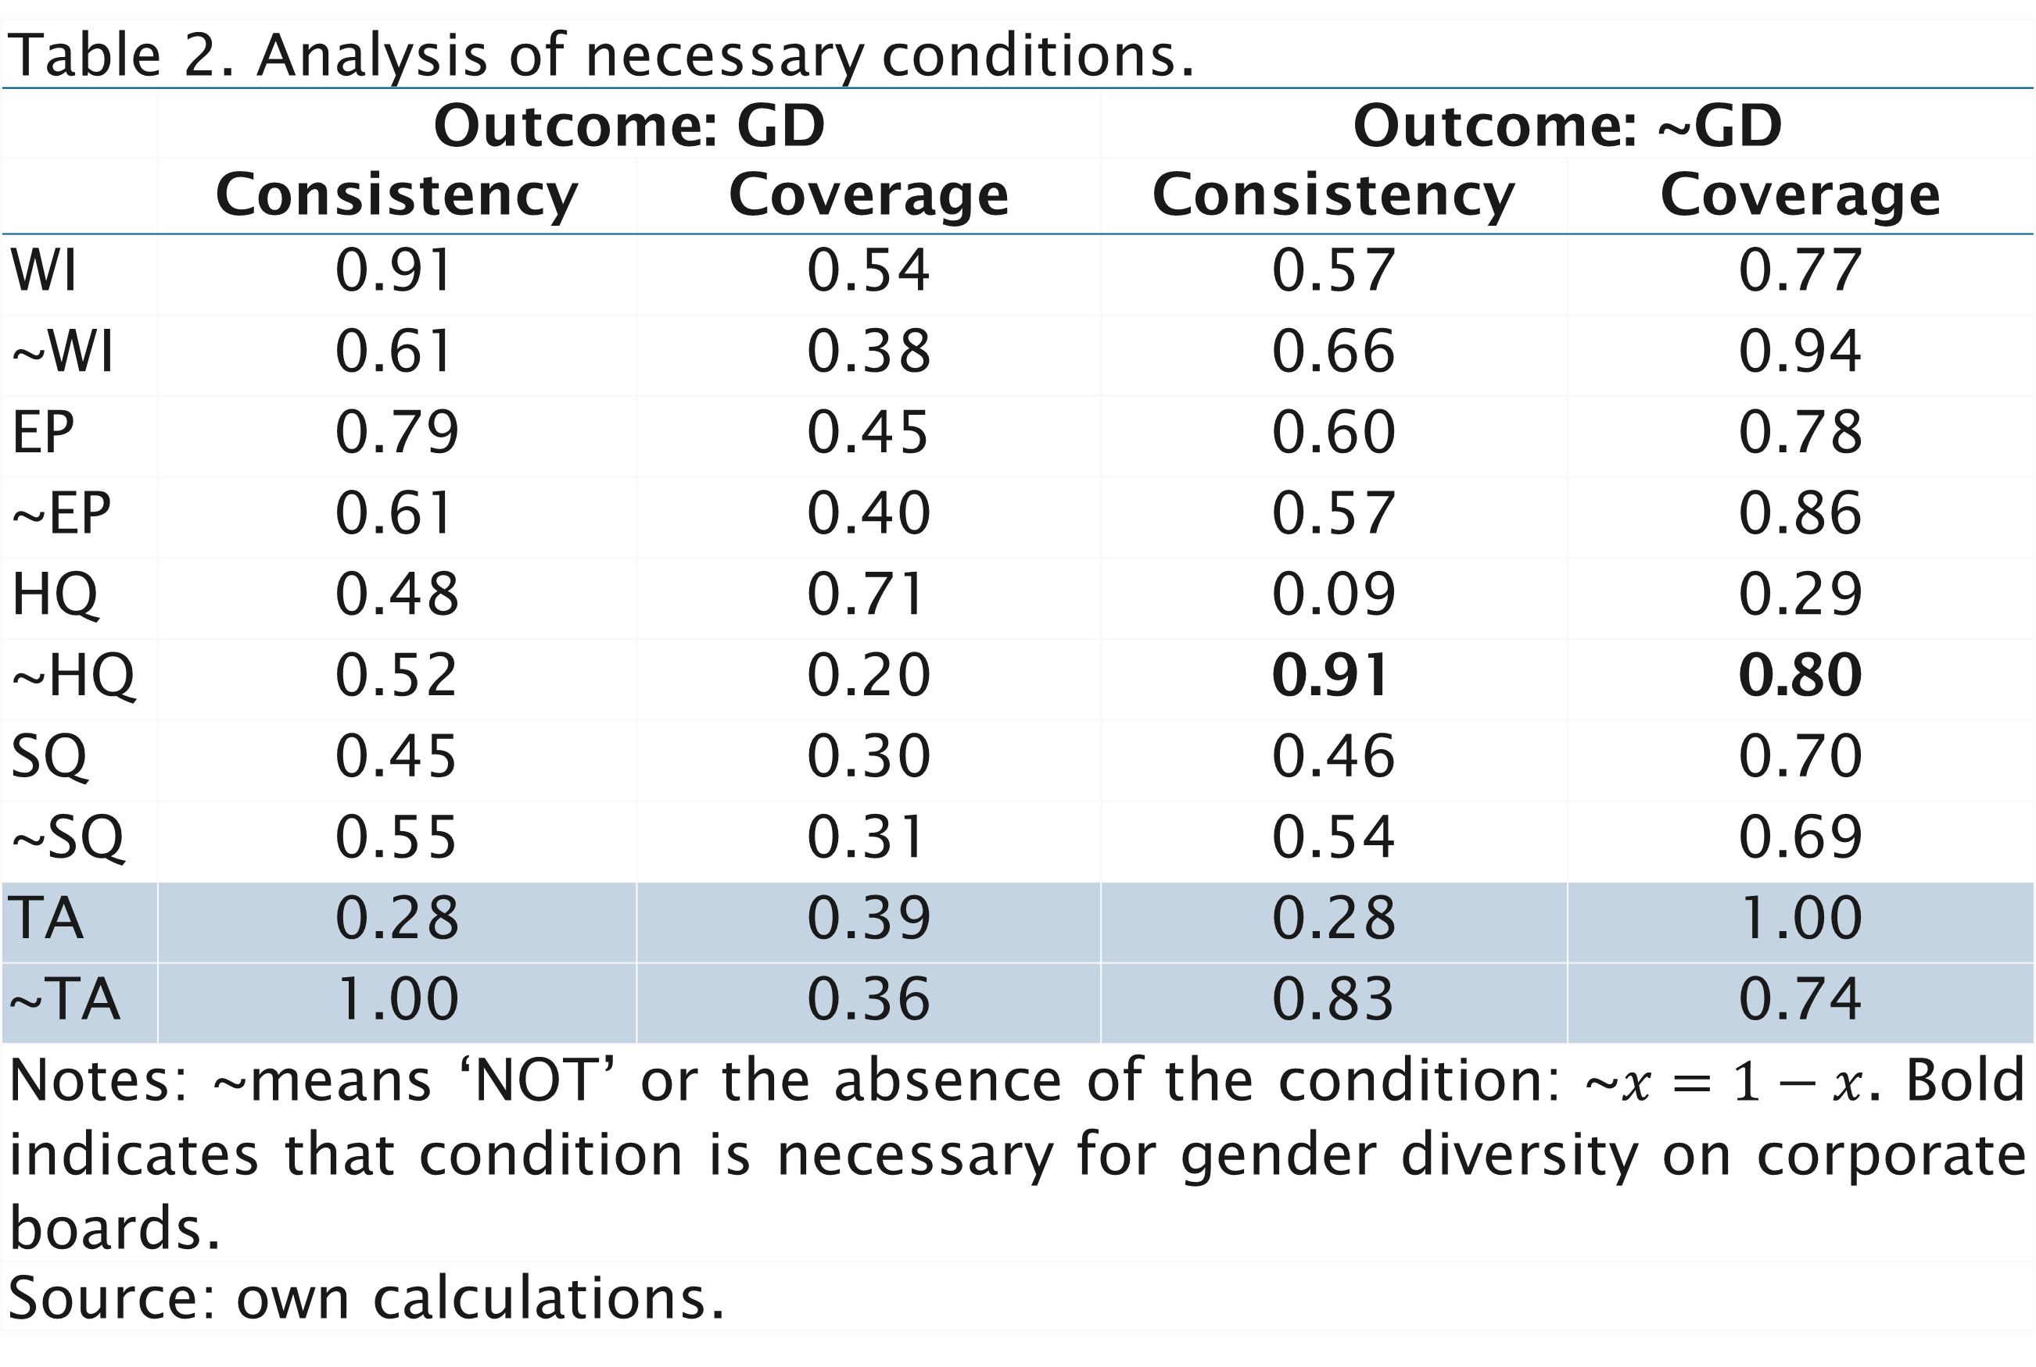
Table 2. Analysis of necessary conditions.
 | Outcome: GD |  | Outcome: ~GD
 | Consistency | Coverage | Consistency | Coverage
WI | 0.91 | 0.54 | 0.57 | 0.77
~WI | 0.61 | 0.38 | 0.66 | 0.94
EP | 0.79 | 0.45 | 0.60 | 0.78
~EP | 0.61 | 0.40 | 0.57 | 0.86
HQ | 0.48 | 0.71 | 0.09 | 0.29
~HQ | 0.52 | 0.20 | 0.91 | 0.80
SQ | 0.45 | 0.30 | 0.46 | 0.70
~SQ | 0.55 | 0.31 | 0.54 | 0.69
TA | 0.28 | 0.39 | 0.28 | 1.00
~TA | 1.00 | 0.36 | 0.83 | 0.74
Notes: ~means ‘NOT’ or the absence of the condition: ~$x=1−x$. Bold indicates that condition is necessary for gender diversity on corporate boards.
Source: own calculations.

Slide 22
Table 3. Truth table.
 | Conditions |  |  |  | Outcome | Number of cases
Row | WS | EP | HQ | SQ | GD
1 | 0 | 0 | 0 | 1 | 0 | 5
2 | 1 | 1 | 1 | 0 | 1 | 4
3 | 1 | 1 | 0 | 0 | 0 | 3
4 | 1 | 0 | 0 | 1 | 1 | 3
5 | 0 | 0 | 0 | 0 | 0 | 3
6 | 1 | 0 | 0 | 0 | 0 | 2
7 | 0 | 1 | 0 | 1 | 0 | 2
8 | 1 | 1 | 0 | 1 | 0 | 1
9 | 0 | 1 | 1 | 0 | 1 | 1
10 | 1 | 1 | 1 | 1 | ζ | 0
11 | 1 | 0 | 1 | 1 | ζ | 0
12 | 1 | 0 | 1 | 0 | η | 0
13 | 0 | 1 | 1 | 1 | ζ | 0
14 | 0 | 1 | 0 | 0 |  | 0
15 | 0 | 0 | 1 | 1 | ζ | 0
16 | 0 | 0 | 1 | 0 | η | 0
Rows 10-16: logical remainders. ζ impossible remainder, i.e. cannot empirically exist, as countries either have hard quotas (belong to HQ) OR soft quotas (belong to SQ) – therefore assigned a score of 0 for GD. η ‘good’ counterfactual based on theory: ~HQ is necessary for ~GD – therefore, ~GD cannot exist in the presence of HQ; hence countries with HQ, i.e. compulsory quotas requiring at least 30% women on boards, will surely have at least 30% of women on boards and so are assigned a score of 1 for GD. A sensitivity analysis (SA1) gives insight into the impacts of this assumption on the results.
Source: own calculations.

Slide 23
Table 4. Fuzzy set membership scores in causal pathways and the outcome.
 | Pathways |  | Outcome
Country | 1 | 2
Australia | 0.00 | 0.36 | 0.48
Austria | 0.00 | 0.37 | 0.24
Belgium | 1.00 | 0.00 | 0.64
Czechia | 0.00 | 0.00 | 0.01
Denmark | 0.00 | 0.54 | 0.53
Estonia | 0.00 | 0.00 | 0.00
Finland | 0.00 | 0.56 | 0.62
France | 1.00 | 0.00 | 0.84
Germany | 1.00 | 0.00 | 0.57
Hungary | 0.00 | 0.00 | 0.01
Ireland | 0.00 | 0.23 | 0.14
Italy | 1.00 | 0.00 | 0.59
Japan | 0.00 | 0.39 | 0.00
Luxembourg | 0.00 | 0.00 | 0.01
Netherlands | 0.00 | 0.49 | 0.07
Norway | 1.00 | 0.00 | 0.91
Poland | 0.00 | 0.00 | 0.01
Portugal | 0.00 | 0.24 | 0.02
Slovakia | 0.00 | 0.00 | 0.06
Slovenia | 0.00 | 0.00 | 0.24
Spain | 0.00 | 0.13 | 0.04
Sweden | 0.00 | 0.69 | 0.74
UK | 0.00 | 0.46 | 0.43
US | 0.00 | 0.00 | 0.12
Consistency | 0.71 | 0.69
Raw coverage | 0.48 | 0.42
Unique coverage | 0.48 | 0.42
Solution coverage (1+2) | 0.91
Pathway 1: HQ Pathway 2: WI*~EP*SQ
Source: own calculations.

Slide 24
Table 5. Details of the sensitivity analyses.
Sensitivity analysis | Impact on results
Dropped assumption regarding ‘good’ counterfactuals by leaving logical remainders with a score of 1 for HQ empty. | New solution: EP*HQ + WI*~EP*SQ; country placements unchanged. Thus, hard quotas are only effective if combined with strong employment-protection legislation. However, this may be because those countries that have introduced hard quotas also have stringent employment protection, rather than strong employment-protection legislation being a necessary part of the causal recipe.
Dropped Denmark as it is (partially) uncovered, i.e. its membership in the outcome exceeds that in the second causal pathway. | Solution coverage increases from 0.89 to 0.91; country placements unchanged.
Dropped France and Norway as they are ‘typical’ cases, with virtually equal (and relatively high) membership in both the solution and the outcome. | Solution coverage increases from 0.89 to 0.90 and consistency decreases from 0.77 to 0.73; country placements unchanged.
Based the ‘Employment Protection’ condition on employment protection legislation for labour market ‘insiders’, i.e. regular employees, only (EP_R). | Solution: HQ only and coverage decreases to 0.51.
Reduced the breakpoints for the outcome, GD, by 5%: 40% = 1.0; 25% = 0.5; 15% = 0.0. | Solution coverage decreases from 0.89 to 0.73; country placements unchanged.

Slide 25
Table A1. Variables and data sources.
Conditions
‘Welfare Interventions’ (WI) | Index comprising: (1) maternity and parental leaves available to mothers; (2) spending on childcare and enrolment rates; (3) coverage of elder care services; (4) share of workforce employed in general government. Data sources and years are as follows: (1) The OECD Family Database, 2018. (2) The OECD Family Database for spending data, 2015 (2014 for Poland); The OECD Family Database and EU-SILC survey for enrolment rates, 2016/17 (2015 for Japan, 2011 for the US). (3) The OECD Health Database, 2017 (2016 for the Netherlands, Slovenia and the US, 2014 for Denmark, 2009 for the Czech Republic). Data for Austria and the UK come from the Multilinks Database (https://multilinks-database.wzb.eu/), 2004. Data for Belgium and Ireland are combined from both sources for the latest available years. (4) The OECD Government at a Glance Database, 2015 (2008 for Australia, 2014 for Portugal).
‘Employment Protection’ (EP) | OECD’s index of employment protection (unweighted average of eprc_v3 + ept_v3) from the OECD’s Employment and Labour Market Statistics, 2013. See http://www.oecd.org/els/emp/EPL-Methodology.pdf and http://www.oecd.org/employment/emp/34846856.pdf.
‘Hard Quotas’ (HQ) and ‘Soft Quotas’ (SQ) | Legislation targeted at increasing gender diversity among corporate boards with deadlines on or before October 2018: https://www2.deloitte.com/content/dam/Deloitte/cn/Documents/risk/deloitte-cn-ra-ccg-e1-women-in-the-boardroom-a-global-perspective-fifth-edition.pdf; http://kompetentsikeskus.volinik.ee/wp-content/uploads/2018/04/2018ReportonequalitybetweenwomenandmenintheEU.pdf; https://www.ifo.de/DocDL/dicereport313-db3.pdf; https://www.equalitylaw.eu/downloads/4537-gender-balanced-company-boards-in-europe-pdf-1-68-mb
Outcome
‘Women on Boards’ (WB) | Percentage of board positions held by women across the largest companies: https://eige.europa.eu/gender-statistics; https://www.womenonboards.net/womenonboards-AU/media/AU-BDI-2018/ASX200_2018_PercentageFemaleDirectors.pdf; https://www.spencerstuart.com/-/media/2018/november/bi-belgium-2018b.pdf?la=en&hash=52F5A3753B1F07E848C2F23E5B61088754C32B20; https://www.msci.com/documents/10199/36ef83ab-ed68-c1c1-58fe-86a3eab673b8

