Slide 1

SMART INDIA HACKATHON 2026
• Problem Statement ID – 26154
• Problem Statement Title - Gen AI Platform for Automated Content Transformation
• Theme - Miscellaneous / AI
• PS Category - Software
• Team ID - 104580
• Team Name - HRL
• Project Resources - https://github.com/hrlpavan/omnitransform-ai-resources

Slide 2

HRL
OMNITRANSFORM (ALL-IN-ONE) AI CONTENT PLATFORM
Proposed Solution Overview
Key Feature & Technology
Innovation & Social Impact
● Simple Web Platform: A clean and fast web application built for government officers, analysts, and students.
● Upload Any Document: Takes long PDFs, research whitepapers, and government reports up to 100+ pages.
● 5 Output Formats in Seconds: Automatically creates 1-page memo, presentation slides, infographics, press release, and 60s voice audio.
● Saves Hours of Manual Work: Officers save 4 to 6 hours daily spent on manually typing summaries and designing PPTs.
● Accurate Page References: Every bullet point links directly to the exact page and line in the original PDF file.
● Works 100% Offline: Can be installed on local office servers without sending sensitive data to the internet.
● Smart PDF Parser: Extracts clean text, headings, and complex tables using PyMuPDF and pdfplumber.
● Fast AI Summarization: Uses open-source Llama 3 and Mistral models to extract key decisions and highlights.
● Slide Deck Creator: Converts raw notes into clean, formatted PowerPoint slides ready for team meetings.
● Multilingual Press Release: Translates official summaries into Hindi, English, and regional Indian languages.
● 60-Second Audio Podcast: Generates clear voice audio briefings using local Piper neural text-to-speech.
● Safe & Private Database: Stores files in a local secure database with zero third-party cloud tracking.
● All-in-One Solution: Replaces 5 separate tools into one simple dashboard (Summary + PPT + Audio + Image + Translate).
● Zero Hallucinations: The AI is locked to only use facts from the uploaded document, preventing fake numbers.
● Click-to-Verify Citations: Clicking any summary sentence instantly opens the PDF with the exact sentence highlighted.
● Regional Language Reach: Helps common citizens read complex government schemes in their own local language.
● Fast Decision Making: Leaders and senior officers can review urgent threat alerts in under 1 minute.
● Low Cost & Open Source: Built on free open-source software with no expensive monthly API bills.
@SIH Idea submission- Template
2

Slide 3
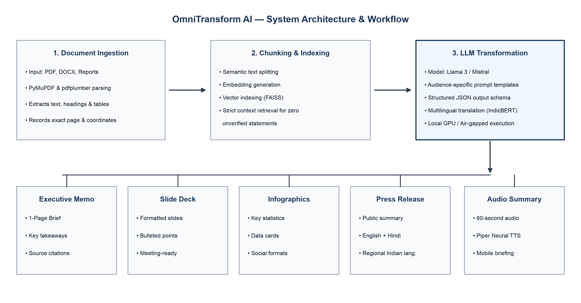
HRL
TECHNICAL APPROACH
• Technologies that are used are Programming languages like
JavaScript with React / Next.js (Web app development),
Python FastAPI (Backend server & API),
PyMuPDF & pdfplumber (PDF text & table extraction),
Llama 3 / Mistral (AI summarization & text processing),
IndicBERT (Multiple Indian Language Translation),
SQLite / Vector DB (Database).
• Methodology and process for implementation :
1) User uploads PDF / Document to web dashboard
2) Parser extracts text, headings, and data tables
3) AI creates 1-page summary & formatted slide deck
4) Audio engine synthesizes 60s voice podcast briefing
5) User previews live and downloads all 5 files
APP PROTOTYPE & RESOURCE REPOSITORY LINK
https://github.com/hrlpavan/omnitransform-ai-resources
@SIH Idea submission- Template
3

Slide 4
HRL
FEASIBILITY AND VIABILITY
ANALYSIS OF THE FEASIBILITY OF THE IDEA
● Technical & Practical Feasibility: Built using standard open-source tools like Python, React, and local AI models. Works smoothly on a standard office laptop or PC.
● Easy Offline Deployment: The complete software runs inside Docker containers on local office computers without needing an active internet connection.
POTENTIAL CHALLENGES
● Complex Tables & Charts: Dense multi-column tables in scanned PDFs can be hard to parse accurately.
● Processing Speed on Long Files: Converting 100+ page documents requires efficient processing to stay under 10 seconds.
STRATEGIES TO OVERCOME CHALLENGES
● Smart Table Parser: Use layout-aware coordinate parsers (pdfplumber) to keep table rows and numbers intact.
● Parallel Page Processing: Split chapters into parallel worker tasks so long reports are summarized in seconds.
KEY FEASIBILITY HIGHLIGHTS
[+] Low Cost Runs on free open-source models with no recurring software license fees.
[+] Zero Setup Packaged in Docker for simple 1-click startup on any Windows/Linux machine.
[+] Complete Privacy No data leaves the office network; 100% safe for official government documents.
[+] High Accuracy Direct page citations guarantee zero fake or made-up facts in summaries.
@SIH Idea submission- Template
4

Slide 5
HRL
IMPACT AND BENEFITS
Impact
For Instance: User Story
● Saves Analyst Time: Reduces 4 to 6 hours of manual report writing to under 10 seconds.
● Faster Decision Making: Officers can quickly read 1-page executive memos during urgent meetings.
● Regional Language Reach: Converts central government policies into Hindi, Kannada, and local Indian languages.
Scenario: Rahul, an intelligence analyst at a government agency, receives a 50-page technical threat report at 9:00 AM. He has to present the key findings to senior officers in a 9:30 AM meeting.
Problem: Reading the full 50 pages and manually typing summary slides takes at least 3 hours. Finding the most critical points in a hurry can lead to missing important details.
Impact with OmniTransform: Rahul uploads the PDF to OmniTransform. In 10 seconds, the platform gives him:
● 1-Page Summary Memo Clear bullet points with key highlights and numbers.
● 5 Presentation Slides Formatted and ready to project in the meeting room.
● Clickable Citations Rahul clicks any bullet point to show the exact page in the raw PDF.
Benefits: Rahul walks into the 9:30 AM meeting fully prepared with accurate, verified facts. What used to take 3 hours was finished in under 10 seconds.
Benefits
● Cost Effective: Eliminates high costs of outsourcing presentation design and document translation.
● 100% Data Privacy: Sensitive government intelligence remains inside local servers without leaks.
● Easy Mobile Access: Field staff can listen to 60-second audio summaries on their mobile phones.
@SIH Idea submission- Template
5

Slide 6
HRL
RESEARCH AND REFERENCES
❖ MASTER RESOURCE REPOSITORY & CODE: https://github.com/hrlpavan/omnitransform-ai-resources
❖ OPEN-SOURCE DATASETS & MODELS GUIDE: https://github.com/hrlpavan/omnitransform-ai-resources/blob/main/OPEN_SOURCE_RESOURCES_AND_DATASETS.md
❖ TECHNICAL DEVELOPMENT SPECIFICATION: https://github.com/hrlpavan/omnitransform-ai-resources/blob/main/PROJECT_DEVELOPMENT_SPECIFICATION.md
❖ SMART INDIA HACKATHON 2026 OFFICIAL PORTAL (PS ID 26154): https://www.sih.gov.in/sih2026PS
❖ NATIONAL TECHNICAL RESEARCH ORGANISATION (NTRO) PORTAL: https://ntro.gov.in
❖ RESEARCH ON RAG & CITATIONS (LEWIS ET AL. 2020): https://arxiv.org/abs/2005.11401
@SIH Idea submission- Template
6

