Slide 1

Environment
The robot is intend to work in a nuclear facility.
The robot is made to work in the and in the water.
The robot will interact with environment through:
Normal environment conditions (rain, water, Snow etc.).
In the potential fire facility.
Potential nuclear radiation environment.
Control Unit for the operations control.
Cargo which contain (people, equipment and carriable weightage).

Slide 2
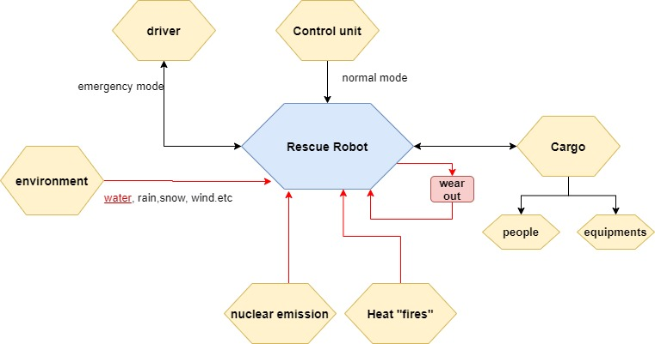
Environment

