Slide 1
Requirements list
No. | Requirements description | D/W
1 | Geometry and design | -
1.1 | Length = 2500 mm | D
1.2 | Width= 1500 mm | D
1.3 | Height = 1500 mm | D
1.4 | Can carry 3 persons (up to 280lb). | D
1.5 | Door shall open from both sides | D
1.6 | Chairs can be folded to use the robot to carry equipment | D
1.7 | Wires and electrical components shall be well isolated from water. | D
1.8 | The robot shall withstand a heat of up to 450 Celsius | D
1.9 | The robot should be made of anti-radiation materials (like lead). | D

Slide 2
Requirements list
2 | Functional requirements | -
2.1 | The robot shall have an 4 electric motor for air motion and a separate motor for water motion. | D
2.2 | The robot shall move with a speed up to 60 mph | D
2.3 | doors shall be able to close automatically | D
2.4 | The system shall be able to run in normal and emergency mode | D
2.5 | The system can switch to the emergency mode automatically or by a user | D
2.6 | The system is provided with a collection of sensors to gather environment changes. | D
2.7 | The system should be able to send all information to the control unit regularly | D
2.8 | The system shall contain a monitoring camera inside the cabinet | D
2.9 | The system shall contain a user manual for manual driving mode | W

Slide 3
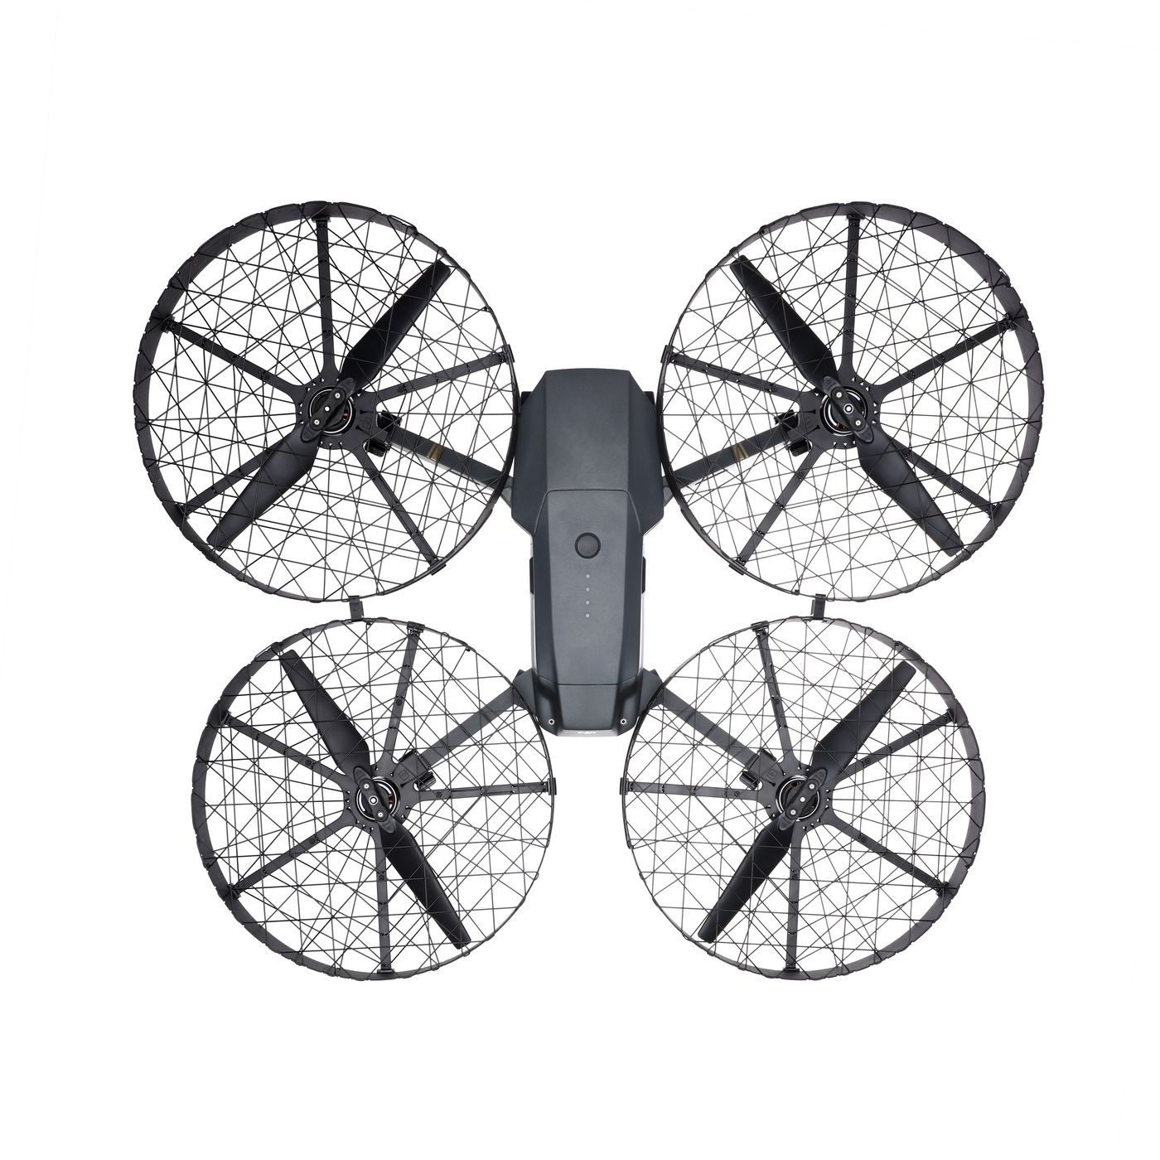
Requirements list
3 | Safety and reliability | -
3.1 | The system shall be provided with solar cells, backup batteries to guarantee no energy shortage | D
3.2 | The system shall stop to move in case of connection failure and switch to manual mode | D
3.3 | The motors blades shall be protected with a shield against any potential animal interfering | D
3.4 | The system should provide First Aid Kit and emergency medical assistance. | W
3.5 | The system should provide an open connection between the control unit and people in the robot | D
3.5 | The system shall detect unauthorized access or hacking and switch to the manual mode when fail to handle the hacking. | D
https://www.theverge.com/circuitbreaker/2017/2/8/14551346/dji-mavic-pro-accessory-battery-propeller

