Slide 1
Flood Protection: Deep Learning for
Water Stage Prediction
Surrogate DL models vs. a 1D–2D HEC-RAS benchmark
1
Notes:
[Sources] - Uploaded paper Paper.pdf, p. 1: title, abstract, and overall claim that DL models outperform HEC-RAS and deliver >500× speedup. - Uploaded paper Paper.pdf, p. 3 (Figure 1): study-area map used as the right-side asset.

Slide 2
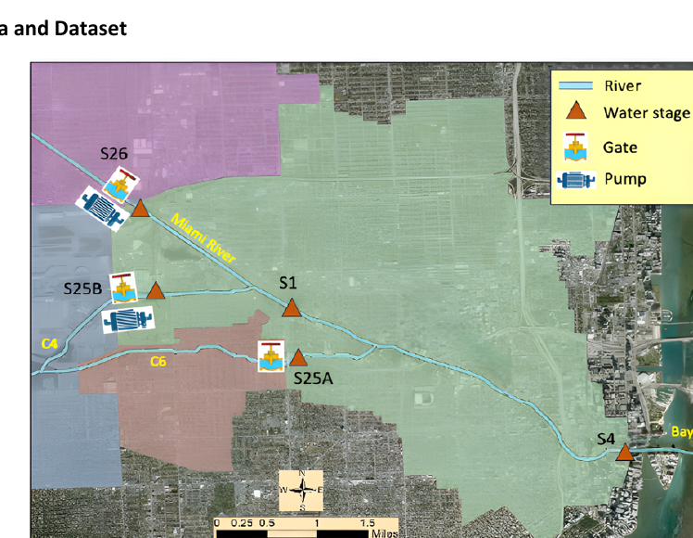
Study area and dataset
A demanding water-resources forecasting problem
11 years of hourly records
5 gauged stations
4 target stages
1D–2D HEC-RAS benchmark
• Lower 5.6 miles of the Miami River plus tributaries C4 and C6.
• Downstream water levels are strongly affected by Biscayne Bay tides.
• Hydraulic structures at S25A, S25B, and S26 include gates and/or pumps.
• Inputs include rainfall, tide at S4, gate flow, pump flow, and recent water stages.
Targets: water stage at S1 and tailwater stage at S25A, S25B, and S26.
2
Notes:
[Sources] - Uploaded paper Paper.pdf, pp. 3-4: study reach, station locations, hydraulic structures, and data features. - Uploaded paper Paper.pdf, p. 3 (Figure 1): map asset. - Uploaded paper Paper.pdf, p. 4: 11-year hourly data record and feature list.

Slide 3
Notebook Example
LSTM Forecasting: Single-Step vs Multi-Step
Forecasting idea
Recent 24 hours -> future forecast
1 hr
Input window
Single-step
Goals
• turn hourly data into LSTM samples
• compare 1-step and 24-step forecasts
• connect model choice to operations
Input window
24-step path
Notes:
[Sources] Derived from uploaded notebook /mnt/data/lstm_workshop_compare_single_vs_multistep.ipynb, especially markdown cells 0, 16, 21, 27, and 29.

Slide 4
Dataset and notebook setup
Hourly rows
Numeric inputs
Target
Train / test
96,432
19
WS_S1
80% / 20%
Preprocessing
Arrays after setup
Datetime detected
Numeric columns only
Missing values filled
Time order preserved
Train rows: 77,145
Test rows: 19,287
X_train: (77,145, 19)
y_train: (77,145, 1)
Notes:
[Sources] Derived from notebook cells 3, 5, 6, 7, 9, and 11.

Slide 5
End-to-end workflow
1
Load CSV
2
Clean data
3
Split time
4
Scale X and y
5
Make sequences
6
Fit LSTM
7
Evaluate
Message
Key time-series step
Engineering judgment
Most of the workflow is familiar engineering data preparation.
Sequence creation converts rows into 3D LSTM inputs.
Lookback, predictors, and horizon should match the decision problem.
Notes:
[Sources] Workflow synthesized from notebook sections 1 through 9 and code cells 3, 5-7, 9, 11, 13, 15, 18-20, 23-28.

Slide 6
Sequence design: what the LSTM sees
Single-step: 24 hr -> 1 hr
Notebook tensor shape
t+1
X_train_1 = (77,121, 24, 19) y_train_1 = (77,121, 1)
24 hourly inputs
Multi-step: 24 hr -> 24 hr
Notebook tensor shape
X_train_24 = (77,098, 24, 19) y_train_24 = (77,098, 24)
24 hourly inputs
24 forecast hours
Notes:
[Sources] Derived from notebook markdown cell 12 and code cells 13, 17, and 22.

Slide 7
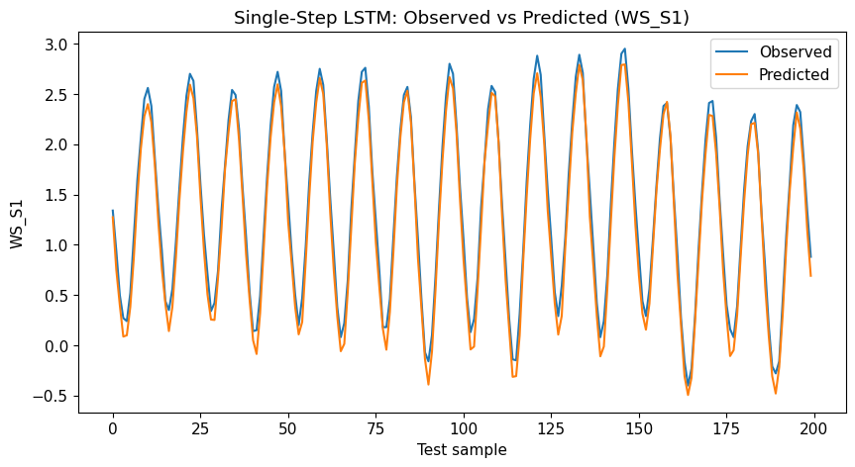
Results: single-step forecast
Test error
RMSE = 0.1329
MAE = 0.1141
What to notice
The prediction tracks the observed oscillation closely.
Meaning
Predicting only the next hour is the easier task.
Notes:
[Sources] Figure and metrics derived from notebook cells 19 and 20.

Slide 8
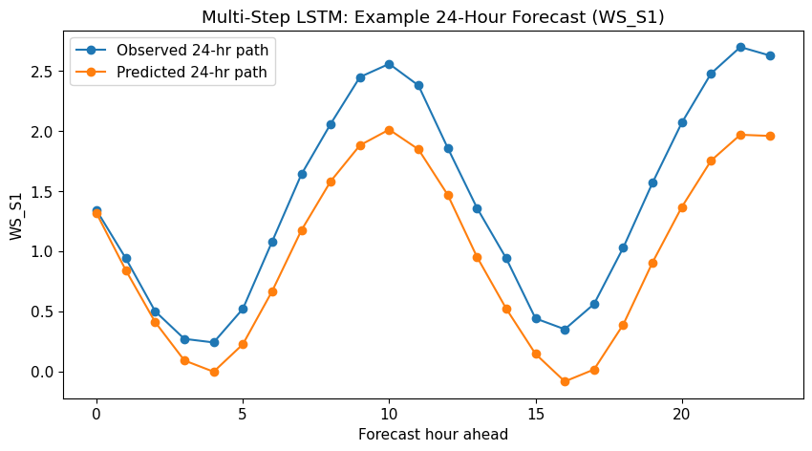
Results: multi-step forecast
Test error
RMSE = 0.2793
MAE = 0.2225
Operational value
The model gives a full 24-hour path in one shot.
Trade-off
A harder task usually means lower accuracy.
Notes:
[Sources] Figure and metrics derived from notebook cells 24 and 25.

Slide 9
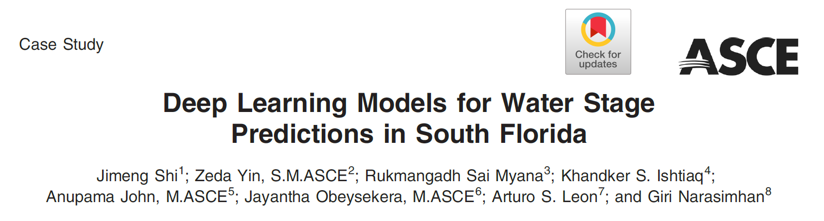

Slide 10
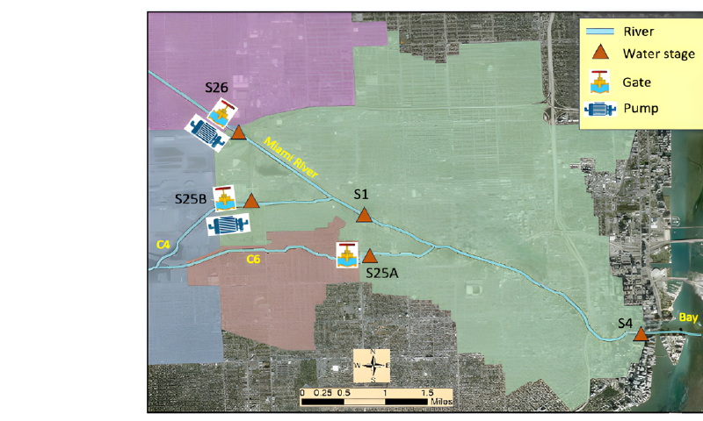
Case study and data
The study focuses on the lower Miami River and uses hourly operational and environmental data.
Study area
Time resolution
5.6 miles of the lower Miami River, plus tributaries C4 and C6.
Hourly data from Jan 2010 through Dec 2020.
Inputs
Targets
Rainfall, tide at S4, gate flows, pump flows, and recent water stages.
Water stage at S1 and tailwater stage at S25A, S25B, and S26.
Train/test split
DL data were min-max normalized. Training = 80% (2010 to Aug 7, 2018); testing = 20% (Aug 8, 2018 to Dec 31, 2020).
Figure 1 from the paper: downstream Miami River, structures, and stage stations
Notes:
[Sources] - Uploaded paper: pp. 3-5 (study area, Figure 1, Table 1, data acquisition, preprocessing, train/test split). - Map image cropped from Figure 1 on p. 3 of the uploaded paper. [/Sources]

Slide 11
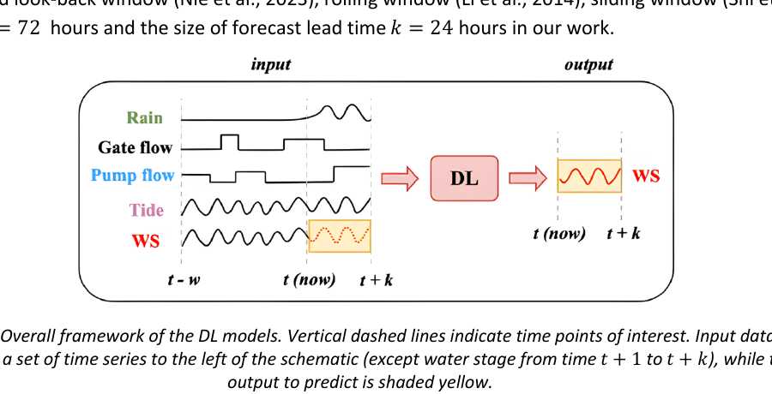
Prediction setup: physics model and DL surrogate
DL surrogate model
HEC-RAS benchmark
• Uses recent system state plus future covariates.
• History window: w = 72 h.
• Forecast horizon: k = 24 h for 4 output locations.
• Future rainfall/tide can come from forecast products; gate/pump settings are assumed scheduled.
• 1D–2D coupled hydraulic model.
• Three upstream flow hydrographs: S26, S25A, S25B.
• One downstream stage boundary: S4.
• 2-year simulation (2019–2020), 1-min computation step, 1-h outputs.
Key distinction: the DL models explicitly exploit both recent memory and future covariates, while HEC-RAS only needs boundary conditions over the prediction period.
3
Notes:
[Sources] - Uploaded paper Paper.pdf, pp. 5-6: HEC-RAS boundary conditions, 2-year simulation setup, and DL formulation. - Uploaded paper Paper.pdf, p. 6 (Figure 2): DL framework schematic used on this slide.

Slide 12
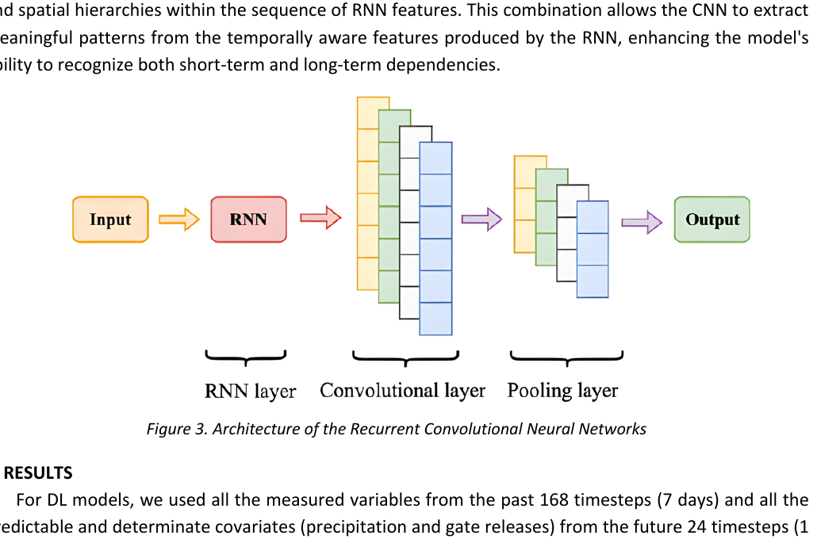
Models tested and what they are meant to capture
Baselines and DL family
Baselines: LR, XGBoost, and HEC-RAS
MLP — nonlinear regression on the flattened input window
RNN — sequence memory for short-term temporal dependence
LSTM — gated recurrent model to reduce vanishing-gradient issues
CNN — local temporal feature extraction across time and variables
RCNN — RNN features followed by CNN pattern extraction
The paper’s intuition: RCNN can learn both sequential dependence (via RNN) and local cross-time / cross-variable patterns (via CNN).
Reported metrics: MAE, RMSE, NSE, and KGE.
4
Notes:
[Sources] - Uploaded paper Paper.pdf, pp. 6-8: descriptions of MLP, RNN, LSTM, CNN, and RCNN. - Uploaded paper Paper.pdf, p. 8 (Figure 3): RCNN architecture asset. - Uploaded paper Paper.pdf, p. 9: definition of MAE, RMSE, NSE, and KGE.

Slide 13
Forecasting workflow in plain language
The models use both recent history and information that is expected or scheduled for the near future.
Recent history
Known or forecast future inputs
Model
Output
Past 72 hours
- water stage
- rainfall
- gate flow
- pump flow
Next 24 hours
- rainfall forecast
- tide forecast
- scheduled gate/pump settings
MLP
RNN
LSTM
CNN
RCNN
Predicted water stage
at t+1 to t+24 hours
Why this is interesting
Lead-time setting
Takeaway
The DL setup uses the “state of the system” from the recent past plus future covariates, while HEC-RAS uses future boundary conditions only.
Look-back window w = 72 h; forecast horizon k = 24 h.
For engineers, feature design matters: the model can only learn from the variables you choose to provide.
Notes:
[Sources] - Uploaded paper: pp. 5-8 (HEC-RAS benchmark, DL workflow in Figure 2, w = 72 h, k = 24 h, descriptions of MLP/RNN/LSTM/CNN/RCNN). [/Sources]

Slide 14
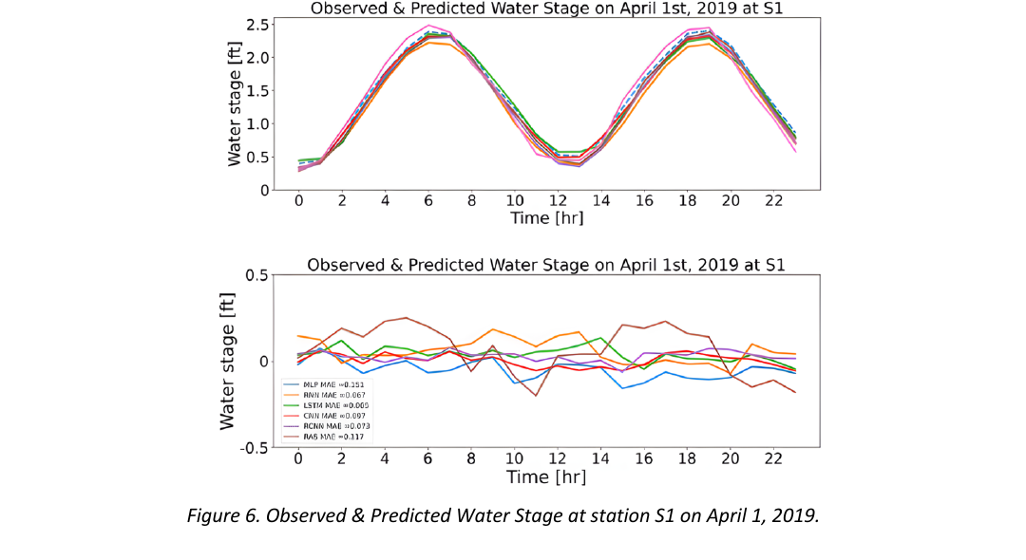
Example hydrograph at S1: normal conditions
On a calm day (April 1, 2019), all models follow the tidal cycle closely, but the DL models produce smaller error traces; in the plotted example RCNN MAE = 0.073 ft versus 0.117 ft for HEC-RAS.
7
Notes:
[Sources] - Uploaded paper Paper.pdf, pp. 13-14 and Figure 6 on p. 13: observed vs predicted water stage at S1 for April 1, 2019. - The MAE values quoted on this slide are read from Figure 6.

Slide 15
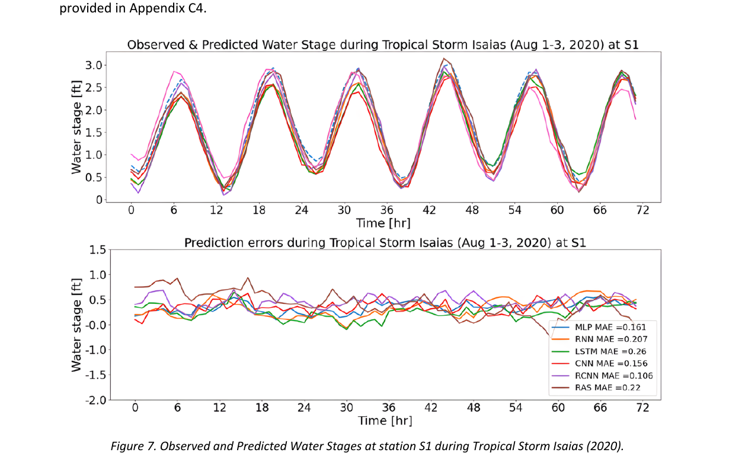
Example hydrograph at S1: Tropical Storm Isaias
During Tropical Storm Isaias (Aug 1–3, 2020), the water stages are higher and more dynamic, but the DL models still outperform HEC-RAS in the plotted 24-hour-ahead example; RCNN MAE = 0.106 ft versus 0.22 ft for HEC-RAS.
8
Notes:
[Sources] - Uploaded paper Paper.pdf, p. 14 and Figure 7: observed vs predicted water stage at S1 during Tropical Storm Isaias (2020). - Uploaded paper Paper.pdf, p. 14: statement that all DL models still outperform HEC-RAS under this extreme storm event. - The MAE values quoted on this slide are read from Figure 7.

Slide 16
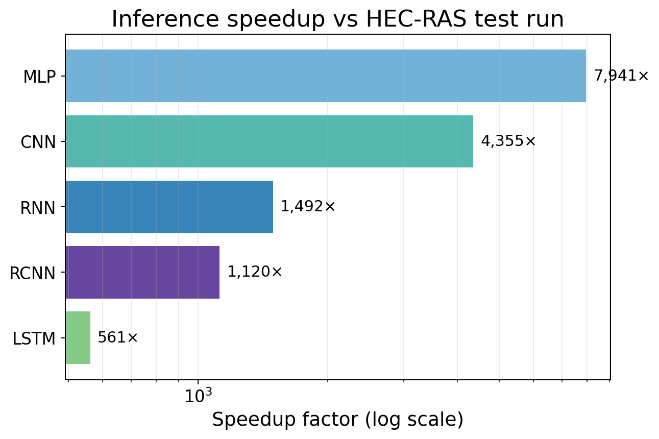
Computation time and engineering takeaways
45 min → 0.34–4.81 s
• Every DL model is at least 500× faster than the HEC-RAS test run; MLP and CNN exceed 4,000×.
• That speed matters for real-time gate/pump operations, fast what-if screening, and flood response.
• Best overall model in this paper: RCNN, because it balances low error, stability over lead time, and >1,000× test-time speedup.
• Practical caveat: the DL model still depends on forecasted rain/tide and on good training data from the river system.
Bottom line for engineers: the paper supports using DL models as fast surrogate predictors alongside, not necessarily instead of, physics-based hydraulic models.
9
Notes:
[Sources] - Uploaded paper Paper.pdf, p. 15 and Table 7: training and test runtimes for HEC-RAS and all DL models. - Uploaded paper Paper.pdf, pp. 1-2 and p. 15: >500× speedup claim and discussion of real-time operations. - Speedup chart on this slide is derived directly from Table 7.

Slide 17
Why this approach matters
The paper addresses a familiar water-resources problem: accurate forecasts are needed, but physics-based simulations can be slow.
Why stage forecasts matter
Conceptual comparison
Water stage prediction supports flood warning, gate and pump operations, and flood mitigation planning.
Physics model
AI/ML surrogate
What limits traditional models?
HEC-RAS
Detailed hydraulics
Many equations
Repeated simulation runs
DL model
Fast inference
Good short-term skill
Useful for operations
learn from
history
HEC-RAS and similar models are physically rich, but they solve many equations over many cells/cross-sections and can be too slow for repeated real-time testing.
Paper idea in one sentence
Train deep learning models as surrogate models: learn the input-output behavior of the river system, then predict water stage in seconds instead of minutes.
Teaching point: In practice, AI/ML often complements physics models rather than replacing them.
Notes:
[Sources] - Uploaded paper: pp. 1-2 (abstract, introduction, motivation, why conventional physics-based models are time-consuming). [/Sources]

Slide 18
Model intuition for beginners
Do not memorize equations first - understand what pattern each architecture is good at learning.
MLP
RNN
LSTM
CNN
RCNN
forget / input / output
gates + cell state
RNN
Treats the input as a big feature vector. Good baseline for non-linear relationships, but it does not naturally remember sequence order.
Reads the sequence step by step. It can remember recent context, but long sequences can make training harder.
An improved RNN with gates that help keep or forget information. Often better than plain RNN for longer memory.
Slides filters over the time series to detect local patterns. Often stable and efficient for repeated shapes or peaks.
RNN first, then CNN. This hybrid captures sequence memory and local pattern extraction together.
What the paper found
RCNN gave the most consistently strong overall performance. RNN and LSTM were more sensitive to longer forecast lead times, while MLP and CNN were relatively more stable as the forecast horizon increased.
Notes:
[Sources] - Uploaded paper: pp. 6-8 (descriptions of MLP, RNN, LSTM, CNN, and RCNN), p. 10 (performance summary by forecast lead time). [/Sources]

Slide 19
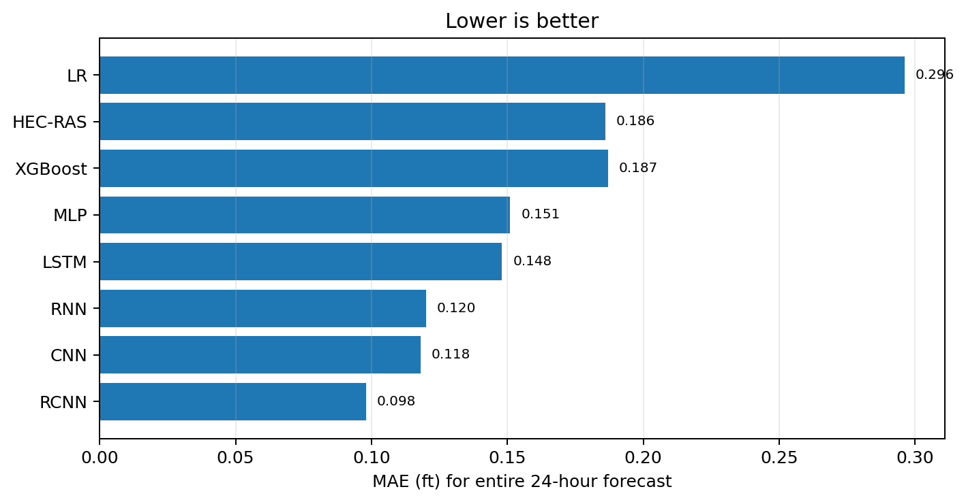
Accuracy snapshot: entire 24-hour forecast
Using the paper’s MAE results is a simple way to explain model comparison to beginners. Lower MAE means smaller average error.
Best overall MAE
Operational reading
RCNN = 0.098 ft
HEC-RAS = 0.186 ft
LR = 0.296 ft
The best DL models beat both simple regression and the benchmark physics model on MAE.
24-hour MAE by station (ft)
Model
S1
S25A
S25B
S26
RCNN
0.072
0.085
0.082
0.182
CNN
0.107
0.093
0.090
0.206
HEC-RAS
0.176
0.182
0.198
0.184
RCNN is best at S1, S25A, and S25B; other DL models are slightly better at S26, but all DL models beat HEC-RAS at every station.
Notes:
[Sources] - Uploaded paper: p. 10, Table 2 (entire 24 h MAE values across models). - Uploaded paper: p. 12, Table 5 (24-hour MAE by location). - Bar chart recreated from Table 2 values in the uploaded paper. [/Sources]

Slide 20
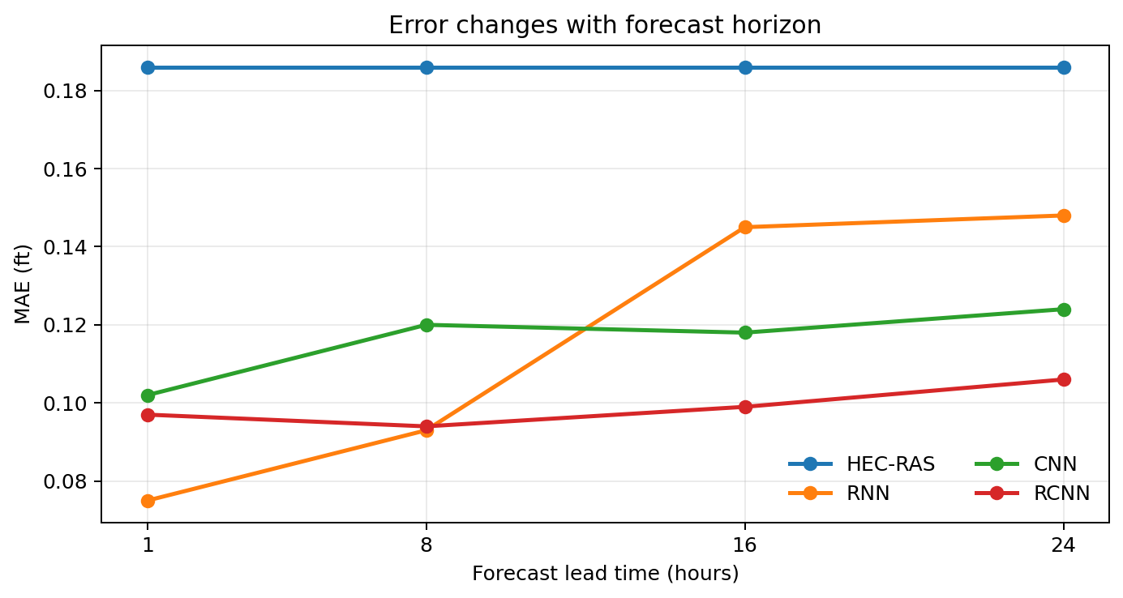
Forecast horizon and stress testing
A useful beginner lesson: some models are very good at short lead times but lose skill as the horizon gets longer.
Reading the figure
The y-axis is MAE. Lower is better. Each point shows how average error changes as the model predicts farther into the future.
Key pattern
RNN is best at 1 hour ahead (0.075 ft), but its error grows with lead time. RCNN stays low and stable from 8 to 24 hours ahead.
Important nuance
HEC-RAS is flat across lead time because the paper uses future boundary conditions directly for that model. It is not forecasting under uncertainty in the same way as the DL models.
Storm and robustness result: during Tropical Storm Isaias, all DL models still outperformed HEC-RAS at S1, and adding 20% random noise to future covariates changed DL MAE only slightly (< 4%).
Notes:
[Sources] - Uploaded paper: p. 10, Table 2 and accompanying discussion. - Uploaded paper: pp. 10-11, Table 3 (robustness to noisy future covariates). - Uploaded paper: p. 14 (Tropical Storm Isaias discussion). - Line chart recreated from Table 2 MAE values in the uploaded paper. [/Sources]

Slide 21
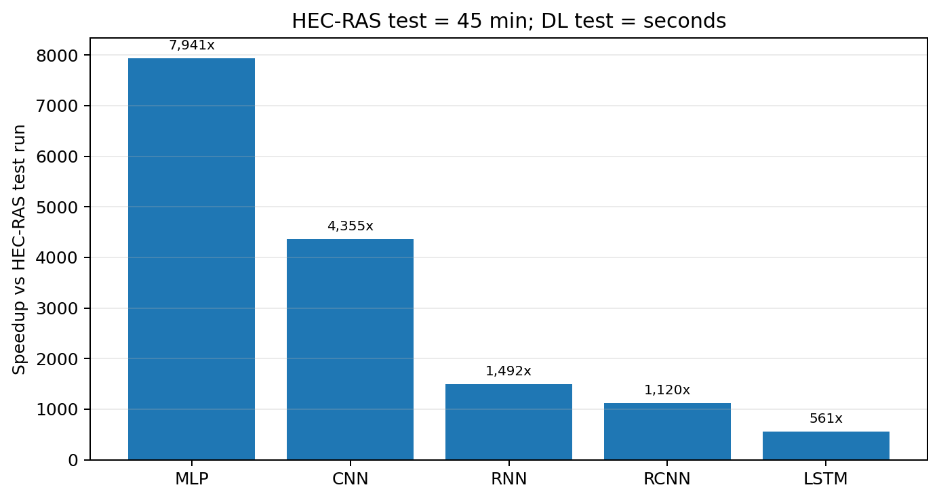
Why operators care: runtime
For real-time or repeated scenario testing, seconds matter.
Test-phase benchmark
HEC-RAS = 45 min
MLP = 0.34 s, CNN = 0.62 s
RCNN = 2.41 s, LSTM = 4.81 s
Training is a one-time cost
Training times in the paper range from 27 min (MLP) to 1033 min (LSTM). That is acceptable when inference later runs in seconds.
Engineering interpretation
A fast surrogate can support many what-if runs for pumps, gates, tides, and rainfall conditions - a major benefit for operations and emergency response.
Notes:
[Sources] - Uploaded paper: p. 15, Table 7 and discussion/conclusions (training time, test time, and 500x+ speedup statement). - Speedup chart recreated from Table 7 test-time values in the uploaded paper. [/Sources]

