Slide 1
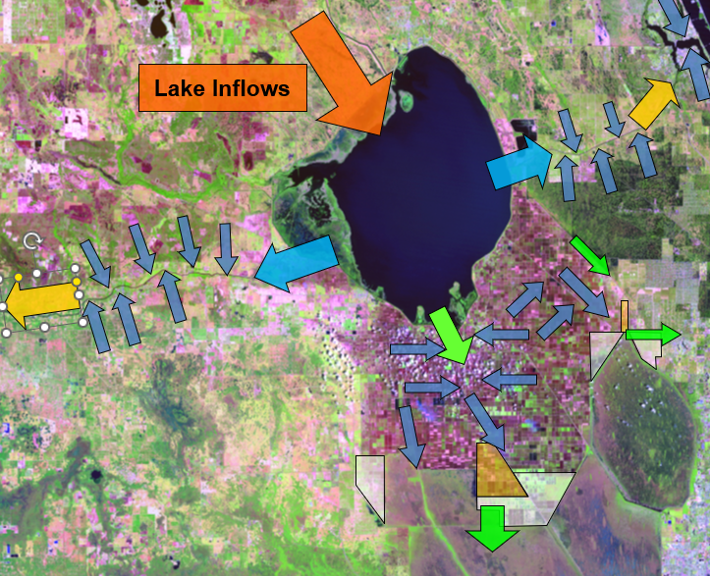

Lake Okeechobee
Seasonal net Inflow Prediction
Load and scope the monthly climate dataset
Convert months into a Nov-Apr water-year summary
Train Linear, Logistic, Random Forest, and XGBoost on the same split
Compare regression R² / RMSE, class accuracy, and feature importance
Uncertainty estimation and parameter optimization

Slide 2
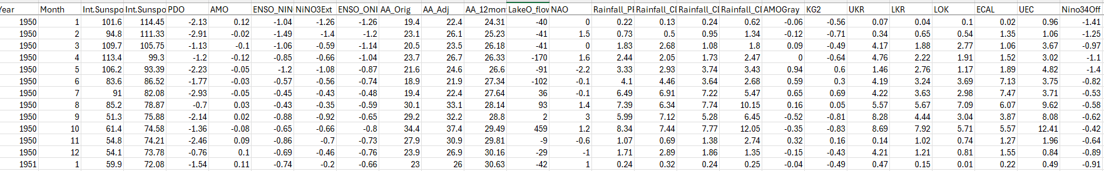
Dataset
Year
Month
Int.Sunspot.Number
Int.Sunspot.Number.Smoothed
PDO
AMO
ENSO_NINO.34
NiNO3Ext
ENSO_ONI
AA_Orig
AA_Adj
AA_12month
LakeO_flow
NAO
Rainfall_PRISM
Rainfall_CD4
Rainfall_CD5
Rainfall_CD6
AMOGray
KG2
UKR
LKR
LOK
ECAL
UEC
Nino34Off

Slide 3
Models Used in the Notebook
Linear regression
Logistic regression
Random Forest
XGBoost
Baseline regression
Classification example
Ensemble trees
Boosted trees
Simple and transparent starting point.
Predicts continuous seasonal flow.
Useful for explaining coefficients and residuals.
Converts flow into low / medium / high classes.
Shows how the same data can support categorical prediction.
Accuracy reported separately from RMSE and R².
Handles nonlinear behavior and interactions.
Provides feature importance and tree-spread uncertainty.
Also tuned with grid search.
Usually strong predictive skill on tabular data.
Sensitive to hyperparameters such as depth and learning rate.
Uncertainty estimated from a bootstrap ensemble.
Start with interpretable models, then add complexity only when it improves skill or insight.
Notes:
[Sources] - User-uploaded notebook: LOKseas_clean_training_with_gridsearch_with_uncertainty_verified.ipynb - Model descriptions based on notebook markdown sections/cells 13, 16, 19, 24, 27, 32, and 35. [/Sources]

Slide 4
Other Topics Covered in the Notebook
Practical uncertainty bounds for tree-based models
For Random Forest, the interval is based on the spread of the individual trees.
For XGBoost, the interval is based on a small bootstrap ensemble of repeated model fits.
Hyperparameter tuning for XGBoost with grid search
XGBoost often performs very well, but it is also sensitive to hyperparameters such as learning rate, tree depth, and number of trees. Grid search helps us test several combinations systematically instead of guessing.

Slide 5
LOK seasonal flow prediction: conceptual problem framing
and predict the seasonal mean LakeO_flow for Lake Okeechobee.
1. Monthly data table
2. Reframe the problem by water year
3. Prediction target
Each row is one month; columns include time, climate indices,
It predicts one seasonal flow value per water year.
Year
Month
AMO
ENSO_NINO.34
LakeO_flow
NAO
Lake Okeechobee
1960
1
0.19
-0.13
96.0
Jan
Feb
Mar
Apr
May
Jun
Jul
Aug
Sep
Oct
Nov
Dec
-2.0
seasonal flow outcome
1960
2
0.23
-0.27
319.0
-3.3
1960
3
0.10
0.20
213.0
-0.8
Predictor families in the CSV
Selected predictor season = November through April
One target value per water year
AMO
ENSO Niño 3.4
NAO
Large-scale climate modes
UKR
LKR
LOK
Result: one seasonal record per year
Flow
Regional or lake-state indicators from the file
668 monthly rows and 9 retained columns
WaterYear
After filtering to Year ≥ 1960:
55 samples • 44 train • 11 test
Nonlinear teleconnections
Notes:
[Sources] - Attached notebook: /mnt/data/LOKseas_clean_training.ipynb - Underlying CSV referenced by the notebook: LOKdat.csv - Claims used in graphic derived from notebook cells showing: selected columns, Year >= 1960 filter, Nov-Apr seasonal aggregation, WaterYear logic, sample counts, and train/test split. [/Sources]

Slide 6
Data Preparation and Problem Setup
Process Flow
Reads the CSV and keeps a small, interpretable set of columns for teaching.
Defines WaterYear so October–December count toward the following year.
Keeps only November–April months, then averages values by WaterYear.
Builds a predictor matrix X and target vector y = LakeO_flow.
Fills missing predictor values with column means and uses a random 80/20 train/test split.
Key sample counts
56
55
44
11
seasonal aggregates
rows with target available
training samples
testing samples
Prediction objective
Use a small set of climate and lake-condition indicators to estimate seasonal flow, then compare model skill and interpretability.
Predictors used: AMO | ENSO_NINO.34 | NAO | UKR | LKR | LOK
Regression track
continuous flow
Classification track
low / medium / high
Target: seasonal Lake Okeechobee flow
Notes:
[Sources] - User-uploaded notebook: LOKseas_clean_training_with_gridsearch_with_uncertainty_verified.ipynb - Data shape and sample counts from notebook outputs in cells 3, 5, 7, and 9. [/Sources]

Slide 7
Notebook Flow
The notebook moves from seasonal data preparation into baseline and tree-based modeling, then finishes with tuning and interpretation.
Load and filter data Monthly climate + flow inputs
Build water year Average Nov–Apr season
Create model table 6 predictors, 55 samples
Split training / test 44 train, 11 test
Fit and compare models Metrics, plots, tuning
Models and analyses included
668 Filtered monthly rows
56 Seasonal aggregates
55 Final model rows
• Linear regression baseline • Logistic regression for low / medium / high flow classes • Random Forest with uncertainty bounds • XGBoost with uncertainty bounds • Grid-search tuning for Random Forest and XGBoost
Predictor set
AMO • ENSO_NINO.34 • NAO • UKR • LKR • LOK
Target variable: LakeO_flow
2

Slide 8
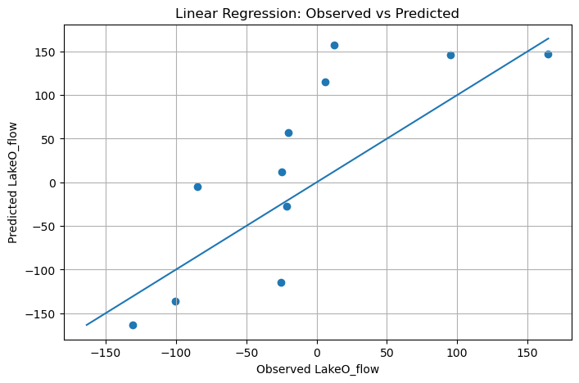
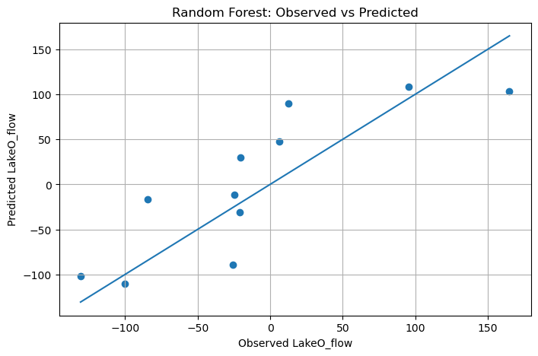
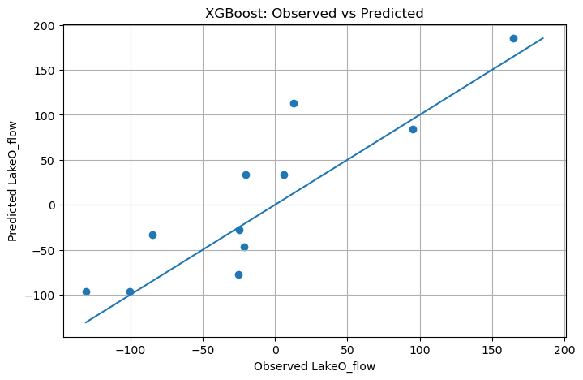
Diagnostics
Observed vs predicted diagnostics
The notebook uses the same diagnostic plot across models, making the improvement from baseline to tree methods easy to see.
Linear regression
Random Forest
XGBoost
Baseline model
R² 0.160 | RMSE 73.9
Stronger non-linear fit
R² 0.663 | RMSE 46.8
Best test performance
R² 0.698 | RMSE 44.3
Closer clustering around the 1:1 line indicates better predictive fit.
4

Slide 9
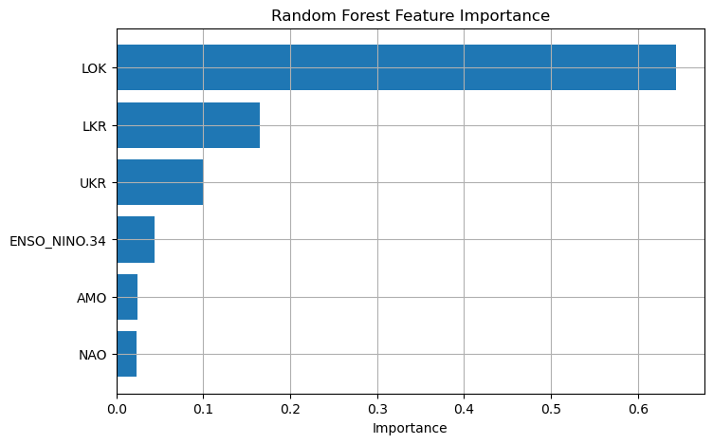
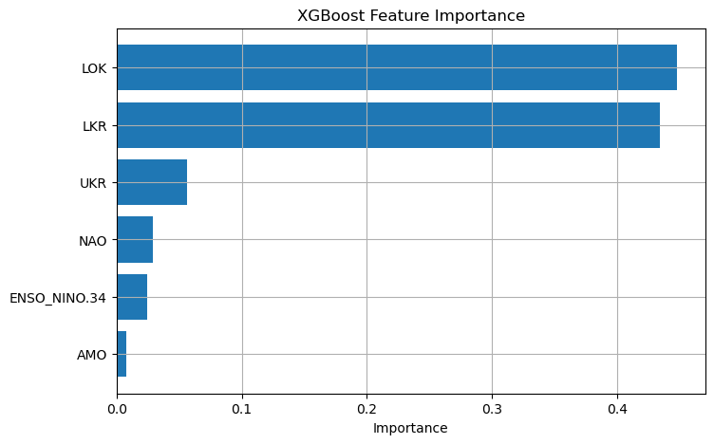
Which Inputs Matter Most?
Feature-importance plots help students connect machine-learning output back to hydrologic reasoning.
Random Forest feature importance
XGBoost feature importance
Interpretation: in this notebook, local lake-condition predictors (especially LOK, with UKR/LKR secondary) dominate the large-scale climate indices.
Notes:
[Sources] - User-uploaded notebook: LOKseas_clean_training_with_gridsearch_with_uncertainty_verified.ipynb - Feature-importance figures extracted from notebook outputs in cells 21 and 29. - Interpretation is an inference from those plots and should be presented as notebook-specific, not universal. [/Sources]

Slide 10
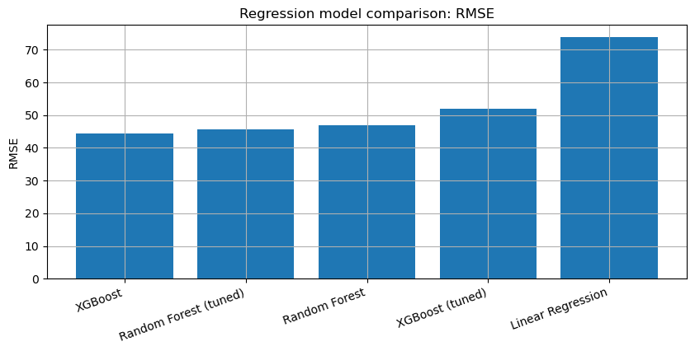
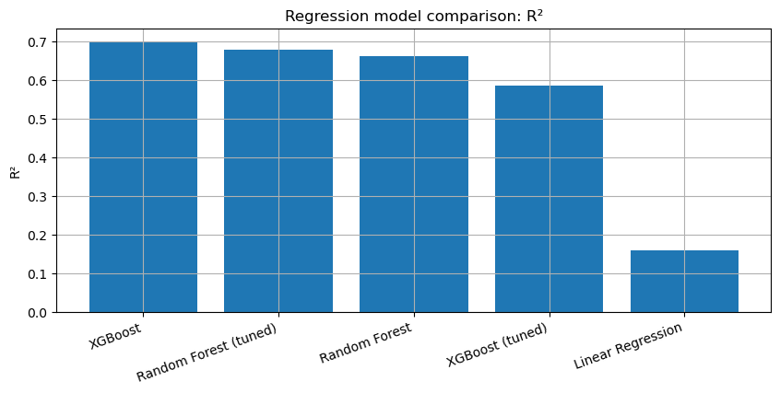
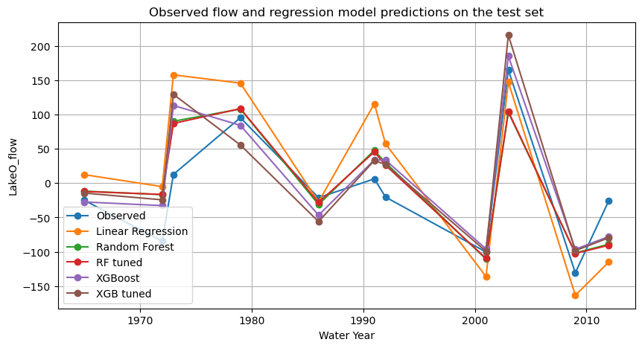
Model Comparison and Main Teaching Takeaways
Best test-set scores
RMSE comparison
R² comparison
XGBoost R² = 0.698 RMSE = 44.3
RF tuned R² = 0.677 RMSE = 45.8
Random Forest R² = 0.663 RMSE = 46.8
XGB tuned R² = 0.585 RMSE = 51.9
Linear R² = 0.160 RMSE = 73.9
Takeaways
Small datasets can still support meaningful model comparison in class.
Better skill does not guarantee better calibrated uncertainty.
Tuning should be judged by both cross-validation and held-out performance.
Use plots and feature importance to reconnect model output to engineering judgment.
Observed and predicted seasonal flows on the test set
Logistic regression accuracy = 0.545
(not directly comparable to regression metrics)
Notes:
[Sources] - User-uploaded notebook: LOKseas_clean_training_with_gridsearch_with_uncertainty_verified.ipynb - Comparison metrics table and charts from notebook outputs in cell 36. - Logistic regression accuracy from notebook outputs in cell 17. [/Sources]

Slide 11
Results
Regression results at a glance
Performance ranking
Model
R²
RMSE
XGBoost
0.698
44.3
Random Forest (tuned)
0.677
45.8
Random Forest
0.663
46.8
XGBoost (tuned)
0.585
51.9
Linear Regression
0.160
73.9
Key takeaways • XGBoost delivered the best test-set fit.
• Tuning improved Random Forest slightly.
• Tuning hurt XGBoost on this split.
• Linear regression remained a useful but much weaker baseline.
3

Slide 12
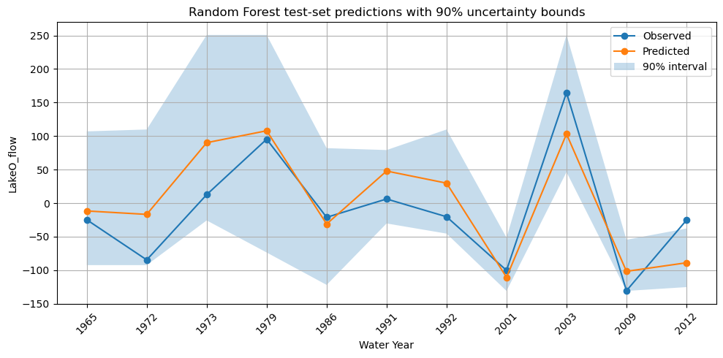
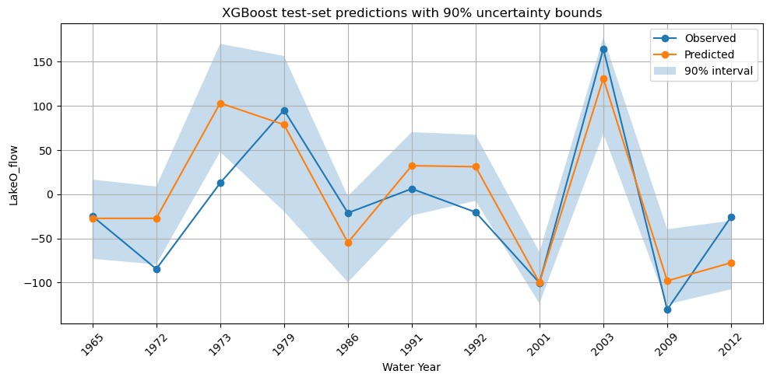
Hyperparameter Tuning and Practical Uncertainty
Grid search setup
How uncertainty is approximated
Random Forest interval example
Random Forest
Random Forest: use the spread across individual trees to form a 90% interval.
XGBoost: refit a small bootstrap ensemble and use the spread of those predictions.
Goal: teach the idea of prediction intervals, not claim full probabilistic calibration.
n_estimators = [100, 300]
max_depth = [None, 5, 10]
min_samples_split = [2, 5]
min_samples_leaf = [1, 2]
XGBoost
XGBoost interval example
n_estimators = [100, 200]
learning_rate = [0.05, 0.10]
max_depth = [3, 4, 5]
subsample = [0.8, 0.9]
colsample_bytree = [0.8, 0.9]
Notes:
[Sources] - User-uploaded notebook: LOKseas_clean_training_with_gridsearch_with_uncertainty_verified.ipynb - Hyperparameter grids and best CV RMSE from notebook outputs in cells 25 and 33. - Uncertainty charts and interval summaries from notebook outputs in cells 23 and 31. [/Sources]

