Slide 1


Predicting Sea Level Variability along the Southeastern United States Coastline using Machine Learning
Anupama John, Florida International University
Jayantha ‘Obey’ Obeysekera, Florida International University
Kaleb Smith, NVIDIA AI Technology Center
Martina M. Rogers, HBC Engineering
Michael C. Sukop, Florida International University
Oscar Guzman, Florida International University

Slide 2
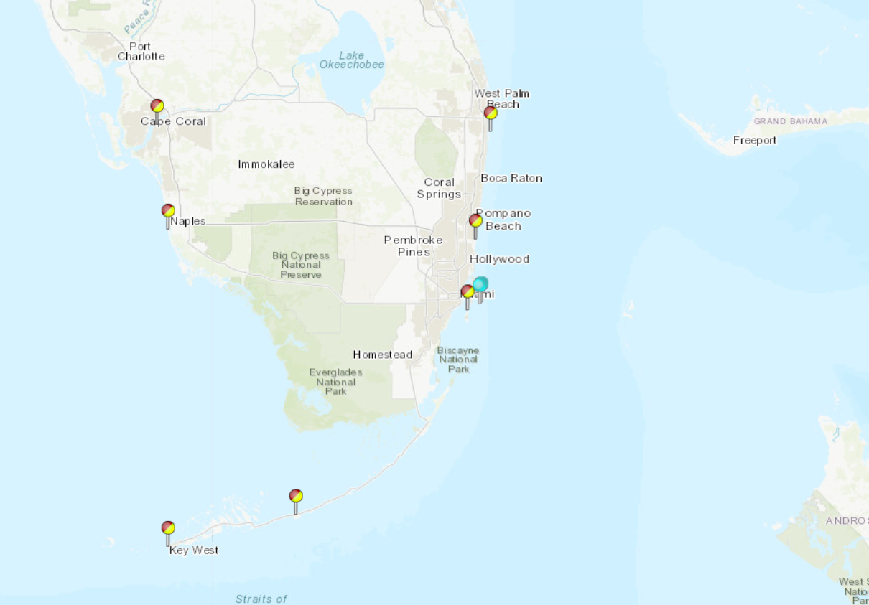
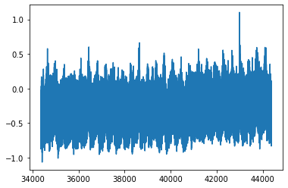
Sea Level Variability
Sea Surface Temperature
Astronomical Tides
Sea Level Rise Trend
U-Wind
V-Wind
Teleconnections
Florida Current
Sea Level Pressure

Slide 3
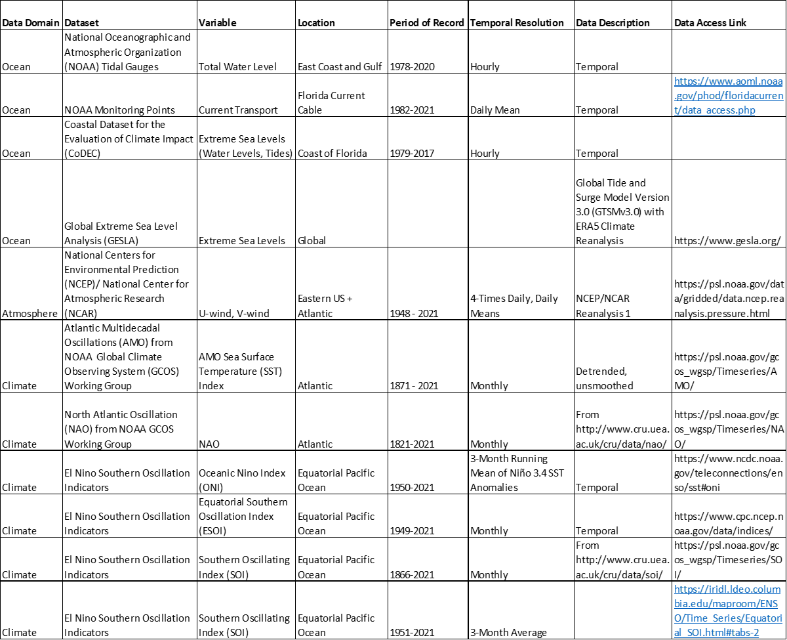
Data

Slide 4
Process flow
What changes inside the notebook
What comes out
What goes in
Station sheet from a multi-station Excel workbook, with water-level and forcing variables.
Missing values are interpolated, lagged forcing terms are added, and the target/predictor matrix is assembled.
Predictions for a held-out test period plus error metrics, residual plots, and feature importance.
Target: residualTide
Chronological 80/20 split
Fair comparison across RF, GB, XGBoost, and LSTM
Notes:
[Sources] - User-provided notebook: cells 0, 3, 8, 10, 12, 14, 16, 17, 19, 34-35. - Process-flow diagram synthesized from the notebook logic listed above.

Slide 5
Time-aware split and model branches
Train: 2010-01-06 to 2018-10-20 | 3,210 rows
Test: 2018-10-21 to 2020-12-31 | 803 rows
2010
2014
2018
2020
Shared feature
matrix: 92 predictors
Random Forest
Gradient Boosting
XGBoost
LSTM
500 trees
max_depth = 10
bagged trees on lagged predictors
scale X → reshape to 3D
LSTM(32) → Dense(1)
early stopping on val_loss
300 trees
lr = 0.05, depth = 4
subsample + column sample = 0.90
500 estimators
learning_rate = 0.01
small trees added sequentially
Notes:
[Sources] - Uploaded notebook: /mnt/data/MachineLearningCombinedNewTrain_cleaned_with_LSTM_XGBoost.ipynb - Train/test dates and sizes come from the notebook split cell output; model definitions and XGBoost parameters come from the training code cell. [/Sources]

Slide 6
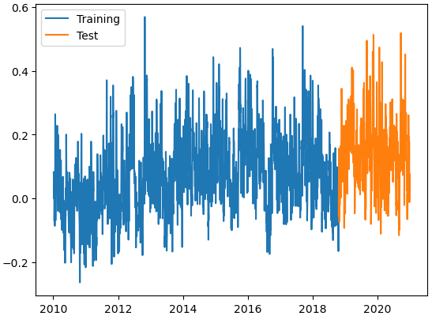
Data preparation and feature engineering
Chronological split avoids letting future information leak into the training period.
What is being modeled?
• One station sheet: 8721604
• Raw input size: 4,018 rows × 80 columns
• Target variable: residualTide
• Lags added for Transport and CRW_SST
• Five previous steps for each lagged variable
• Final modeling table: 4,013 rows × 90 columns
• Predictors used in training: 87
Train/test periods used in the notebook
Training: 3,210 rows from 2010-01-06 to 2018-10-20
Testing: 803 rows from 2018-10-21 to 2020-12-31
Engineering implication: every model is judged on the same unseen period, so the comparison is operationally meaningful.
Notes:
[Sources] - User-provided notebook: cells 3, 6, 10, 12, 14 and their saved outputs.

Slide 7
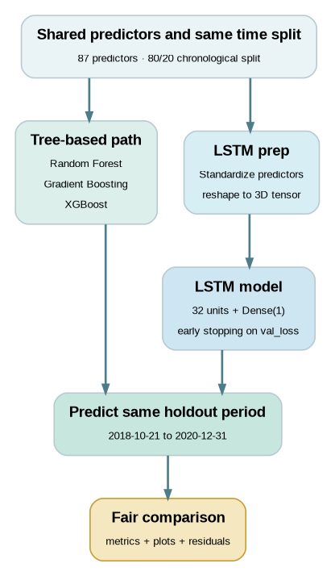
How the models are trained
Three tree-based regressors are compared with one neural-network path.
Shared rules for a fair comparison
• Same target variable and same predictor set
• Same chronological train/test split
• Same holdout period for every prediction
• Same evaluation metrics: MAE, RMSE, R², and MSE
Tree models
Random Forest: 500 trees, depth 10
Gradient Boosting: 500 estimators, learning rate 0.01, depth 10
XGBoost: 300 trees, learning rate 0.05, depth 4, 90% row/column subsampling
LSTM note
Inputs are standardized, reshaped to a 3D tensor, and sent into a small 32-unit LSTM with early stopping. This is a useful classroom baseline, but not a full sequence-to-sequence hydrologic setup.
Notes:
[Sources] - User-provided notebook: cells 15, 16, 17, 18, 19. - Model-flow diagram synthesized from notebook logic and hyperparameters in those cells.

Slide 8
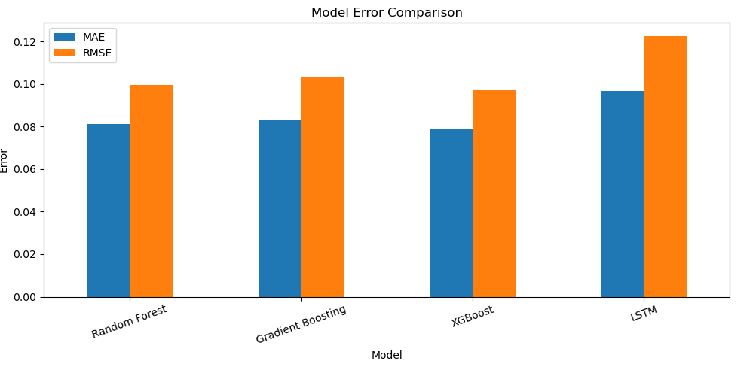
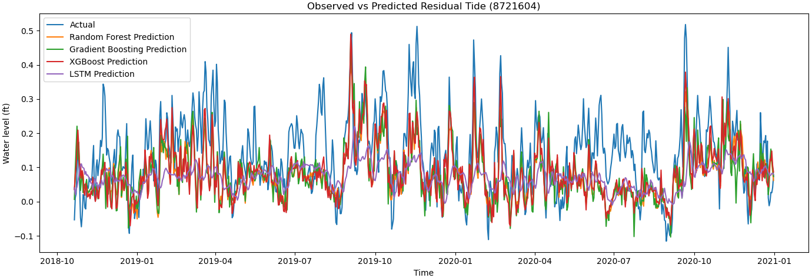
Held-out test results
Best held-out score: XGBoost | MAE 0.079 | RMSE 0.097 | R² 0.210
Interpretation
• Tree-based methods beat the current LSTM setup on the same holdout period.
• XGBoost gives the lowest MAE and RMSE and the highest R².
• The time-series overlay shows where each model misses peaks, not just average error.
Model
MAE
RMSE
R²
Random Forest
0.081
0.100
0.165
Gradient Boosting
0.083
0.103
0.106
XGBoost
0.079
0.097
0.210
LSTM
0.097
0.123
-0.263
Notes:
[Sources] - User-provided notebook: cells 19, 21, 23, 24, 30 and their saved outputs.

Slide 9
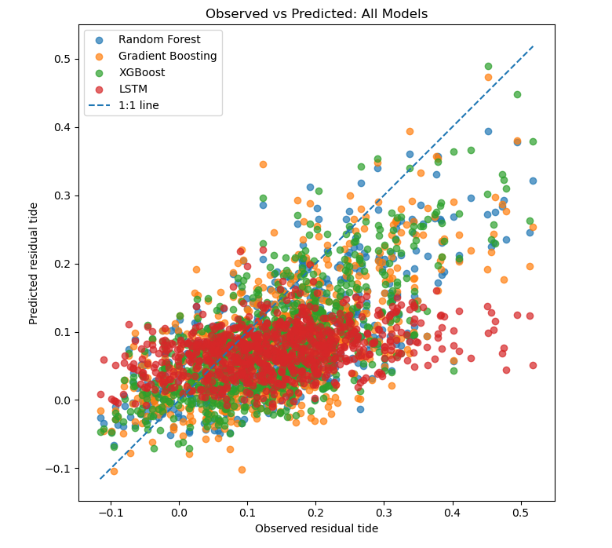

Slide 10
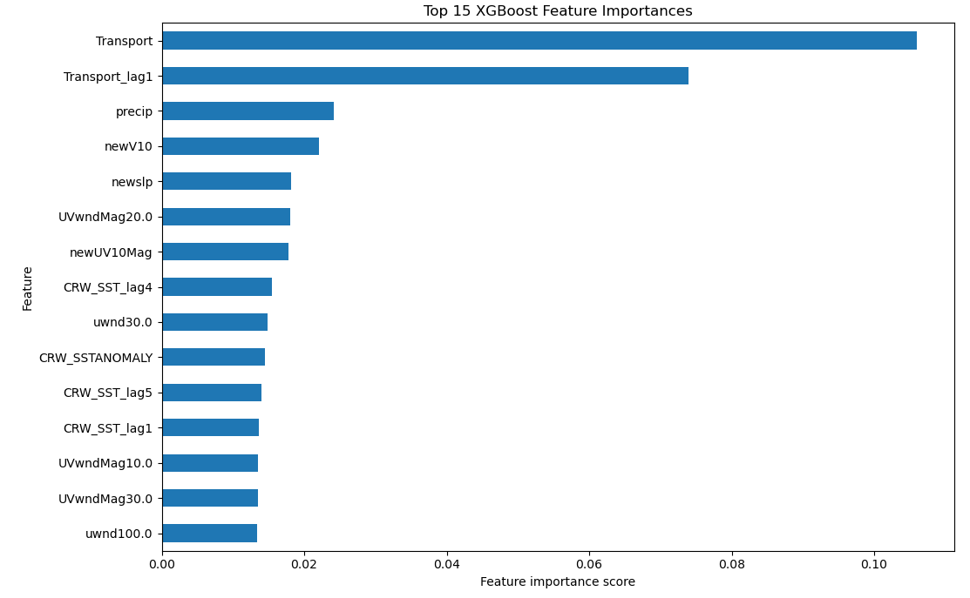
Engineering takeaways
What the notebook suggests and how to adapt it for another station or study.
• Transport is the dominant signal in the best-performing model.
• A recent transport lag also matters strongly, supporting a short-memory interpretation.
• Meteorological and SST-related variables still contribute, but less than transport.
Why this matters in practice
Notes:
[Sources] - User-provided notebook: cells 17, 19, 33, 34, 35 and their saved outputs.

Slide 11
Complete Study (in progress)
Sea levels along many coastal regions of the United States coast are rising faster than the global average.
Largest increases along the eastern gulf and southeastern parts of the country.
Machine learning techniques are computationally more efficient than dynamical modeling tools.
Past applications of machine learning for predicting sea level variability
Approach | Previous Work | Method
Using lagged data | Makarynskyy et al. (2004) | Artificial Neural Networks (ANNs)
 | Ghorbani et al. (2010) | Genetic Programming (GP) and ANNs
 | Kaloop et al. (2017) | Wavelet Neural Networks (WNNs) and Adaptive Neuro Fuzzy Inference System (ANFIS)
 | Hazrin et al. (2023) | Linear Regression, Support Vector Machines (SVMs), Wavelet Hybrid Support Vector Machine (WSVM), Ensemble Regression, ANNs, Gaussian Process Regression (GPR)
 | Li et al. (2024) | Convolutional Neural Network Bidirectional Long Short-Term Memory (CNN BiLSTM) and cauchy version of the sparrow search algorithm (SCSSA) CNNBiLSTM
Using oceanic or atmospheric variables | Muslim et al. (2020) | Multilayer perceptron neural network (MLP-ANN) and an adaptive neuro-fuzzy inference system (ANFIS)
 | Sithara et al. (2020) | SVMs and WSVMs
 | Ishida et al. (2020) | LSTMs
 | Nieves et al. (2021) | GPR and Recurrent Neural Networks (RNNs)
 | Tur et al. (2021) | Multiple Linear Regression and ANFIS
 | Radin and Nieves (2021) | Gated Recurrent Unit Recurrent Neural Networks (GRU RNNs)
Notes:
Sea levels along the United States coastline have been rising faster than the global average
With some of the largest increases observed along the eastern gulf and the southeastern parts of the country
There is a need for advanced prediction of sea level in efforts to mitigate the flood risk of coastal communities
Machine learning is advantageous as it offers a more computationally efficient than dynamical modeling tools.
Machine learning has previously been applied to predict sea variability. There two common approaches – one uses lagged data and second using oceanic and atmospheric variables.
In this work, we use the second approach. Our objective was to use oceanic and atmospheric variables in predicting sea levels. Here we present the results from the application of the Random Forest regressor.

Slide 12
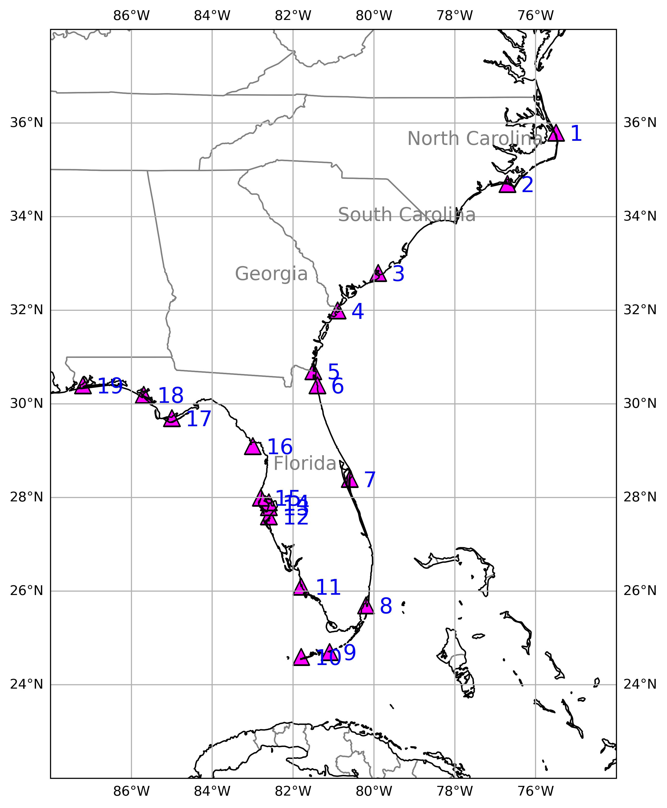
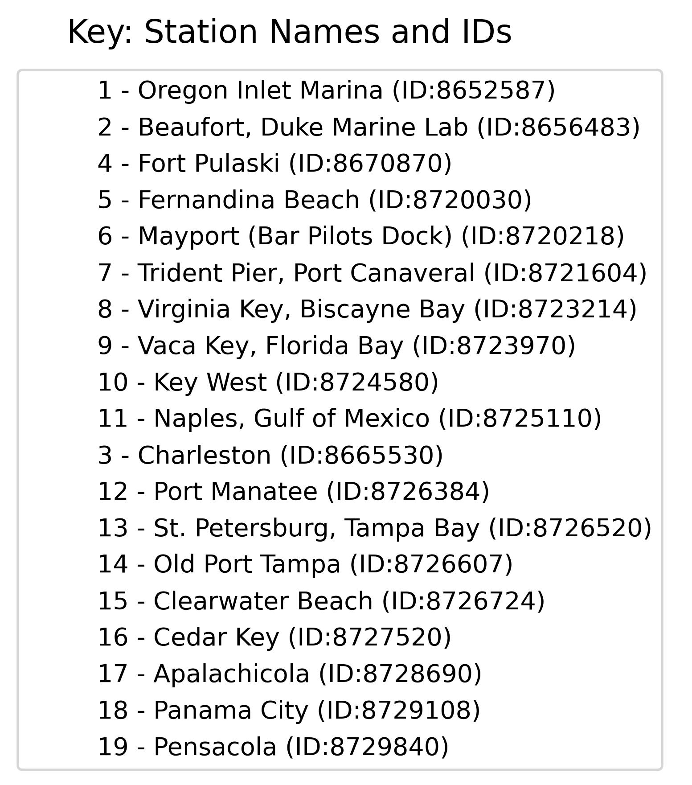
DATA SOURCES
Data | Source | Spatial Resolution | Timestep
Sea Level & Tide | NOAA Tides and Currents | Point | Hourly
Sea Level Pressure | ERA5 | 0.25º x 0.25º | Hourly
Zonal (u10) and Meridional (v10) Winds | ERA5 | 0.25º x 0.25º | Hourly
Sea Surface Temperature | NOAA Coral Reef Watch | 5 km x 5 km | Daily
Florida Current | NOAA's Atlantic Oceanographic and Meteorological Laboratory | Point | Daily
Notes:
We obtained hourly sea level and tide from NOAAs Tides and Currents for the 19 tide gauge stations shown in the map. We also obtained hourly sea level pressure and wind data from ERA5. Daily sea surface temperature was downloaded from NOAAs Coral Reef Watch and Florida Current Transport data from NOAA’s Atlantic Oceanographic and Meteorological Laboratory

Slide 13
RESULTS
 |  |  | Case 1 |  |  |  |  | Case 2
Station | Station Name | Record Length [days] | MAE [cm] | RMSE [cm] | R² |  | MAE [cm] |  | RMSE [cm] | R²
8652587 | Oregon Inlet Marina | 7547 | 7.26 | 9.44 | 0.56 |  | 7.13 |  | 9.22 | 0.58
8656483 | Beaufort, Duke Marine Lab | 7596 | 6.60 | 8.46 | 0.60 |  | 6.40 |  | 8.38 | 0.60
8665530 | Charleston | 7596 | 8.16 | 10.72 | 0.53 |  | 8.25 |  | 10.76 | 0.52
8670870 | Fort Pulaski | 7559 | 8.77 | 11.45 | 0.54 |  | 8.67 |  | 11.24 | 0.56
8720030 | Fernandina Beach | 7293 | 9.00 | 11.92 | 0.56 |  | 8.75 |  | 11.46 | 0.60
8720218 | Mayport (Bar Pilots Dock) | 6701 | 8.32 | 10.76 | 0.62 |  | 8.14 |  | 10.39 | 0.64
8721604 | Trident Pier, Port Canaveral | 7498 | 6.30 | 8.00 | 0.69 |  | 6.12 |  | 7.77 | 0.70
8723214 | Virginia Key, Biscayne Bay | 7554 | 5.40 | 6.74 | 0.60 |  | 5.44 |  | 6.79 | 0.66
8723970 | Vaca Key, Florida Bay | 7437 | 4.33 | 5.40 | 0.66 |  | 4.45 |  | 5.62 | 0.69
8724580 | Key West | 7542 | 4.81 | 6.03 | 0.72 |  | 4.66 |  | 5.89 | 0.66
8725110 | Naples, Gulf of Mexico | 7375 | 4.70 | 6.41 | 0.64 |  | 4.57 |  | 6.39 | 0.69
8726384 | Port Manatee | 6718 | 5.57 | 7.49 | 0.68 |  | 5.57 |  | 8.02 | 0.62
8726520 | St. Petersburg, Tampa Bay | 7575 | 5.77 | 7.99 | 0.67 |  | 5.65 |  | 8.19 | 0.60
8726607 | Old Port Tampa | 6329 | 6.33 | 8.61 | 0.62 |  | 6.68 |  | 9.62 | 0.53
8726724 | Clearwater Beach | 7453 | 5.51 | 7.41 | 0.63 |  | 5.41 |  | 7.69 | 0.63
8727520 | Cedar Key | 7250 | 7.28 | 11.14 | 0.65 |  | 7.15 |  | 11.00 | 0.58
8728690 | Apalachicola | 7528 | 7.19 | 10.28 | 0.56 |  | 7.01 |  | 10.33 | 0.52
8729108 | Panama City | 7266 | 6.33 | 8.56 | 0.52 |  | 6.07 |  | 8.32 | 0.63
8729840 | Pensacola | 7337 | 6.60 | 8.71 | 0.61 |  | 6.43 |  | 8.50 | 0.60
Notes:
Here we present the mean absolute error, the root mean squared error and the r-squared for the testing dataset. For these results, we have added both the trend and tide components back before computing the errors so we can compare with the observed sea levels.
R² values for Case 1 ranged from 0.52 to 0.72 and case Case 2 ranged from 0.52 to 0.70. Overall, the R²-values for Case 1 and Case 2 are comparable, with some stations like Vaca Key, Port Manatee, St. Petersburg, Old Port Tampa, and Clearwater Beach performing better for Case 1. Old Port Tampa has the largest difference in R² between the two cases with an R² of 0.62 for Case 1 and 0.53 for Case 2.

Slide 14
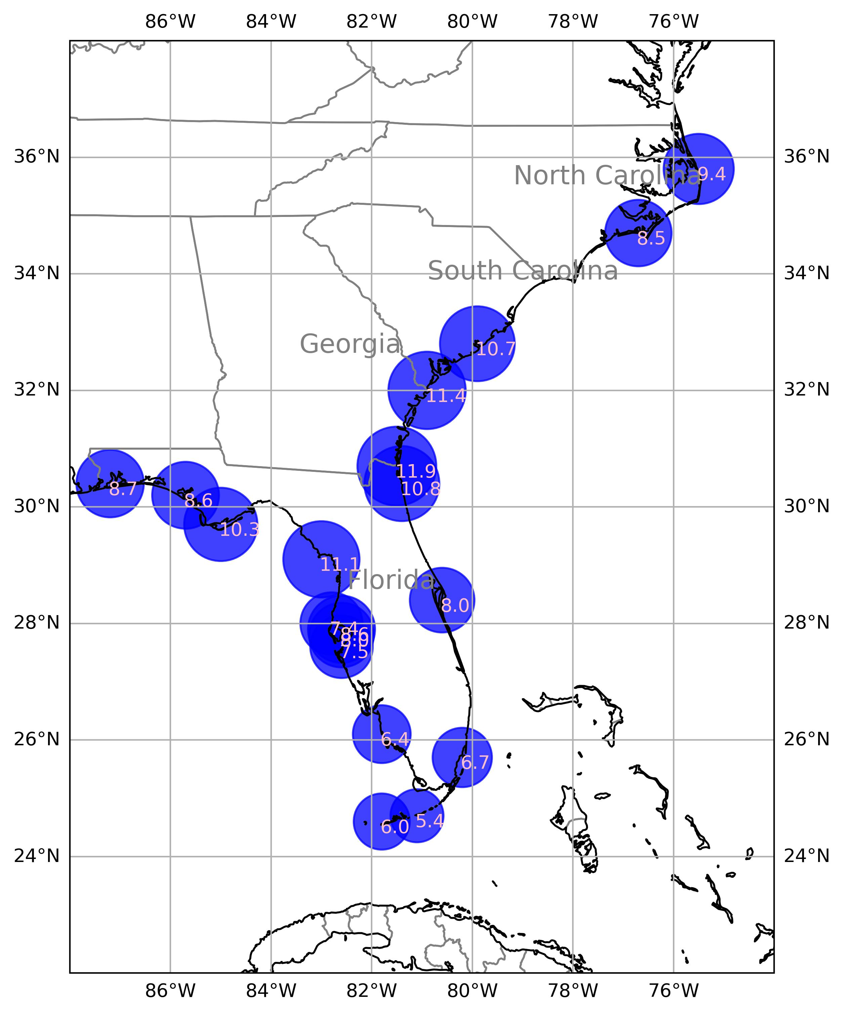
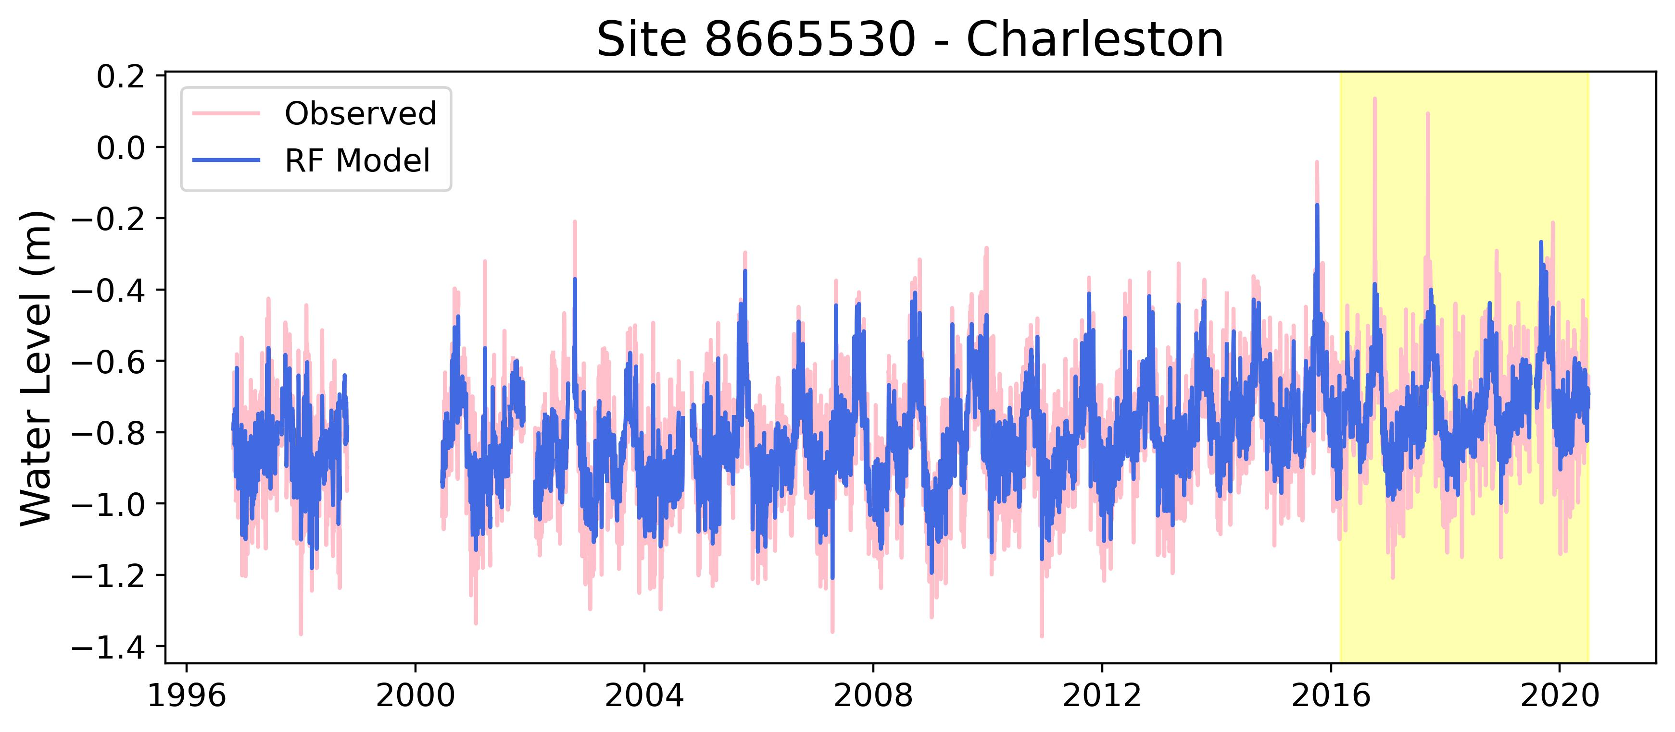
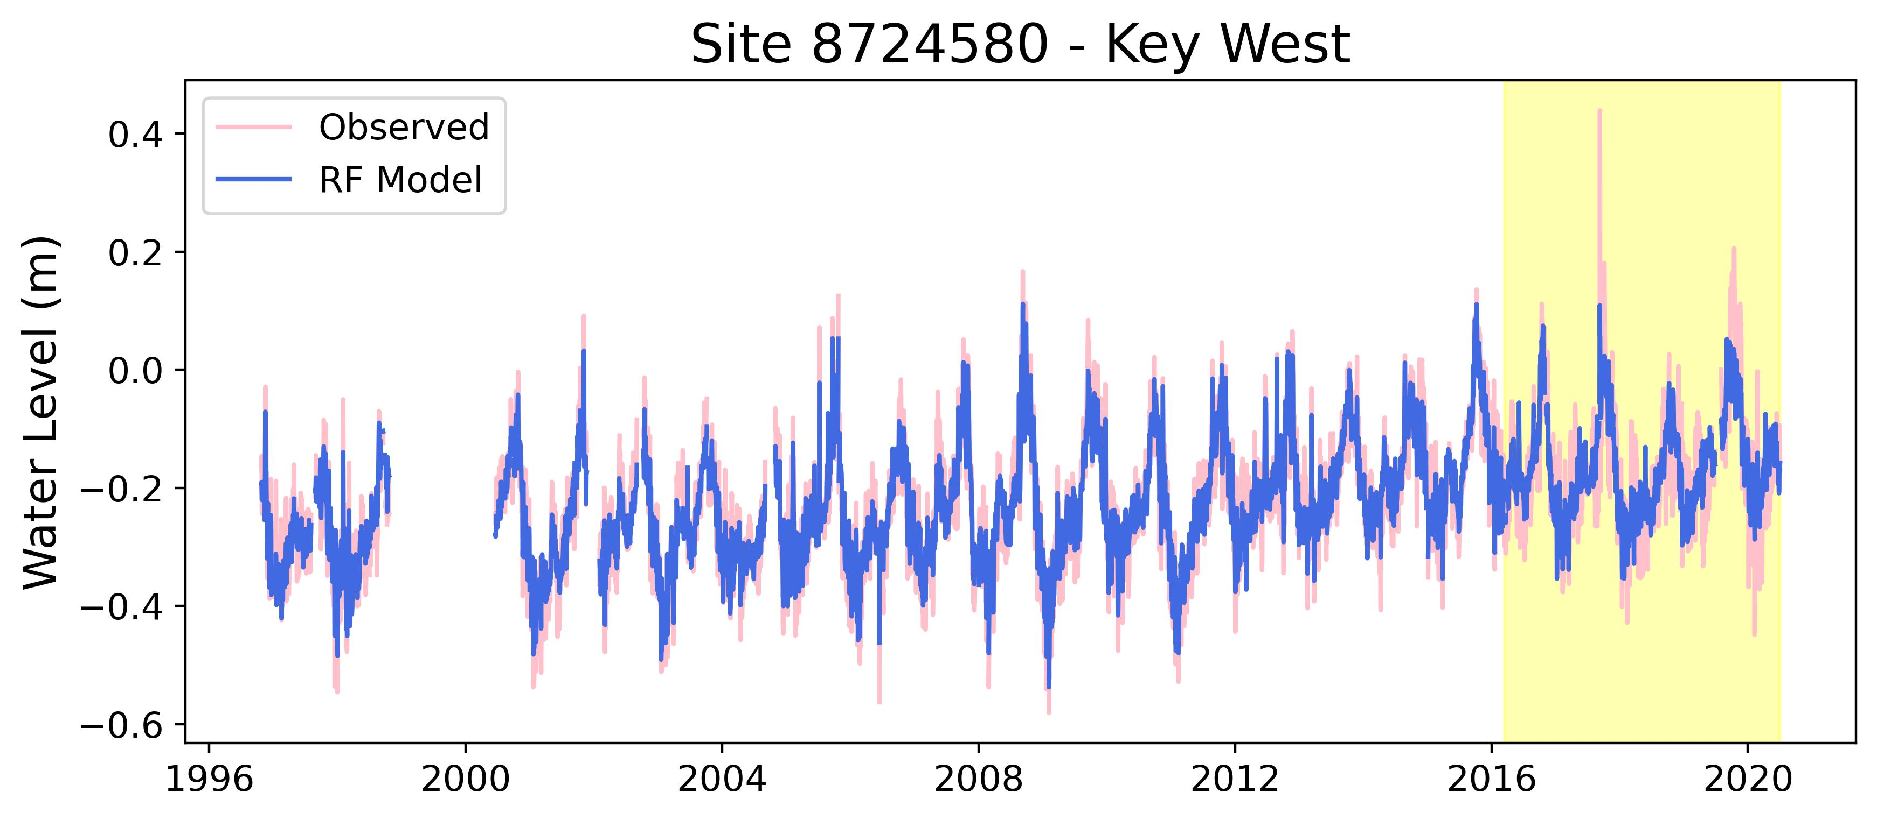
RESULTS
RMSE [cm]
RMSE: 10.7 cm
RMSE: 6.0 cm
Case 1: Predicting detrended sea level from variables as is
Notes:
A map of RMSEs for Case 1 is presented on the left.
For all cases, the lowest RMSEs were calculated for stations in South Florida: Virginia Key, Vaca Key, and Key West. Higher RMSEs are observed for the northwest coast of Florida with RMSEs ranging from 8.7 cm to 11.1 cm for Case 2. The RMSEs of the central-west coast are comparable with RMSEs ranging from 7.5 cm to 8.6 cm for Case 1. The spatial grouping of stations with high RMSEs, like the one observed along the coasts of South Carolina and Georgia might indicate the presence of a local variable, not considered in this study, influencing sea levels at these stations.
Presented on the right side is the Case 1 observed versus modeled for the training dataset with the white background and the testing dataset with the yellow background. In both cases, the models captures the daily fluctuations, but not necessarily the magnitude. In both cases it tends to miss the highs and the lows in the dataset, and this is more apparent in the case of an extreme event, where the model tends to under predict sea level.

Slide 15
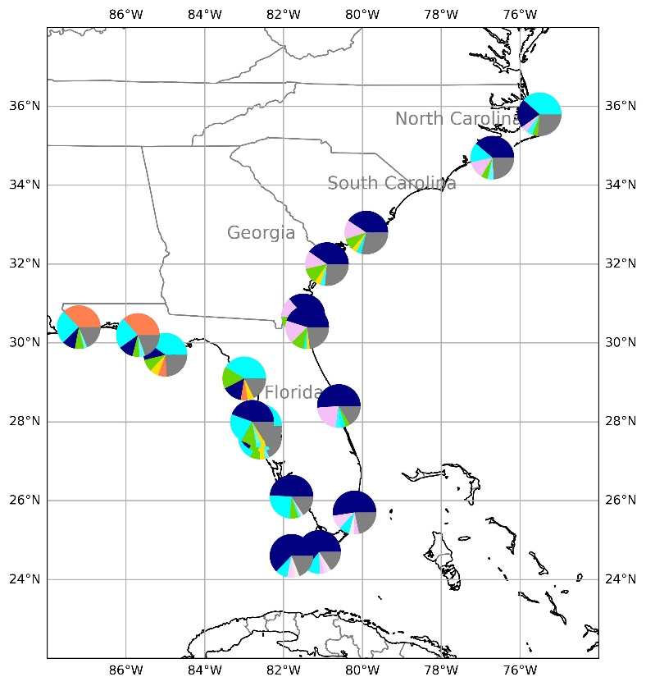
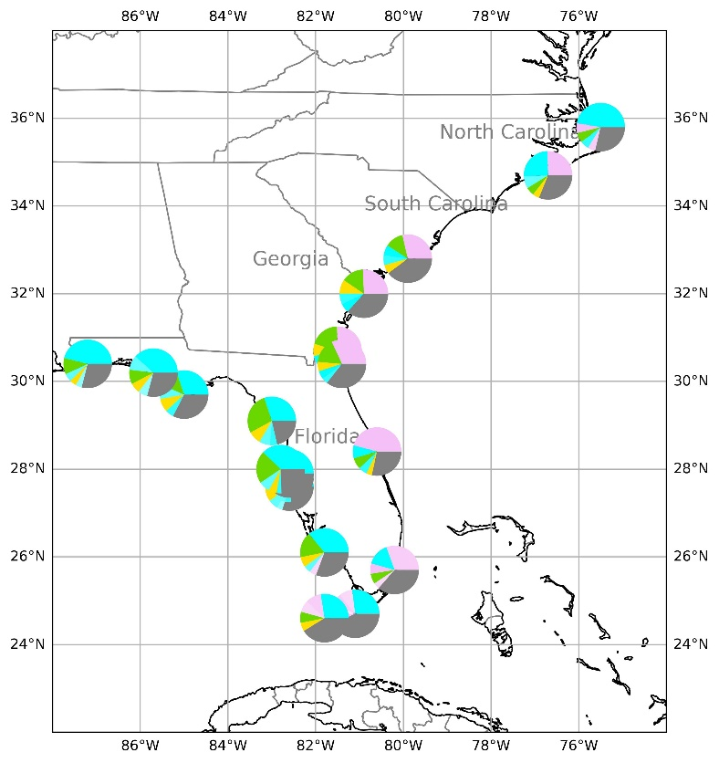
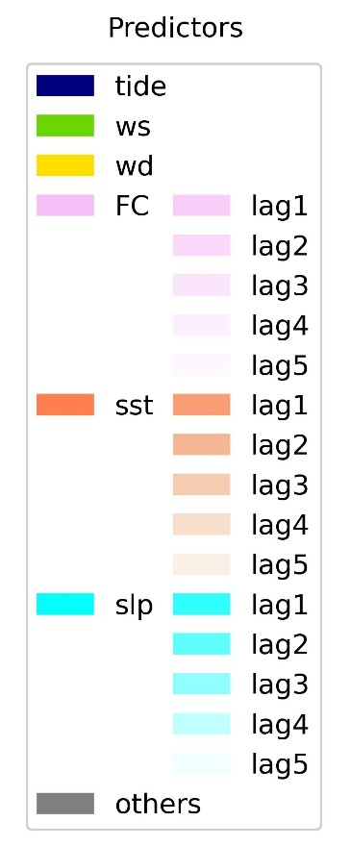
RESULTS
Feature Importance
Case 1: Predicting detrended sea level from variables as is
Case 2: Predicting nontidal residuals from variables as is
Notes:
These maps present the top five important features for Case 1 (on the left) and Case 2 (on the right). The grey color in the pie charts indicate the sum the importance of the top five subtracted by one.
Overall, stations that are in close geographic proximity tend to have similar top features. For example, we have a group with similar features off the coast of South Carolina, Georgia and North Florida. There is another group of stations in South Florida and one in central west florida, and finally another in northwest florida.
For Case 1, there appears to be a pattern of increasing tidal importance as we go down the eastern coast. This increase in tidal importance also corresponds to a decrease in the importance of the Florida current. FC is the second most important feature for all stations on the east coast from Charleston to Virginia Key. When tide is removed for those stations, as in Case 2, FC becomes the most important feature. For Case 2, the most important feature appears to be sea level pressure for west coast stations, while it is the second most important feature for east coast stations. For west coast stations under Case 2, ws is the second most important feature.
The sensitivity of the model performance to the inclusion of different variables was tested by running the models by excluding one variable at a time for Case 1 and Case 2. In nearly all cases, R2 drops when important features are excluded from the model with up to 30% drop in R-squared when the important feature to the model is dropped.
Don’t forget to talk about how dropping the most important features resulted in drop in R-squared

Slide 16
SUMMARY
Random forest regressor with multiple variables like tide, sea level pressure, wind speed and direction, sea surface temperature, and Florida Current to build models at 19 tide gauges along the Southeastern US coast.
The models captures the daily fluctuations, but not necessarily the magnitude. There is a tendency to miss the highs and lows. The models appear to underestimate sea levels during extreme events.
Important features were identified as tide, Florida Current, sea level pressure, and wind speed.
Notes:
In summary, we used the random forest regressor with multiple variables like tide, sea level pressure, wind speed and direction, sea surface temperature, and Florida Current to build models at 19 tide gauges along the Southeastern US coast.
The models captures the daily fluctuations, but not necessarily the magnitude. There is a tendency to miss the highs and lows. The models appear to underestimate sea levels during extreme events. Part of the reason is that the model is not sufficiently trained for extreme water levels because the number of data points with hurricane-induced sea levels is small in the training dataset. The other explanation is that these models are trained with data from point locations or a single cell in the case of gridded data, and these are not sufficient to capture the dynamics of an extreme event like a hurricane.
Important features were identified as tide, Florida Current, sea level pressure, and wind speed. And we confirmed their importance by testing the sensitivity of the model to these variables.

