Slide 1
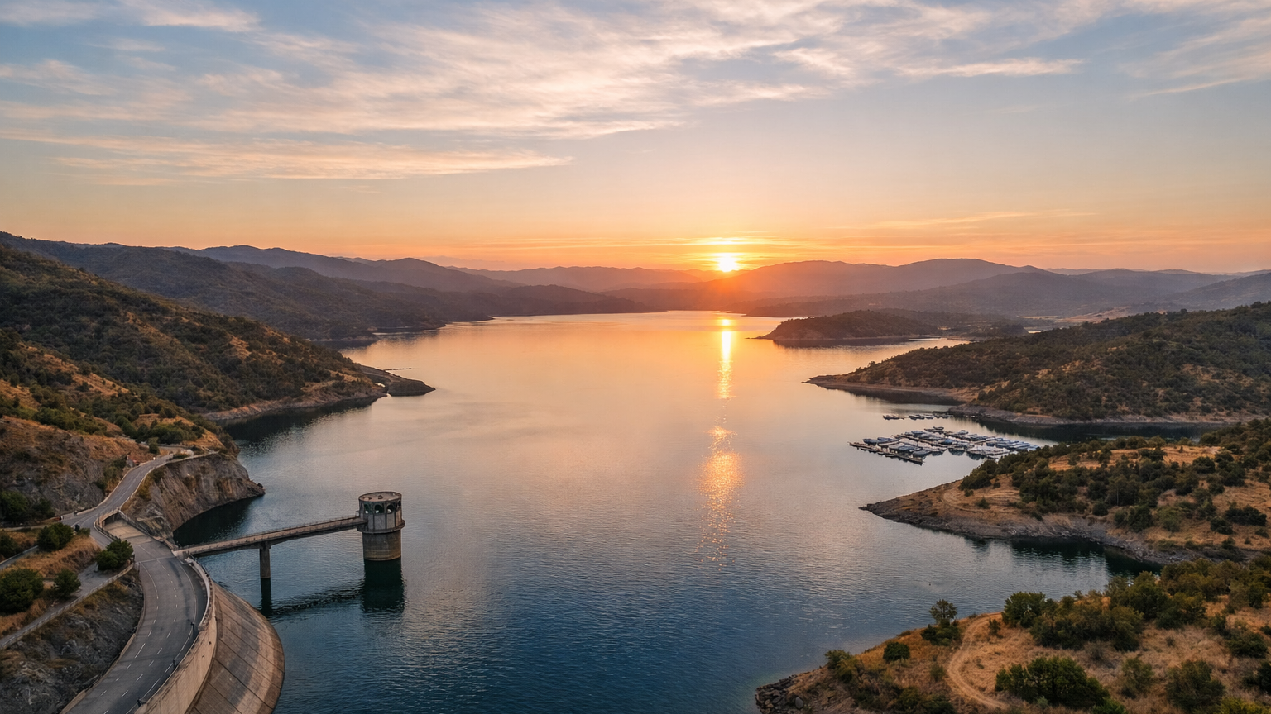




AI & Machine Learning Training Workshop
for Water Resources & Environmental Applications: A Primer
Beginner-friendly
Water-focused
Hands-on mindset
EWRI 2026 Congress
April 26, 1-5 PM
Mobile, Alabama
Notes:
[Sources] - Course content adapted from the user-provided outline in Outline.docx (uploaded in conversation). - Hero image generated with OpenAI image generation on 2026-03-24. [/Sources]

Slide 2
Opening Remarks
Workshop Objectives (managing expectations)
Introduction of Instructors
Jayantha Obeysekera, Research Professor, Institute of Environment, FIU
Todd Crowl, Professor, Director, Institute of Environment, FIU
Jason Liu, Professor, KFSCIS, College of Engineering and Computing, FIU
Wenqian Dong, Assistant Professor, Electrical Engineering and Computer Science, Oregon State University
Dongkuan Xu, Assistant Professor, Computer Science, NC State University
Hamed Najafi, Graduate Student, KFSCIS, FIU

Slide 3

EWRI 2026
AI & Machine Learning Training Workshop for Water Resources & Environmental Applications
https://cybertraining.dk-lab.xyz/workshop/ewri-2026

Slide 4
Schedule for Today
Time | Topic | Instructor
1:00-1:15 | Opening Remarks and Introductions | Jayantha Obeysekera
1:15-1:45 | Role of AI in Water and Environmental Science: Case Study in South Florida | Todd Crowl
1:45-2:15 | Introduction to AI/ML: Fundamentals, Hybrid approaches, Uncertainties, Ethical considerations | Jason Liu
2:15-2:30 | Q/A and/or Break
2:30-3:45 | AI/ML Methods:(Classification, Regression, RF, MLP, XGBoost, LSTM, CNN). Software systems (notebook options) | Wenqian Dong Dongkuan Xu (DK)
3:45-4:45 | Case Studies (10 mins each): Lake Okeechobee inflows Sea Level Variability Groundwater Flood protection Downscaling Water quality | Jayantha Obeysekera, Hamed Najafi
4:45-5:00 | Concluding Remarks, Q&A

Slide 5
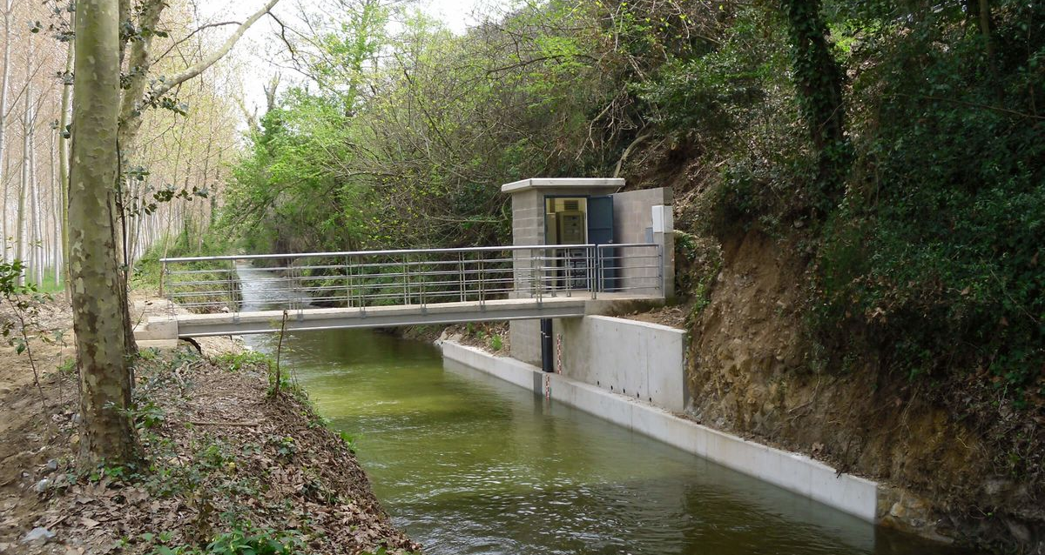
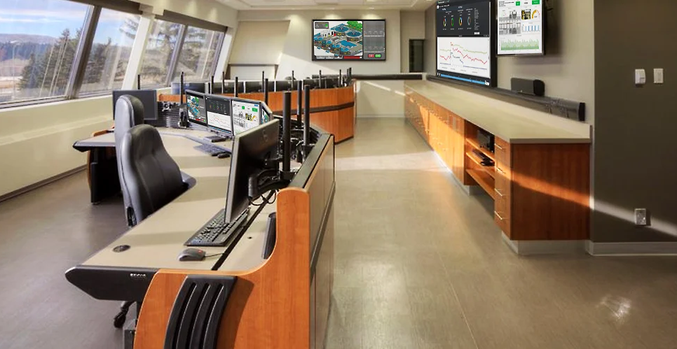
Why AI/ML matters in water resources
Engineers already work with noisy, high-frequency, spatial, and time-dependent water data. ML helps when the goal is to:
• forecast streamflow, stage, groundwater, or water quality • classify flood / non-flood or wet / dry conditions(image recognition) • find patterns across watersheds and operating regimes • flag sensor drift, outliers, and data-quality issues
Real-time monitoring
Operations & decision support
Examples in this workshop
Streamflow
Downscaling
Flood
Groundwater
Sea Level
Key idea: use ML to augment engineering judgment, not replace it.
Notes:
[Sources] - Content adapted from the user-provided outline in Outline.docx (uploaded in conversation). - Monitoring station photo: https://www.adasasystems.com/en/technology/online-stream-gauging-station.html - Control room photo: https://www.evansonline.com/control-room-solutions-for-water-and-waste-water-centers [/Sources]

Slide 6
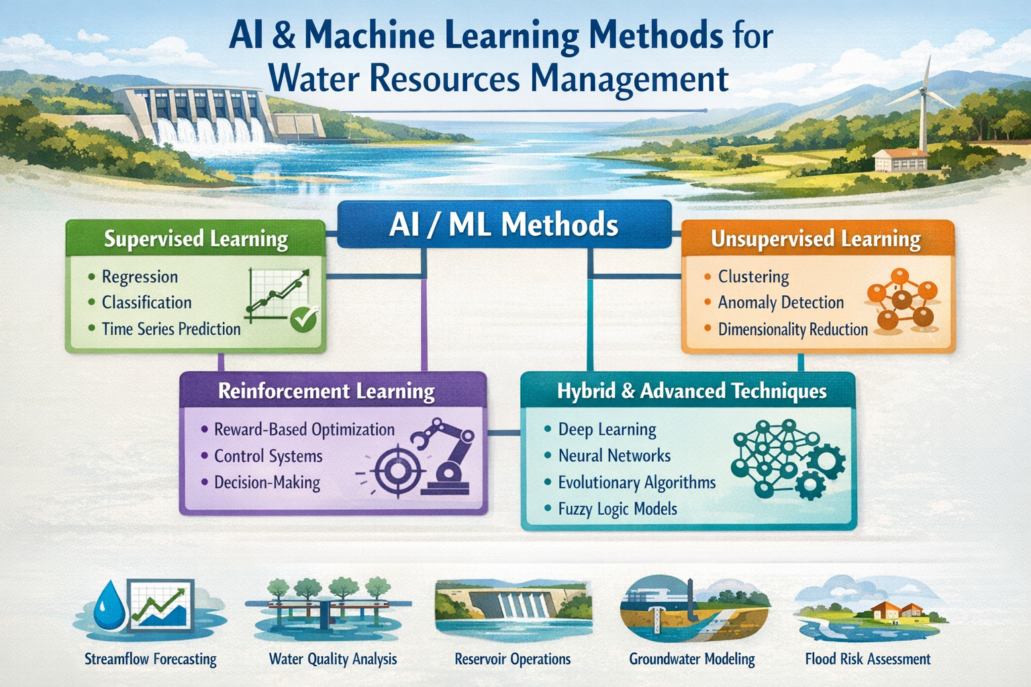

Slide 7
Few Basics
Artificial intelligence
AI is the broad field of building systems that simulate intelligent behavior.
Machine learning
Supervisd learning
Unsupervised learning
Reinforcement learning
Machine learning is a subset of AI that learns from observed data.
Deep learning uses deep neural networks and now powers many practical tasks in text, speech, and vision.
Deep learning contributes to all three
Deep learning as one important branch of ML, not as the whole of AI.
Notes:
[Sources] - Prince, attached PDF, chapter 1 introduction and figure 1.1 discussion (pages 15–16). - Prince, attached PDF, preface statement that the book focuses on ideas rather than coding (page 11).

Slide 8
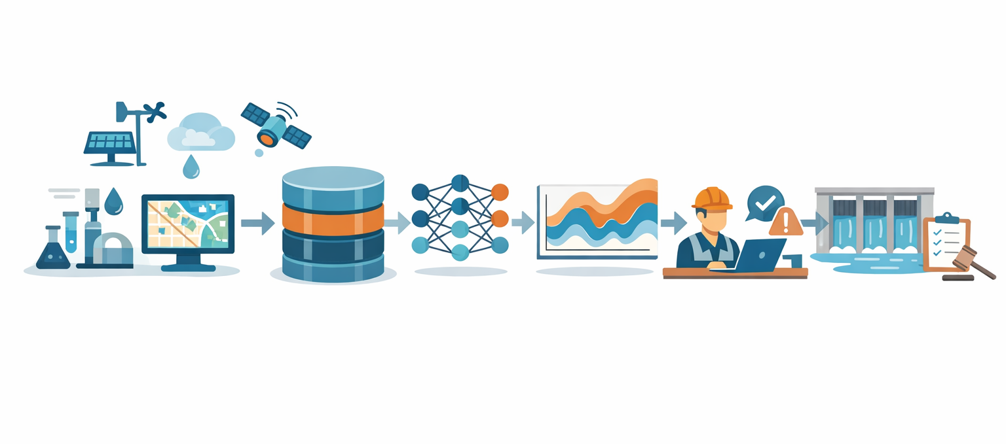
Making AI usable in practice: data, uncertainty, ethics
The hard part is not only fitting a model — it is building a workflow engineers can defend.
From raw data to a defensible decision
AI-ready data
Data limitations
units, timestamps, locations
metadata, QC flags, versioning
missing sensors and sparse labels
rare extremes and shifting conditions
Uncertainty checks
Ethics & governance
blocked train/test splits
ensembles, intervals, transfer tests
transparency, bias, privacy
cybersecurity and human override
raw water data
AI-ready database
model + uncertainty
human decision
Ask “Do we trust the data, quantify the uncertainty, and know who owns the decision?”
Notes:
[Sources]
- Slide content adapted from the user's requested topic expansion in chat.
- Workflow infographic generated with OpenAI image generation on 2026-03-24.
[/Sources]

Slide 9
What kinds of problems will practitioners solve?
USE CASES
Anchor around a few high-value engineering tasks rather than a long list of algorithms.
Continuous prediction
Classification
Clustering
Anomaly detection
streamflow, stage, water quality, groundwater
flood / non-flood, wet / dry, drought class
similar basins, operating regimes, event types
sensor drift, telemetry gaps, impossible values
problem framing
data split
baseline model
better ML model
error analysis
Always connect the model choice back to the engineering decision.
Notes:
[Sources] - Content adapted from the user-provided outline in Outline.docx (uploaded in conversation). [/Sources]

Slide 10
Data & workflow foundations
Problem
Data
Split
Score
Deploy
target + lead time
features + labels
train / valid / test
metric by use case
check drift + failure modes
Habits
Match metrics to decisions
Assess reliability, not only accuracy
Takeaway
Leakage checks, missing-data strategy, scaling, lag selection, and a true baseline.
A model can score well on average and still fail under new hydrologic conditions.
RMSE/MAE for level errors, NSE or KGE for hydrographs, precision-recall for rare events.
Good workflow design before prevents many “ML mistakes” model tuning even starts.
Notes:
[Sources] Asset — Unsplash water texture image URL used as decorative strip: https://images.unsplash.com/photo-1601325059290-eac581b71510?crop=entropy&cs=tinysrgb&fit=max&fm=jpg&ixid=MnwxMjA3fDB8MXxzZWFyY2h8M3x8d2F0ZXIlMjB0ZXh0dXJlfHwwfHx8fDE2Mjg3Mjc5MDE&ixlib=rb-1.2.1&q=80&w=1080 Claim — USGS, “Data Science for Water Resources,” highlights reproducible and collaborative data workflows as a core focus area: https://www.usgs.gov/mission-areas/water-resources/science/data-science-water-resources Claim — Yang & Chui (2021), “Reliability Assessment of Machine Learning Models in Hydrological Predictions Through Metamorphic Testing,” emphasizes that average prediction accuracy may not reflect reliability for a specific input and that reliability checks matter under new conditions: https://doi.org/10.1029/2020WR029471 [/Sources]

Slide 11
A method ladder for beginners
METHODS
Move from interpretable baselines to more flexible models only when the data and objective justify it.
Linear + logistic
regression
Decision trees +
random forest
Gradient boosting
/ XGBoost
Basic neural
networks
LSTM for
time series
Clustering +
PCA
Evaluation +
interpretation
Start here
Then add flexibility
Use deep learning selectively
Teach train/test split, overfitting, leakage, and interpretable baselines first.
Tree ensembles often work very well on tabular hydrologic and water-quality datasets.
LSTMs are especially useful when forecasting sequential behavior such as inflow or stage.
Notes:
[Sources] - Content adapted from the user-provided outline in Outline.docx (uploaded in conversation). [/Sources]

Slide 12
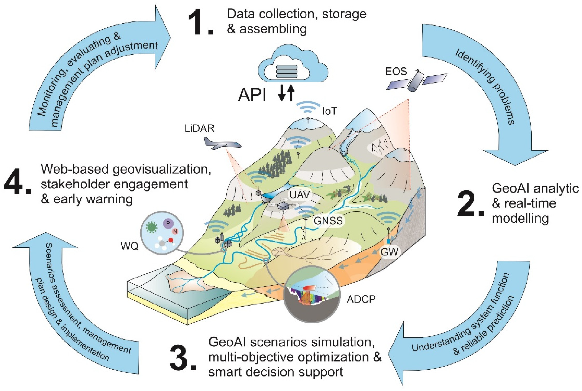
Reliability, interpretation, and physics-aware thinking
For engineers, model evaluation is not an afterthought. It is part of the method.
Reliability checklist
Physics + ML
Reinforce that ML works best alongside hydrologic understanding, process-based models, and domain constraints.
Train
Validate
Test
• cross-validation or hindcasting • clear error metrics and residual checks • feature importance or SHAP-level interpretation • watch for leakage and extrapolation risk
Useful framing for beginners
• physics informs feature design • ML adds speed, pattern recognition, and surrogate behavior • operators still need defensible, explainable outputs
Engineering warning: a good score can still hide a bad model.
Notes:
[Sources] - Content adapted from the user-provided outline in Outline.docx (uploaded in conversation). - GeoAI / IWRM diagram: https://www.mdpi.com/water/water-14-02211/article_deploy/html/images/water-14-02211-g002.png [/Sources]

Slide 13
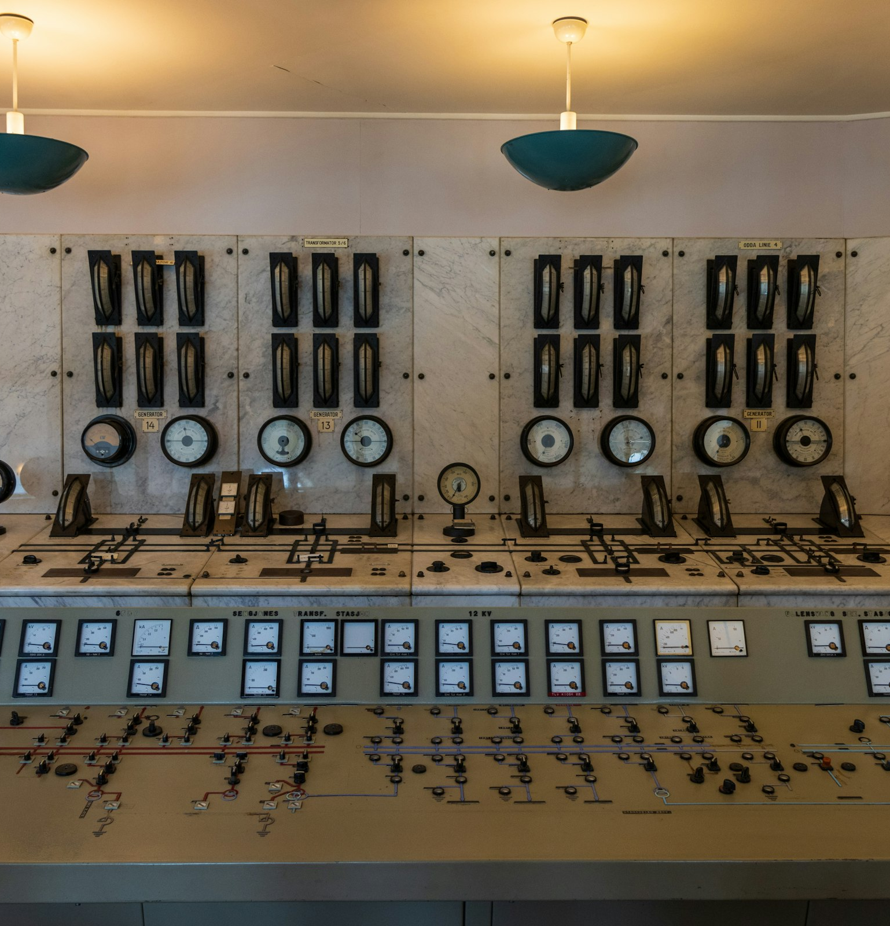
Methods: Tabular supervised learning
05
1
2
3
4
Linear
regression
Decision
trees
Random
forest
Boosting
(XGBoost)
Baseline
First ML
Workhorse
Performance
Robust on tabular data; gives variable importance.
Fast, interpretable, essential for benchmarking.
Handles nonlinear thresholds and interactions; easy to explain.
Often strongest on structured features when tuned carefully.
Water examples
daily streamflow
groundwater level
chloride / nitrate
drought index
Suggested order: baseline linear model → one decision tree → random forest → gradient boosting, always comparing against the baseline hydrograph or regression result.
Notes:
[Sources] Asset — Frantisek Duris, “A large control room with lots of control knobs,” Unsplash photo page: https://unsplash.com/photos/a-large-control-room-with-lots-of-control-knobs-C3DfIgig1j8 ; image file used: https://images.unsplash.com/photo-1738918937796-743064feefa1?fm=jpg&q=80&w=2400 Claim — NOAA overview “Machine Learning for Hydrologic Sciences: An Introductory Overview” describes decision trees, random forests, and boosting/XGBoost as common conventional ML methods for hydrologic sciences and notes that RF provides variable-importance scores: https://repository.library.noaa.gov/view/noaa/57067/noaa_57067_DS1.pdf [/Sources]

Slide 14
Time-series deep learning
07
This is the first deep-learning topic most water engineers should see.
t-3
t-2
t-1
NN
L
S
T
M
Best beginner water uses
daily streamflow
Dense / MLP
network
LSTM / sequence
model
Lagged
features
reservoir inflow
Classic way to give tabular models some “memory”.
Good to explain the idea of a neural network before sequence models.
Designed to learn time dependence directly from the sequence.
water level / stage
groundwater level
rainfall–runoff
Key teaching contrast: tabular models need hand-built lags and rolling features; LSTMs can learn long-term dependencies from sequences more directly.
After forests/boosting so we know what extra complexity buys them.
Notes:
[Sources] Claim — NOAA overview explains that conventional ML methods generally do not explicitly represent temporal evolution in hydrologic processes and that LSTM is an RNN architecture designed to learn long-term dependencies in time series: https://repository.library.noaa.gov/view/noaa/57067/noaa_57067_DS1.pdf Claim — NOAA repository summary for “Deep learning rainfall–runoff predictions of extreme events” states that LSTM networks remained relatively accurate for extreme-event rainfall–runoff prediction compared with conceptual and process-based models in that study: https://repository.library.noaa.gov/view/noaa/46523 [/Sources]

Slide 15
Methods: Unsupervised learning and interpretation
08
Tools for discovery, simplification, and trust-building.
Clustering
PCA
Interpretation
Feature importance
rainfall lag
PET
basin area
soil index
Use for catchment grouping, regime discovery, and exploratory analysis.
Reliability checks
• errors by season / flow regime
• sensitivity to new conditions
• sanity checks against physics
Dimensionality reduction and collinearity relief.
k-means
hierarchical
“why does the model believe this?”
Notes:
[Sources] Claim — NOAA hydrologic ML overview defines clustering as an unsupervised learning method and identifies k-means as a popular clustering algorithm: https://repository.library.noaa.gov/view/noaa/57067/noaa_57067_DS1.pdf Claim — The same NOAA overview notes that random forests provide variable-importance scores and describes tree ensembles and feature selection/value-importance concepts useful for interpretation: https://repository.library.noaa.gov/view/noaa/57067/noaa_57067_DS1.pdf Claim — Yang & Chui (2021) argue that reliability assessment matters because accuracy on observed data can be uncorrelated with consistency under new conditions: https://doi.org/10.1029/2020WR029471 [/Sources]

Slide 16
Summary:
Machine Learning Methods
for Water-Resources Engineers
Spreadsheet / tabular data
When to use Random Forest, XGBoost, LSTM, CNN, and MLP — with simple engineering analogies.
Random
Forest
XGBoost
MLP
Time series / sequential data
Choose the model that matches the structure of your data:
LSTM
• Spreadsheets / watershed attributes → Random Forest, XGBoost, or MLP
• Time series / forecasting → LSTM
• Images, maps, and gridded data → CNN
Images, maps, and grids
CNN

Slide 17




IDEs for ML & Deep Learning
A simple stack: notebooks for exploration, VS Code for daily work, Colab for cloud access, and PyCharm for larger projects.
VS Code
1 Explore in Jupyter / Colab
JupyterLab
Flexible daily editor for Python environments, packages, and debugging.
2 Build and debug in VS Code
Best for quick experiments, plots, equations, and notebooks.
3 Move to PyCharm for larger projects
Google Colab
PyCharm
Zero setup and easy access to cloud runtimes and GPUs.
Helpful for larger Python projects and stronger organization.
Notes:
[Sources] - Visual assets are cropped from an assistant-generated illustration created in this conversation; no external assets were used. - Slide content is an instructional synthesis created for the user; no external non-trivial claims are cited. [/Sources]

