Slide 1
OpenMP
Martin Kruliš
Jakub Yaghob

Slide 2
About
OpenMP (http://www.openmp.org)
API for multi-threaded, shared memory parallelism
Supported directly by compilers
C/C++ and Fortran
Activated by compiler directive (e.g., g++ -fopenmp)
Three components
Compiler directives (pragmas)
Runtime library resources (functions)
Environment variables (defaults, runtime configuration)

Slide 3
History
Specification versions
1.0 – C/C++ and FORTRAN versions (1997-1998)
2.0 – C/C++ and FORTRAN versions (2000-2002)
Supported by MSVC
2.5 – combined C/C++ and FORTRAN (2005)
3.0 – tasks (2008)
3.1 – additional extensions for tasks and atomics (2011)
4.0 – SIMD, cancellation, array sections (2013)
4.5 – Fortran 2003 (2015)
Widely available (gcc 6+, Intel compilers, clang)
5.0 – memory model, accelerators (GPU), unified shared memory, iterators, debugger support (2018)
5.1 – full C++20 and Fortran 2008 support, C++ attributes (2020)
Partial support (gcc 11, Intel compilers, clang)

Slide 4
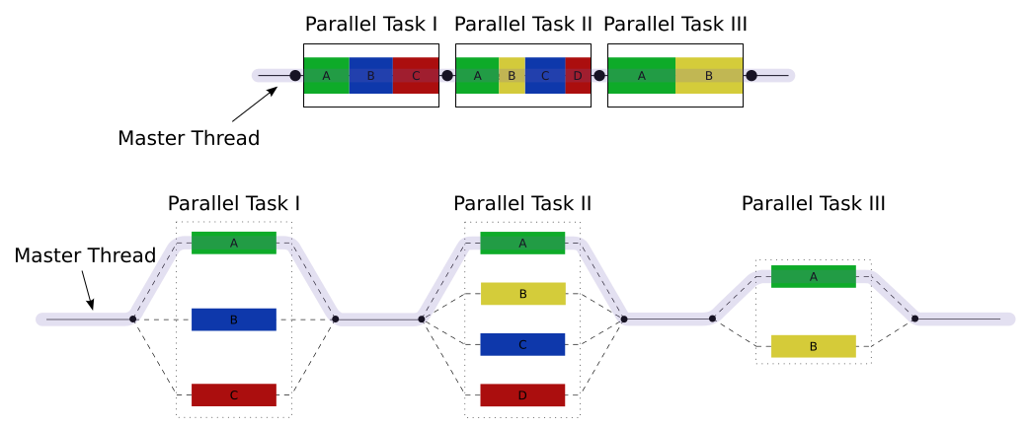
Execution Model
„Team” of threads
Fork/join model
Nested (recursive) fork/joins may be allowed optionally
Threads allocated dynamically, but thread pool may be used to optimize management

Slide 5
Memory model
Relaxed consistency, shared memory model
Memory
Storage location may by associated with one or more devices
Only threads on devices may access it
Thread private memory
Not accessible by other threads
Load/store are not guaranteed to be atomic
Memory operations are considered unordered, unless some defined cases

Slide 6
Pragmas
Basic Syntax
#pragma omp directive [clause, …]
Code should work without the pragmas (as serial)
Pragmas may be used to
Spawn a parallel region
Divide workload among threads
Serialize sections of code
Synchronization

Slide 7
Directives as C++ attributes
Effort to remove C++ preprocessor
[[ omp :: directive( directive [clause, …] ) ]]
or
[[ using omp : directive( directive [clause, …] ) ]]
Attribute directives that apply to the same statement are unordered
Ordering can be imposed
[[ omp :: sequence( [omp::]directive , [omp::]directive ) ]]

Slide 8
Directives as C++ attributes – demo
[[ omp::sequence( directive(parallel), directive(for)) ]]
for(...) {}
#pragma omp parallel
#pragma omp for
for(...) {}

Slide 9
Parallel Region
Spawning a thread team
#pragma omp parallel
{
int tid = omp_get_thread_num();
// use tid to do thread’s bidding
}
Implicit barrier at the end
No branching/goto-s that will cause the program to jump in/out to/of parallel blocks
Regular branching or function calls are OK
Spawns one thread per CPU code by default
Thread index within its team (master == 0)

Slide 10
Variable Scope
Variables Scope
Private – a copy per each thread
Shared – all threads share the same variable
Synchronization may be required
int x, y, id;
#pragma omp parallel private(id), shared(x,y)
{
id = x + omp_get_thread_num();
...
}

Slide 11
Variable Scope
Private Scope
Most variables are private by default
Variables declared inside the parallel block
All non-static variables in called functions
Values are not initialized (at the beginning and the end of the block)
Except for classes (default constructor must be accessible)
Other scopes and additional clauses
Will be presented later

Slide 12
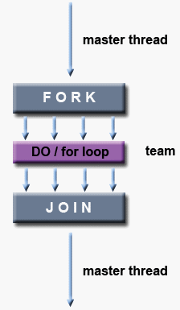
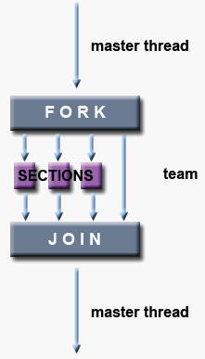
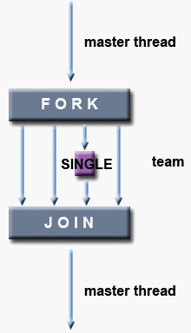
Work-sharing Constructs
Divide the work in parallel block

Slide 13
Work-sharing Constructs
For-loop
#pragma omp parallel
{
#pragma omp for
for (int i = 0; i < N; ++i) { ... }
}
Additional clauses of for directive
schedule(strategy) – scheduling (work division)
static, dynamic, guided, runtime, auto
collapse(n) – encompass nested for-loops
Spawns the threads
Divide for-loop workload among the threads

Slide 14
Work-sharing Constructs
For-loop
#pragma omp ordered
A block inside for-loop that must be executed in exactly the same order, as if the code was serial
#pragma omp parallel for
Shorthand for both creating parallel block and apply it on a parallel for-loop
May have clauses applied to both parallel and for directives
Probably the most often used construct in OpenMP

Slide 15
Work-sharing Constructs
For-loop Pitfalls
Use #pragma omp for outside of #pragma omp parallel block
Has no effect, there is only one thread available
Forgetting the for itsef
#pragma omp parallel
for (int i = 0; i < N; ++i) { … }
The entire loop is executed by ALL threads

Slide 16
Work-sharing Constructs
Sections
Independent blocks of code executed concurrently
#pragma omp parallel
{
#pragma omp sections
{
#pragma omp section
load_player_data();
#pragma omp section
load_game_maps();
...
}
}

Slide 17
Work-sharing Constructs
Single
Code executed by single thread from group
#pragma omp parallel
{
#pragma omp for
for (...) ...
#pragma omp single
report_progress();
#pragma omp for
...
}
Only one thread reports the progress

Slide 18
Work-sharing Constructs
Synchronization
Implicit barrier at the end of each construct
for, sections, single
nowait clause
Removes the barrier

Slide 19
Synchronization Constructs
Synchronization Directives
To be used within a parallel block
#pragma omp master
Region being executed only by master thread
Similar to #pragma omp single
#pragma omp critical [name]
Standard critical section with lock guard
Only one thread may be in the section at a time
If name is provided, all sections with the same name are interconnected (use the same lock)

Slide 20
Synchronization Constructs
Synchronization Directives
#pragma omp barrier
All threads in a team must meet on a barrier
#pragma omp atomic
Followed by a statement like x += expr; or ++x;
Allowed operations: +, *, -, /, &, ^, |, <<,or >>
#pragma omp flush [memory-ordering]
Make sure changes of shared variables become visible
Executed implicitly for many directives
barrier, critical, parallel, …

Slide 21
Tasks
Tasks
Pieces of code that may be executed by a different thread (within a parallel section)
#pragma omp task
Additional clauses
untied – different thread may resume task after yield
priority(p) – scheduling hint
depend(list) – tasks that must conclude first
And few other that control when and who can execute the task

Slide 22
Tasks
Tasks Synchronization
#pragma omp taskwait
Wait for all child tasks (spawned in this task)
#pragma omp taskyield
Placed as statement inside a task
The processing thread may suspend this task and pick up another task
#pragma omp taskgroup
Spawning thread will not continue unless all tasks in the group are completed

Slide 23
Data Sharing Management
Data-related Clauses
We already know private and shared
firstprivate – similar to private, but the value is initialized using the value of the main thread
lastprivate – value after parallel block is set to the last value, that would be computed in serial processing
copyprivate – used with single block, last value is broadcasted to all threads

Slide 24
Data Sharing Management
Reduction
Variable is private and reduced at the end
#pragma omp ... reduction(op:list)
Op represents operation (+, *, &, |, …)
Each operation has its own default (e.g., + has 0)
List of variables
Custom reducers
#pragma omp declare reduction (identifier : typename-list : combiner) [initializer-clause]

Slide 25
Synchronization Constructs
Local Thread Storage
#pragma omp threadprivate(list)
Variables are made private for each thread
No connection to explicit parallel block
Values persist between blocks
Variables must be either global or static
copyin(list) clause (of parallel block)
Similar to firstprivate
Threadprivate variables are initialized by master value

Slide 26
Runtime Library
Runtime Library
#include <omp.h> usually required
Functions
void omp_set_num_threads(int threads)
Set # of threads in next parallel region
int omp_get_num_threads(void)
Get # of threads in current team
int omp_get_max_threads(void)
Current maximum of threads in a parallel region

Slide 27
Runtime Library
Functions
int omp_get_thread_num(void)
Current thread index within a team (master == 0)
int omp_get_num_procs(void)
Actual number of CPU cores (available)
int omp_in_parallel(void)
True, if the code is executed in parallel
omp_set_dynamic(), omp_get_dynamic()
Dynamic ~ whether # of threads in a block can be changed when the block is running

Slide 28
Runtime Library
Locks
Regular and nested locks
omp_lock_t, omp_nest_lock_t
Initialization and destruction
omp_init_lock(), omp_init_nest_lock()
omp_destroy_lock(), omp_destroy_nest_lock()
Acquiring (blocking) and releasing
omp_set_lock(), omp_unset_lock(), …
Acquiring the lock without blocking
omp_test_lock(), omp_test_nest_lock()

Slide 29
Environmental Variables
Environmental Variables
May affect the application without recompilation
OMP_NUM_THREADS
Max number of threads during execution
OMP_SCHEDULE
Scheduling strategy for for-loop construct
The loop must have the strategy set to runtime
OMP_DYNAMIC
Enables dynamic adjustment of threads in a block

Slide 30
Thread Team Configuration
Actual number of threads in parallel region
if(condition) clause is evaluated
num_threads(n) clause is used if present
omp_set_num_threads() value is used
OMP_NUM_THREADS env. value is used
System default (typically # of CPU cores)
Affinity
Whether threads are bound to CPU cores
proc_bind(policy) clause
OMP_PROC_BIND, OMP_PLACES

Slide 31
Nested Parallelism
Nested Parallel Blocks
Implementations may not support it
Must be explicitly enabled
omp_set_nested(), OMP_NESTED
Nesting depth may be limited
omp_set_max_active_levels(), OMP_MAX_ACTIVE_LEVELS
More complex to get the right thread ID
omp_get_level(), omp_get_active_level(), omp_get_ancestor_thread_num()

Slide 32
SIMD Support
SIMD Instructions
Generated by compiler when possible
Hints may be provided by pragmas to loops
#pragma omp simd, #pragma omp for simd
Important clauses
safelen – max. safe loop unroll width
simdlen – recommended loop unroll width
aligned – declaration about array(s) data alignment
linear – declaration of variables with linear relation to iteration parameter
Use both SIMD and parallel for

Slide 33
Accelerator Support
Offload Support
Execute code on accelerator (GPU, FPGA, …)
#pragma omp target ...
Slightly more complicated
Memory has to be allocated on target device
And data transferred there and back
Or memory has to be mapped to target device
Target device may have more complex thread structure
OpenMP introduce thread teams directive

