Slide 1
Technical Assessment for Data Scientist Position
Presenter: Hamidreza Nademi
Armani Middle East Trading | Data engineering · Forecasting · Dashboard · Dynamic pricing
Notes:
Welcome. This presentation walks through how I approached the assessment: what problem each part poses, how I investigated it, which technical decisions I made and why, and what the results are. The emphasis is on the reasoning and the method, not only the final numbers.

Slide 2
Four parts, one chain: each answer feeds the next
THE BRIEF AND MY APPROACH
Part | Business problem | The question I asked first | What I built
1 Data and ETL | Raw weekly file of 30 products | Can I trust every number, and what does each column really measure? | Validated pipeline, star schema, audit trail
2 Forecast | Demand volatility | What exactly should I forecast, and how do I prove a model works? | Demand rebuild, 13-model test, 26-week forecast
3 Dashboard | Managers need KPIs and alerts | What would a manager decide on Monday morning? | Plain-language dashboard with alerts
4 Pricing and risk | Static prices, credit and liquidity | Where does price really earn money, and what could go wrong? | Rule engine, safety limits, pilot plan
Diagnose before modelling
Test on unseen data
Simple unless proven otherwise
State and stress assumptions
What the data measures is understood before a method is chosen.
Every choice is judged on weeks the model has not seen.
A complex model must beat a plain rule to be used.
Where data is missing, assume openly and show the range.
Notes:
The assessment names three business problems: demand volatility, static prices and credit/liquidity risk. I treated them as one chain: you cannot forecast before the data is trustworthy, you cannot price before you know demand, and a dashboard makes the whole thing usable. For each part I started from a question rather than a technique. Four habits guided every decision: diagnose before modelling, test on unseen data, prefer the simple solution unless evidence says otherwise, and state every assumption and stress it.

Slide 3
The constraint is availability, not demand or price
EXECUTIVE SUMMARY
~40%
4.6%
$10.8M
+$1.3M
of customer demand went unserved in the last 52 weeks: products ran out of stock
average forecast miss (WAPE) for the next 26 weeks, 13% better than the best simple rule
tied up in 5 over-stocked products, while the other products sell out
extra profit in 26 weeks from stock-aware pricing (range $1.2M to $1.3M)
What it means: customers want more than can be served, so the money is in stock planning first and pricing second.
What was built: a clean database, a forecast engine, a manager dashboard with alerts, and a rule-based pricing framework with safety limits.
Next steps: purchasing of the five over-stocked products stops, cover for the lean ones rises, and a short pricing pilot precedes roll-out.
Notes:
Four numbers carry the story. About 40% of customer demand went unserved last year because stock ran out; a simple model forecasts the next 26 weeks within 4.6%; five over-stocked products tie up $10.8M; and pricing that respects scarcity adds about $1.3M profit without selling fewer units.

Slide 4
A pipeline that never loses or hides information
PART 1 · DATA ENGINEERING
1
Extract and check
2
Validate
3
Clean
4
Recover and flag
5
Load
schema, types, untouched raw copy kept
typed exceptions, bad rows to quarantine
39 exact duplicates dropped, infinite growth values nulled
16 missing sales = revenue / price; odd rows flagged
star schema in one transaction, run log
Why: nothing is ever lost
Why: fatal errors stop the load
Why: repeats would double count
Why: information is kept, not erased
Why: repeatable and auditable
7,800
15 / 15
unique product-weeks from 7,839 raw rows
exception tests passed on a corrupted copy
Star schema: product, date and weekly-sales tables plus audit tables, so every later question is a simple query.
Notes:
Design goal: every number in later parts must be trustworthy and every correction traceable. The raw file is copied untouched into a staging table first, so nothing is lost. Validation separates fatal problems (stop the load) from fixable ones (log and correct). Exact duplicates are dropped because a repeated row would double count sales. Missing sales are recovered from revenue / price. Odd values are flagged, not deleted, because later analysis shows they carry information. The load is one transaction so it is repeatable. Exception handling was proven on a deliberately corrupted copy: 15 tests, all passed. The integrity index rises from 79.7 to 99.7.

Slide 5
Nine data problems, each treated with a reason
PART 1 · DATA CHALLENGES
Challenge | Evidence | Treatment | Reason
1 Exact duplicate rows | 39 rows (0.5%) | Dropped, first kept; conflicting keys would be quarantined (none) | A repeated week double counts sales
2 Missing Sales_Units | 16 rows | Recovered as revenue / price, flagged | Revenue and price were intact
3 Missing legacy forecast | 606 rows (7.8%) | Kept empty and flagged, not imputed | Imputing would invent a baseline
4 Infinite revenue growth | 897 rows | Set to NULL, growth recomputed | Growth from zero revenue is undefined
5 Inconsistent derived fields | consistency score 36.6% | Revenue, profit, margin, growth, turnover recomputed | KPIs must reproduce 100%
6 Inventory in the wrong week | 907 rows: zero stock, positive sales | Stock available = previous row's inventory (lag 1) | After the shift: 0 sales above stock
7 Pile-ups and zero weeks | 27% of sales, 53% of inventory at 1,500 / 2,500; 1,329 zero weeks | Flagged, never deleted | They are stock caps and carry information
8 Outliers | 23 sales values (robust z > 4) | Flagged; winsorised copy added, original untouched | Extremes may be real peaks
9 No dates, customers, competitors | week numbers only | Synthetic calendar; labelled scenario inputs | Nothing is invented silently
Notes:
These are the data challenges met in the raw file, in the order they were found. Principle: fix what is provably wrong, flag what is merely unusual, and never delete information whose meaning is not yet understood. Duplicates and missing sales were corrected because the correct value is determinable. The legacy forecast was not imputed because that would invent a baseline. The inventory timing issue looked like data corruption (907 rows with zero stock but positive sales) but was in fact a misaligned column: sales in a week are limited by the previous row's inventory. The pile-ups and zero weeks looked like errors but turned out to be stock caps, which later became the key to the whole solution. Outliers were flagged with a robust z-score and a winsorised copy was added, leaving the choice to the model. The data has no dates, customers or competitor prices, so those parts rely on labelled assumptions.

Slide 6
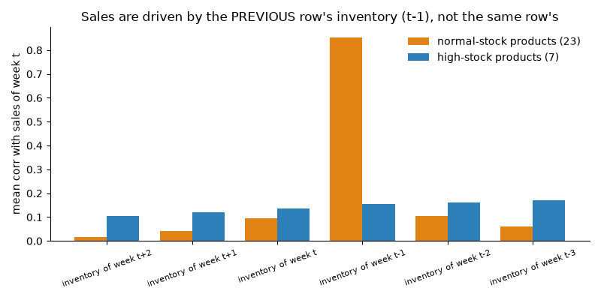
Stock caps sales, so sales understate demand
PART 1 · KEY DISCOVERY
0.85
1,329
53%
sales vs last week's stock (correlation)
stock-out weeks, all zero sales
of weeks capped by stock
Zero stock always means zero sales; 2,813 more weeks sell exactly the stock.
So sales = min(demand, stock): they understate what customers wanted.
Later steps rely on this: forecast demand, lost sales, pricing.
Assumptions made, and why
Synthetic calendar (week 1 = 6 Jan 2020): the file has week numbers only; seasonal findings are relative to it.
Odd values are flagged, never deleted: pile-ups and zero weeks are signals of stock limits, not errors.
Inventory read as the previous row's stock: verified, zero violations after the realignment.
Notes:
Sales in a week track the previous row's inventory (correlation 0.85), zero stock means zero sales, and sales pile up exactly at the stock caps 1,500 and 2,500. So sales equal min(demand, stock). 53% of product-weeks are affected. Forecasting raw sales would forecast stock availability.

Slide 7
Demand is reconstructed before forecasting
PART 2 · PRE-PROCESSING
Week type | Share | Demand used
Unconstrained (sales < stock) | 46.5% | observed sales
Stock-limited (sales = stock) | 36.1% | max(sales, blend)
Stock-out (stock = 0) | 17.0% | max(sales, blend)
First week (stock unknown) | 0.4% | max(sales, blend)
Seasonal model (the structure)
log demand = product level + shared trend + Fourier seasonality over week of year
Fourier order K = 2 and shared trend chosen by blocked 5-fold CV, 1-SE rule (CV MAPE 6.66%)
Blend and legacy forecast
Legacy forecast on known weeks: bias -0.4%, corr. 0.97
Weight 0.40 fitted out-of-fold; held-out products agree
606 missing legacy values: model-only (325 weeks)
Result
6.2M units of demand (39%) were lost to stock limits
Limitation: unconstrained weeks lean to lower demand, so the blend error is an estimate
Notes:
Step 1: every product-week is classified by the stock available for sales (previous row's inventory): unconstrained if sales are below stock, stock-limited if sales equal stock, stock-out if stock is zero. Step 2: the legacy forecast is validated on unconstrained weeks, where true demand equals sales: bias -0.4 percent, correlation 0.97, about 10 percent multiplicative noise, so it is a usable noisy measure of demand. Step 3: a seasonal model is fitted in log space with a product level, a shared trend and a Fourier seasonal curve. The Fourier order K and the trend structure are chosen by blocked 5-fold cross-validation with the one-standard-error rule: K=2, shared trend. Step 4: the demand estimate in censored weeks is the larger of observed sales and a 0.40 / 0.60 blend of the legacy forecast and the model; the weight is fitted on out-of-fold predictions and confirmed on held-out products. Where the legacy forecast is missing (606 rows) the model alone is used. One caveat: unconstrained weeks are slightly biased toward lower demand, so the accuracy of the blend is an estimate.

Slide 8
Features built in three layers
PART 2 · FEATURE ENGINEERING
A Data and stock features
B Target and structure
C Model inputs
built in the ETL
built in pre-processing
built in forecasting
stock_available_for_sales = previous row's inventory (lag 1)
censor status: unconstrained, stock-limited, stock-out, unknown
flags: stock-out, stock-limited, pile-up, imputed, outlier, forecast missing
recomputed margin, growth, turnover; winsorised sales copy
demand_est: reconstructed demand, with source and uplift %
seasonal-model prediction (shared Fourier curve)
calendar: week of year, quarter, season, year index
stock regime (k-means, 2 regimes) and high / normal stock profile
Structural: product level, shared trend, sin / cos pairs (K = 2)
LightGBM: horizon, week of year, trend index, same week last year and neighbours, 13 / 26 / 52-week levels, product and regime codes
target relative to the 52-week level (removes product size)
Purpose: what does each sales number measure?
Purpose: the target and the product descriptors.
Purpose: simple structure vs richer learner.
Rules that protect the features
Only information known at the forecast origin is used; the legacy forecast builds the target but is never an input.
Price, cost and margin were tested and left out: no calendar effect and no measurable demand effect.
Notes:
Feature engineering happened in three layers. Layer A, in the ETL: the most important feature of the whole project is stock_available_for_sales, the previous row's inventory, which turned an apparent data error into the explanation of the sales pattern. Together with the censoring status and the flags it describes what each sales number really measures. Layer B, in pre-processing: the reconstructed demand target, the seasonal-model prediction, calendar fields from the synthetic dates, and product descriptors: stock regime from k-means on stock-out rate, capped-week rate and stock cover, and the high-stock versus normal-stock profile. Layer C, model inputs: the structural model needs only product level, a trend and two Fourier pairs. LightGBM received a richer set known at the forecast origin: horizon, week of year with sine and cosine, trend index, demand of the same week last year and its neighbours, 13, 26 and 52-week levels, and product, segment, regime and category codes; its target is demand relative to the 52-week level, which removes product size. Three rules protect the features: only information known at the forecast origin is used, the legacy forecast is never a model input (it only helps build the target), and price and cost were tested and left out because they have no measurable effect.

Slide 9
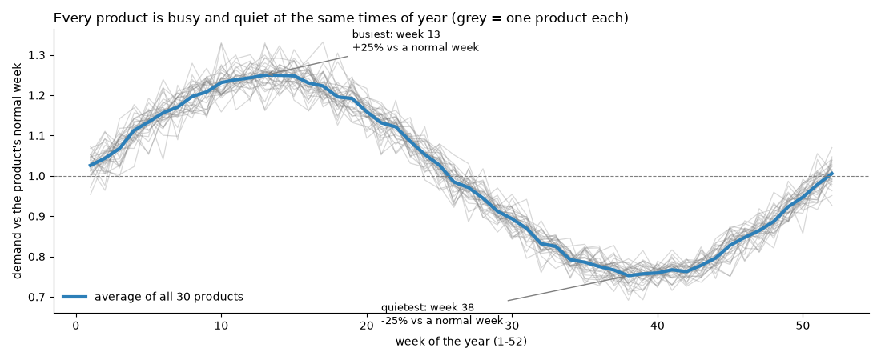
The evidence behind the feature choices
PART 2 · EVIDENCE FOR THE FEATURES
78-86%
0.97
-0.017
demand variance by week of year
profile correlation
price effect (not significant)
Decisions that follow from the evidence
One shared seasonal curve for all 30 products; sub-clusters by shape add noise, not signal.
Price and cost are not features; stock only caps sales and is not a demand driver.
Seasonality and last year's pattern carry about 95% of the learner's importance, which is why a simple structure matches it.
Notes:
Features were kept or dropped based on evidence. Calendar effects were tested by the share of variance explained by week of year, compared with a permutation null in which labels are shuffled within each product: week of year explains 78 to 86 percent of demand variance, whereas price, cost and unit margin show no calendar effect and stock level only 5 percent. Product profiles correlate 0.97, so one shared seasonal curve is justified; clustering products by shape added little. In the LightGBM model, importance is concentrated in week of year and its sine and cosine terms plus demand of the same week last year; product size, level features and category codes carry almost nothing once the target is relative to the 52-week level. A within-product regression of log demand on log price gives -0.017 (95 percent interval -0.056 to +0.021), so price is not a demand driver in this data. These findings justify the simple structure and the exclusion of price.

Slide 10
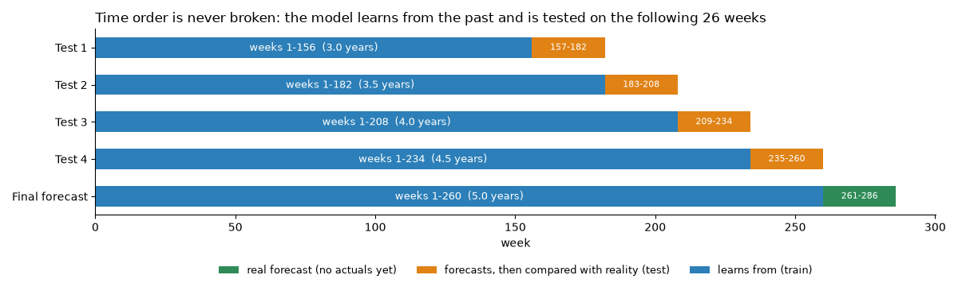
13 candidate models, one fair test
PART 2 · MODELLING METHOD
Baselines
same week last year, 52-week mean, mean x shared season index; nothing to tune
Holt-Winters, SARIMAX
per product; structure by AICc; SARIMAX with Fourier seasonality and ARMA errors
Structural (pooled / per segment)
log demand = level + trend + Fourier terms; order K and trend by inner CV
Time order is never broken: each test learns from the past and is scored on the next 26 weeks.
Why this design
LightGBM (global / per segment)
direct multi-horizon; hyper-parameters on a trailing 26-week validation block
No peeking: every free setting, including the 0.40 / 0.60 blend weight, is tuned on training weeks only.
Not one lucky window: four rolling origins, each 26 weeks ahead like the real task.
WAPE (volume-weighted) is primary; MAE, RMSE, MAPE, MASE and bias are also reported.
Paired bootstrap over products: is the winner really better than the best simple rule?
Prophet
yearly seasonality; settings by inner CV on 6 sample products
Ensembles
average of 5 fixed methods; average of best 3 chosen only from earlier folds
Notes:
Two risks make forecasting comparisons misleading: peeking at the future and choosing one lucky window. Rolling-origin backtests were used: train on 156, 182, 208 and 234 weeks and test on the next 26, the same task as the real forecast. Every free parameter is tuned inside the training window only: AICc for Holt-Winters and SARIMAX, inner time-series cross-validation for the structural model and Prophet, a trailing validation block for LightGBM. WAPE is primary because it weights errors by volume and is robust to small values; MAE, RMSE, MAPE, MASE and bias are also reported. A paired bootstrap over products tests whether differences are real. Simple baselines are included on purpose: a complex model must beat a plain rule to be used.

Slide 11
13 methods, 4 tests: the simple structure wins
PART 2 · FORECASTING
4.57%
97
WAPE of the winner
units: mean error per product-week
13% better than the best simple rule, 34% better than 'same week last year'.
How tested: 4 rolling origins, next 26 weeks each; every setting tuned on training data only.
Honest figure: 6.6% on weeks where demand was observed directly.
Simple is enough: a plain size x season x growth recipe is within 0.15 points.
Notes:
Rolling-origin backtests: train on 156, 182, 208 and 234 weeks and test on the next 26. All tuning happens inside the training window. Metrics: WAPE (primary), MAE, RMSE, MAPE, MASE, bias. The winner is statistically better than the best simple rule (bootstrap CI excludes zero) and equal to the per-segment version, so the simpler pooled model is selected. Honest accuracy on directly observed weeks is 6.6%.

Slide 12
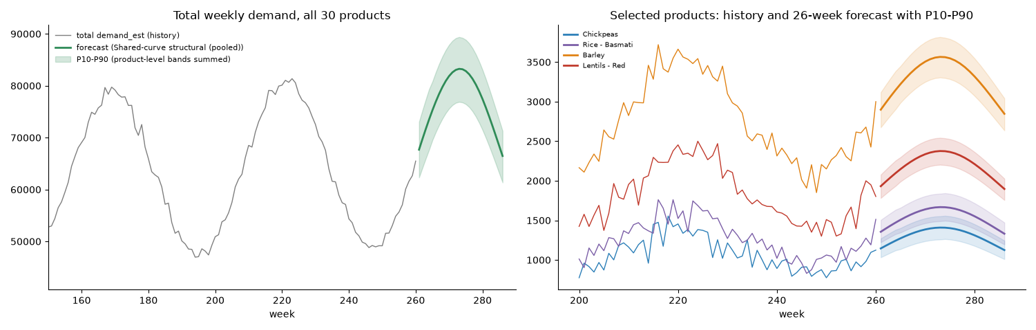
Next 26 weeks: demand up 2.8%
PART 2 · FORECASTING
2.0M
units forecast, +2.8% vs same weeks last year
80%
of outcomes inside the P10-P90 band
$64.6M
$28.7M
revenue potential, no stock limit
at risk at today's stock levels (44%)
Assumptions: future stock follows each product's own last 104 weeks; prices stay at the last 13-week average; no promotions. The likely range comes from backtest errors, so it is measured, not assumed.
Notes:
The forecast covers weeks 261 to 286. P10-P90 bands come from backtest errors and cover 80% of outcomes. At historical stock levels 44% of the forecast revenue would again be unserved, because stock, not demand, is the limit.

Slide 13
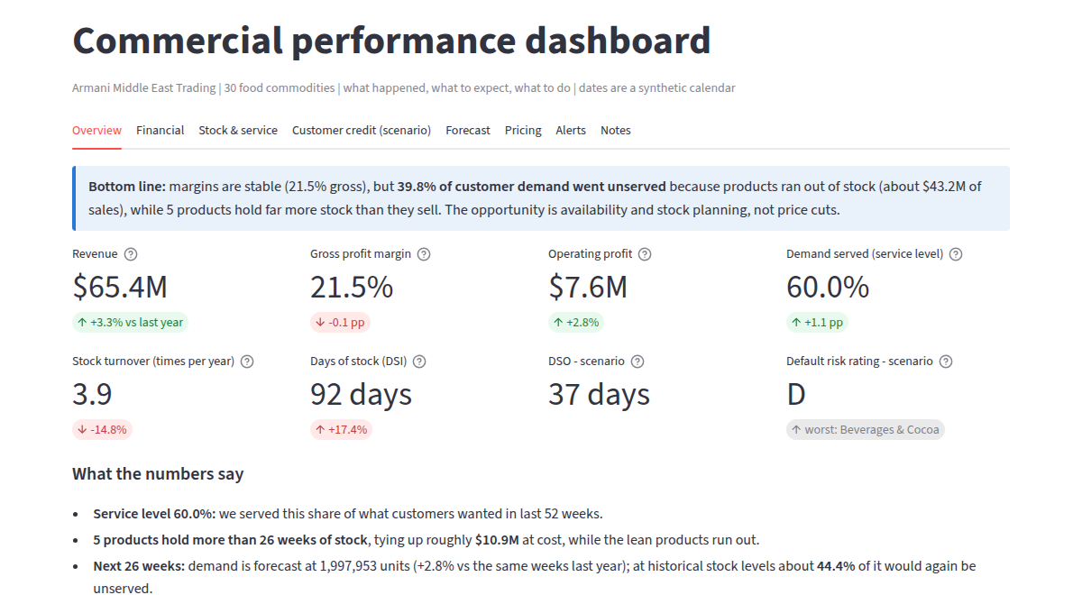
A dashboard built for managers, not analysts
PART 3 · DASHBOARD
Start from the reader: bottom line first, everyday words (days of stock, demand served).
One tab, one question: financial, stock and service, credit, forecast, pricing, alerts.
No data, no pretending: credit uses editable, labelled scenario inputs.
Alerts are rules, not black boxes: six rules, editable thresholds, money at stake, next action.
Trust: 24 automatic tests reconcile every KPI to the database.
Overview tab (live demo available)
$65.4M
21.5%
60%
16 high
revenue, +3.3% vs last year
gross margin, flat
of demand served; $43.2M lost
priority alerts, each with an action
Notes:
I designed the dashboard around the reader: senior managers who are not technical. Each of the eight tabs answers one business question and opens with a one-sentence bottom line. KPIs are grouped as financial (margin, growth, operating profit), operational (turnover, days of stock, service level, lost sales), credit (DSO, A-E default-risk rating) and forward-looking (26-week forecast with a likely range, recommended prices). The data has no customers or invoices, so the credit layer is a scenario with editable assumptions, labelled as such. Alerts are six rules with editable thresholds and show the money at stake and a suggested action. 24 automatic tests reconcile KPIs to the database. I will show the live dashboard here.

Slide 14
Price follows scarcity and season
PART 4 · DYNAMIC PRICING
State | Meaning | Action
Scarce (78%) | part of demand cannot be served | raise price up to +8%, only as far as the same units still sell
Balanced (5%) | stock covers demand | hold the price
Surplus (17%) | over 26 weeks of stock | markdown only if it pays; otherwise fix purchasing
Why this rule
When stock sells out anyway, units are set by stock, not price, so a higher price is pure profit.
It does not need the unknown price sensitivity.
Example: Barley, week 1: only 48% of demand can be served, so the rule suggests +6%; protection allows +4.5%; the weekly step limit makes it +3.0%.
Notes:
Each product-week is scarce, balanced or surplus. When part of the demand cannot be served the product sells out anyway, so a small price rise is extra profit. The rise grows with scarcity, is largest in peak season, and is capped at 8%. 78% of the forecast product-weeks are scarce.

Slide 15
Six rules turn the forecast into a price
PART 4 · THE PRICING ENGINE
1 Scarcity premium
2 Sell-out protection
3 Surplus markdown
rise = 8% x min(1, g / 30%) x season
largest rise M with E[units] >= 99% of today's
up to 10%, deeper as weeks of stock exceed 26
g = share of demand that cannot be served; only if g > 5%. Season: peak 1, normal 0.75, off-peak 0.5.
Tested by 1,000 simulated demand draws, with customers twice as price-sensitive.
Applied only if simulated profit improves, counting the carrying-cost saving.
Why: if stock sells out anyway, a higher price is pure profit.
Why: price sensitivity is unknown; do not rely on it.
Why: a discount gives away margin on every unit.
4 Credit risk
5 Guardrails
6 Final price
D/E: no markdown, premium = default share + DSO/365 x 8%
cost floor, market band 0.92 to 1.10, step 3% a week
today's price, rules 1-4, then clipped by rule 5
Rating C: markdown capped at 5%.
Floor = cost + 5% + holding cost, adjusted for expected credit loss.
The binding limit is recorded for every product-week.
Why: risky credit must pay for loss and funding.
Details on the next slide.
Why: every price can be explained.
Notes:
This is the algorithm in plain terms; the full mathematics is in the Word rulebook. Rule 1: the share g of expected demand that cannot be served drives a premium of up to 8 percent, scaled by season (peak 1.0, normal 0.75, off-peak 0.5). Rule 2: sell-out protection finds the largest rise M for which expected units sold stay at least 99 percent of the baseline, even if customers were twice as price-sensitive, using 1,000 simulated demand draws. Rule 3: for surplus stock a markdown of up to 10 percent is applied only if simulated profit rises, counting the carrying-cost saving. Rule 4: credit-risky categories get no markdown and pay a risk premium covering default loss and funding. Rule 5: hard guardrails. Rule 6: assembly, recording which limit was binding so every price is explainable.

Slide 16
Safety limits keep every price sensible
PART 4 · RISK GUARDRAILS
Guardrail | Rule | Why
Sell-out protection | raise only as far as units sold stay within 1%, even if customers were twice as price-sensitive | price sensitivity is unknown; the rule does not rely on it
Cost floor | never below cost + 5% markup + carrying cost, covering expected credit loss | no sale below a profitable level
Competitive band | within -8% and +10% of today's price (13-week average) | stay close to the market; no competitor data exists
Weekly step | at most 3% change from one week to the next | customers never see price jumps
Credit risk D/E | no discounts, +2.5% risk premium, 15 days shorter terms | credit sales cost default loss and funding; risky categories should pay for it
Profit test for markdowns | discount only if expected profit rises, counting stock-holding savings | a discount gives away margin on every unit
All 19 automatic checks pass: band, floor, weekly step, credit rules, hand-calculated arithmetic, and a replay that uses only information available at the time.
Notes:
Each guardrail answers a business risk. All are tested automatically on the 26-week plan and on a 52-week replay: 19 checks passed. Competitor prices are not in the data, so the 13-week average price is the proxy for the market.

Slide 17
How the pricing engine was tested
PART 4 · VALIDATION
1
Simulate
2
Stress sensitivity
3
Replay the past
4
Stress the inputs
1,000 demand and stock draws per product-week; profit with the engine vs holding today's price, same draws for both.
Repeat for price sensitivity 0, -0.5, -1, -2, -3. The result is a range, not one number.
Last 52 weeks: decide at weeks 208 and 234 using only past information and a naive forecast.
16 parameter variations, and a test where real demand is only 60% of the estimate.
Why a range instead of one number
19 / 19
0 leaks
Price effect is not measurable here: -0.017, 95% range -0.056 to +0.021.
The engine raises prices only where stock sells out anyway, so the gain is nearly independent of it.
automatic checks pass
replay uses only information available at the time
Notes:
The central difficulty is that customer price sensitivity cannot be measured from this data: prices move only about 4 percent within a product, and the estimated effect is -0.017 with a 95 percent range from -0.056 to +0.021, which includes zero. So instead of pretending to know it, I designed the engine so that its gain does not depend on it, and I tested that claim four ways. Each test uses the same simulated demand and stock for the engine and for the do-nothing case, so the difference is purely the pricing.

Slide 18
About +$1.3M profit in 26 weeks, robustly
PART 4 · EXPECTED IMPACT
+$1.4M
+$0.94M
replay of the last 52 weeks
if demand is 60% of estimate
Robust: all 16 parameter settings tested stay positive ($0.64M to $1.6M).
Same units: units change by -0.4% in the planning case.
Largest setting risk: how many lost units are accepted; 0% halves the gain.
Assumption: customer price sensitivity cannot be estimated from the data (effect -0.017, 95% range -0.056 to +0.021), so results are shown as a range.
Notes:
Profit means gross profit minus expected credit losses, versus holding today's price, using the same simulated demand and stock. Because prices are raised only where stock sells out anyway, the result barely depends on how customers react: $1.15M if they are very price-sensitive, $1.30M if they ignore price. Replaying the last 52 weeks with only past information gives +$1.4M. If real demand were only 60% of the estimate the gain would still be $0.94M.

Slide 19
Beyond price: stock, credit and pilots
PART 4 · BEYOND PRICE
$1.3M
17-49%
a year to carry the excess, more than the pricing gain
price cut needed to clear it in a year
Over-stock: purchasing stops; bulk or export deals. 200 test markdowns did not pay.
Credit D/E: no discounts, 2.5% risk premium; 15 days shorter terms free about $361K.
Lean products: raise stock cover; a price gain needs continued sales.
Assumptions: holding cost 12% a year, funding cost 8% a year, credit ratings from scenario inputs.
Pilots replace the two open assumptions with measurements
Pilot A (8 weeks): 6 scarce products at +3% / +5% with matched controls; success = units within 1% of control and stock still sells out.
Pilot B (8 weeks): high-stock products at +3% / -3% in random weeks to measure real price sensitivity (weekly noise about 8%).
Notes:
Five products hold between 64 and 370 weeks of stock: $10.8M at cost and about $1.3M a year to carry, which is more than the whole pricing gain. Selling the excess within a year by price alone would need cuts of 17 to 49 percent even for very price-sensitive customers, and a price below cost at the planning sensitivity. 200 candidate markdowns were tested and rejected because they do not pay. Beverages and Cocoa is rated D in the credit scenario. Two assumptions remain open, price sensitivity and competitor prices, so two pilots are proposed. For products that sell out, units sold equal stock, so a price test there only shows whether they still sell out; real sensitivity needs products with ample stock.

Slide 20
Assumptions, reasons and how each is replaced
ASSUMPTIONS REGISTER
Assumption | Why it was made | How it is checked or replaced
Synthetic calendar from 6 Jan 2020 | the file has week numbers only | real dates replace it; no result depends on the start date
Sales = min(demand, stock) | stock-outs give zero sales; pile-ups sit at the stock caps | verified: zero violations in the database
Old forecast is a usable demand signal | unbiased (-0.4%) on weeks where truth is known | blend weight learned out-of-fold; accuracy also on clean weeks
Future stock follows its own history | future purchasing is unknown | dashboard shows the stock-limited and unconstrained views
Credit terms, delays, default rates | no customer or invoice data exists | editable in the dashboard; replace with payment history
Price sensitivity -1 (plan) and -2 (stress) | price barely varies (4%), so the data cannot measure it | results shown from 0 to -3; Pilot B measures it
Competitor band -8% / +10%, holding 12%, funding 8% | no competitor data; standard cost-of-capital levels | adjustable parameters; replace with observations
Notes:
Every assumption is documented in the notebooks and the README. The three that matter most for decisions are price sensitivity, credit data, and the demand reconstruction; each has a test or a pilot attached.

