Slide 1
Blood Bag: A Web Application to Manage All Blood Donation and Transfusion Processes
presented at the IEEE WiSPNET 2017 conference
報告者:職電子所 林清河
指導老師:李仁貴 老師
報時時間:108年1月10日

Slide 2
Outline
Introduction
Proposed Method
Conclusion
Taiwan Blood Bank

Slide 3
Introduction
Problems of blood bags shortage:
The fear of donating blood.
The misconception that donating blood is harmful and transmits diseases.
According to some Egyptian statistics:
Lack of blood bags in hospitals threatens the lives of around 15% of the patients.
Up to 300 thousand bags deficit every year.
Blood knowledge:
The normal grown-up has around 5 l of blood inside their body, conveying fundamental components, expelling hurtful squanders, and coursing through their vessels.

Slide 4
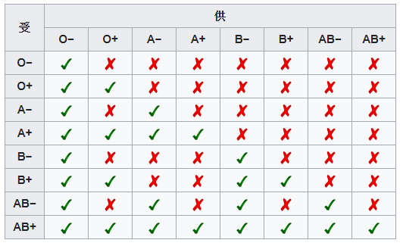
Introduction
Blood banks:
Provision of a large amount of blood of various categories.
Contribution to the society and illustrate the importance of blood to save lives.
Different blood groups need to be matched correctly:

Slide 5
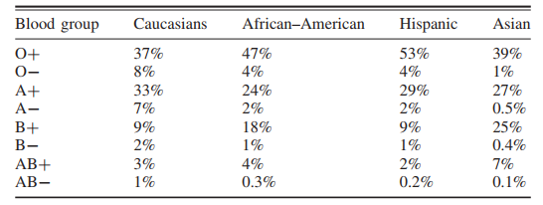
Introduction
BLOOD GROUPS RATIOS IN HUMANS :

Slide 6
Introduction
Donation eligibility requirements:
Age: 18–60.
Weight: More than 50 kg.
Donation rate (female: every 4 months, male: every 3 months).
Ideally nibble-two hours before donating for the first time.
Hemoglobin: (female: more than 11.5, males: more than 12.5).
Hematocrit ratio: (female: more than 38, male:- more than 41)
Blood Pressure: 90–180 to 50–100.
Pulse: regularly 50–100/min.
Temperature: 35–37 ◦C.
The absence of any symptoms

Slide 7
Proposed Method
Scope definition:
The “Blood Bag” as a web-based application connected to a centralized database which gathers and organizes the data from all blood banks and the blood donation campaigns.
This system sorts out and controls the entire basic procedures identified with blood donation, testing and storing blood bags, and delivering it to the patient.
Requirement analysis:
Observation the work environment during actual donation and all processes related to the donation.
Interviews to collect information about donation, campaigns, and blood analysis.

Slide 8
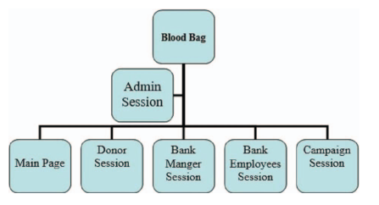
Proposed Method
Problem analysis:
Where blood groups are available.
The difficulty in obtaining the required blood group.
Fear of blood donation.
Lack of knowledge of the benefits of donating blood.
Blood bag system components:

Slide 9
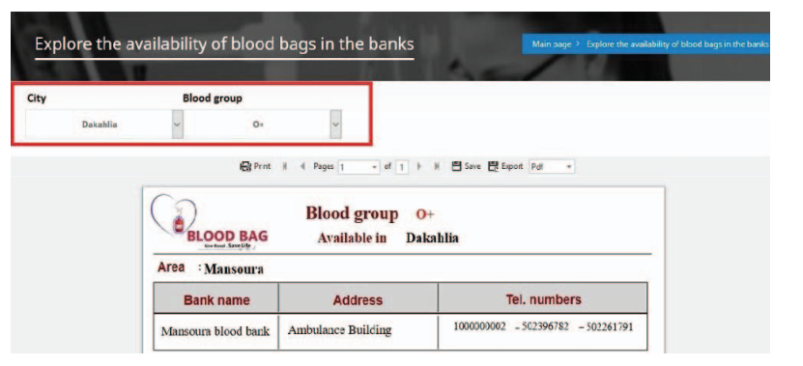
Proposed Method
Search for blood:

Slide 10
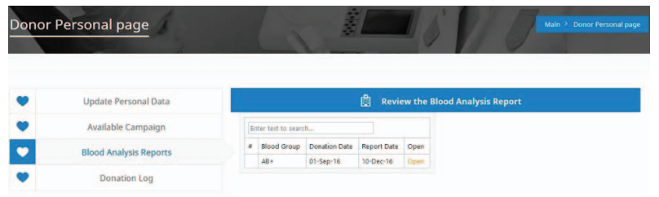
Proposed Method
Review the blood analysis reports page:

Slide 11
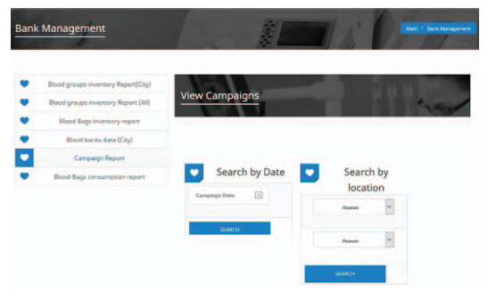
Proposed Method
Review report from bank manager session:

Slide 12
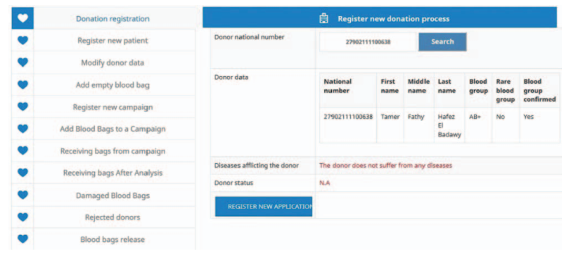
Proposed Method
The employee session (register new donation process):

Slide 13
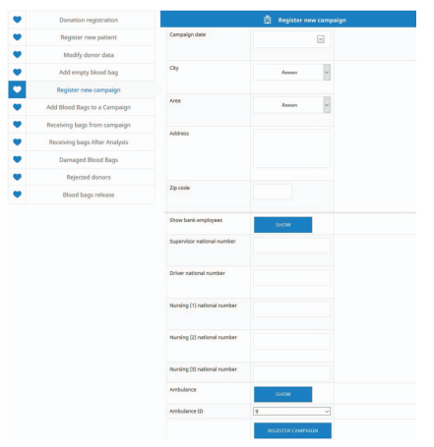
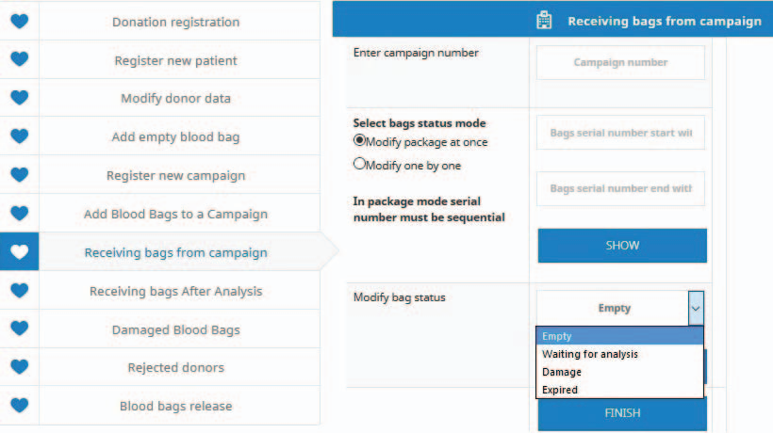
Proposed Method
The employee session (register new campaign):

Slide 14
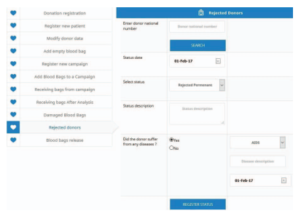
Proposed Method
The employee session (Rejected donors) :

Slide 15
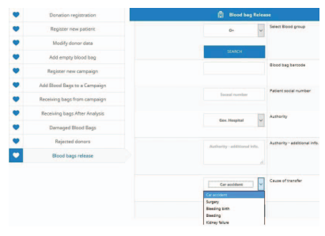
Proposed Method
The employee session (blood bag release):

Slide 16
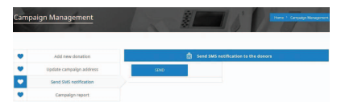
Proposed Method
The campaign session (send SMS):

Slide 17
Conclusion
Blood Bag system helps blood banks and donors save lives of the patients through a controlled system which manages all blood donation and transfusion processes.
We aim to ensure that the transfusion blood is safe, and reliable.
FUTURE WORK:
connect all of the blood banks labs.
insert the detailed blood analysis reports to implement a quantitative analysis of the diseases that appeared and repeated in a specific area.

Slide 18
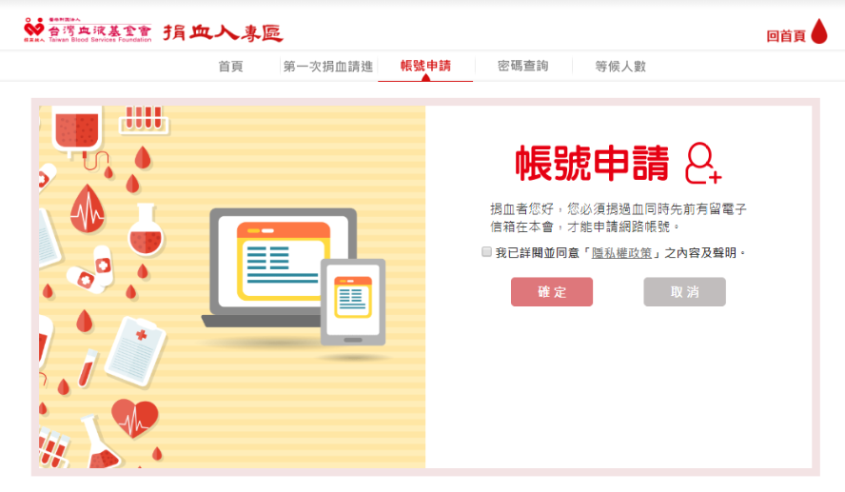
Taiwan Blood Bank

Slide 19
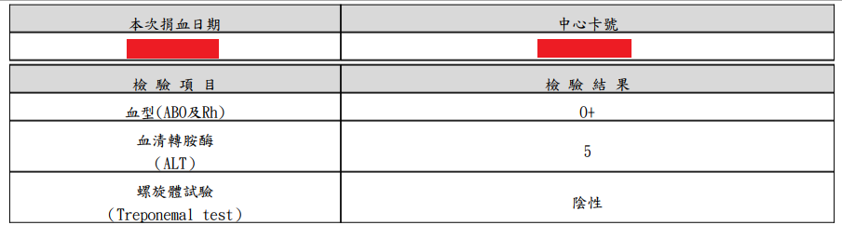
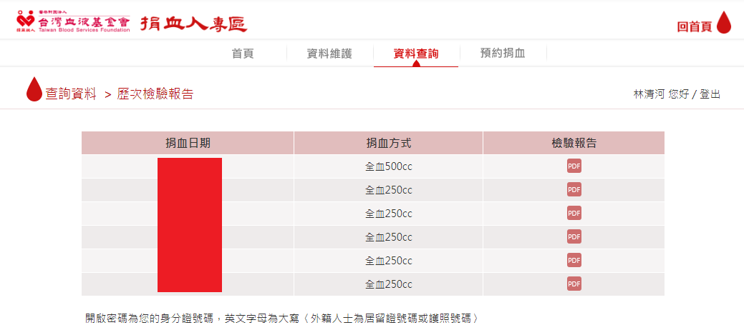
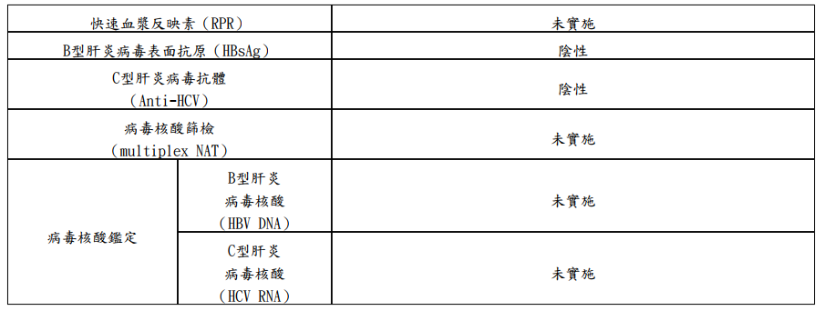
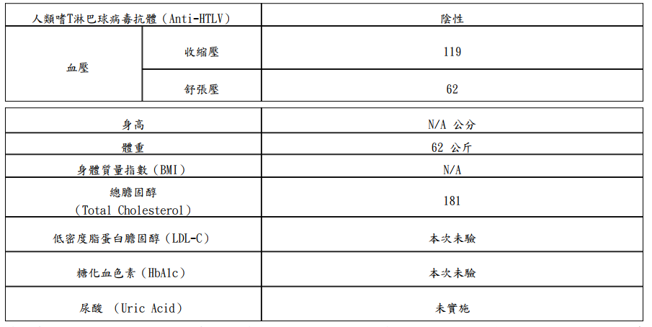

Slide 20
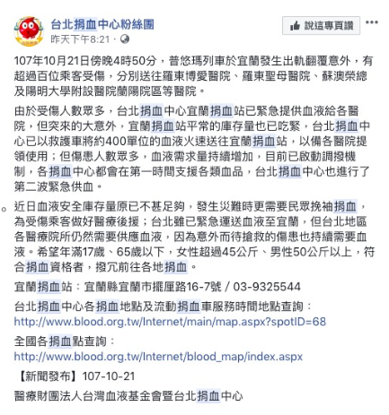
Taiwan Blood Bank

