Slide 1
Machine Real-Time Monitoring System Base On OPC UA
學生:107368505 林清河
指導教授:黃士嘉 老師
授課老師:李宗演 老師

Slide 2
Outline
Introduction
Related Work
System Architecture and Design
Experimental Results
Conclusion
Reference

Slide 3
Introduction
Assist in Upgrading Industries, Towards Industry 4.0:Smart Manufacturing.
It’s very difficult to replace the new machine.
Cost too high.
Collecting Machine Data.
Add sensor.
Read the existing information of the machine.
Base on industrial communication standard: OPC UA protocol, develop a system with data collection and monitoring.
Transfer data to server use wifi or bluetooth.
Display monitoring data by web and app.

Slide 4
Introduction(con.)
Implement a monitoring system with cross-platform and unified communication standards.
Arduino as external sensor control.
Expandability.
Low-cost.
Break through the limited of factory space.
OPC UA advantage:
Machine to machine communication protocol.
Focus on data collection and control.
Open, Cross-platform, SOA, Robust security.

Slide 5
Related Work
MT Connect:
Manufacturing standard.
Lightweight, Open, Flexible protocol.
Read-only.
OPC:
Standards and specifications for industrial telecommunication
Use in process control and manufacturing automation applications.
Base on Microsoft.
MT Connect-OPC UA:
Communicate with each other.
Including the advantages of both, but it’s difficulties in implementation.

Slide 6
Related Work(con.)
 | MT Connect | OPC | OPC UA | MT Connect-OPC UA
Transport format | XML | XML、binary | XML、binary | XML、binary
Communication Protocal | HTTP | Web Service、TCP | Web Service、TCP | Web Service、TCP
Complexity | Low | Medium | Medium | High
Security | High | Low | High | High
Write | No | Yes | Yes | Yes
Cross-Platform | Yes | No | Yes | Yes
Interoperability | Low | Low | High | High

Slide 7
System Architecture and Design
OPC UA Client
Machine
OPC UA Server
Web Server
Browser
I/0
Port
DB Server
Server
API
Sensor
Machine
Arduino
Windows
APP

Slide 8
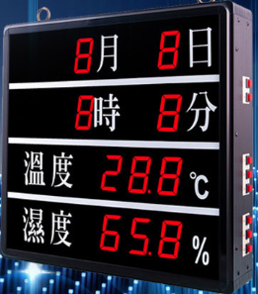
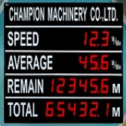
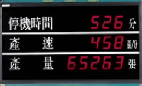
Experimental Results
Existing way :
Only see the current information and historical data cannot be known.
Unable to monitor instantly.

Slide 9
Experimental Results
Use OPC UA:
Real time monitor factory information
See the history data.
Show wrong message.
Real-Time Transmission :
One sensor :12-14 time/s.
About 280KB each time.
Total:3.3-3.9Mbps.
Bluetooth transmission speed:24Mbps.
Achieves purpose of real time monitor.
Real-Time
Information
Monitor Screen
Yield
Browser
APP
Historical Production Report
Alarm

Slide 10
Conclusion
Considering the upgrade cost of the machine and the flexibility of the equipment expansion, we propose the "Machine Real-Time Monitoring System Base On OPC UA" .
Design a system to read the sensor and machine information.
Real time display machine information via the web and app.
Need to be customized.
Improve the ability of traditional manufacturing information integration.

Slide 11
Reference
W. K and M. S, “Standalone OPC UA Wrapper for Industrial Monitoring and Control Systems,” IEEE Access, vol. 6, pp. 36557-36570, Jul. 2018.
B. K. Kim, Y. J. Heo, J. C. Na, “Design of unidirectional security gateway system for secure monitoring of OPC-UA data,” in Proc. ICTC. Korea, Oct. 2017.
S. G, J. P, F. Palm, “RESTful Industrial Communication With OPC UA,” IEEE Transactions on Industrial Informatics, vol. 12, pp. 1832-1841, Feb. 2016.

Slide 12
Thank you

