Slide 1
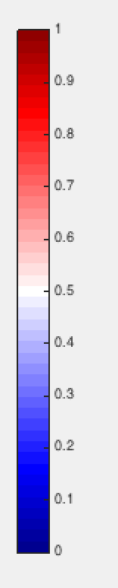


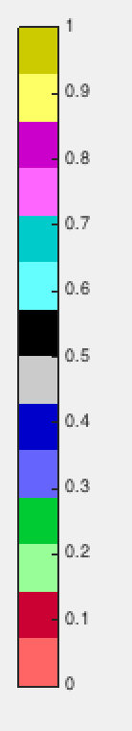
Redblue.mat
Redblue_hjr.mat
Colormap_blue_red_hjr.m
Colormap7_light_dark.m

Slide 2
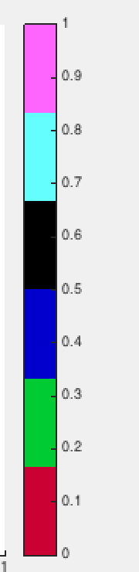
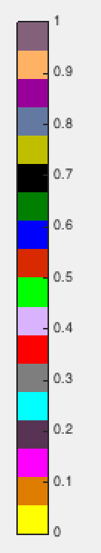
Colormap7.m
Colormap17.m

Slide 3
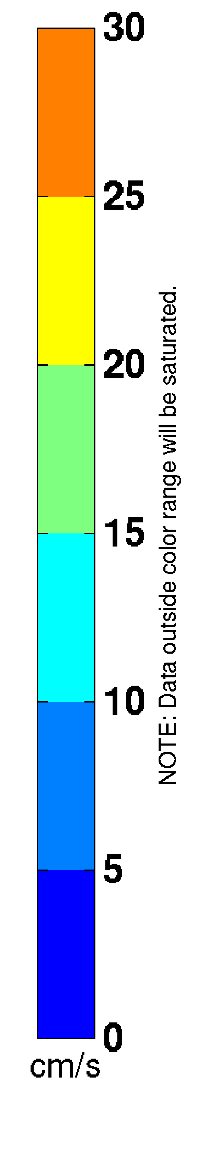
Colorticks=0:5:30
Caxis([0,30])
Colormap(feval(jet,numel(colorticks)-1)

