Slide 1
Crunching the Numbers: A Visual Exploration of Traffic Violations
Presented by Devi, Erika, Haley, Samantha

Slide 2
In Focus
Our project delved into the landscape of traffic violations, aiming to gain a comprehensive understanding of the factors influencing outcomes, whether in the form of citations or warnings.
Our data collection process meticulously captured diverse elements of each traffic stop, including the driver's state, the make of the vehicle, and demographic information such as race and gender.
Employing a combination of statistical analysis and machine learning, we scrutinized these features to unravel correlations and patterns within the dataset.

Slide 3
Sources
Our data comes from Montgomery County, Maryland. The dataset contains traffic violation information from all electronic traffic violations issued in the county and is updated daily. The raw data has 1.89 million rows and 43 columns.
Goes back to 2012.
The dataset was pulled on November 16, 2023.
Using
Python/Pandas
Tableau
Machine Learning
Pyspark

Slide 4

Data Cleaning

Slide 5
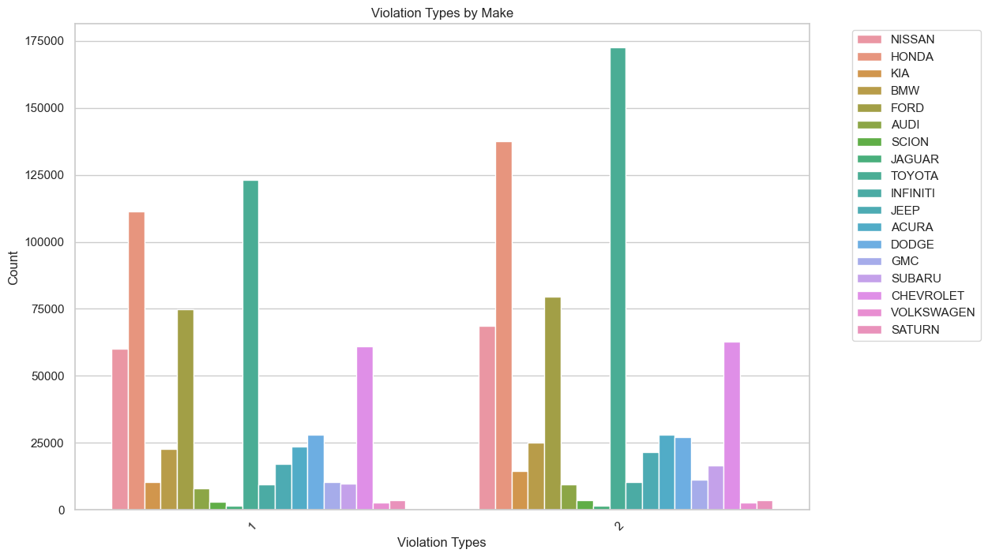
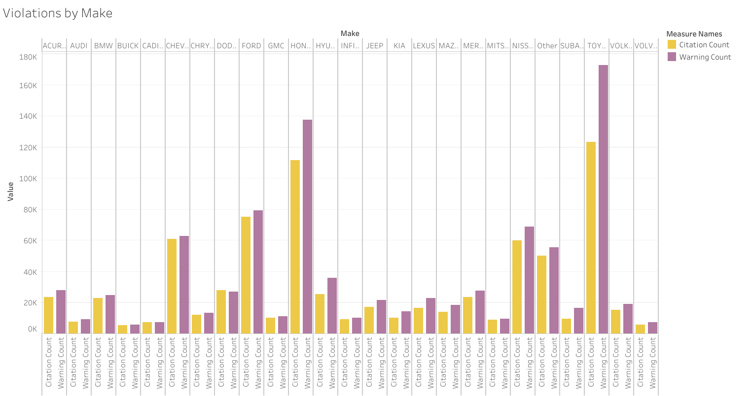
Vehicle Makes

Slide 6
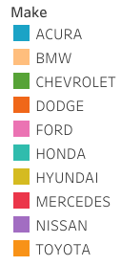
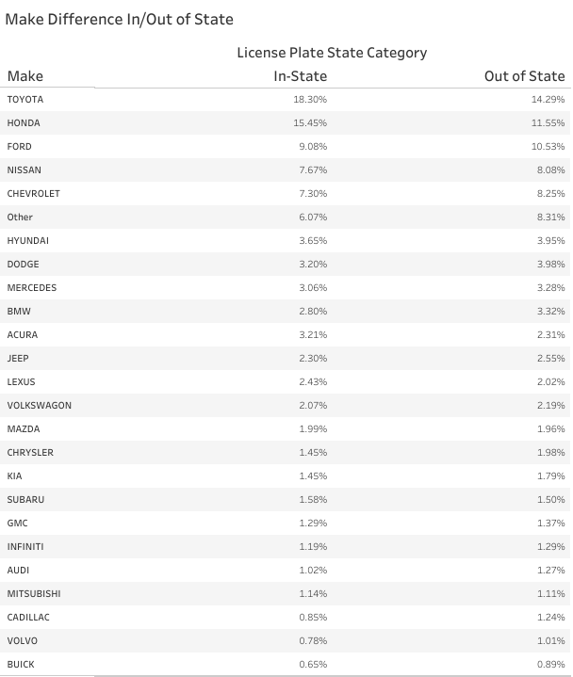

In-State vs. Out of State
In-State
Out of State
Out of State has fewer Toyotas and Hondas.

Slide 7
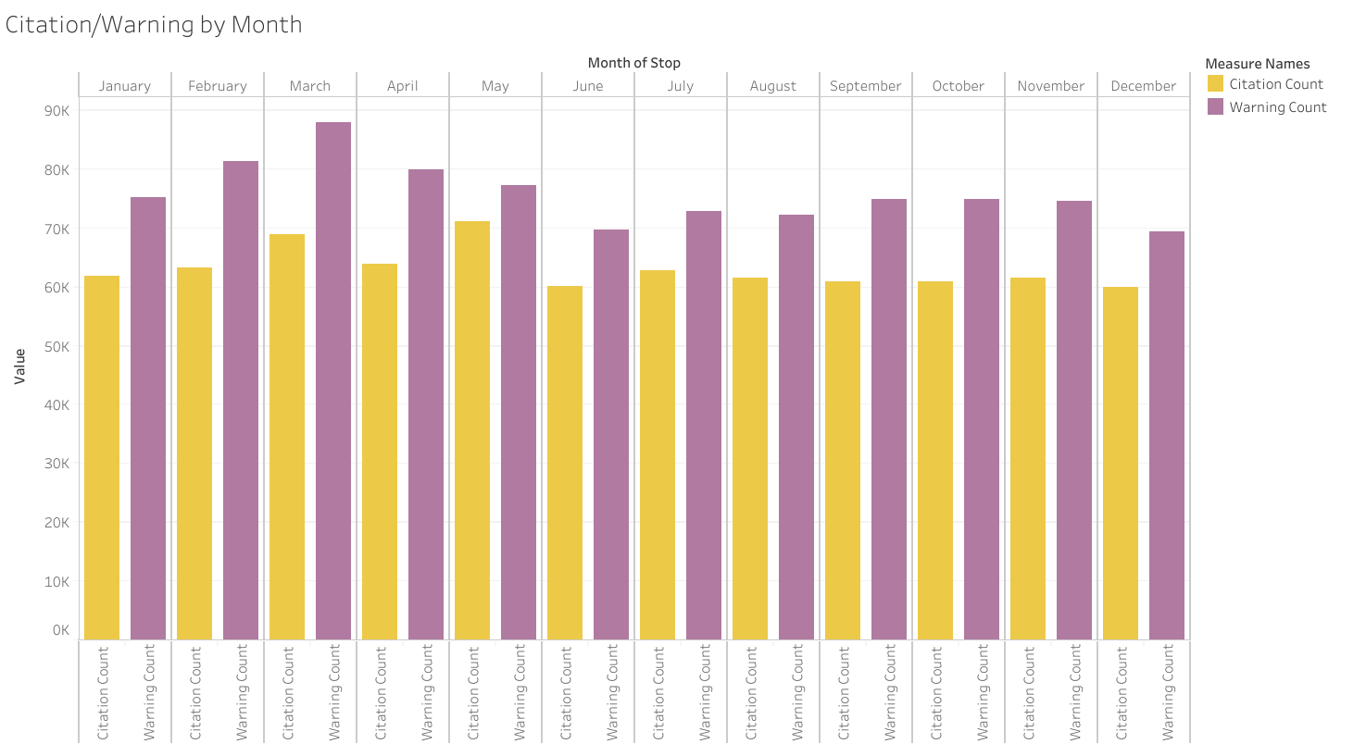
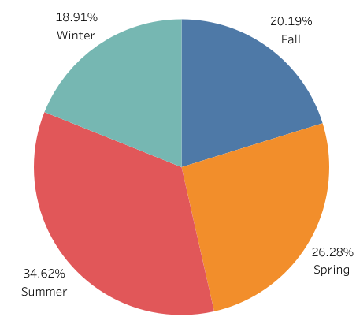
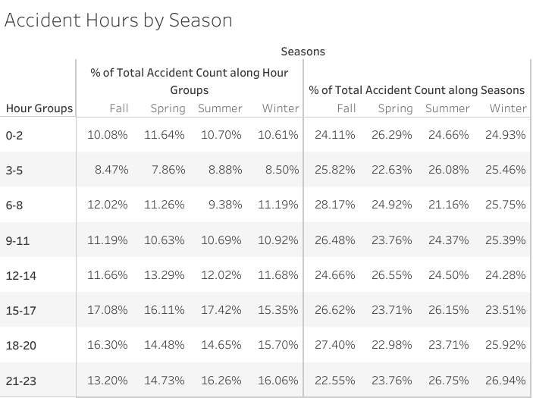
Seasons

Slide 8
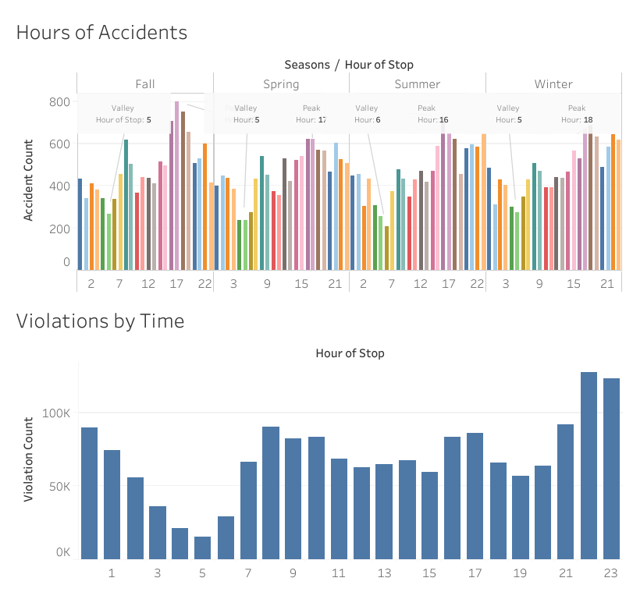
Peak Hours

Slide 9
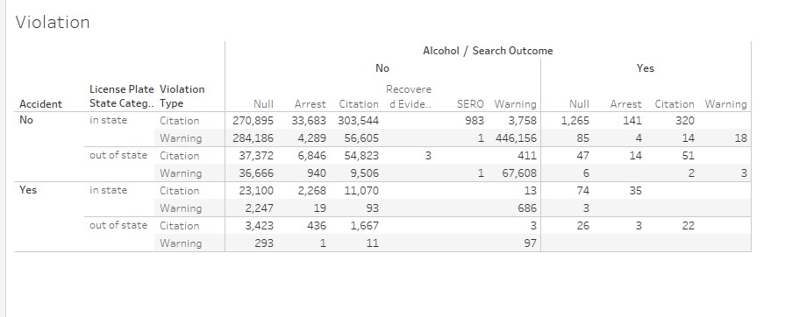
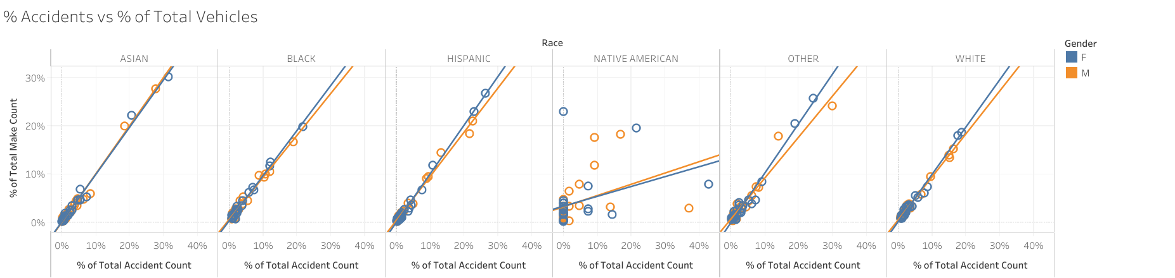
Accidents

Slide 10
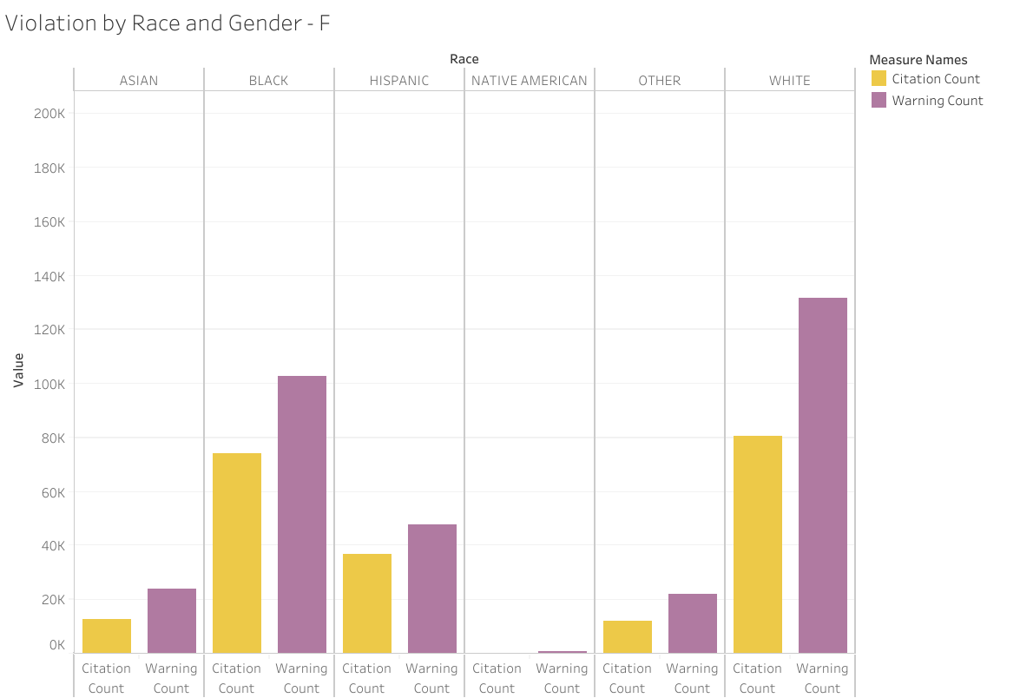
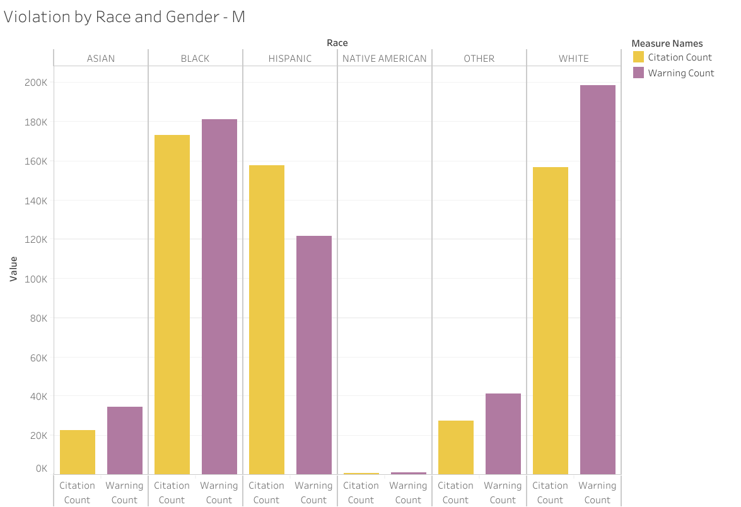
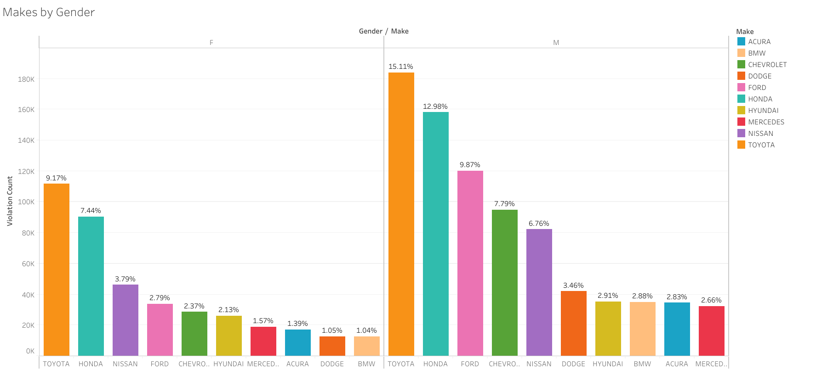
Gender

Slide 11
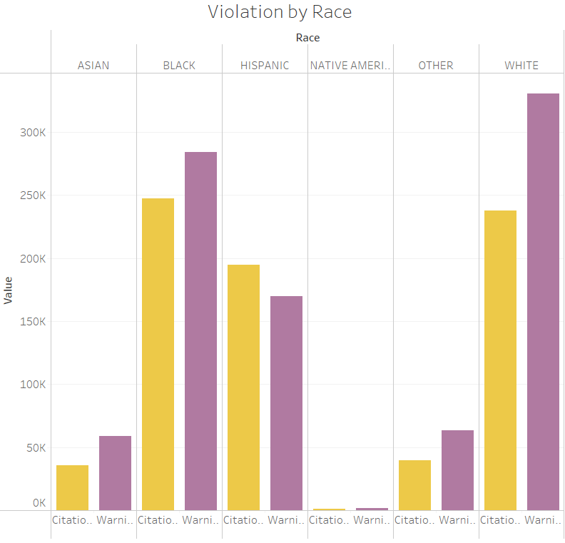
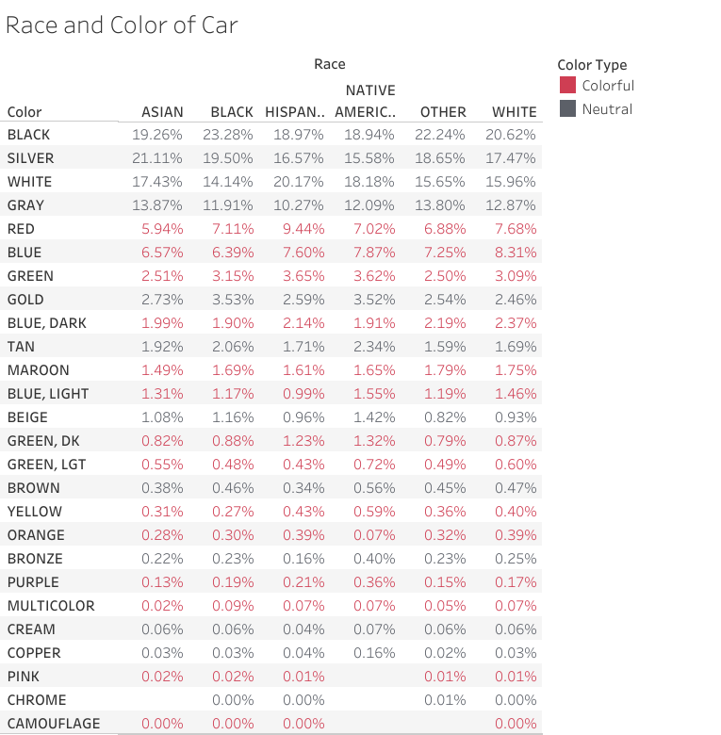
Race

Slide 12
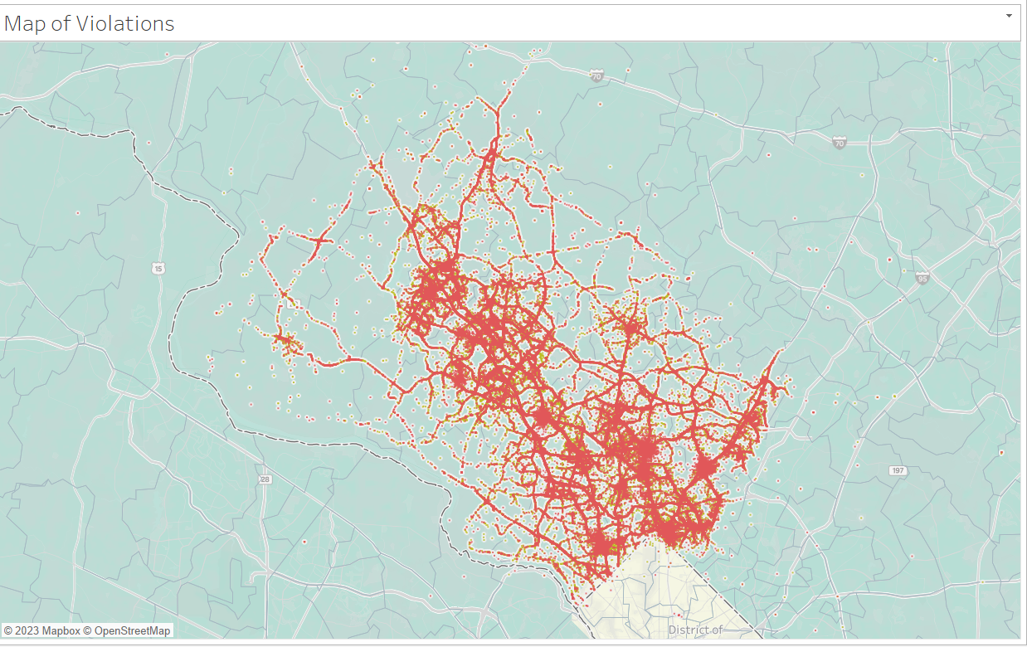
Map

Slide 13
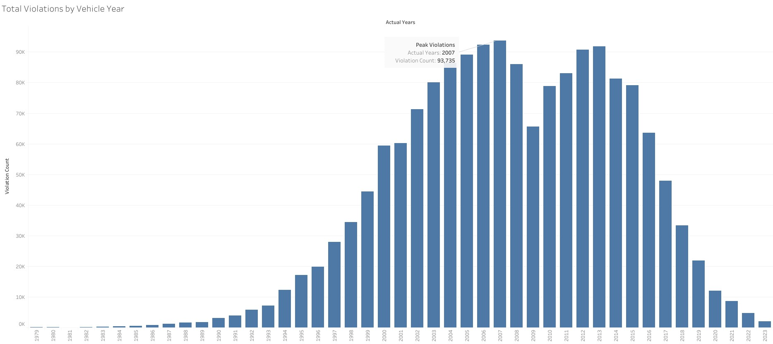
Year

Slide 14
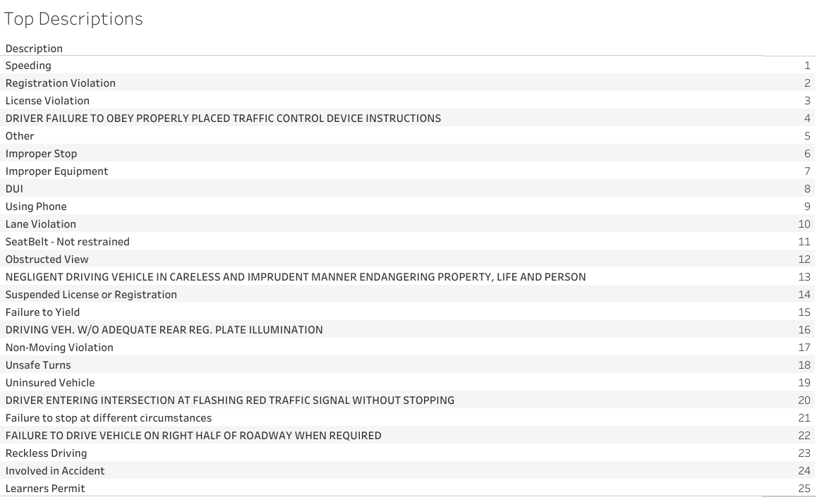
Top 25 Descriptions

Slide 15
Machine Learning Models
Random Forest
Logistic Regression
Input features used for the models:
Description
Accident
Alcohol
Search Outcome
License Plate State Category
Predicting value :
Violation Type - [Citation/Warning]

Slide 16
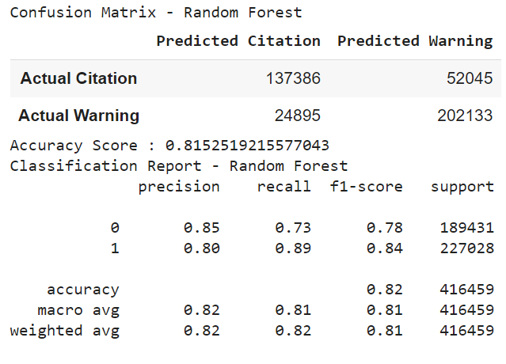
Random Forest Model - Results
Accuracy Score: 81.5%
Citation – Precision - 85%, Recall – 73%
Warning - Precision - 80%, Recall – 89%

Slide 17
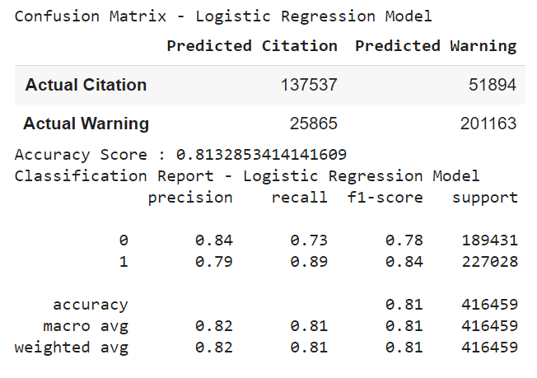
Logistic Regression Model - Results
Accuracy Score: 81.3%
Citation – Precision - 84%, Recall – 73%
Warning - Precision - 79%, Recall – 89%

Slide 18
Pyspark
Without Partition
Partition on Description
To get number of incidents for each description for each violation type: 6.8 Seconds
To get 25 locations with highest citations of "Speeding" recently: 5.9 Seconds
To get number of incidents for each description for each violation type: 2.1 Seconds
To get 25 locations with highest citations of "Speeding" recently: 1.6 Seconds
Note: The seconds may slightly vary each time the query is executed.

Slide 19
Room for Improvement
Get Description and Make columns even more uniform.
Use Big Data tactics to tackle our data better.
More statistical analysis between features.
Test out more models of machine learning.
Look at time series data.
Test out more combinations of features.
Target a feature to see what other predictions we could do.

Slide 20

Conclusion

