Slide 1
Crunching the Numbers: A Visual Exploration of Traffic Violations
Presented by Devi, Erika, Haley, Samantha

Slide 2
In Focus
Our project delved into the landscape of traffic violations, aiming to gain a comprehensive understanding of the factors influencing outcomes, whether in the form of citations or warnings.
Our data collection process meticulously captured diverse elements of each traffic stop, including the driver's state, the make of the vehicle, and demographic information such as race and gender.
Employing a combination of statistical analysis and machine learning, we scrutinized these features to unravel correlations and patterns within the dataset.

Slide 3
Sources
Our data comes from Montgomery County, Maryland. The dataset contains traffic violation information from all electronic traffic violations issued in the county and is updated daily. The raw data has 1.89 million rows and 43 columns.
Using
Python/Pandas
Tableau
Random Forest
Pyspark

Slide 4
Data Cleaning

Slide 5
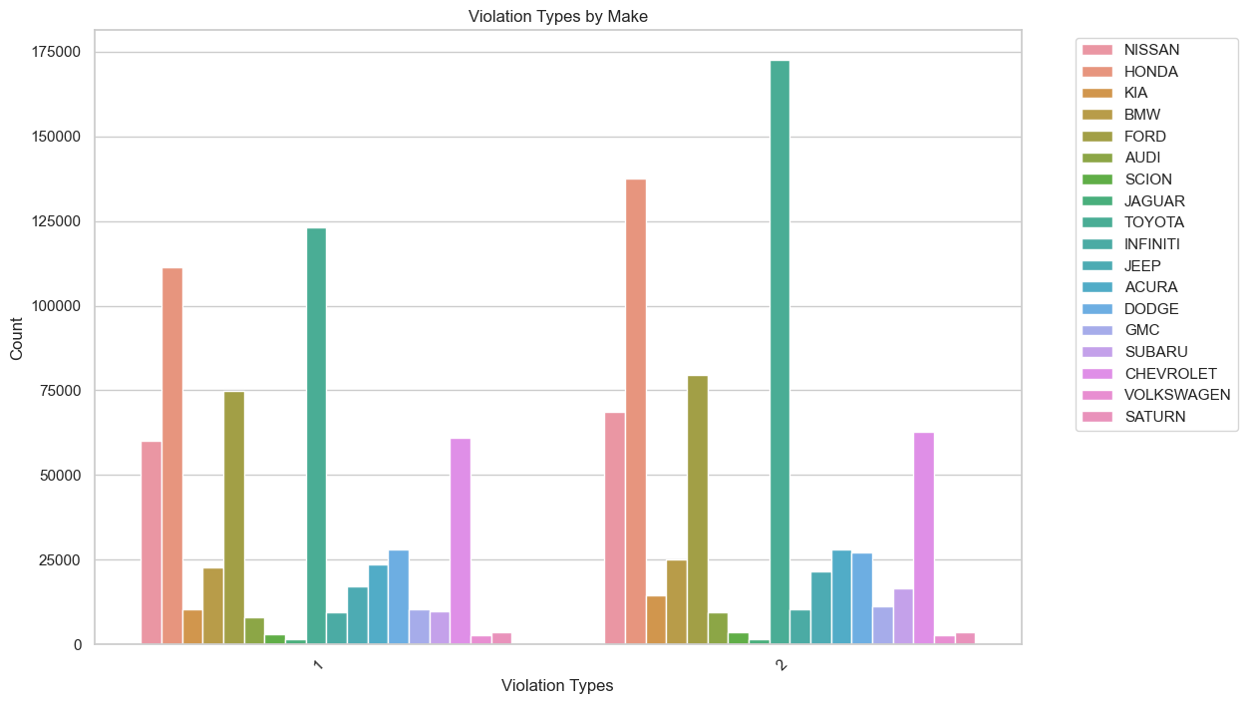
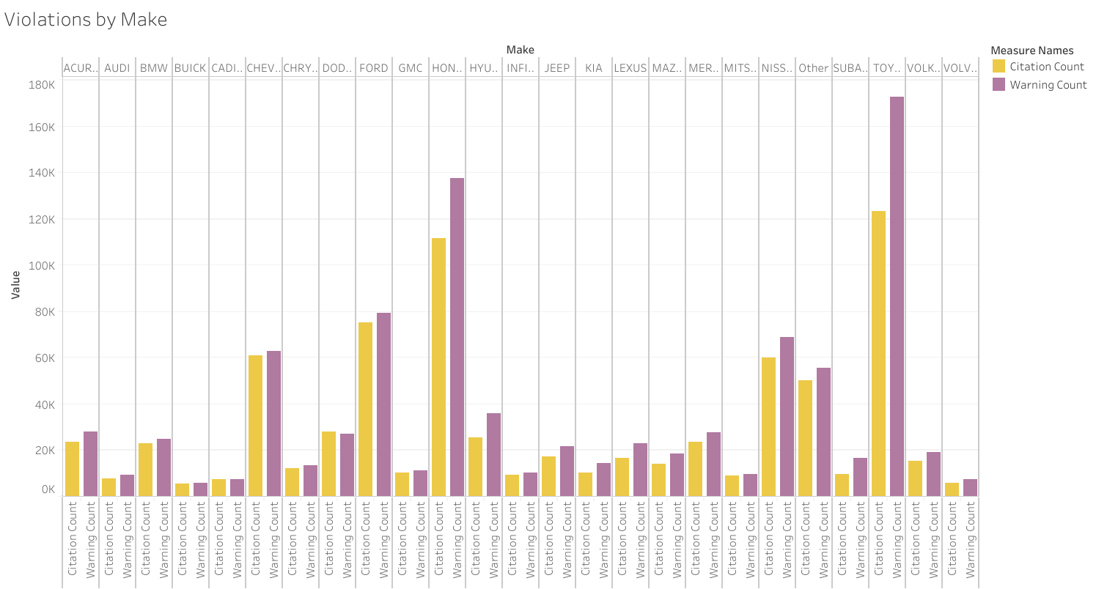
Vehicle Makes

Slide 6
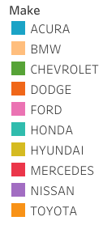
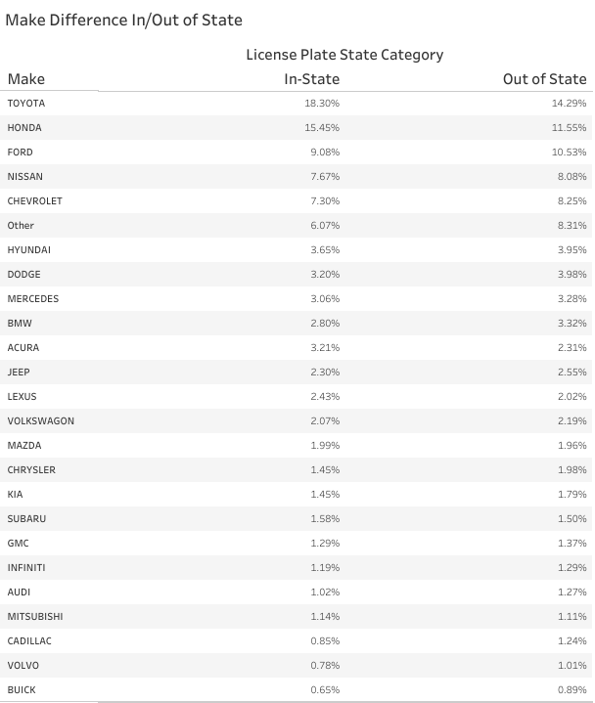

In-State vs. Out of State
In-State
Out of State
Out of State has fewer Toyotas and Hondas.

Slide 7
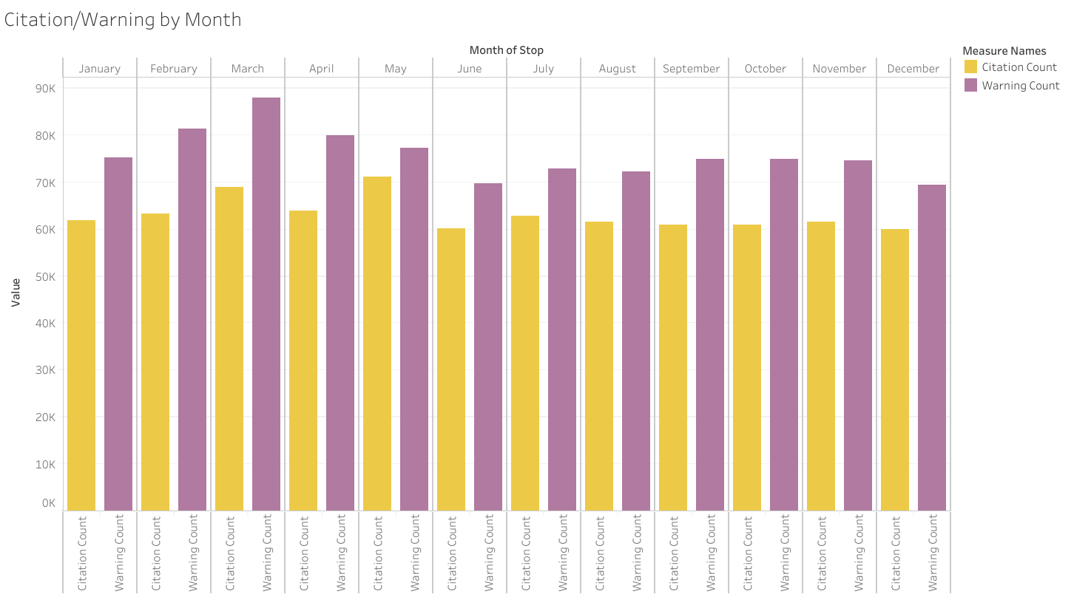
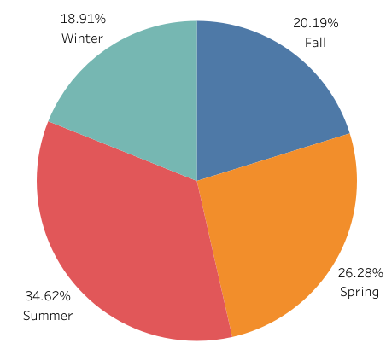
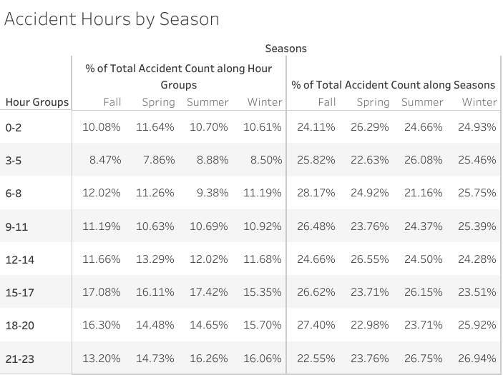
Seasons

Slide 8
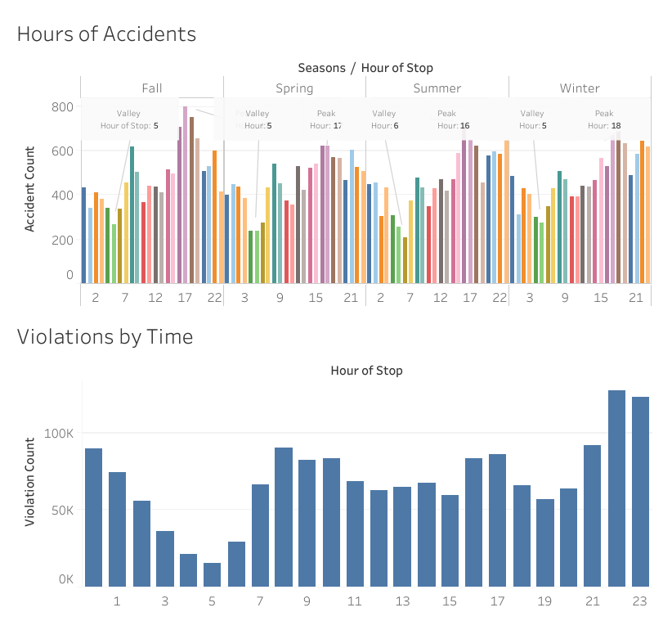
Peak Hours

Slide 9
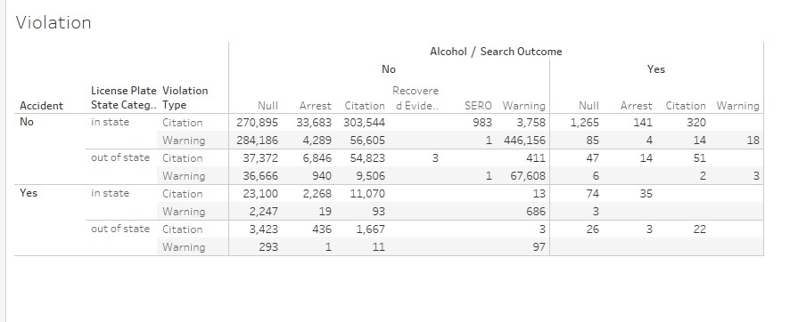
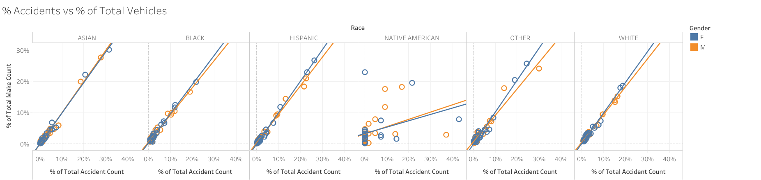
Accidents

Slide 10
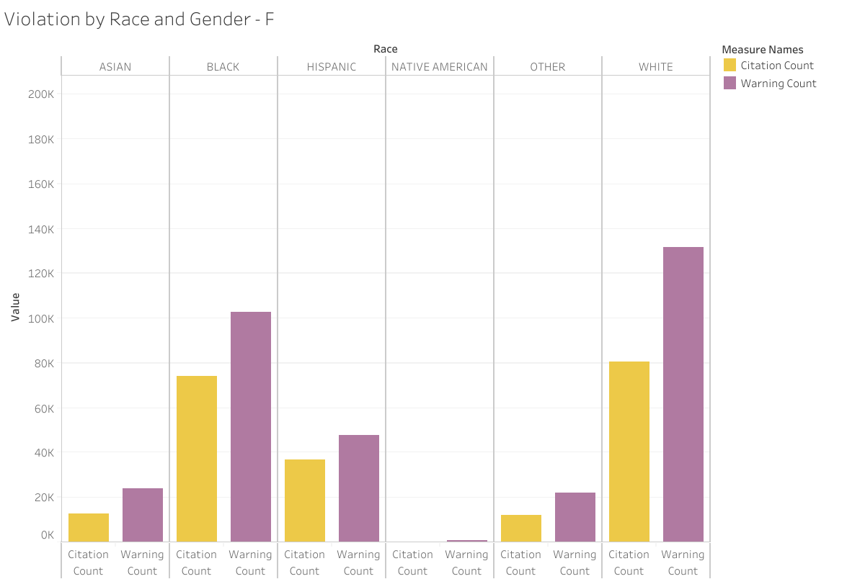
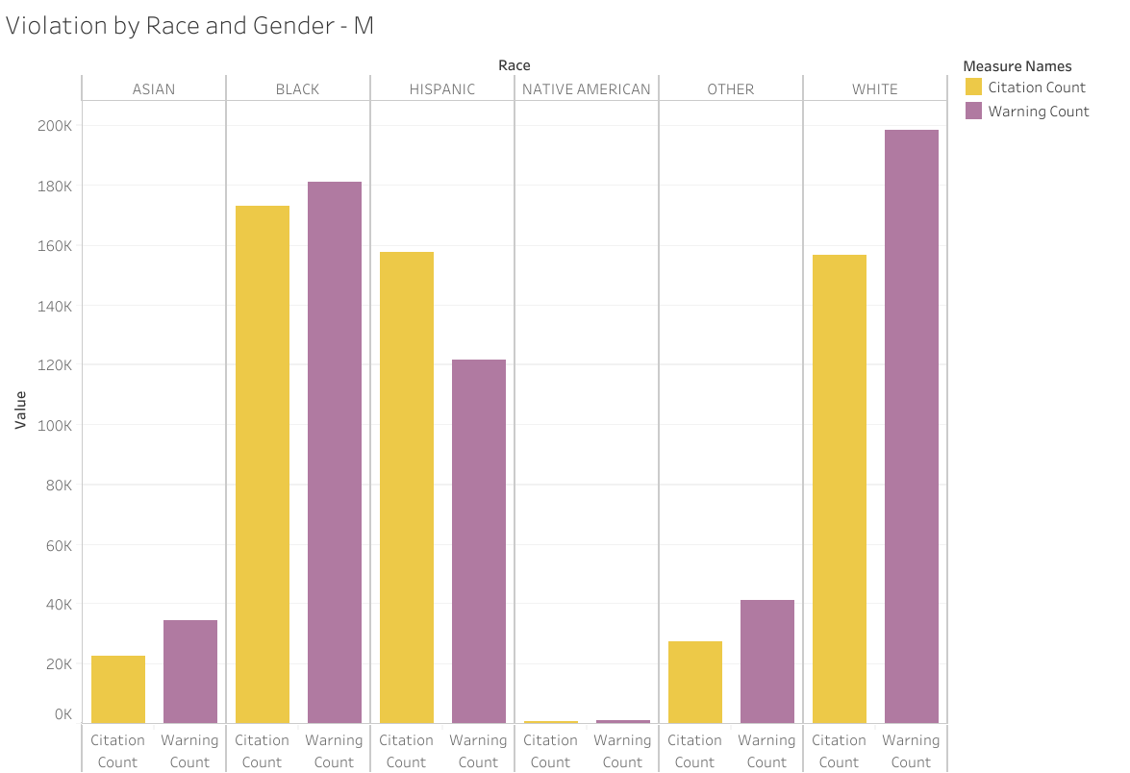
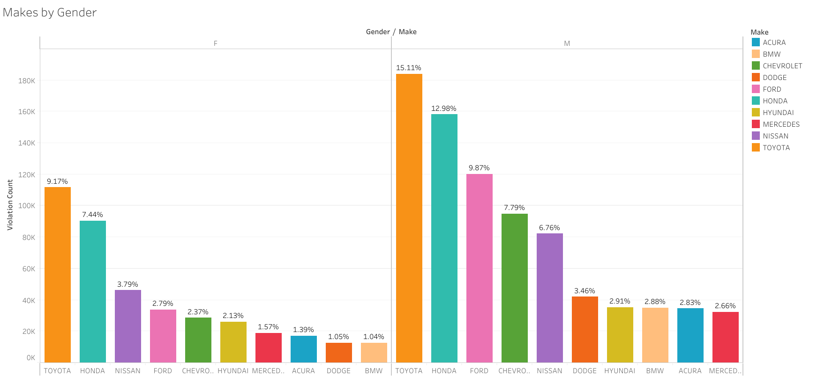
Gender

Slide 11
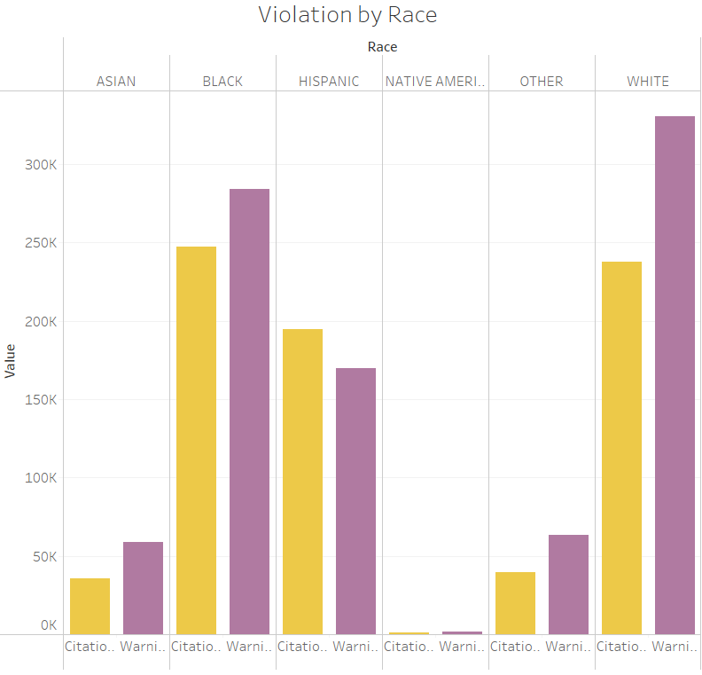
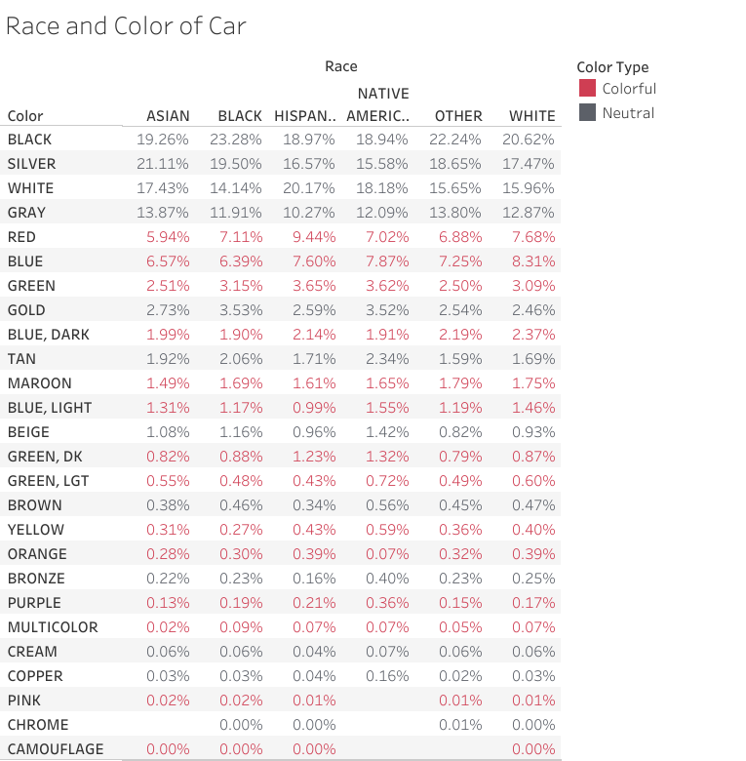
Race

Slide 12
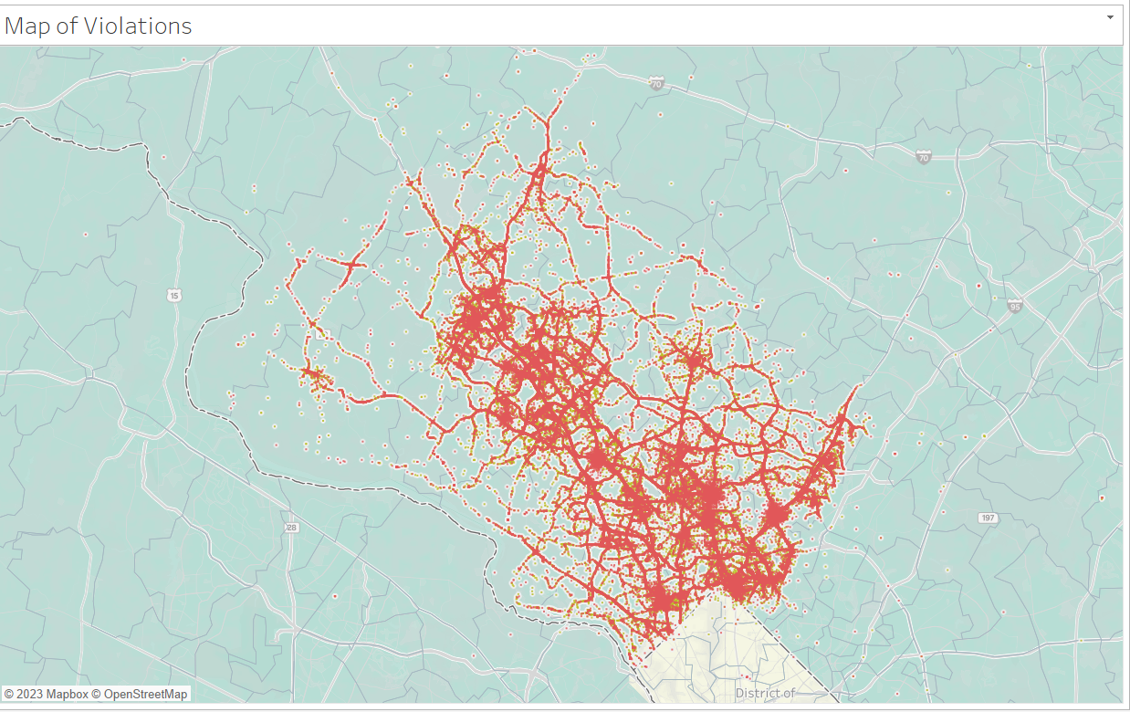
Map

Slide 13
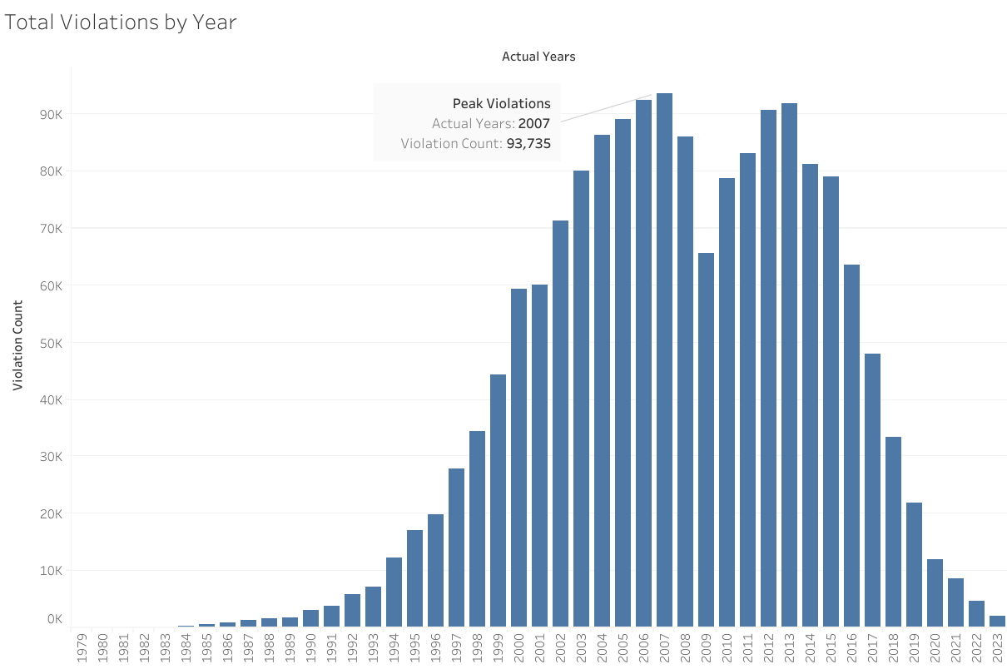
Year

Slide 14
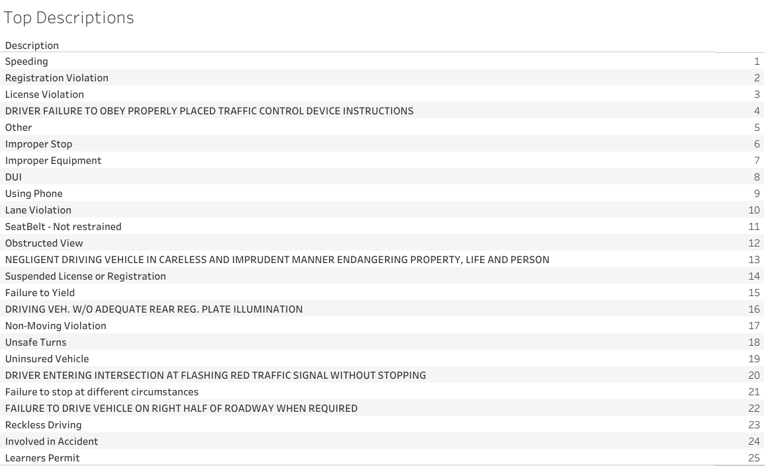
Top 25 Descriptions

Slide 15
Machine Learning Models
Random Forest
Logistic Regression
Input features used for the model:
Description
Accident
Alcohol
Search Outcome
Violation Type
License Plate State Category
Predicting value :
Violation Type - [Citation/Warning]

Slide 16
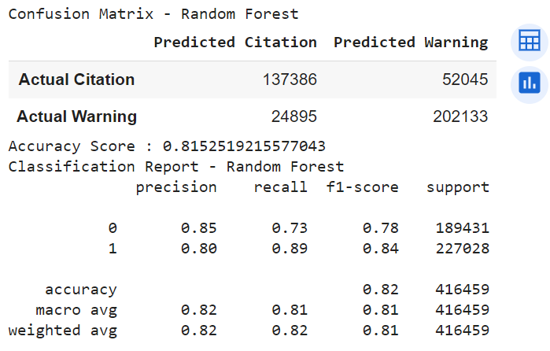
Randon Forest - Results
Accuracy Score: 81.5%
Citation – Precision - 85%, Recall – 73%
Warning - Precision - 80%, Recall – 89%

Slide 17
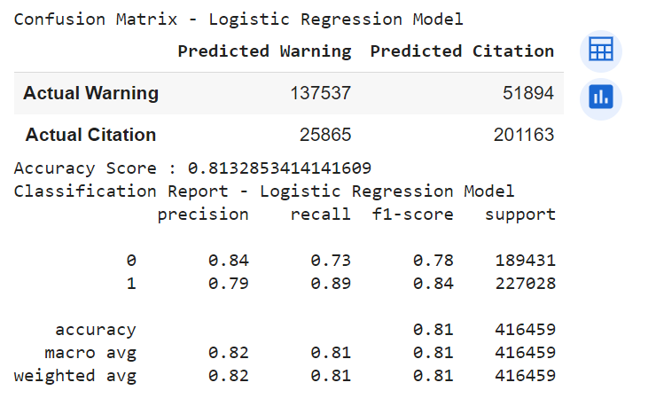
Logistic Regression Model
Accuracy Score: 81.3%
Citation – Precision - 84%, Recall – 78%
Warning - Precision - 79%, Recall – 84%

Slide 18
Pyspark
Without Partition
With Partition on Descritpion
To get number of incidents for each description for each violation type: 6.8 Seconds
To get 25 locations with highest citations of "Speeding" recently: 5.9 Seconds
To get number of incidents for each description for each violation type: 2.1 Seconds
To get 25 locations with highest citations of "Speeding" recently: 1.6 Seconds

Slide 21

Conclusion

