Slide 1
WEEK 4 SDEV400
Secure Programming in the Cloud
Craig Poma
craig.poma@faculty.umgc.edu

Slide 2
BLUF – Bottom Line Up Front
Things to get done this week
Homework #2 – worth 17.5% of overall grade – due June 13, 2023 @ 11:59PM ET
I will post a solution to Homework 2 on June 24, 2023 @ 12:00AM ET for students to review. After this answer is posted - I cannot accept anymore Homework 2 submissions. Make sure you get your Homework 2 in before the solution is posted.
Carry over from Week 3 – None:
Discussion Closed: “Discussion - S3 Read Permissions”

Slide 3
Roadmap
Discussion for this week – AWS CLI and DynamoDB Database
Region – region_name=‘us=east-1’
Classroom Code Examples
Use Local DynamoDB Example (Experimentation Only)
https://docs.aws.amazon.com/amazondynamodb/latest/developerguide/DynamoDBLocal.DownloadingAndRunning.html
Handle Questions about Homework #2
CourseID needs to be the Hash key
Table Waiter Use
Custom Table Waiter Example
Filter Expression Tip

Slide 4

Region – Use US-EAST-1
The AWS Samples are written with the Region set to US-WEST-1
Please remove the region (it will then default to US-EAST-1 due to where your EC2 is deployed) or set it to US-EAST-1 in t the code.
The Vocareum classroom wants us to operate out of US-EAST-1

Slide 5
Classroom Code Examples
Create table
Validate that it doesn’t already exist
Delete the table
Insert a record
Get a single record
Insert a bunch of records
Look at the difference between:
Scan for records
Query for records

Slide 6
Questions at this point?
Any questions at this point so far about?
Code Examples
Create table
Validate that it doesn’t already exist
Insert a record
Get a single record
Insert a bunch of records
Look at the difference between:
Scan for records
Query for records
Delete the table

Slide 7
Local DynamoDB – Experimentation Only
FOR EXPERIMENTATION ONLY
All assignment must run in AWS CLOUD9 Properly using the real US-EAST-1 DynamoDB Endpoint.
Download JAR File of DynamoDB
https://docs.aws.amazon.com/amazondynamodb/latest/developerguide/DynamoDBLocal.DownloadingAndRunning.html
Make sure you have JAVA JRE installed
Java Runtime Environment (JRE) version 8.x or newer
https://www.java.com/en/download/ (Windows)
WARNING: Running locally, you WILL NOT encounter all STATE transitions you need to account for in code.

Slide 8
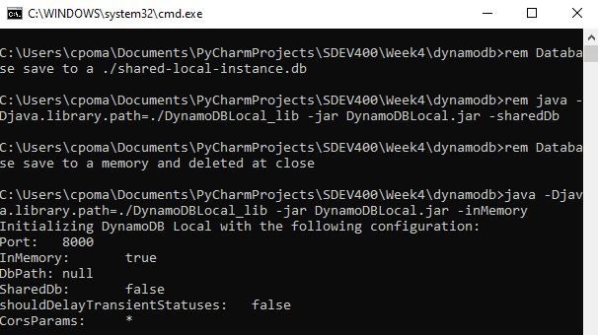
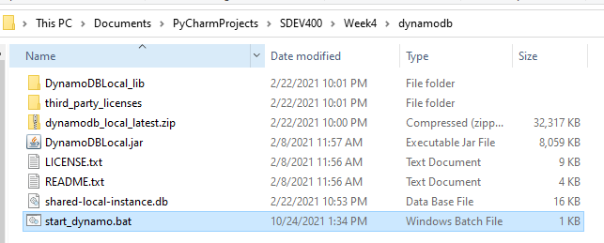
Start Local DynamoDB
Start_dynamodb.bat file
rem THIS FOLDER PATH MUST EXIST AND BE WHERE YOU PUT THE DynamoDB.jar file
cd C:\Users\cpoma\Documents\PyCharmProjects\SDEV400\Week4\dynamodb
rem Database save to a ./shared-local-instance.db
rem java -Djava.library.path=./DynamoDBLocal_lib -jar DynamoDBLocal.jar -sharedDb
rem Database save to a memory and deleted at close
java -Djava.library.path=./DynamoDBLocal_lib -jar DynamoDBLocal.jar -inMemory

Slide 9
Questions at this point?
Any questions at this point so far about?
Running DynamoDB Locally
FOR EXPERIMENTATION ONLY
All assignment must run in AWS CLOUD9 Properly using the real US-EAST-1 DynamoDB Endpoint.
WARNING: Running locally, you WILL NOT encounter all STATE transitions you need to account for in code.

Slide 10
Homework #2
HASH Key - CourseID
Why is this sub-optimal? – But REQUIRED?
DynamoDB wait_until_exists()
Custom Table Waiter
FILTER EXPRESSION TIP
Look at the class examples we just went over ☺

Slide 11
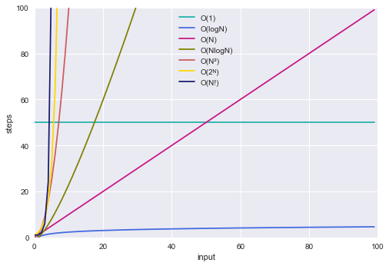
HASH Key - CourseID
Designed to have you think about and differentiate Scan() versus Query()
The table would have been built "ideally" with the Subject being the Hash key (grouping all SDEV, CMIS, ENG, etc) and the CatalogNbr being the Range key to isolate a course (you could then search on SDEV in 325 - 455 or whatever)
Search Requirement: User to search for a title given the Subject and CatalogNbr
Performance time taken – O(Log(n))
Logarithmic Time == O(log (n))
You will be forced to build a scan query with a filter expression
Performance time taken – O(n)
Linear Time == O(n)

Slide 12
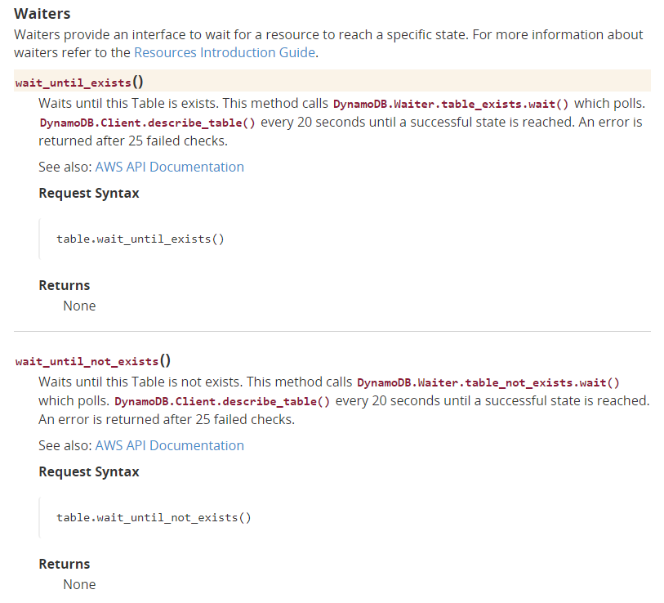
DynamoDB wait_until_exists()
# https://docs.aws.amazon.com/amazondynamodb/latest/developerguide/DAX.client.run-application-python.01-create-table.html import boto3 def main(dyn_resource=None): """ Creates a DynamoDB table. :param dyn_resource: Either a Boto3 or DAX resource. :return: The newly created table. """ if dyn_resource is None: dyn_resource = boto3.resource('dynamodb') table_name = 'TryDaxTable' params = { 'TableName': table_name, 'KeySchema': [ {'AttributeName': 'partition_key', 'KeyType': 'HASH'}, {'AttributeName': 'sort_key', 'KeyType': 'RANGE'} ], 'AttributeDefinitions': [ {'AttributeName': 'partition_key', 'AttributeType': 'N'}, {'AttributeName': 'sort_key', 'AttributeType': 'N'} ], 'ProvisionedThroughput': { 'ReadCapacityUnits': 10, 'WriteCapacityUnits': 10 } } table = dyn_resource.create_table(**params) print(f"Creating {table_name}...") table.wait_until_exists() return table
if __name__ == '__main__': dax_table = main() print(f"Created table.")

Slide 13
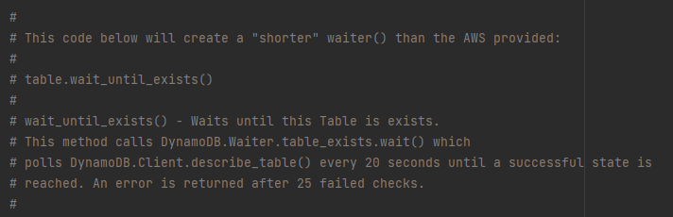
Custom Table Waiter
def table_waiter(table_name=None, wait_status='ACTIVE', wait_time=60, dynamodb_handle=None): """ :param table_name(str): Table name to wait on :param wait_status(str): Expected status to wait for - ACTIVE, CREATING, UPDATING, etc :param wait_time(int): Seconds to wait for status - DEFAULT: 60 seconds :param dynamodb_handle(boto3.session.Session.client): Access to DynamoDB via \ client libraries :param dynamodb_resource_handle(boto3.session.Session.resource): Access to \
DynamoDB via resource libraries :rtype: **bool** :return: **status_achieved(bool)**: Returns TRUE if status achieved during \
``wait_time``. """ status_achieved = False try: current_table = dynamodb_handle.describe_table(TableName=table_name) # print("Table value(table_waiter): {}".format(current_table)) if 'Table' in current_table: # print("Table status: {}".format(current_table['Table']['TableStatus'])) while current_table['Table']['TableStatus'] != wait_status and wait_time != 0: if current_table['Table']['TableStatus'] == wait_status: # Set to True below; Might never get into While loop if status is already valid # status_achieved = True break
time.sleep(1) wait_time -= 1 # Get updated table status after waiting current_table = dynamodb_handle.describe_table(TableName=table_name) # print("Table status: {}".format(current_table['Table']['TableStatus'])) if wait_time == 0: log_msg = 'Table {} never entered proper status of {}.'.format(table_name, wait_status) generic_output_msg(log_message=log_msg, exit_app=False) if current_table['Table']['TableStatus'] == wait_status: status_achieved = True except ClientError as aws_client_error: error_code = aws_client_error.response['Error']['Code'] error_msg = aws_client_error.response['Error']['Message'] log_msg = 'Try your action again. The table_waiter had an issue with the {} table.'.format( table_name) generic_output_msg(log_message=log_msg, exit_app=False) generic_output_msg(log_message='Exception was:\r\n\t {}: {}.'.format(error_code, error_msg), exit_app=False) return status_achieved

Slide 14
Table Waiter Custom Example
After calling your “create table code”
# Wait until table is ACTIVE to return try: print('Waiting for DynamoDB to mark {} table as ACTIVE......'.format(table_name)) if table_waiter(table_name=table_name, wait_status='ACTIVE', wait_time=60, dynamodb_handle=dynamodb_handle): print('Table {} is ACTIVE'.format(table_name)) except ClientError as aws_client_error: error_code = aws_client_error.response['Error']['Code'] error_msg = aws_client_error.response['Error']['Message'] print('I tried to check on {} table.'.format(table_name)) generic_output_msg( log_message='Exception was:\r\n\t {}: {}.'.format(error_code, error_msg), exit_app=False)

Slide 15
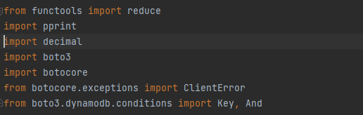
FILTER EXPRESSION TIP
If you are using the Boto3 Resource (versus Boto Client) connection for your HW#2 you may find yourself building a "FilterExpression" like:
The And and Key in the expression are actually boto3.dynamodb.conditions functions. Please make sure to import them:
FilterExpression=reduce(And, ([Key(k).eq(v) for k, v in filters.items()])))

Slide 16
Questions at this point?
Any questions at this point so far about?
Homework #2

Slide 17
Things to get done this week
Homework #2 – worth 17.5% of overall grade – due June 13, 2023 @ 11:59PM ET
I will post a solution to Homework 2 on June 24, 2023 @ 12:00AM ET for students to review. After this answer is posted - I cannot accept anymore Homework 2 submissions. Make sure you get your Homework 2 in before the solution is posted.
Carry over from Week 3 – None:
Discussion Closed: “Discussion - S3 Read Permissions”

Slide 18
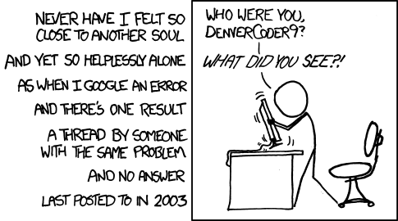
Have a great evening!
Start your Homework #2 EARLY……

Slide 19
WEEK 4
SDEV400

