Slide 1
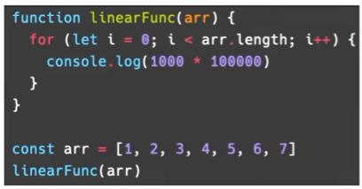
Big O(n) Function
Big O( n )
Constant time

Slide 2
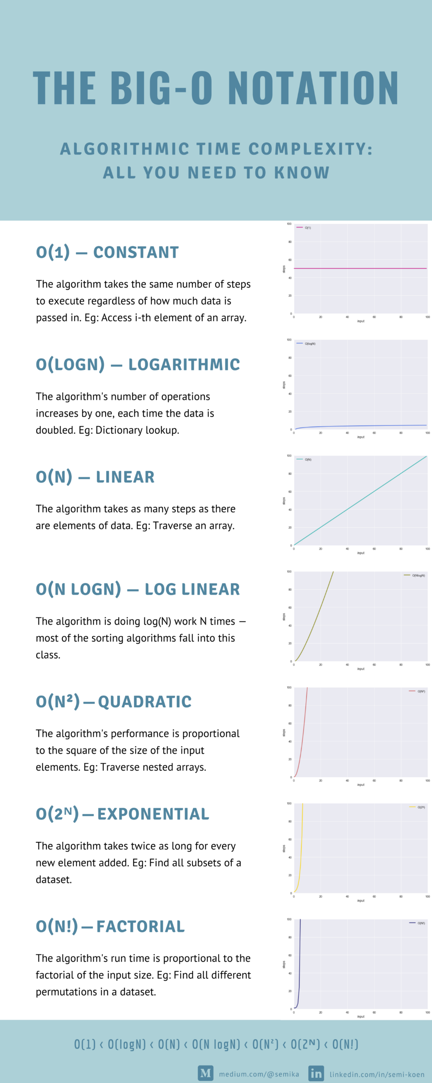
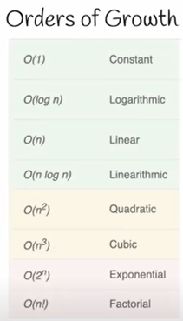
Source: https://miro.medium.com/max/1400/1*-nM9NNb8FW9uUT64rzhkOA.png

Slide 3
Source: https://miro.medium.com/max/1400/1*-nM9NNb8FW9uUT64rzhkOA.png

