Slide 1
Intrapreneurship

Slide 2
1.
Datos de Empresa

Slide 3
Pachas AG Consultoría e Ingeniería de Seguridad

Slide 4
RUC
20600920121
Dirección
Av. Miguel Grau 1032 Cal
Ingresos Anuales
S/. 120,000.00
Principales Actividades
Brinda servicios en el área de ingeniería de seguridad.
Ofrece soluciones informáticas para diferentes empresas.

Slide 5
Jefe de Proyecto
Jefe de Desarrollo
Encargado de Marketing
Encargado de Gestión
Desarrolladores Web
Organigrama

Slide 6
2.
Cinco fuerzas de Porter

Slide 7
Competencia en el mercado
Proveedores
Sustitutos
Clientes
Nuevos entrantes

Slide 8


Slide 9
3.
Matriz FODA

Slide 10
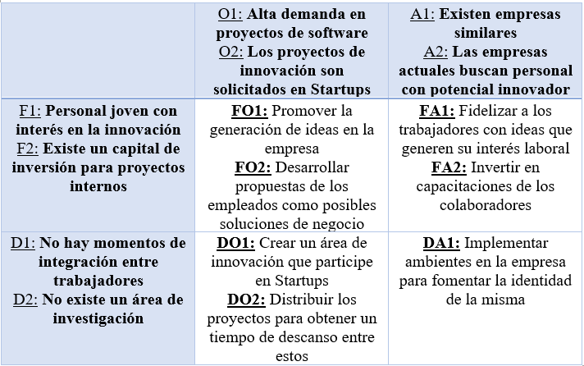

Slide 11
4.
Matriz Stakeholders

Slide 12

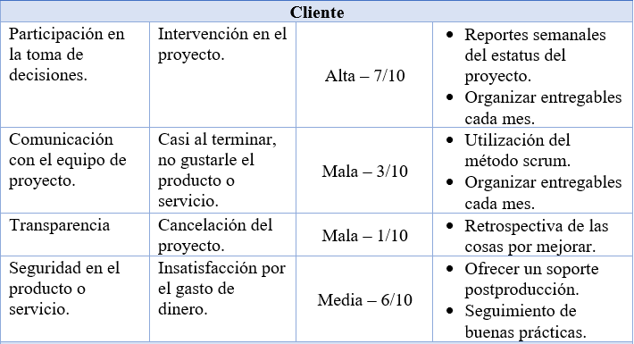

Slide 13
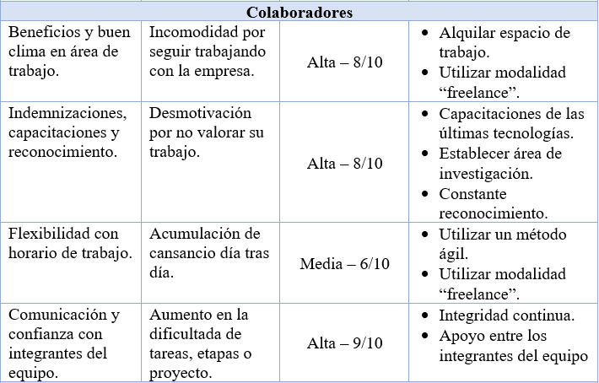

Slide 14
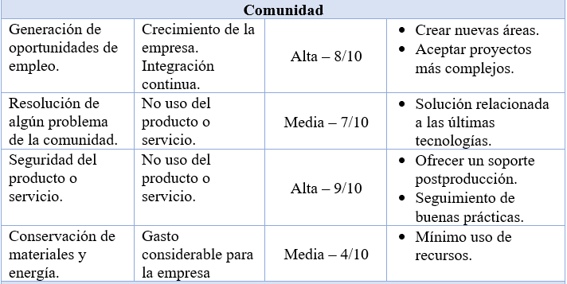

Slide 15
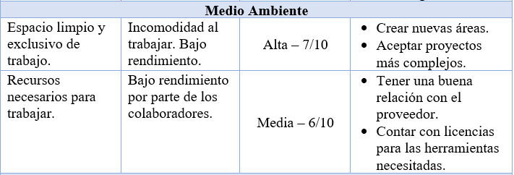

Slide 16
Thanks!

Slide 17

Instructions for use
EDIT IN GOOGLE SLIDES
Click on the button under the presentation preview that says "Use as Google Slides Theme".
You will get a copy of this document on your Google Drive and will be able to edit, add or delete slides.
You have to be signed in to your Google account.
EDIT IN POWERPOINT®
Click on the button under the presentation preview that says "Download as PowerPoint template". You will get a .pptx file that you can edit in PowerPoint.
Remember to download and install the fonts used in this presentation (you’ll find the links to the font files needed in the Presentation design slide)
More info on how to use this template at www.slidescarnival.com/help-use-presentation-template
This template is free to use under Creative Commons Attribution license. You can keep the Credits slide or mention SlidesCarnival and other resources used in a slide footer.

Slide 18

Hello!
I am Jayden Smith
I am here because I love to give presentations.
You can find me at @username

Slide 19
“Quotations are commonly printed as a means of inspiration and to invoke philosophical thoughts from the reader”

Slide 20
This is a slide title
Here you have a list of items
And some text
But remember not to overload your slides with content
Your audience will listen to you or read the content, but won’t do both.

Slide 21
Split your content
White
Is the color of milk and fresh snow, the color produced by the combination of all the colors of the visible spectrum.
Black
Is the color of coal, ebony, and of outer space. It is the darkest color, the result of the absence of or complete absorption of light.

Slide 22
In two or three columns
Yellow
Is the color of gold, butter and ripe lemons. In the spectrum of visible light, yellow is found between green and orange.
Blue
Is the colour of the clear sky and the deep sea. It is located between violet and green on the optical spectrum.
Red
Is the color of blood, and because of this it has historically been associated with sacrifice, danger and courage.

Slide 23
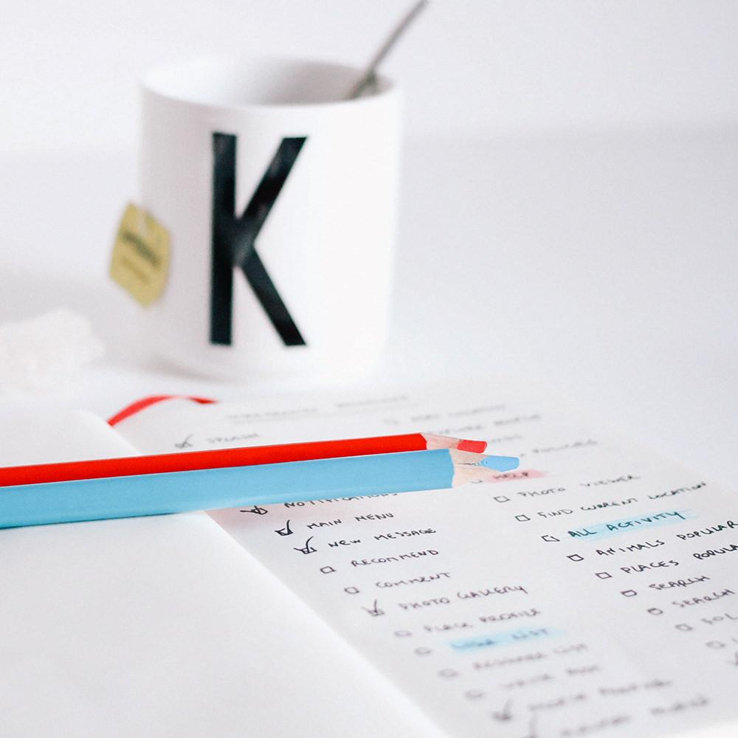
A picture is worth a thousand words
A complex idea can be conveyed with just a single still image, namely making it possible to absorb large amounts of data quickly.

Slide 24
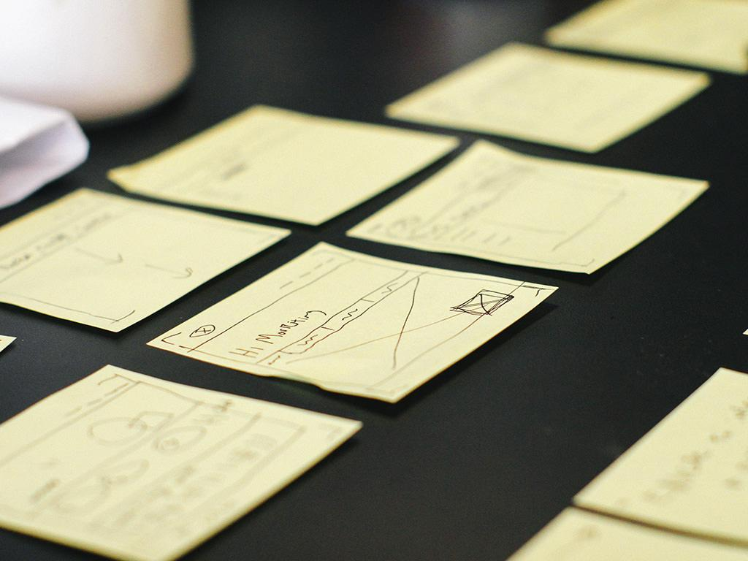
Want big impact?
Use big image.

Slide 25
Charts explain your ideas
Gray
White
Black

Slide 26

And tables compare data
 | A | B | C
Yellow | 10 | 20 | 7
Blue | 30 | 15 | 10
Orange | 5 | 24 | 16

Slide 27
Maps
our office

Slide 28
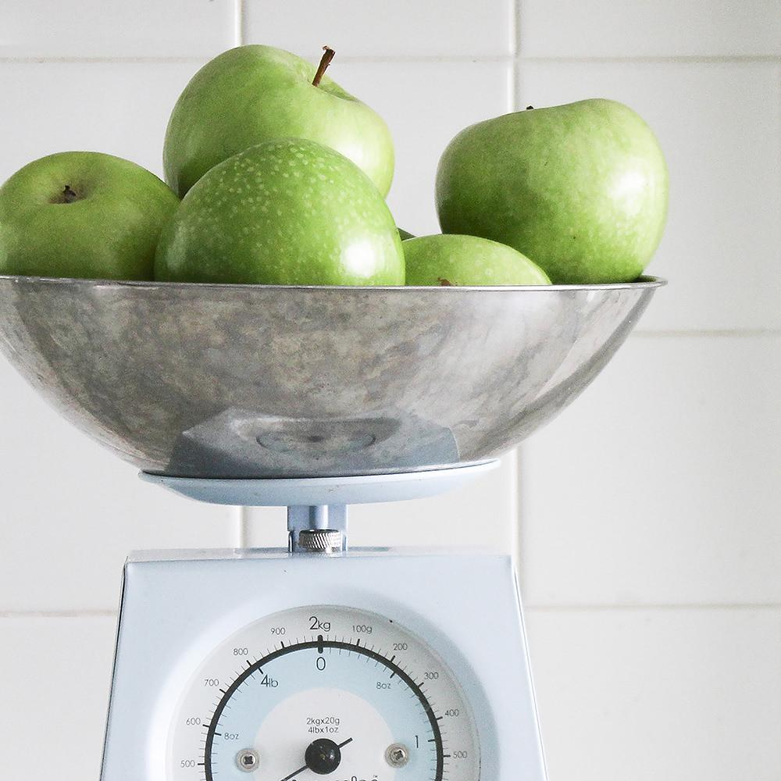
89,526,124
Whoa! That’s a big number, aren’t you proud?

Slide 29

89,526,124$
185,244 users
100%
That’s a lot of money
And a lot of users
Total success!

Slide 30
Our process is easy
first
second
last

Slide 31
Let’s review some concepts
Yellow
Is the color of gold, butter and ripe lemons. In the spectrum of visible light, yellow is found between green and orange.
Blue
Is the colour of the clear sky and the deep sea. It is located between violet and green on the optical spectrum.
Red
Is the color of blood, and because of this it has historically been associated with sacrifice, danger and courage.
Yellow
Is the color of gold, butter and ripe lemons. In the spectrum of visible light, yellow is found between green and orange.
Blue
Is the colour of the clear sky and the deep sea. It is located between violet and green on the optical spectrum.
Red
Is the color of blood, and because of this it has historically been associated with sacrifice, danger and courage.

Slide 32
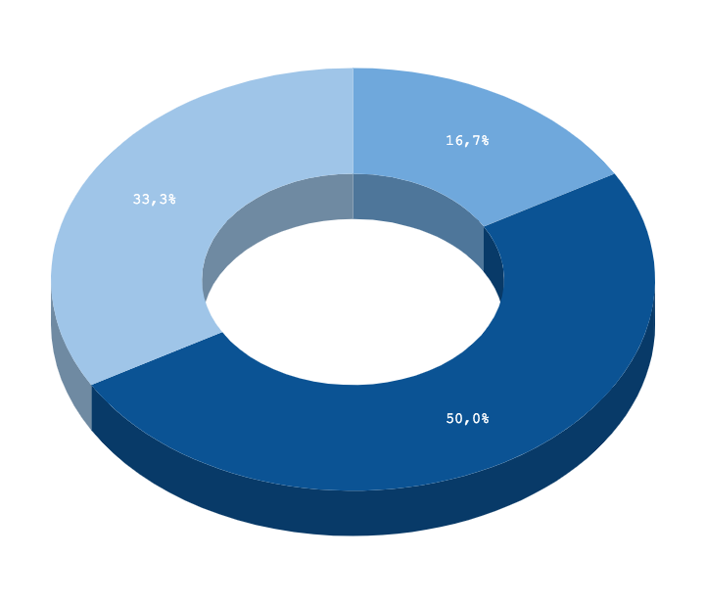
You can insert graphs from Google Sheets

Slide 33
Android project
Place your screenshot here
Show and explain your web, app or software projects using these gadget templates.

Slide 34
iPhone project
Place your screenshot here
Show and explain your web, app or software projects using these gadget templates.

Slide 35
Tablet project
Place your screenshot here
Show and explain your web, app or software projects using these gadget templates.

Slide 36
Desktop project
Place your screenshot here
Show and explain your web, app or software projects using these gadget templates.

Slide 37
Thanks!
Any questions?
You can find me at:
@username
user@mail.me

Slide 38
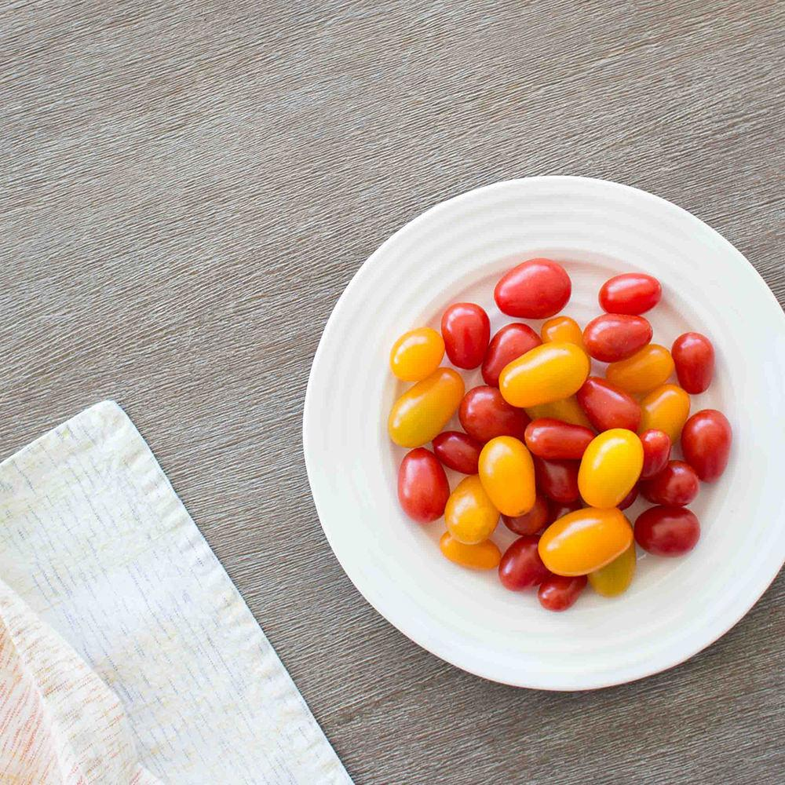
Credits
Special thanks to all the people who made and released these awesome resources for free:
Presentation template by SlidesCarnival
Photographs by Death to the Stock Photo (license)

Slide 39

Presentation design
This presentation uses the following typographies:
Titles: Inconsolata
Body copy: Pangolin
You can download the fonts on these pages:
https://www.fontsquirrel.com/fonts/inconsolata
https://www.urbanfonts.com/fonts/Pangolin.font
You don’t need to keep this slide in your presentation. It’s only here to serve you as a design guide if you need to create new slides or download the fonts to edit the presentation in PowerPoint®

Slide 40
SlidesCarnival icons are editable shapes.
This means that you can:
Resize them without losing quality.
Change fill color and opacity.
Isn’t that nice? :)
Examples:

Slide 41
😉
Now you can use any emoji as an icon!
And of course it resizes without losing quality and you can change the color.
How? Follow Google instructions https://twitter.com/googledocs/status/730087240156643328
✋👆👉👍👤👦👧👨👩👪💃🏃💑❤😂😉😋😒😭👶😸🐟🍒🍔💣📌📖🔨🎃🎈🎨🏈🏰🌏🔌🔑 and many more...

