Slide 1
Case Study – Intermediary Presentation Automobiles: ICEV vs. EV
Hasan Roshan
Notes:
Faculty Note:
Enter lecture title, and subtitle if present, in the text box above. Enter name and credentials on the second line as shown. The slide background graphic for this introduction slide can be replaced with an alternate image more suited to the topic or department (this step will be handled by our graphics team in the production phase).

Slide 2
Needs & Objectives
Context & Needs:
In 2019, transportation was the 4th largest contributor (15%) to global Emissions (IPCC, 2022)
In 2022, it was the largest contributor (28%) of U.S. direct GHG emissions (EPA, 2024)
Internal Combustion Engine Vehicles (ICEV) are responsible for the absolute majority of sectoral emissions, with over 94% of emissions from petroleum-based fuel (EPA, 2024)
Passenger cars are responsible for 20% of this sector’s GHG emissions (EPA, 2024)
NZE requires >3% annual CO₂ reduction from the transport sector by 2030 (IEA, 2022)
Electric Vehicles (EV) offer the potential for reduced energy use and GHG emissions, particularly from renewable sources (IEA, 2022)
LCA enables us to compare the environmental impacts of ICEVs and EVs
Informed decisions aid sustainable transportation policies and consumer choices
Objective: Compare the environmental impacts of:
A. Internal Combustion Engine Vehicle (ICEV) B. Electric Vehicle (EV)
Notes:
Introduction: case study description and objective, rationale,
Give just enough information on introduction so that the listener understands the needs and your goal definition

Slide 3
Function
PRODUCTS | MAIN FUNCTION | SECONDARY FUNCTION & OTHER PERFORMANCES
ICEV | Transportation | Temporary Residency Food Services (food truck) Entertainment
EV
Notes:
Define the main and possible scenario specific secondary functions.

Slide 4
Reference Flows & Key Environmental Parameters
PRODUCTS | FUNCTIONAL UNIT (service offered) | REFERENCE FLOWS (what is purchased) | KEY ENVIRONMENTAL PARAMETERS (linking reference flows to functional unit)
ICEV | 1 Vehicle-km | 1/150000 ICEV 6.19 kg gas | Raw materials used Vehicle’s weight Vehicle’s lifespan Fuel Source (gas, fossil fuels, mix, renewables) Efficiencies
EV |  | 1/225000 EV 0.26 kWh electricity
Notes:
Write down the selected (number of) functional unit
For each scenario, list the reference flows corresponding to the selected functional unit. Do provide for each reference flow the QUANTITY used per functional unit. Then add key parameters that affect the reference flows

Slide 5
Main Hypotheses & Data Used
Assumptions:
Lifespan:
ICEV: 150000 km
EV: 225000 km
Transport Types:
Ship (Oceanic Freight)
Train
Truck
Energy Usage:
ICEV: 6.19E-2 kg /FU (gas)
EV: 0.26 kWh/FU (electricity)
Sensitivity Analysis:
Lifespan: 0-350000 v-km
Energy Source for Electricity Production: Hard Coal, Mix-Grid, PV, Wind
Sources:
Ecoinvent Dataset
Tesla3 LCA paper at: https://doi.org/10.1051/e3sconf/201913601009
Notes:
Summarize your main hypotheses (transport distances, number of use, etc. and data in one slide)

Slide 6
Process Tree: ICEV
Alkyd Paint: 2.91E-5 kg
Ethylene glycol: 3.36E-5 kg
Polyethylene HD: 7.14E-4 kg
Sulfuric acid: 5.6E-6 kg
Aluminum (pr): 3.63E-4 kg
Flat glass: 2.11E-4 kg
Polyethylene: 3.43E-4 kg
Synthetic rubber: 3.09E-4 kg
Manufacturing
Chromium ox.: 1.68E-5 kg
Heat (NG): 1.55E-2 MJ
Polyvinylchloride: 1.12E-4 kg
Tap Water: 2.25E-2 kg
Copper (sheet): 1.41E-4 kg
Lead: 9.1E-5 kg
Steel (section bar): 1.42E-3 kg
Zink: 4.12E-5 kg
Electronics (CU): 4.08E-5 kg
Light fuel oil: 4.41E-4 MJ
Steel (sheet): 3.79E-3 kg
Electricity (MV): 4.16E-3 kWh
Ethylene: 1.3E-4 kg
Nickel: 9.8E-6 kg
Steel (low-alloyed): 6.93E-3 kg
1/150000 ICEV
Transportation
Ship Transportation: 6.93E-2 t-km
Train Transportation: 3.71E-3 t-km
Truck Transportation: 3.94E-4 t-km
Use
Supply chain petrol: 6.19E-2 kg
Direct Combustion: 6.19E-2 kg
1 Vehicle-km during 150k km lifespan
Emulsion Paint Incineration:
2.91E-5 kg
Glass Incineration:
2.91E-5 kg
Plastic Mixture Incineration:
2.91E-5 kg
Zinc in car shredder residue Incineration:
2.91E-5 kg
Aluminum recycling:
2.91E-5 kg
Disposal
Notes:
Develop your process tree until you reach processes available in databases: see example light bulb on next slide

Slide 7
Process Tree: EV
Alkyd Paint: 1.85E-5 kg
Electronics (CU): 1.04E-4 kg
Lubricating oil: 1.51E-5 kg
Polyurethane: 4.04E-3 kg
Battery(Li-ion): 3.64E-4 kg
Ethylene glycol: 6.49E-4 kg
Aluminum: 3.4E-4 kg
Steel (low-alloyed): 4.24E-3 kg
Manufacturing
Copper: 1.28E-3 kg
Plastic (extruded): 7.24E-4 kg
Steel: 4.24E-3 kg
Synthetic rubber: 2.37E-4 kg
Flat glass: 2.18E-4 kg
Polypropylene: 7.24E-4 kg
1/225000 EV
Transportation
Ship Transportation: 4.24E-2 t-km
Train Transportation: 2.47E-3 t-km
Truck Transportation: 2.63E-4 t-km
Use
Electricity (MV): 0.26 kWh
1 Vehicle-km during 225k km lifespan
Recycling of iron & mixed metal:
4.25E-3 kg
Glass landfill:
2.18E-4 kg
Plastic Mixture Incineration:
7.24E-4 kg
Mineral Oil Incineration:
1.51E-5 kg
Waste Polyurethane foam:
4.04E-5 kg
Aluminum recycling:
3.4E-4 kg
Disposal
Notes:
Develop your process tree until you reach processes available in databases: see example light bulb on next slide
Develop your process tree until you reach processes available in databases
Submit your slides as GA1a (for the intermediary presentation itself you might have the process tree and the energy balance grouped together for each scenario)

Slide 8
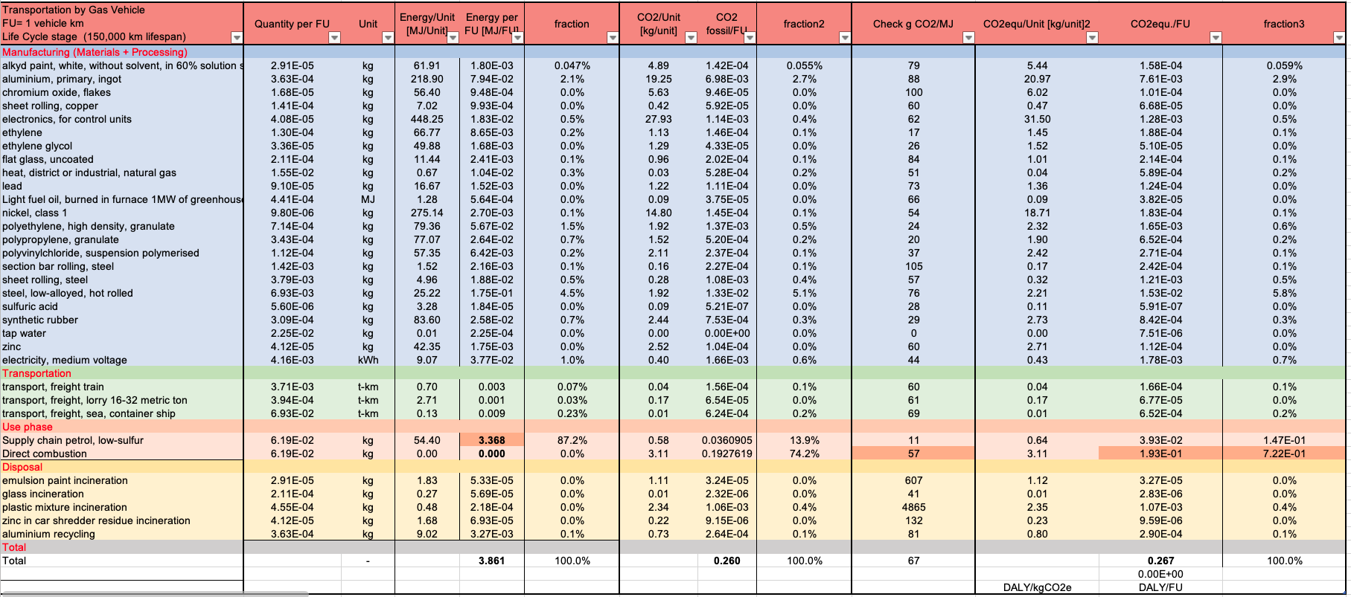
Energy & CO₂ Balance: ICEV
Notes:
Adapt excel template Energy and CO2 balance hands drying - answerkeys 1a.xlsx. Look for data for MJ/unit and gCO2/unit in Energy and CO2 balance hands drying - answerkeys 1a.xlsx

Slide 9
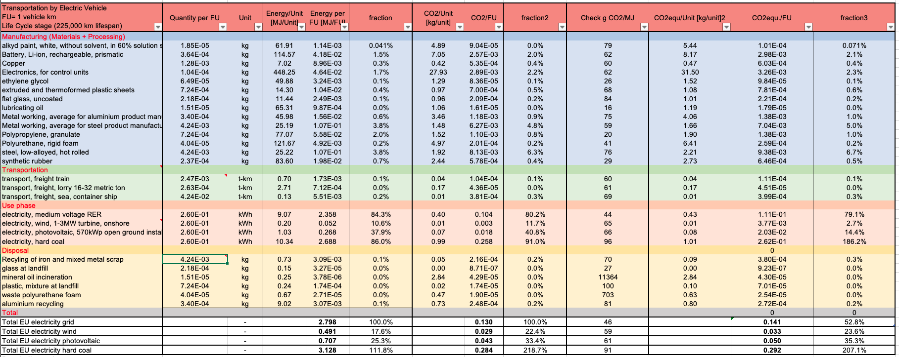
Energy & CO₂ Balance: EV
Notes:
Adapt excel template from Energy and CO2 balance hands drying - answerkeys 1a.xlsx

Slide 10
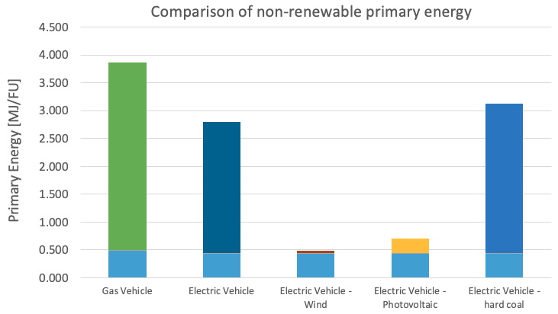
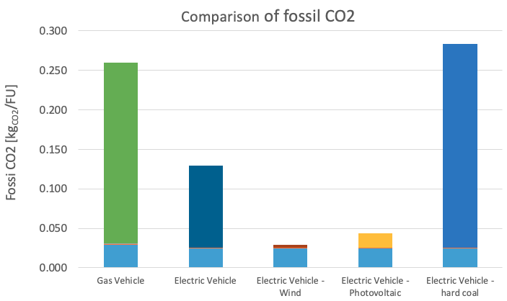
Comparison of Energy & CO₂ Balance across Scenarios
The most impactful LCA phase for both vehicle types is the use phase
At the manufacturing stage, EV has slightly less energy & CO₂ impact than ICEV
Overall:
ICEV has the highest energy impact
EV + hard coal has the highest CO₂ impact
EV + Wind has the lowest energy & CO₂ impact
Notes:
Create two stacked bar graphs
one for Energy, one for CO₂ one stacked bar per scenario on each graph

Slide 11
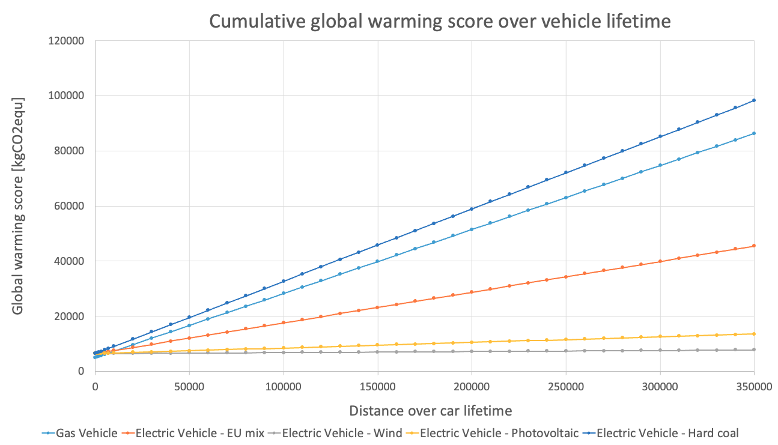
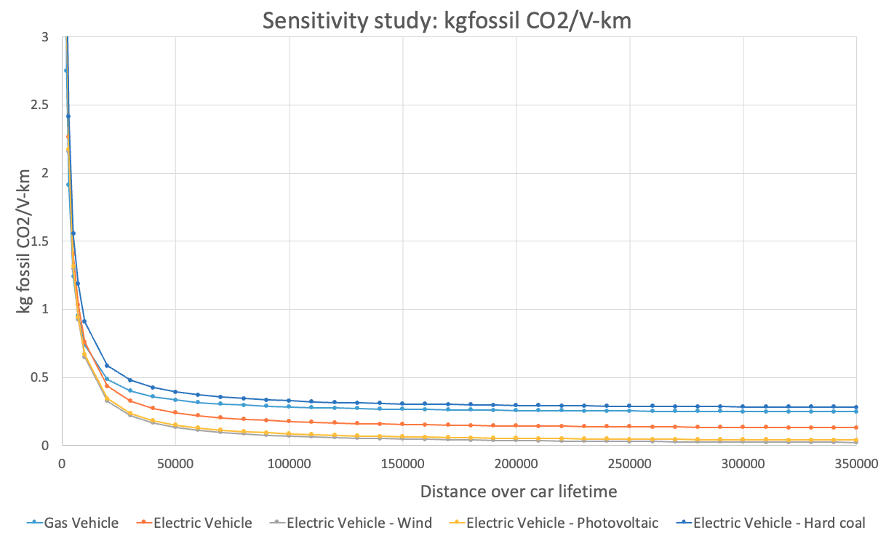
Interpretation – Sensitivity Study
The CO₂ impact of ICEV & EV are comparable at the manufacturing stage
As the lifespan increases, the difference between the highest and lowest impact scenarios increases
After 100k km, the rates of change reach a plateau
Depending on which resource is used to produce electricity for charging the EV, its CO₂ performance could be significantly better or slightly worse than the ICEV:
Best: EV + Wind
Worse: EV + Hard Coal
Notes:
based on hand calculations then use again after Open LCA
Identify which main use parameter affect your results and the ranking between scenario (e.g. number of use, lifetime, frequency of a give operation, transport distances). Create a sensitivity graph showing how your total energy and CO₂ varies as a function of this parameter. Cumulative graphs usually easier to apprehend, than the graph per FU shown here.

Slide 12
Key Parameter: Collection of Primary Data
Transportation Phase: Transport Distance & Weight:
Inaccurate transport distances (ship, train, truck) & weights for ICEV & EV
The total weight/FU of each vehicle based on the data:
ICEV: 3.73E-2 kg
EV: 1.26E-2 kg
Data Collection Approach:
Literature Review
ICEV: LCAs for average/example weight & transportation data
Industry Contact:
EV: Tesla for data on weight, manufacturing plant location & transportation data
Notes:
Identify one key data or parameter for which it would be useful to get better primary data. Propose an approach to obtain these data (small survey, systematic literature search, industry contact).

Slide 13
Conclusion & Next Steps
Results:
Use phase: the most impactful LCA phase for both vehicle types
Manufacturing phase: comparable Energy & CO₂ impacts for both vehicle types
Overall:
ICEV has the highest energy impact
EV + hard coal has the highest CO₂ impact
EV + Wind has the lowest energy & CO₂ impact
As the lifespan increases, the difference between the highest and lowest impact scenarios increases
After 100k km, the rates of change reach a plateau
Depending on which source is used to produce electricity for charging the EV, its CO₂ performance could be significantly better or slightly worse than the ICEV
Best: EV + Wind
Worse: EV + Hard Coal
Renewable Electricity for EVs is the game-changer
Next Steps:
Data collection for the transportation phase
Notes:
Final slides on main conclusions and next steps

