Slide 1
Drupal Training
Gagan Singh
Ross Brodbeck

Slide 2
Agenda
What is Drupal?
How does it work?
Why Drupal?
Drupal Concepts
Drupal Architecture

Slide 3
WHAT IS DRUPAL?

Slide 4
What is Drupal?
Open Source Web Content Management System
Written in PHP
Fairly mature product
Pluggable architecture using “modules”
648,625 people in 228 countries speaking 181 languages who work with Drupal
Drupal 6 to Drupal 7 transitional phase (concepts, work)

Slide 5
What Can you do with Drupal?
Blog
Corporate Websites
Photo Galleries
Video Galleries
Forums
E-commerce
E-learning
Intranet
Wiki
Applications
Notes:
This chart illustrates the major differences between the versions of SharePoint 2007.

Slide 6
HOW DOES IT WORK?

Slide 7
Framework or CMS?
Drupal as a framework
  Functionality extended via modules and code
Drupal as a CMS
  Start with the basics, build it yourself
Distributions
  Prepackaged Drupal instances
  “out of the box functionality

Slide 8
Drupal Distributions
Pressflow
  “fast” version of base Drupal
Acquia Commons
  Wiki’s, discussions, etc out of the box
OpenPublish
  Run a news publishing site
OpenPublic
  Run a government collaboration site
OpenAtrium
  Collaboration Suite

Slide 9
Drupal as Open Source
Drupal as an Open Source product
Vibrant community of developers
Many add-ons, projects
  Pro: lots to choose from
  Con: lots to choose from (and not always good)

Slide 10
WHY DRUPAL?

Slide 11
Drupal Strengths
Large community of developers
Always improving (open source)
Many modules – first step to creating functionality: find a module
Well documented
Many large scale implementations (proven)
Accepted by many government agencies

Slide 12
Drupal Weaknesses
Not a full scale CMS
Always changing
More maintenance work than a traditional website
No single vendor
Learning curve

Slide 13
Who is using Drupal?
Government
  White House.gov
  Energy.gov
  Dutch government
Entertainment
  Grammy’s (grammy.com)
  MTV (mtv.co.uk/)
  WWE (wwe.com/)
Corporate Website
  AT&T
  Intel

Slide 14
DRUPAL CONCEPTS

Slide 15
Drupal Concepts You Should Know
Drupal is “content soup”.
Business
Forms
Workspaces, Mgmt,
Security, Storage,
Topology, Site Model
Content Management
Search

Slide 16
Nodes
Primary Building blocks of all content
Nodes have “Fields”
Example node: Blog Post
  Blog post has a title (field)
  Blog post has a body (field)
  Blog post has an attachment (field)
Each node is a page
  (but can be show in lists as well)
Nodes can (and will) have multiple URLs

Slide 17
Content Types
All nodes in a system are organized by content type
  Not by hierarchy or taxonomy!
First question on creation is:
  “what type of node do you want?”
Content types are global throughout the system

Slide 18
Menus
All pages in drupal are managed by their URL:
  www.drupal.com/url1
  www.drupal.com/url2/argument
Menus attach nodes to various URLs
Menus create a “heirarchy” of URLs
  Main Menu
    Page 1 (attached to node 1)
    Page 2 (attached to node 2)

Slide 19
Taxonomy
Taxonomy is separate from menus
Use tags to classify content
Create multiple sets of tags using “vocabularies”
Vocabulary 1
  Tag 1
  Tag 2
Vocabulary 2
  Tag 1
  Tag 2

Slide 20
Module
Set of PHP code for extending Drupal
1000’s of modules on Drupal.org (prebuilt)
Use “hooks” concent to invoke Drupal API
User interface for “enabling”/”disabling”
Can drastically alter Drupal functionality

Slide 21
Themes
Themes define how content looks
Themes are sets of PHP pages with variables in them
Themes exist in various layers
  Theme parts of a page (region)
  Theme parts of a module
  Theme parts of a menu
Themes define their own regions

Slide 22
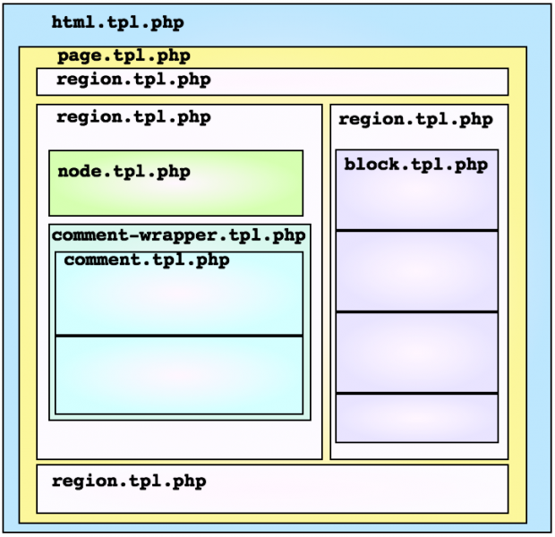
Theme Layout

Slide 23
Block
Part of a page
Predefined piece of content
Think “Portlet”

Slide 24
Important Things
Drupal does not have a predefined “page heirarchy”
  There can be multiple menus
  There can be multiple themes
Content is “floating in space”
  Can be searched
  Can be accessed via URL
  Can be added to a menu

Slide 25
DRUPAL ARCHITECTURE

Slide 26
Drupal Concepts You Should Know
Primarily a LAMP stack
  Linux
  Apache
  MySQL
  PHP
  Features usually targeted here first
Can run on Windows
  IIS
  PHP
  MySQL
Support for SQL Server, NoSQL databases coming in 7
Business
Forms
Workspaces, Mgmt,
Security, Storage,
Topology, Site Model
Content Management
Search

Slide 27
Drupal Architecture
Drupal
PHP
Web Server
Database

Slide 28
Common Modules
CCK- Allows you to add custom fields to existing content types.
Views - Provides a flexible method for Drupal site designers to control how lists and table of content are presented
LDAP Integration- Allows users to authenticate against multiple LDAP
Form Builder – Allows you to build form easily using AJAX interface
WYSIWYG – Allows user to enter content through a WYSIWYG interface.
SimpleNews- Allows you to create newsletter
Organic Group – Allows you create groups among users and have their own private sites.

Slide 29
BRINGING IT TOGETHER

Slide 30
Required Skills
PHP Programming
Jquery
Javascript
CSS
Apache/IIS Knowledge
MySQL/Database knowledge
Go to Drupal.org. Get involved.
  Blog aggregator
  Module contributor

Slide 31
Typical Drupal Process
Get the base code from Drupal’s site
Select the modules you want
Code custom modules for missing functionality
Configure
Create a theme for custom look
Tweak site based on issues/concerns
Apply patches/updates

