Slide 1
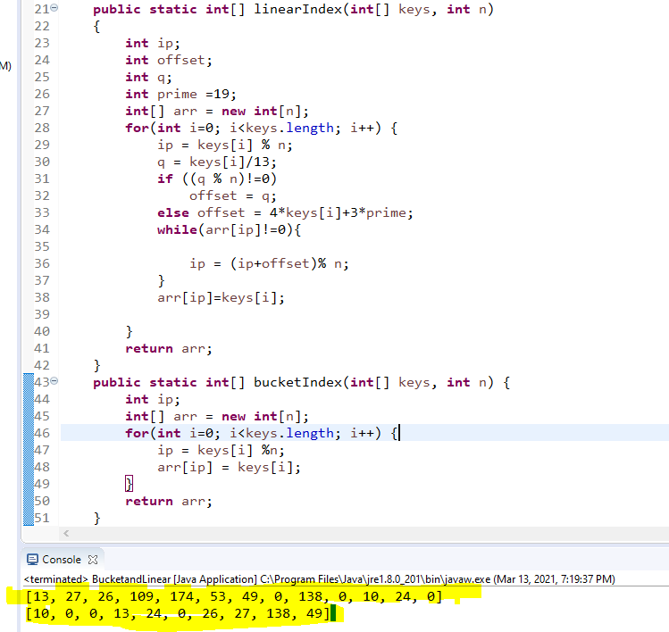
Hashing Lab
1. Given the following key values, show what the data structures would look like after insertions
27 53 13 10 138 109 49 174 26 24
(no preprocessing necessary: p_{k} = key)
Linear array of 10 elements using division hashing
and the linear-quotient collision path algorithm
N = 13, 4k+3 prime = 19
LQHashing:
1. ip = pk % N
2. q=pk/N
if (q%N != 0)
offset = q
else
offset = 4k+3 prime
3. While collisions:
ip’ = (ip + offset) % N
4. Set Array[ip]=key
Bucket hashing of 10 elements (N=10) ip = (p_{k}) % N
Array:
Array:
0
1
2
3
4
5
6
7
8
9
10
11
12
13
0
1
2
3
4
5
6
7
8
9
10
27
26
109
53, 13
174
174, 24
53
49
24
0
27
138
138
0
109, 49
10
24
0
Name: Hasib Rostaiee

Slide 2
2. Fill in the table based on exercise 1
Number of comparisons to retrieve this element
Key
Linear array -
(Length of
Collision Path +1)
Buckets -
(# of elements
in linked list
compared)
53
2
1
138
1
1
109
4
1
4
2
49
174
2
1
26
2
1

