Slide 1
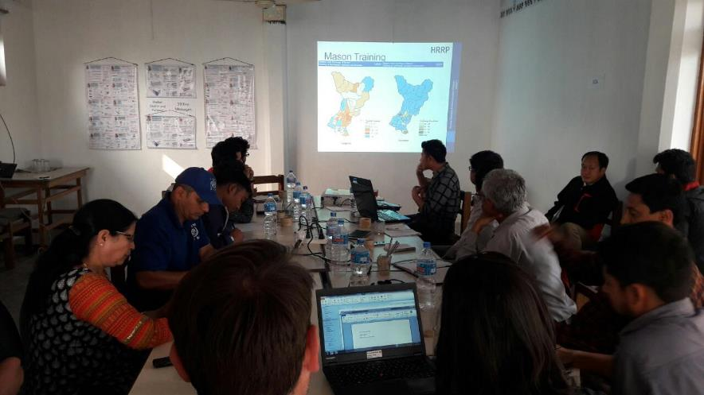
NRA/HRRP GORKHA Coordination Meeting
HRRP
Western Hub - Gorkha
10th Oct, 2017
NRA/HRRP Coordination meeting
Gorkha

Slide 2
Meeting Agenda
1. Introduction and Welcome
2. NRA request and updates
Recent media news about partners and clarification
Joint Monitoring field visit and Rural/Municipality coordination meeting- (Action plan and invitation procedure)
3. HRRP updates and Gaps
Skilled mason training(Maps)
OJT/Vocational training (Maps)
Door to door assistance (D2D) (Maps)
Households and community orientation (Maps)
NRA/HRRP/Partners’ Rural/Municipality focal point
4. Support requested from partners
Facilitation and transportation of PA agreement documents from wards to district
Information flow (Tranche update) from District to rural municipality to ward level
Volunteers manpower support for data entry if needed.
5.Update about recent publication
Hybrid structure manual
Repair and retrofit manual for RCC and masonry structures.
6. AOB

Slide 3
NRA request and updates
Recent media news about partners and clarification
Joint Monitoring field visit and Rural/Municipality coordination meeting- (Action plan and invitation procedure)
Survey and Data collection (Tools to be provided)

Slide 4
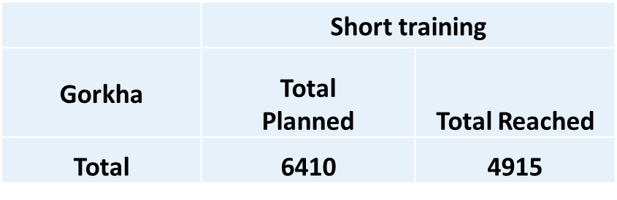
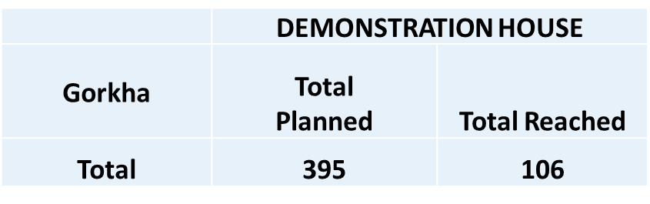
District Activity Updates
Short training(Short training/Skilled Mason training)
Vocational training/OJT
Demonstration house construction
5103
Including EOI data | Vocational training
Gorkha | Total Planned | Total Reached
Total | 4551 | 2059
2094
94

Slide 5
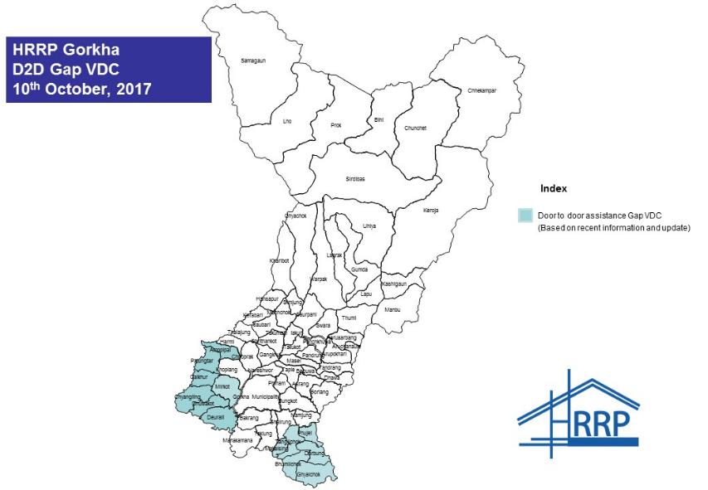
Door to door (D2D) technical assistance- Gap VDCs

Slide 6
Rural/Municipality Coordinator(Focal Point)
Based in Rural/Municipality to support and strengthen overall reconstruction process in coordination with HRRP/NRA/DLPIUs/POs/Gaupalika/Nagarpalika/Wards
Conduct regular technical coordination meeting at Rural municipality/Ward level to develop a common understanding amongst POs and government of comprehensive technical assistance and maintain uniformity in technical assistance and dissemination of information technical and general.
Work with POs to identify and document emerging technical issues, and submit to district level for advice, direction and advocacy.
Identify gaps or duplications in coverage of technical assistance, or quality issues in the implementation of technical assistance and work with the partners, government engineers, HRRP, rural municipality and NRA.
Provide training / capacity building opportunities for POs and GoN staff as required and orientation on reconstruction plan, policies, guideline and technical standards to all stakeholders.
Support and strengthen rural municipality’s capacity in terms of coordination, information management, technical assistance and overall reconstruction process.
Support NRA, HRRP, Local government and POs to develop strategy based on context and will support DLPIU engineers and POs technical staff for door to door assistance to increase compliance rate and construction rate.

Slide 7
Tranche release process presentation by EHRP/DCC

Slide 8
Support requested from partners
Facilitation and transportation of PA agreement documents from wards to district
Information flow (Tranche update) from District to rural municipality to ward level
Volunteers manpower support for data entry if needed.

Slide 9
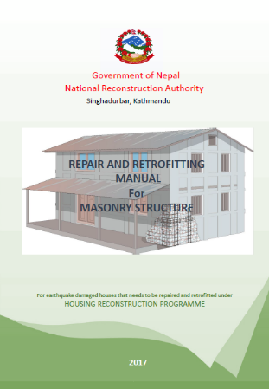
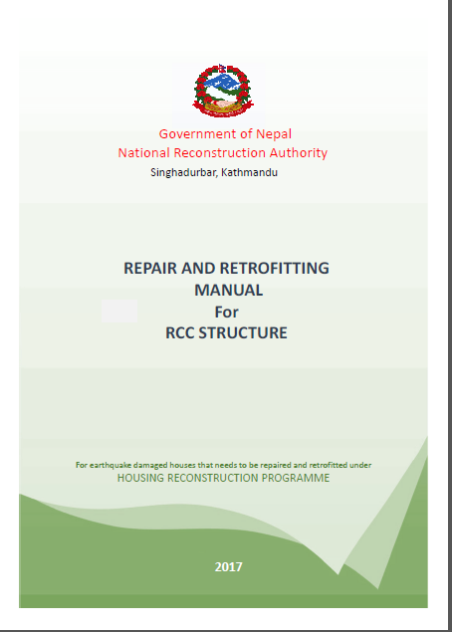
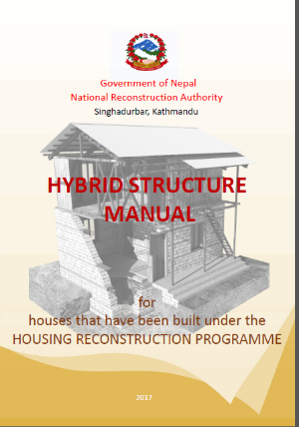
Update about recent publication

Slide 10
Upcoming Orientation, trainings and program
3 days technical social mobilization training (after Tihar)
Orientation on “ How to use HRRP IM products”

Slide 11
Thank You!!
HRRP

