Slide 1
HRRP General Meeting
Chair: Mr Rabi Shah, DDG, DUDBC
Chief Guest: Dr Chandra Shrestha, Executive Member, NRA
Moderation and updates: Dr Jennifer Duyne and Mr Arshad Rashid, Team Leaders HRRP
Kathmandu, Babar Mahal, DUDBC, Meeting Hall,
Friday, 22 January 2016, 15:00 -16:30

Slide 2
Agenda
Welcome
Update on housing reconstruction policy and programme by Mr Rabi Shah, DUDBC
Update on NRA and CBS Survey by Dr Chandra Shrestha, NRA
Update on HRRP’s activities
Update and analysis on 4W
PO Mapping by DUDBC
Comments, questions and suggestions by POs
Next meetings
AOB

Slide 3
Update on HRRP’s activities
TOR approved by DUDBC
Almost full team on board
Office with meeting rooms and working space for POs established
District Focal Points (DFP) and Hub Coordination (HC) established
HRRP website operational (http://hrrpnepal.org/)
Q&A system operational: for questions related to housing recovery and reconstruction please write to: ask@hrrpnepal.org
4W survey with focus on reconstruction started in parallel with district level data collection (merging of data ongoing)
Support to DUDBC for PO mapping provided
Support to NRA on various communication aspects provided (immediate action plan for NRA launch, NRA website, logo, slogan and PSAs)
Technical Notes on housing standards, training, financial inclusion, social inclusion and mobilisation, communication, and supply chain under preparation
Market Study and Urban study tendering done and consultants selected

Slide 4
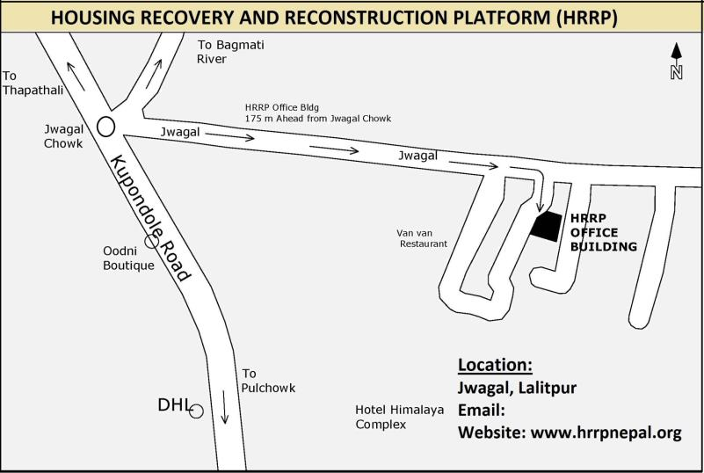
HRRP Office location

Slide 5
HRRP TA Team
Dr Jennifer Duyne Barenstein, Team Leader
Prafulla Pradhan: Government Liaison Advisor
Ramesh Kumar Gautam, Financial Inclusion Specialist
Suman Shakya: Marketing /Logistic Specialist
Om Dharananda Rajopadhyaya with Anil Maharjan : Housing Standard Specialists
Arjun Koirala with Jeny Shrestha: Technical training specialists
Usha Maskey with Nitu Barnawal: Social Mobilization and inclusion specialists
Brabim Kumar K.C. Communication and outreach specialist

Slide 6
Role of HRRP TA team
Provide support to GON in finalizing/detailing reconstruction policy and implementation strategy;
Facilitate the establishment of and participate in TWGs
Collect, consolidate and disseminate housing reconstruction and recovery policy instruments;
Provide support and guidance to POs on relevant topics
Facilitate contacts amongst POs

Slide 7
Update on 4W survey
4W survey by HRRP sent to POs on 5th January 2016, 24 POs responded so far;
Survey content is being updated and revised with the aim of collecting more focused information on reconstruction and recovery;
4W survey will be conducted fortnightly ;
We are working on simplifying the system!
For those among you who have not yet responded, please kindly do so!

Slide 8
Training and skills development

Slide 9
Training and skills development

Slide 10
Social Mobilisation, supervision and guidance
Construction supervision and guidance
Social Mobilization

Slide 11
Other support to housing reconstruction

Slide 12
4W Findings

Slide 13
PO Mapping by DUDBC
DUDBC kindly request the support of HRRP for conducting a PO mapping.
DUDBC’s PO mapping is not to be confused with 4W survey! It needs to be filled out only once and updated upon DUDBC’s request
DUDBC’s questionnaire was sent via email through HRRP to POs on
So far 8 responses received
For those have not yet compiled it please do so asap!
For those who have not received it: the questionnaire can be downloaded from HRRPs website (http://hrrpnepal.org/news-events/news-updates/hrrp-nepal-4w-tool/ )
Thank you for your cooperation!

Slide 14
Schedule of future meetings
CSG and HRRP General Meeting (GM) every fortnight: Next HRRP GMs on Thursday 4.02.16
PO Forum possibly every fortnight combined with HRRP GM with thematic focus: POs are invited to make proposal for themes and presentations!
TWG to be convened based on needs
Special events (workshops, conferences) may be organised in collaboration with GON and POs

Slide 15
AOB
Other issues?
Questions?
Comments?
Thank you!

